Slide 1
140MIC: Microbiology
Lecture- 3
Principles of Microbiology (Part-2)

Slide 2
140MIC: Microbiology
Principles of Microbiology
Content
1.1 Microbiology and Microorganisms
  The importance of microorganisms
1.2 Microbial Cells
  Cell chemistry and key structure
  Characteristics of living systems
  Cell functions: coding and metabolism.
1.3 Microorganisms and Their Environments
  Microbial interaction
1.4 The Impact of Microorganisms on Humans
  Microorganisms as disease agents
  Microorganisms and agriculture
  Microorganisms and food
  Microorganisms, energy and there environment
  Microorganisms and their genetic resources
  Microbiology as a career

Slide 3
140MIC: Microbiology
1.3 Microorganisms and Their Environments
Microorganisms in nature live in populations of interacting assemblages called microbial communities.
A population is a group of cells derived from a single parental cell by successive cell divisions.
The environment in which a microbial population lives is its habitat
Ecosystem refers to all living organisms plus physical and chemical constituents of their environment (aquatic , terrestrial , other organisms such as plant)
Microbial ecology is the study of microbes in their natural environment

Slide 4
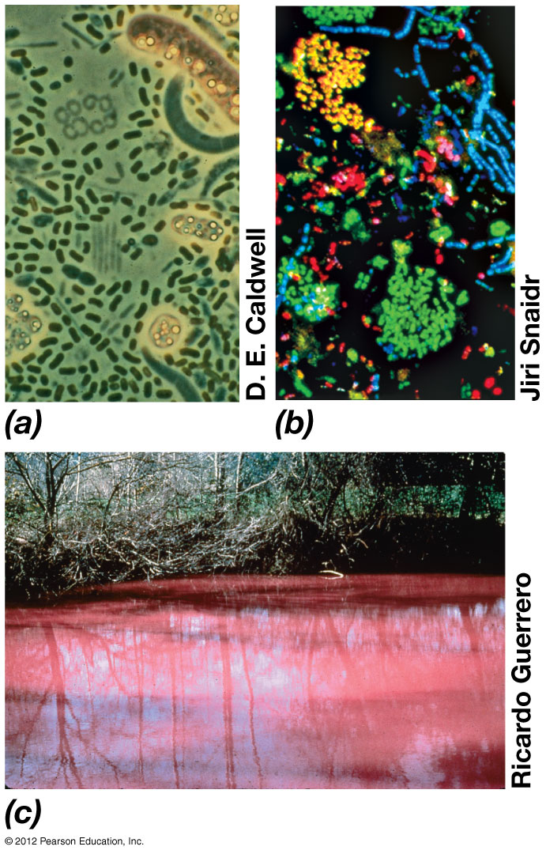
Different bacterial communities:
a)- from depth of small lake showing cells of green and purple phototrophic bacteria .
b)- sewage sludge sample .
C)- purple sulfur bacteria formed a bloom .
Notes:
4
Figure 1.5 Microbial communities.

Slide 5
140MIC: Microbiology
1.3 Microorganisms and Their Environments
Diversity and abundances of microbes are controlled by resources (nutrients , food ) and environmental conditions (e.g., temperature , pH, O₂)
The activities of microbial communities can affect the chemical and physical properties of their habitats.

Slide 6
140MIC: Microbiology
Microbes also interact with their physical and chemical environment
  Ecosystems greatly influenced (if not controlled) by microbial activities
  Microorganisms change the chemical and physical properties of their habitats through their activities
    For example, removal of nutrients from the environment and use them to build new cells
    At the same time , they excrete waste products back into the environment.
Microbial ecosystems expand and contract depending on the resources and conditions available.
1.3 Microorganisms and Their Environments

Slide 7
140MIC: Microbiology
The Impact of Microorganisms on Humans
  Microorganisms as disease agents
  Microorganisms can be both beneficial and harmful to humans
  Emphasis typically on harmful microorganisms (infectious disease agents which known as pathogens).
    Pathogens pose a major threat to human’s life in developing countries
    Some disease caused by microorganisms include:
      Malaria, tuberculosis, cholera, African sleeping sickness, measles, pneumonia and other respiratory diseases and diarrheal syndromes.
    Emerging infectious diseases are of particular importance because they spread quickly
      Such as Ebola, bird flu and Middle East respiratory syndrome-related coronavirus (MERS-CoV)
  Many more microorganisms are beneficial than are harmful
    Microbial flora: In microbiology, collective bacteria and other microorganisms in a host are known as flora
    Normal microbiota: The microorganisms that colonize a host without causing disease; also called normal flora.

Slide 8
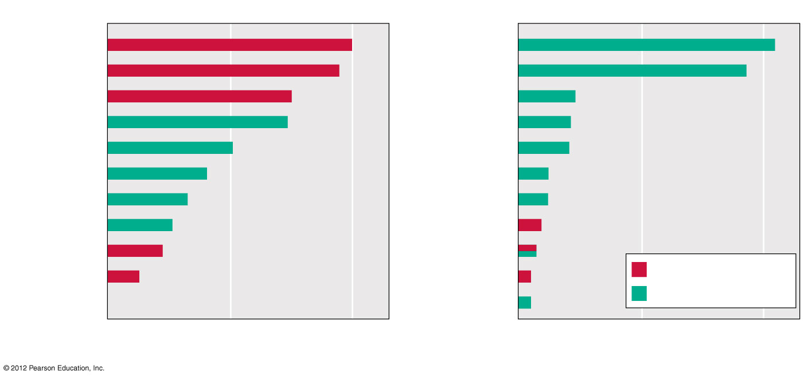
140MIC: Microbiology
The Impact of Microorganisms on Humans
  Microorganisms as disease agents
1900
Today
Influenza and
pneumonia
Heart disease
Tuberculosis
Cancer
Gastroenteritis
Stroke
Heart disease
Pulmonary
disease
Stroke
Accidents
Kidney disease
Diabetes
Accidents
Alzheimer’s
disease
Cancer
Influenza and
pneumonia
Infant diseases
Kidney disease
Diphtheria
Septicemia
Infectious disease
Suicide
Nonmicrobial disease
0
100
200
0
100
200
Deaths per 100,000 population
Deaths per 100,000 population
© 2012 Pearson Education, Inc.

Slide 9
140MIC: Microbiology
The Impact of Microorganisms on Humans
  Microorganisms and agriculture
  Many aspects of agriculture depend on microbial activities. There are positive and negative impacts per as the following table:-
    Positive impacts
      1) Microbes to fix chemical components in the soil (Nitrogen, Sulfate)
      2) cellulose-degradation microbes in the rumen
      3) regeneration of nutrients in soil and water
    Negative impacts
    They can cause diseases in plants and animals plants and animals used for human food cause major economic losses in the agricultural industry .

Slide 10
Some details about the positive impacts of microbe in agriculture.
    1. Microbes to fix chemical components in the soil (Nitrogen, Sulfate)
    Number of major crop plants are legumes which live in close association with bacteria that form a structure called nodules on their roots.
    In the root nodules , the bacteria convert atmospheric nitrogen N2 into ammonia (NH3) that the plants use as a nitrogen source for growth.
    These bacteria called a nitrogen -fixing bacteria such as Rhizobium.
    Other Bactria cycle sulfur compounds , oxidizing toxic sulfur species such as hydrogen sulfide (H₂S) into sulfate SO₄²⁻ which is an essential plant nutrient.
  2. cellulose-degradation microbes in the rumen
    Microorganisms that inhabit ruminant animals such as cattle ,sheep and goat play an important role also.
    These animals have a characteristic digestive vessel called rumen in which large populations of microorganisms digest and ferment cellulose , the major component of plant cell walls at neutral pH.
    Without these symbiotic microorganisms , cattle and sheep could not thrive on cellulose –rich food such as grass and hay
    3. regeneration of nutrients in soil and water
    As example:- Some microbes can make the decomposition of organic matter and mineralization of organic N, S, and P.

Slide 11
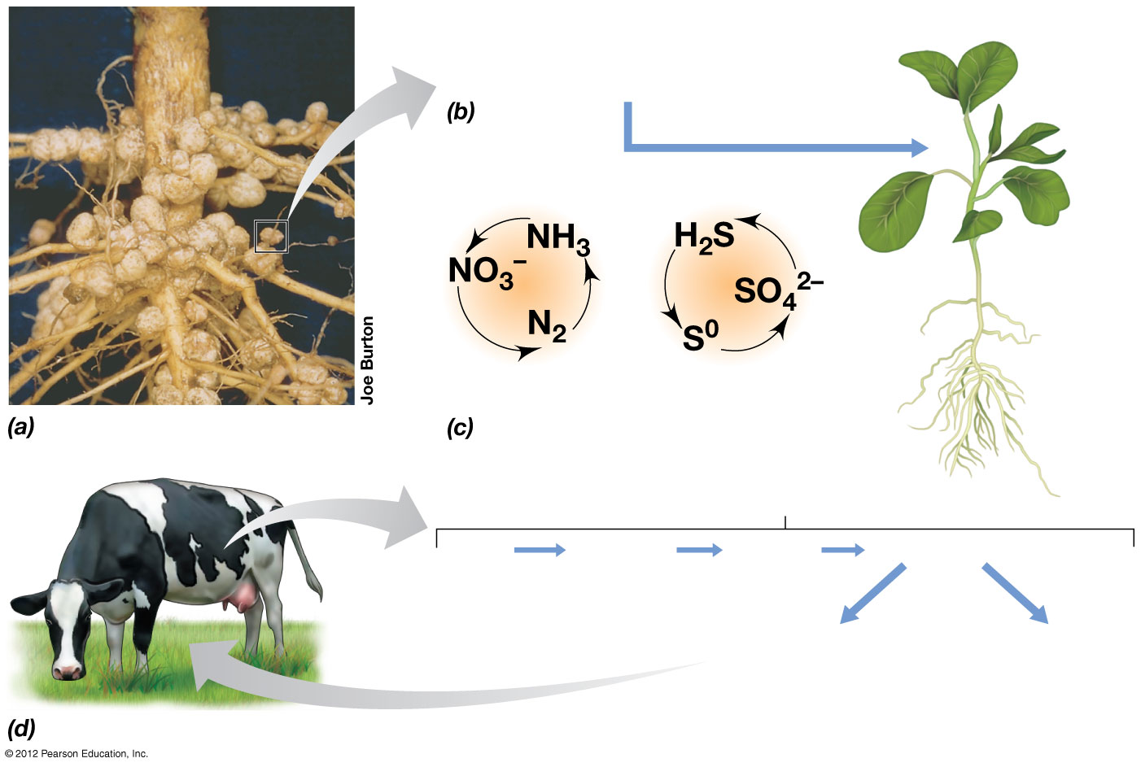
N₂ + 8H
2NH₃ + H₂
Soybean
plant
N-cycle
S-cycle
Rumen
Grass
Cellulose
Glucose
Microbial fermentation
Fatty acids
(Nutrition for animal)
CO₂ + CH₄
(Waste products)
© 2012 Pearson Education, Inc.
Notes:
11
Figure 1.9 Microorganisms in modern agriculture.

Slide 12
140MIC: Microbiology
The Impact of Microorganisms on Humans
  Microorganisms and food
Microorganisms and Food
  Negative impacts
    Food spoilage by microorganisms cause economical loss
    requires specialized preservation of many foods (caning , frozen and dried food )
    Food poisoning due to microbial contamination (Salmonella / Escherichia coli (E.coli)
    → Requires constant monitoring to ensure food safety.

Slide 13
140MIC: Microbiology
The Impact of Microorganisms on Humans
  Microorganisms and food
Microorganisms and Food
  Positive impacts
    Microbial transformations (typically fermentations) yield
      Many dairy products depend on the activities of microorganisms (e.g., cheeses, yogurt)
      Many baked goods rely on the fermentation activities of yeast which generate CO2 to raise the dough .
      other food products (e.g., sauerkraut, pickles, leavened breads, vinegar)

Slide 14
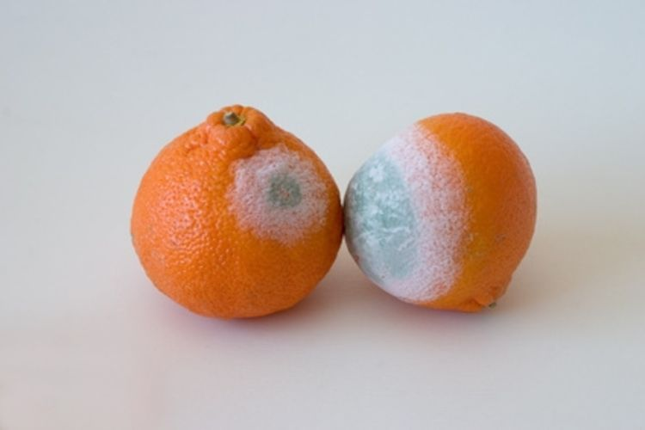
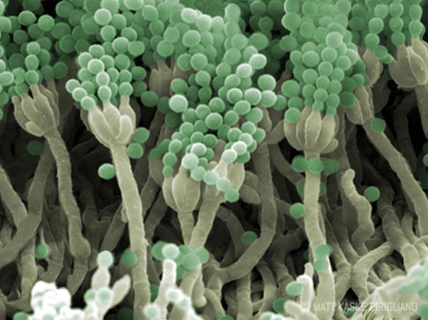
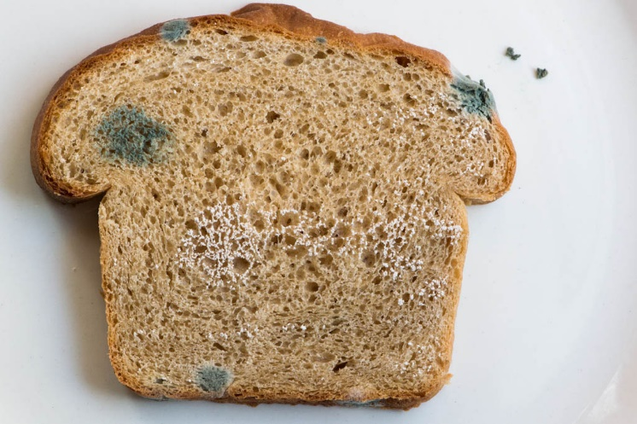
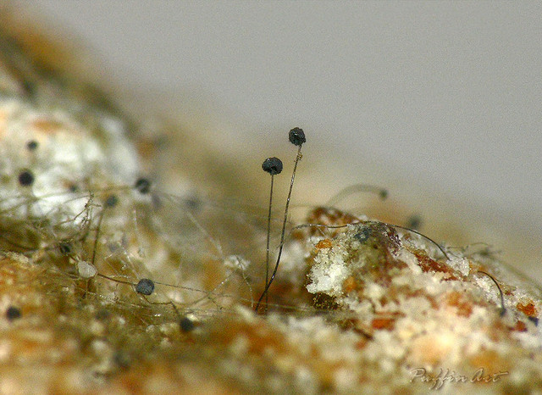
140MIC: Microbiology
The Impact of Microorganisms on Humans
  Microorganisms and food (NEGATIVE IMPACT)
ELECTRON
MICROSCOPE
Penicillium sp.
LIGHT
MICROSCOPE
Rhizopus sp.

Slide 15
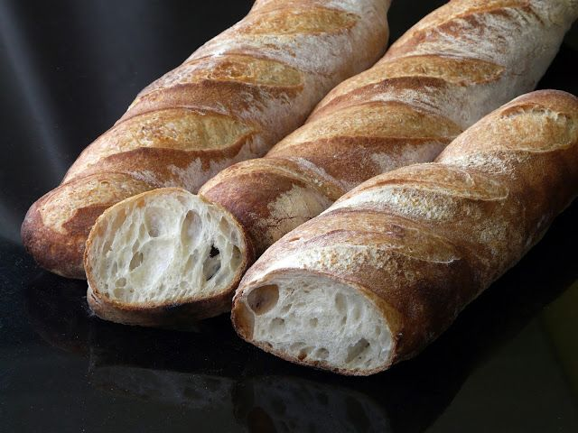
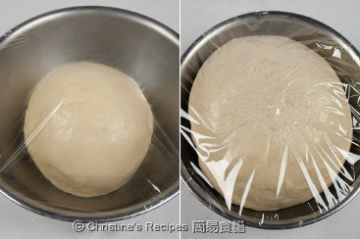
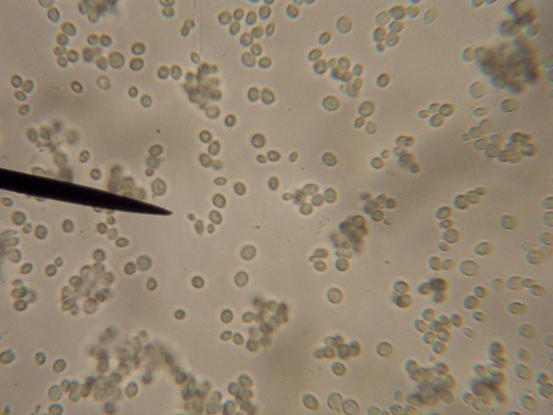
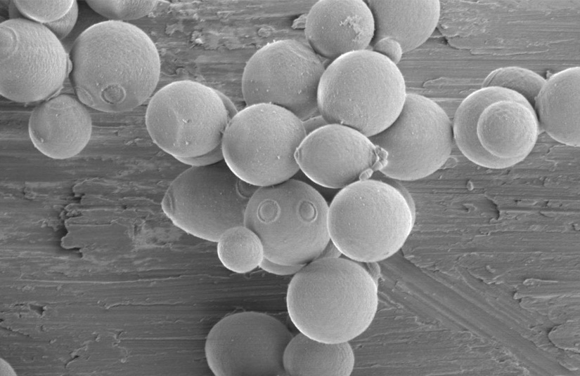
140MIC: Microbiology
The Impact of Microorganisms on Humans
  Microorganisms and food (POSITIVE IMPACT)
Saccharomyces cerevisiae

Slide 16
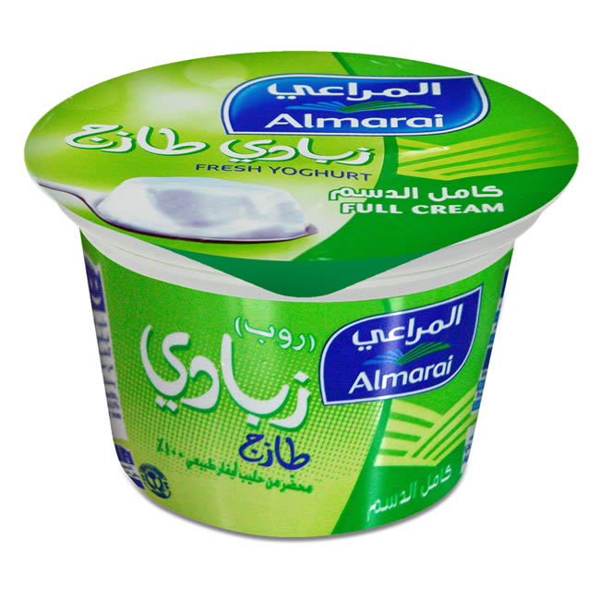
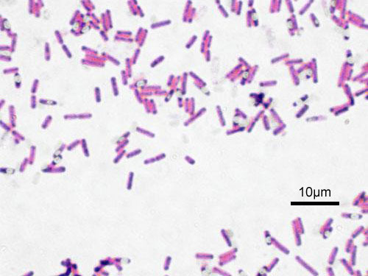
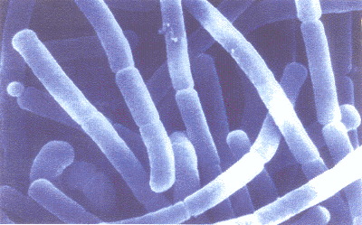
140MIC: Microbiology
The Impact of Microorganisms on Humans
  Microorganisms and food (POSITIVE IMPACT)
Lactobacillus delbrueckii subsp. bulgaricus

Slide 17
140MIC: Microbiology
The Impact of Microorganisms on Humans
  Microorganisms, Energy, and the Environment
  The role of microbes in biofuels production . For example:
  methane a natural gas , which is a product of anaerobic degradation of organic matter by methanogenic bacteria.
  ethanol , which is produced by microbial fermentation of glucose .
Industrial microbiology: Growing microorganisms in large scales to make products of low commercial value. e.g. antibiotics and various chemicals (such as citric acid).

Slide 18
The Impact of Microorganisms on Humans
Microorganisms, Energy, and the Environment
The role of microbes in cleaning up pollutants (bioremediation).
- There are 2 ways:
  By introducing specific microorganisms to a polluted environment
  By adding nutrients that stimulate preexisting microorganisms to degrade the pollutants.

Slide 19
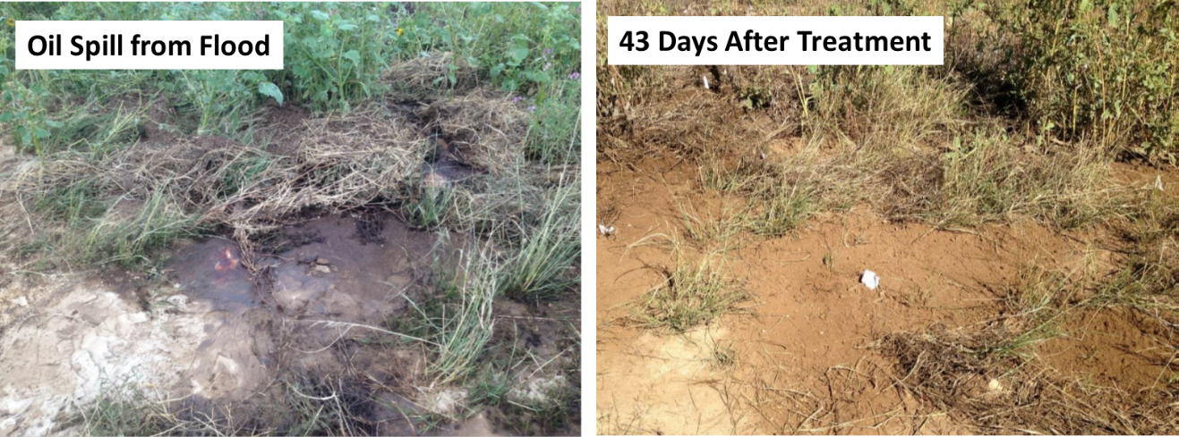
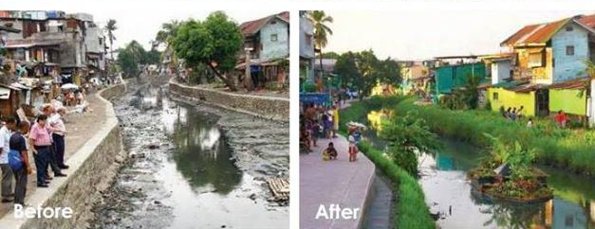
140MIC: Microbiology
The Impact of Microorganisms on Humans
  Microorganisms, Energy, and the Environment
Oil spill –bioremediation treatment
Sewage spill –bioremediation treatment

Slide 20
140MIC: Microbiology
The Impact of Microorganisms on Humans
Microorganisms and Their Genetic Resources
Biotechnology employs genetically engineered microorganisms to generate products of high value to humans, such as insulin and human proteins.
Microbiology as a Career:
Clinical medicine
Research and development – pharmaceutical, chemical/biochemical, biotechnology
Microbial monitoring in food and beverage industries, public health, government.

Slide 21

REMEMBER
You can always ask questions through our discussion board on www.lms.ksu.edu.sa

