Slide 1
460MBIO
Medical Bacteria
Lecture 2
Micrococcus ) Streptococcus and Enterococcus(

Slide 2
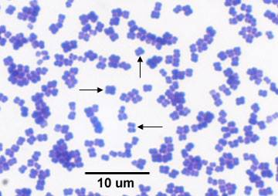
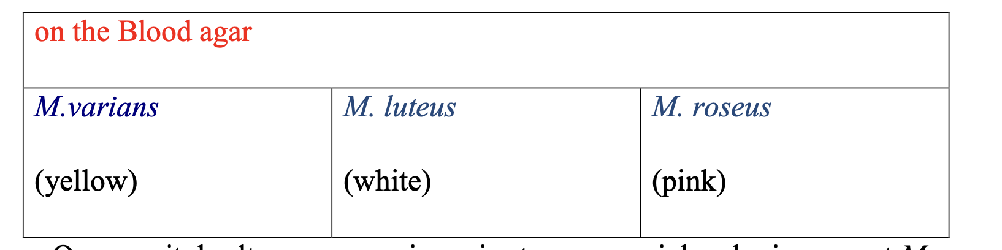
Micrococcus
General characteristics
Morphology:
- Gram +ve cocci
- Arrangement : Tetrads
- Non motile, non capsulated, non sporulated
Habitat:
a normal presence in the upper respiratory tract
Species :
1- M. varians 2- M. luteus 3- M. roseus
Culture:
Strictly aerobic at 37°C incubation (24 hr)
Grow on ordinary media (Nutrient agar)
Grow on Blood agar
Grow on mannitol salt agar grow given rise to rose or pink colonies except M. luteus.(yellow)

Slide 3
Biochemical
Catalase (+ve)
Coagulase (-ve)
Oxidative-fermentation of glucose : (oxidative )
To differential between Micrococcus and Staphylococcus by Furazolidone test
    Micrococcus → resistance.
    Staphylococcus → sensitive
Disease:
Acute endocarditis
Urinary tract infection
Mastitis
Chest infection
Resistance:
Resistant to many antibiotics

Slide 4
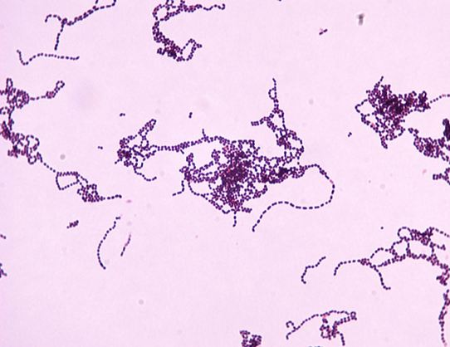
Streptococcus
General characteristics
Morphology:
Gram (+ve) cocci
Arrangement : chain
Non motile
Non sporulated
Capsulated or not .
Biochemical
Catalase (-ve)
Culture characters :
Facultative anaerobic
On fluid media : Sediment
Grow very poor on ordinary media as dew drops like colonies, but growth enhanced with blood or serum and glucose

Slide 5
Classification of Streptococci and Enterococci based on
1. Brown`s classification: depend on the degree of hemolysis
2. Sherman`s classification: depend on the ability of the microorganism to grow at 10°C and 45°C
3. Lancefield classification: depend on carbohydrate Antigen in the cell wall

Slide 6
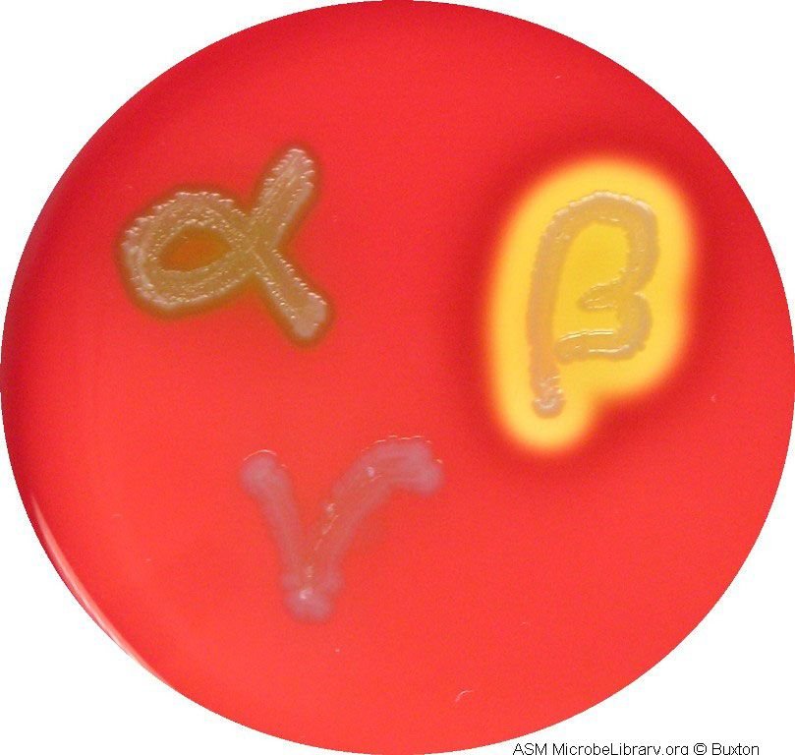
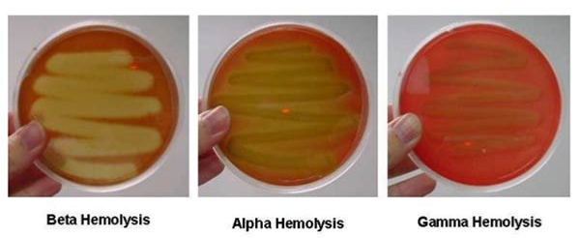
Brown`s classification:
depend on degree of hemolysis reactions on blood agar
Beta-hemolytic ( β)
Complete lysis of red cells surrounding the colony, it appears as a clear zone.
most pathogenic group
e.g. Strep. Pyogenes
Alpha-hemolytic (α)
Partial hemolysis (greenish discoloration) associated with reduction of red cell hemoglobin.
Mild pathogenic group
e.g. Strep. pneumoniae and Strep. viridans
Gamma-hemolysis (γ )
Non hemolytic group
(Mainly saprophytic)
e.g. S. lactis and Enterococcus faecalis

Slide 7
2. Sherman`s classification ) Biochemical /Physiological properties (
depend on the ability of microorganism to grow at 10°C and 45°C
 | grow at 10°C | grow at 45°C | 6.5 % NaCl
Pyogenic group e.g S. pyogens | - | - | _
Enterococci group Enterococcus faecalis | + | + | +
Lactic group: S. lactis | + | - | -
Viridans group S. viridans | - | + | -

Slide 8
3. Lancefield classification
depend on carbohydrate Antigen in the cell wall
The identification of streptococci based on the serologic reactivity of "cell wall" polysaccharide antigens described by Rebecca Lancefield.
Serological detection of cell wall antigens: streptococci can be classified alphabetically according to the possession of specific cell wall antigens (Lancefield groups A–H , K–V and untypable group ).
Group A :
S. pyogens
Group B:
S. agalactia
Group C:
S. dysgalactiae → mastitis in cattle.
Group D:
Enterococcus faecalis (previously identified as Streptococcus faecalis)
Group G, N, K : → animal strain
S. lactis
untypable group
S. pneumonia → pneumonia in man.
S. uberis → mastitis in cattle.

Slide 9
(Group A streptococcus) Streptococcus pyogenes
General characteristics
Morphology: As general characters , (have a capsule composed of hyaluronic acid)
Culture character : As general character + β hemolysis
    Requires enriched medium containing blood to grow.
Biochemical test : As general character
Antibiotic sensitivity:Bacitracin sensitive
Strep. pyogenes is usually an exogenous secondary invader, following viral disease or disturbances in the normal flora
Disease
affect the human causing scarlet fever-acute tonsillitis – abscess – sore throat – otitis media- puerperal sepsis and pyogenic infection
Also cause post streptococcus disease as : Rheumatic fever (It is an autoimmune disease due to the similarity between Ag on the heart muscle and on Streptococcus, so the Ab-formed against Streptococcus will attack the heart → Carditis )
Rheumatic kidney.
Bovine mastitis in cattle.

Slide 10
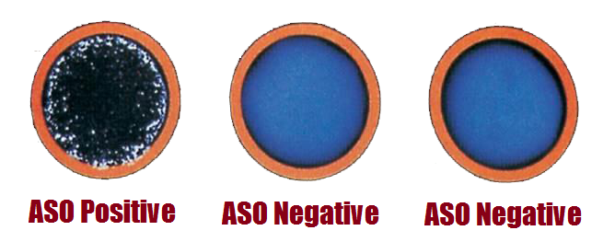
Virulence Factors
Protein M (major virulence factor), Protein F and lipoteichoic acid to facilitate adherence to host cells.
A capsule of hyaluronic acid provides protection against phagocytosis.
Invasions such as: streptokinase, hyaluronidase, haemolysins
Exotoxins, such as erythrogenic toxin; causes scarlet fever.
DNAase, Protease, Amylase, C5a peptidase (inactivates the C5a component of the complement system)
Laboratory diagnosis
Serological test:
C-reactive protein (CRP): is a test used for the diagnosis of post-streptococcal disease
Anti-streptolysin O titer (ASO): is a blood test to measure antibodies against streptolysin O.
Strep. pyogene → produce:
    Erythrogenic toxin produce skin rash
    streptokinase (Fibrinolysin)
    streptolysin S
    streptolysin O

Slide 11
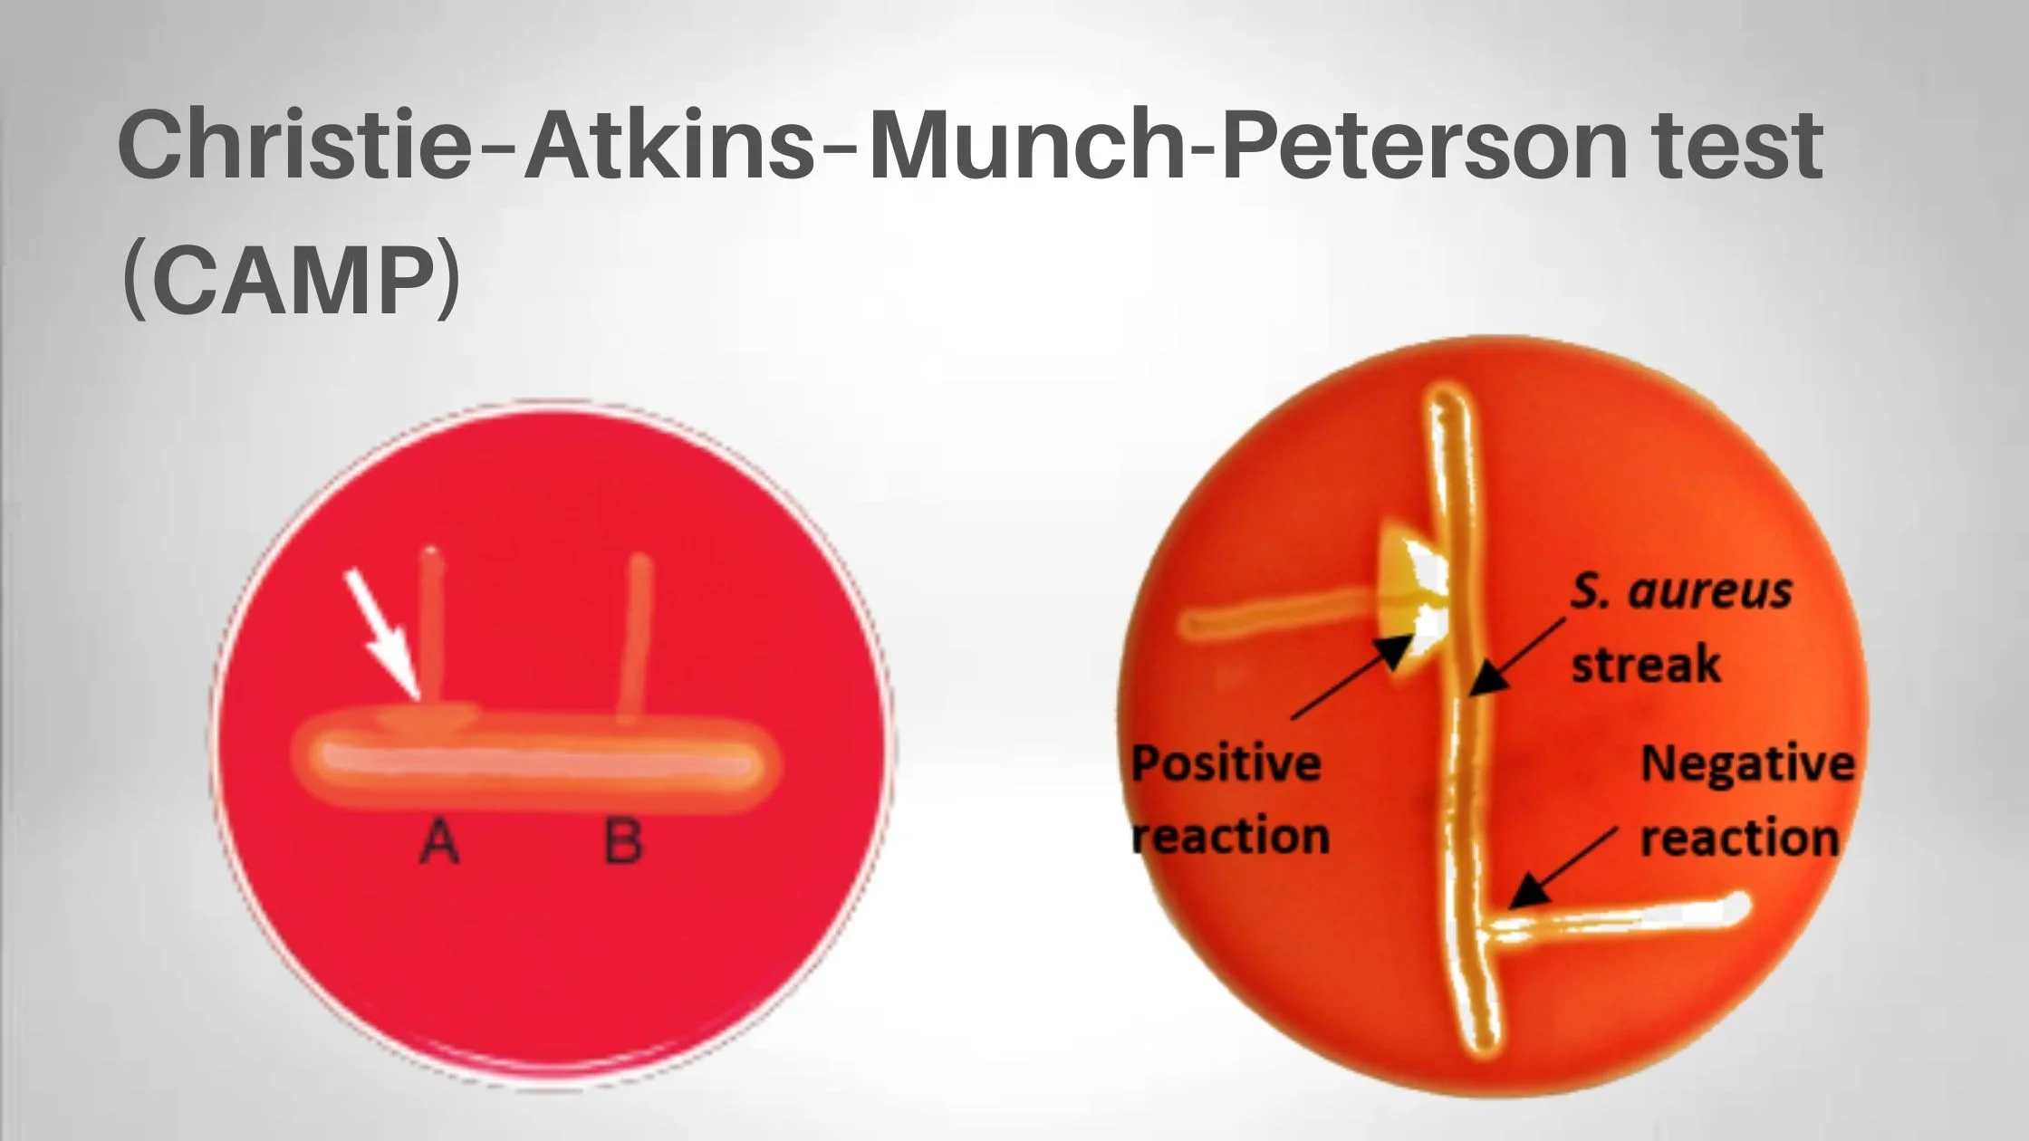
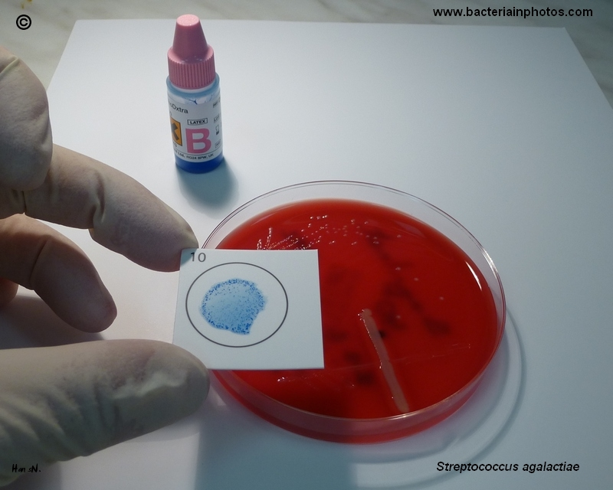
(Group B streptococcus) Streptococcus agalactiae
General characteristics Beta hemolytic
Diseases
mainly affect the bovine causing mastitis.
Regularly resides in the human vagina, pharynx and large intestine, can be transferred to infant during delivery and cause severe infection .
Puerperal infection, pneumonia, meningitis, Septic abortion.
Laboratory diagnosis
Latex agglutination tests
The CAMP test: group B streptococci produce a diffusible extracellular hemolytic heat-stable protein (CAMP factor) that acts synergistically with the beta-lysin of Staphylococcus aureus to cause enhanced lysis of red blood cells.
The group B streptococci are streaked perpendicular to a streak of S. aureus on blood agar.
A positive reaction appears as an arrowhead zone of hemolysis adjacent to the place where the two streak lines come into proximity.
A sample is mixed with latex beads coated with antibodies.
Strep. agalactiae possess specific carbohydrate antigen,
If the antigen is present, it will react with the antibodies causing the latex beads to clump.

Slide 12
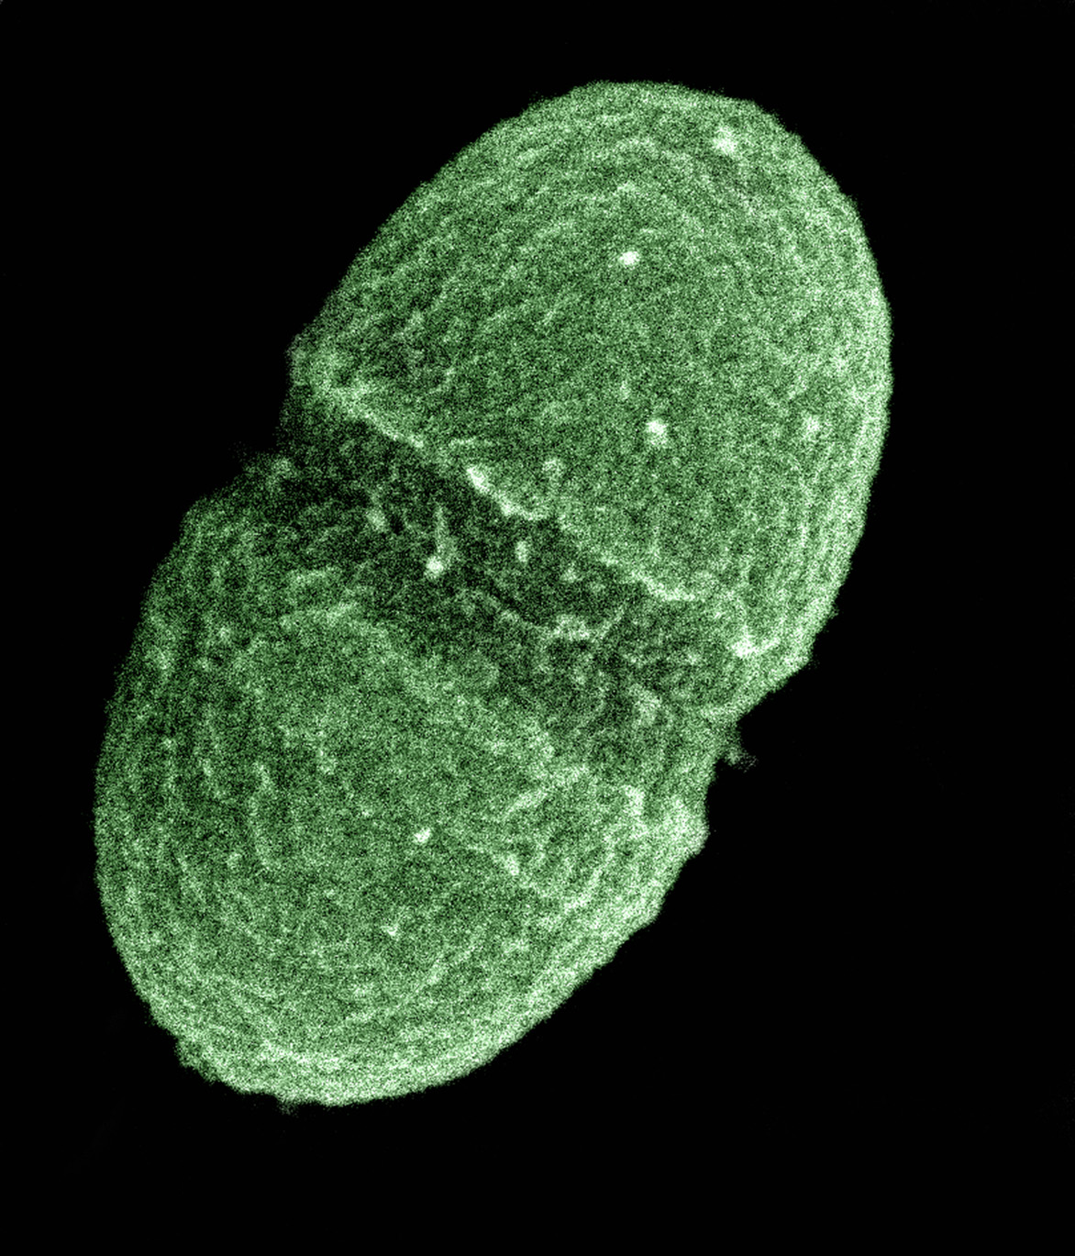
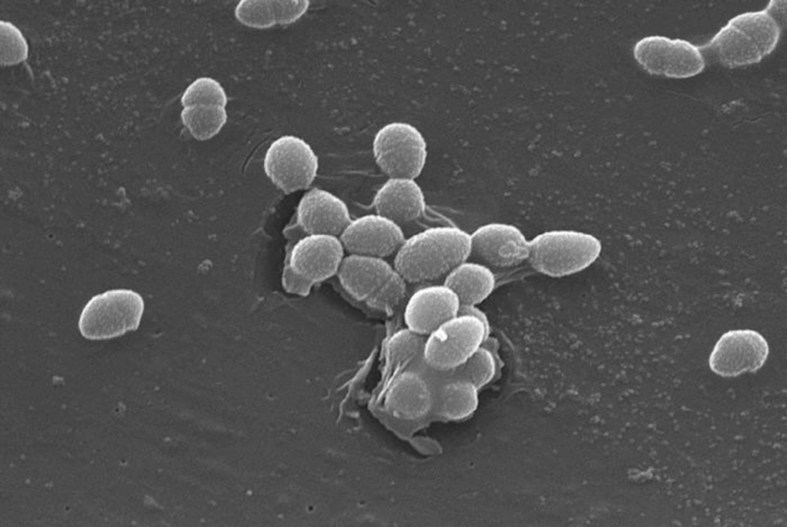
(Group D streptococcus) Enterococcus faecalis
General characteristics
arranged individually, in pairs, or short chains.
Commensal bacterium(Normal colonists of human large intestine)
Grow in the presence of 6.5% NaCl.
Usually non-hemolytic or α hemolytic
Naturally high levels of antibiotic resistance
Diseases
Causes nosocomial infections, opportunistic urinary, wound and skin infections.
Laboratory diagnosis
Group D streptococcus can grow in presence of extreme conditions such as-6.5% NaCl, 40% bile, pH 9.6, 45°C, and 10°C.

Slide 13
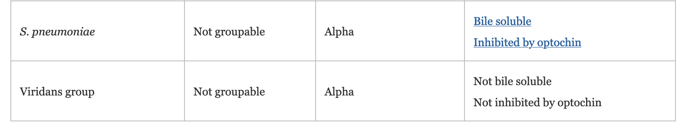
Lancefield group ungroupable
Viridans group streptococci (VGS)
Streptococcus pneumoniae (Diplococcus pneumoniae)
They possess no Lancefield antigens

Slide 14
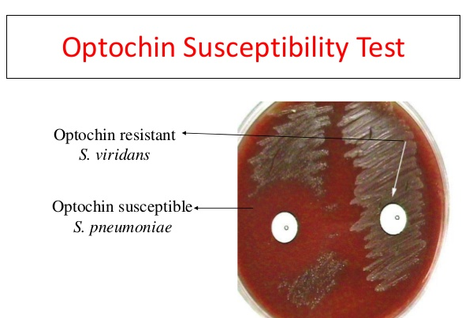
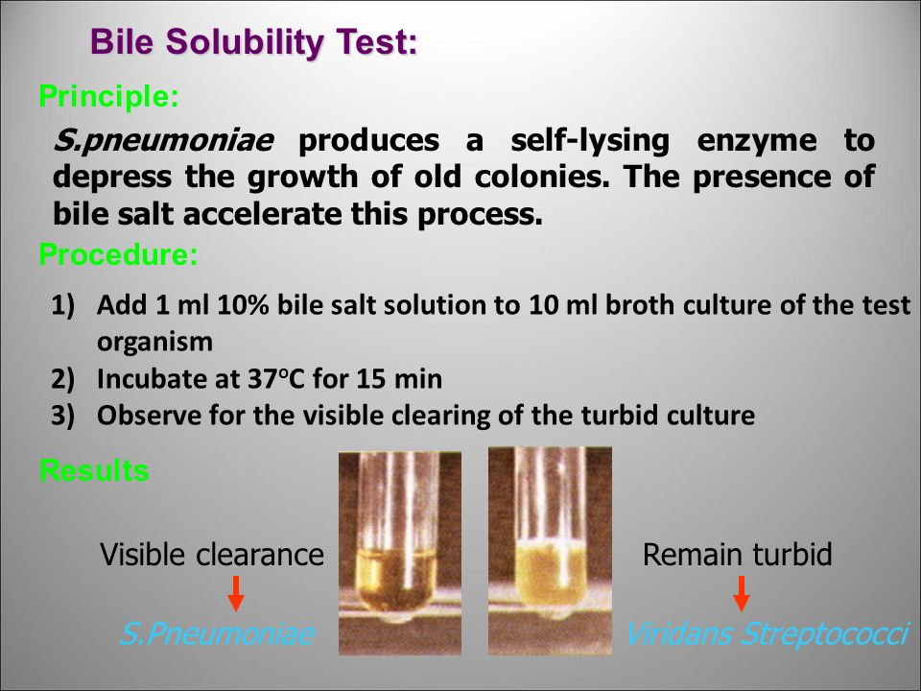
Viridans group streptococci (VGS)
Heterogeneous group of organisms (Human commensals or Pathogens).
Alpha haemolytic or non haemolytic.
Optochin resistant.
Not soluble in bile salts (biochemical tests are often used for their identification).
Causes endocarditis, bacteremia.
E.g. Streptococcus mutans (dental caries), Streptococcus salivarius

Slide 15

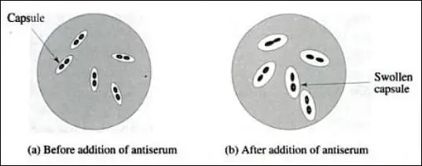
Streptococcus pneumoniae (Diplococcus pneumoniae)
Usually, pairs of cocci (diplococci).
Alpha hemolytic
Fastidious.
Growing best in 5% CO₂.
Often have a polysaccharide capsule.
Fermentative aerotolerant anaerobe
Young colonies resemble dew-drops due to capsule- spontaneous autolysis of bacteria.
A normal inhabitant of the human upper respiratory tract.
Cause pneumonia, sinusitis, otitis media, meningitis.
It also causes osteomyelitis, endocarditis, and brain abscesses.
Optichin sensitive.
Bile soluble
Inulin fermenter.
90 different capsule types of pneumococci have been identified and form the basis of antigenic serotyping of the organism.
Laboratory diagnosis
Quellung test ( Also called precipitin capsule test)
It is a diagnostic test for Streptococcus pneumoniae.
• Film of sputum + Anti pneumococcal serum = Swelling of the capsule

Slide 16


