Slide 1
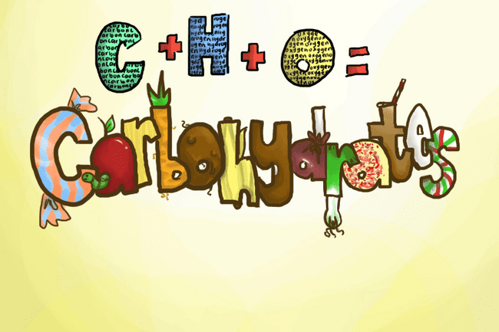
Histochemistry of Carbohydrates

Slide 2
Carbohydrate
Compounds contain C, H, O with general formula of C_{m}(H₂O)_{n}
All have C=O and -OH functional groups
Classified based on
Size of base carbon chain
Number of sugar unit
Location of C=O group
Stereochemistry

Slide 3
Types of Carbohydrates
Classification based on the number of sugar units in the total chain
Monosachcarides Single sugar unit
Disaccharides Two sugar units
Oligosaccharides from (3-10) sugar units
Polysaccharides > 10 sugar units

Slide 4
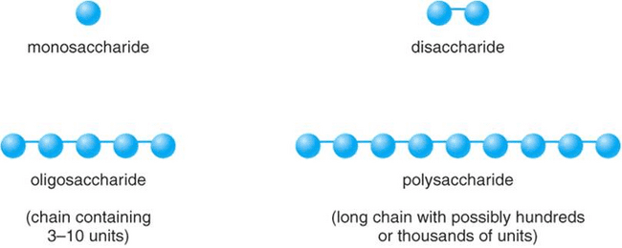

Slide 5
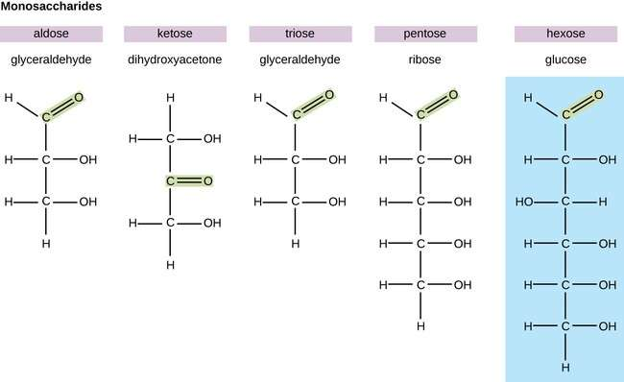
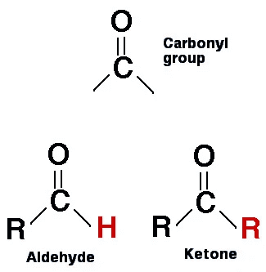

Slide 7
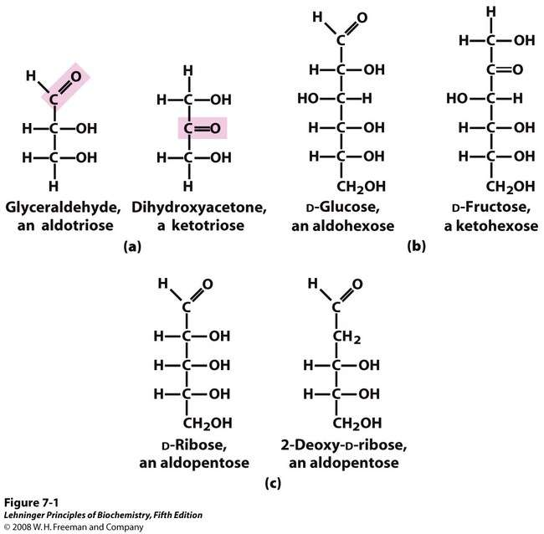
Notes:
FIGURE 7-1 Representative monosaccharides. (a)Two trioses, an aldose and a ketose. The carbonyl group in each is shaded. (b) Two common hexoses. (c) The pentose components of nucleic acids. D-Ribose is a component of ribonucleic acid (RNA), and 2-deoxy-D-ribose is a component of deoxyribonucleic acid (DNA).

Slide 8
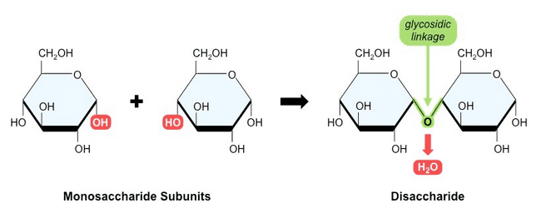
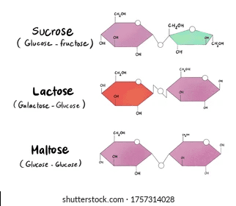

Slide 9
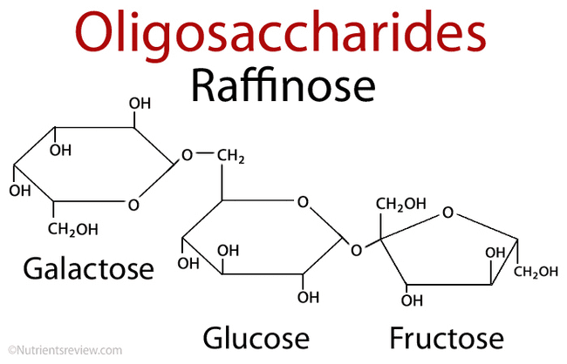

Slide 10
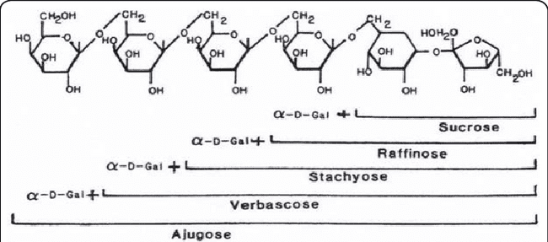

Slide 13
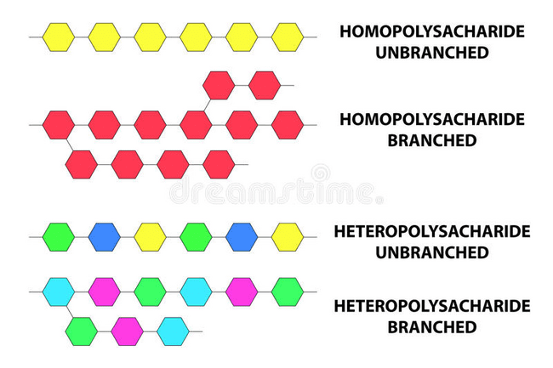

Slide 14
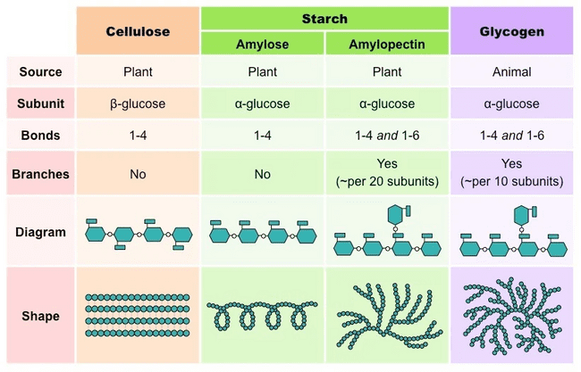
Nonstarch polysaccharides are large-sized carbs that aren’t digested, but some are fermented once they reach the large intestine. ...
Starches are polysaccharides, but they're digestible because you have the enzymes needed to break the bonds between each sugar molecule.

Slide 15
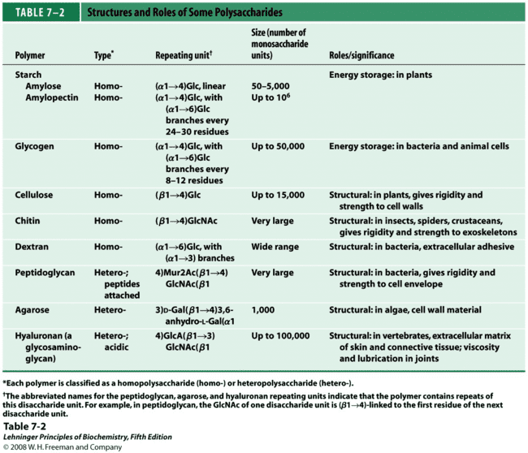

Slide 16
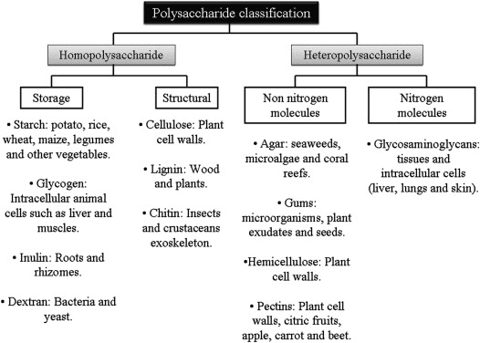

Slide 17
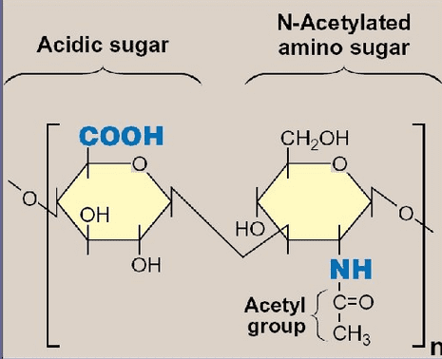
Glycosaminoglycans (GAGs) or Acid mucopolysaccharides
are long linear polysaccharides consisting of repeating disaccharide units (i.e. two-sugar units). The repeating two-sugar unit consists of a uronic sugar and an amino sugar (hexosamine).
Because GAGs are highly polar and attract water, they are used in the body as a lubricant or shock absorber.
Uronic acids are sugars where the CH2OH group has been oxidised to form a carboxylic acid group.

Slide 18
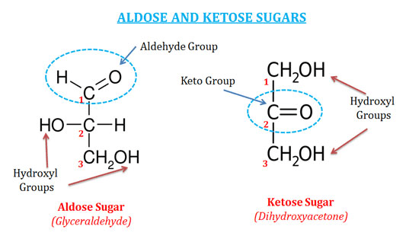
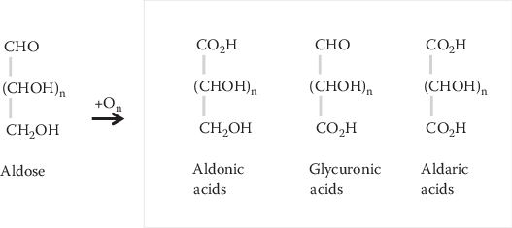

Slide 20
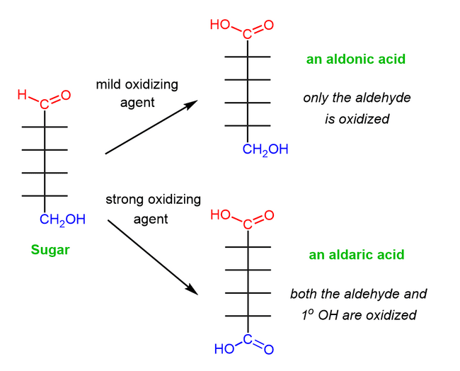

Slide 21
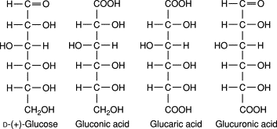

Slide 23
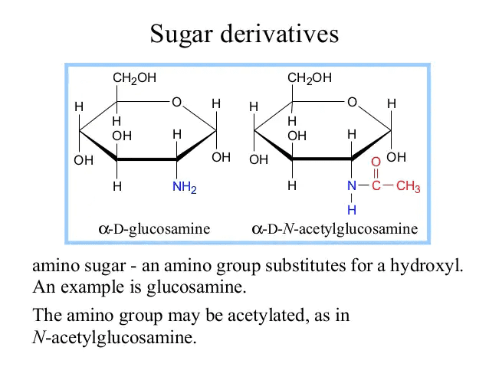

Slide 24
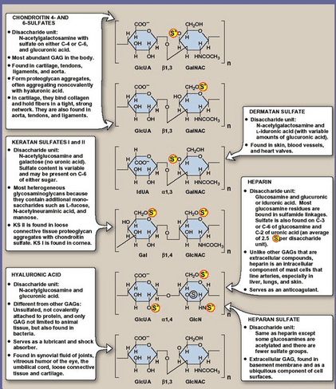

Slide 25
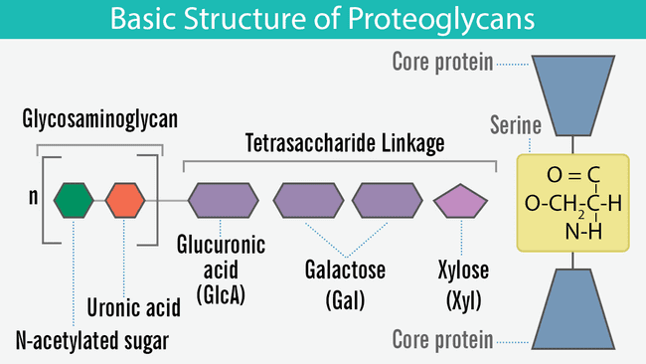
Proteoglycans
Glycosaminoglycan + Protein = proteoglycans

Slide 27
Glycoprotein
A glycoprotein is a compound that contain a protein moiety to which carbohydrate (or glycan) are covalently linked or attached.
In contrast to proteoglycans, the protein moiety usually predominates, and these molecules do not contain the linear polysaccharides formed by repeating disaccharides containing hexosamines.
In stead, the carbohydrate moiety of glycoproteins may be in the form of a monosaccharide, disaccharide(s). oligosaccharide(s), polysaccharide(s), or their derivatives (e.g. sulfo- or phospho-substituted). One, a few, or many carbohydrate units may be present and is frequently a branched structure.

Slide 29
Proteoglycans are a subclass of glycoproteins
proteoglycans
Glycoproteins

Slide 30
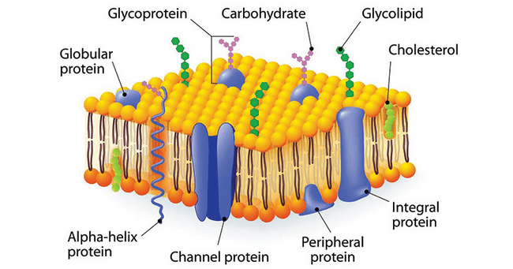

Slide 32
