Slide 1
460 MBIO
Medical Bacteria
Lecture 13
Spirochaetaceae
(Treponema, Borrelia)

Slide 2
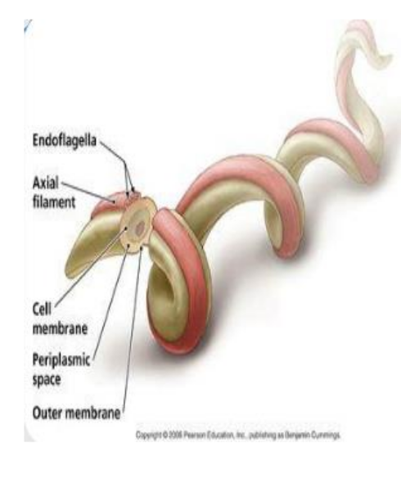
Spirochaetaceae
General Characteristics
Free or strict parasites.
Medical importance species:
Treponema
T. pallidum----- cause Syphilis , Congenital syphilis
Borrelia
B. recurrentis----- cause relapsing fever
B. hermsii ----- cause relapsing fever
      B. burgdorferi ------- cause Lyme Disease
3. Leptospira
L. interrogans----- cause Leptospirosis

Slide 3
Morphology
Gram-negative rods
Spiral single cells, or corkscrew-shaped.
extremely thin and can be very long.
Most spirochetes cannot be viewed using conventional light microscopy. Dark-field microscopy must be used to view spirochetes.
Motile, move by bending and rotating body movements.
Spirochete consists of a protoplasmic cylinder bounded by a cell wall and outer membrane.
There is an axial filament or endoflagella (preiplasmic flagella) between the cell wall and outer membrane.
Culture character
Aerobic to strict anaerobic

Slide 4
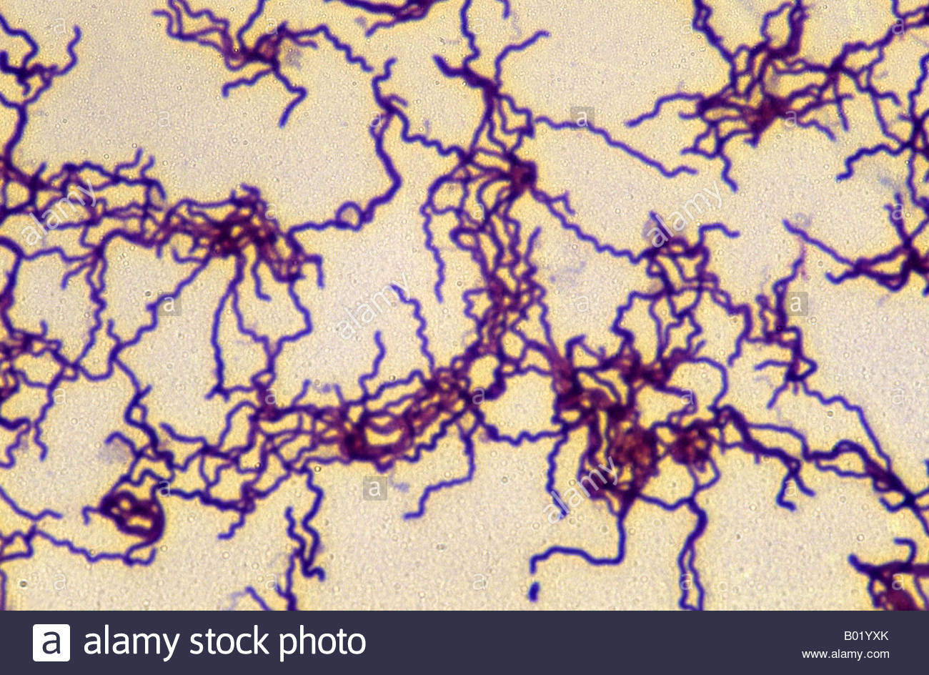
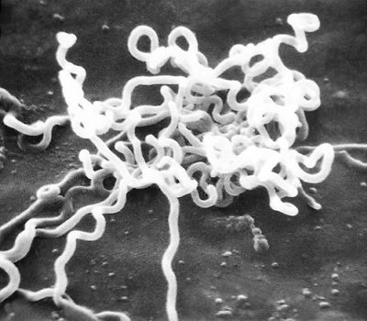
Treponema pallidum
General Characteristics
Intracellular pathogen (Not cultured in artificial media, cultured in tissue culture (Do not survive well outside of the host).
Remain viable in the blood or plasma store at 4c̊ at least for 24 hrs (transmitted via blood transfusion)
Morphology
Gram-negative spiral bacteria;
motile;
non-capsulated
non-sporing
The bacteria is too thin ( Dark microscope –motility)
Actively motile, rotating steadily around their endoflagella.
Virulence Factors
Outer membrane proteins (promote adherence)
Hyaluronidase enzyme.
Laboratory diagnosis:
Diagnosis is principally based on serology, but microscopy can be useful in early infection.

Slide 5
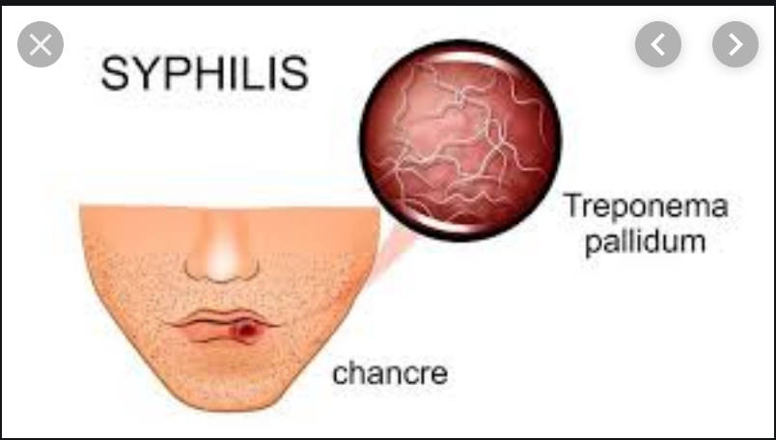
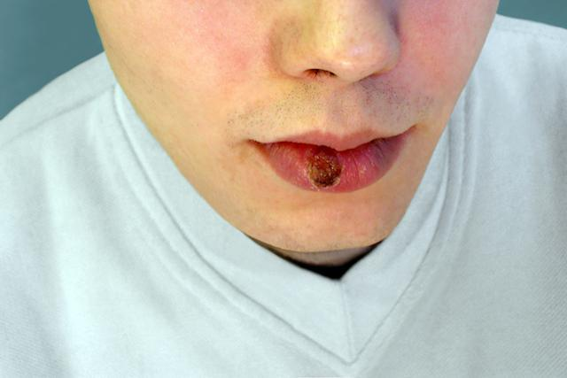
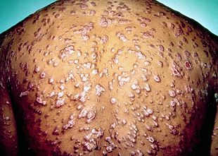
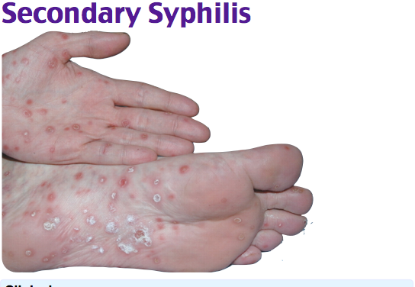
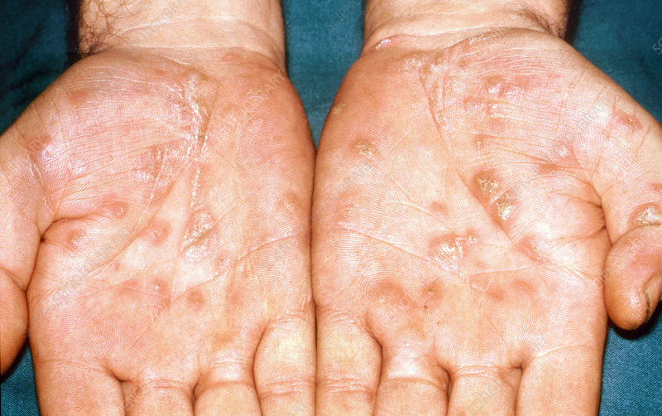
Disease:
Cause syphilis (sexually disease), Route of Transmission is sexually contacting or from mother to fetus.
Incubation period is 3-4 weeks.
Rash, fever, organ damage
There are four stages of syphilis (primary, secondary, latent, and tertiary).

Slide 6
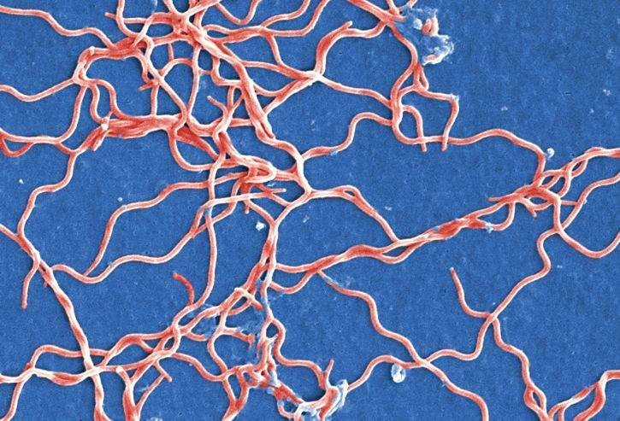
BorreliaBorrelia
Morphology:
Highly flexible irregular spiral organism, and move by rotation and twisting.
Culture character:
Cultured in complex serum-rich artificial media.
Virulence Factors
Famous in antigenic variation
Antigenic variation: The relapsing picture is related to the ability of Borrelia species to vary their outer surface protein antigenic structure as many as 30 times, thus evading specific host antibodies for some time
Laboratory diagnosis:
Borrelia identified in stained blood smears

Slide 7
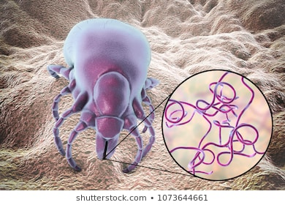
Disease:
Causes relapsing fever (Borreliosis)-Transmitted by arthropod, two types.
Both types of relapsing fever follow the same symptoms.
12- 15 days after infection, there is a sudden start of fever, headache, myalgia for 4- 10 days.
Antibodies are formed and the number of organisms is decreased.
This leads to a fever period for a few days to several weeks.
The fever then relapse because the organism has undergone antigenic variation.
The antibodies have no longer effective and the organism number increase.
Several relapses may occur.

Slide 8


