Slide 1
460 MBIO
Medical Bacteria
Lecture 1
Staphylococci

Slide 2
Gram positive cocci
Aerobic cocci
Anaerobic cocci
facultative anaerobic
Staphylococci
Streptococci
Micrococci
peptostreptococci

Slide 3
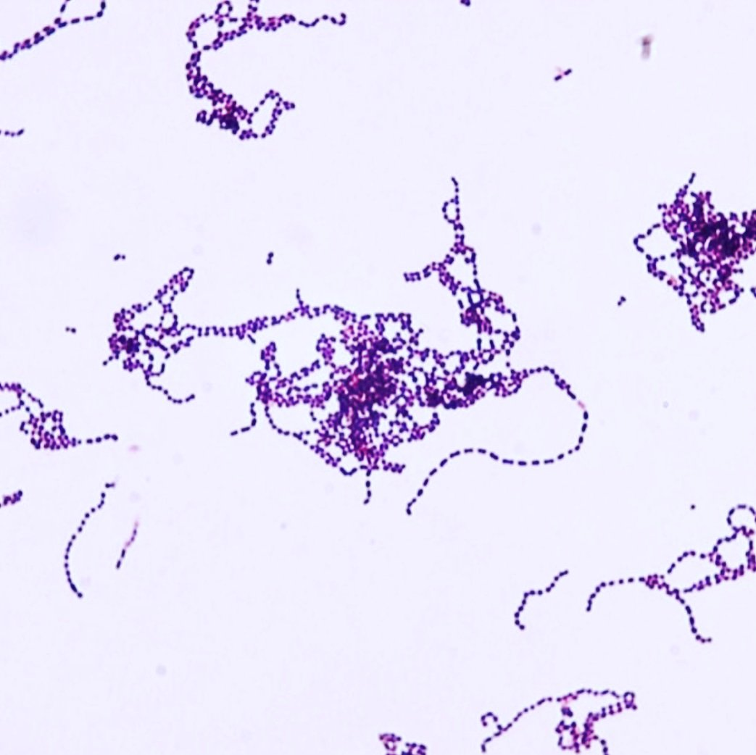
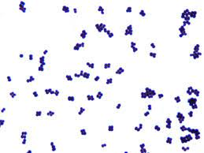
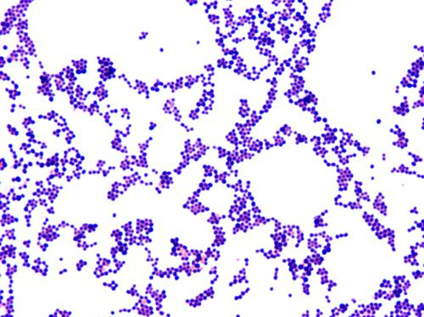
  How do you differentiate between Staphylococcus, Streptococcus and Micrococcus?
Morphology
Grapes like clusters
chain
tretrads

Slide 4
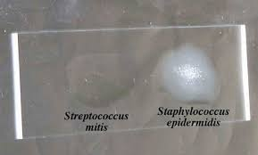
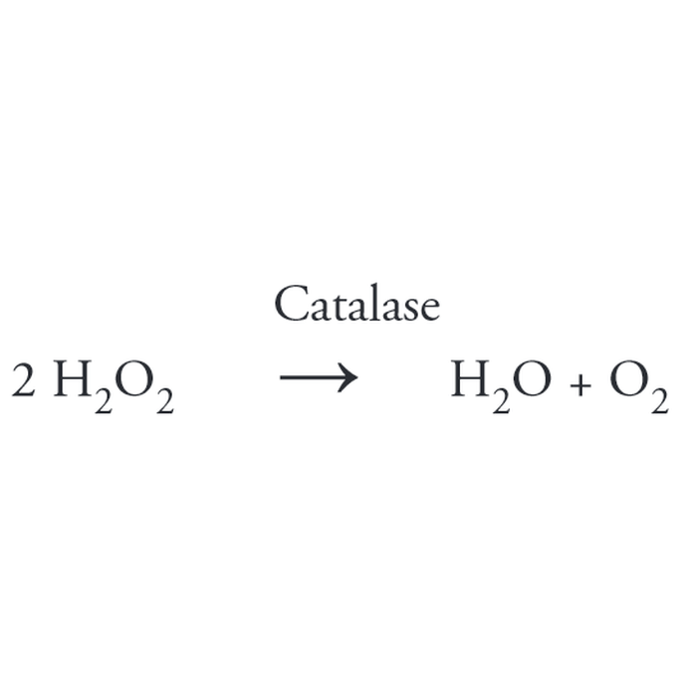
  How do you differentiate between
  Staphylococcus, Streptococcus and Micrococcus?
  Biochemical test
  1. Catalase test
  Catalase test is important in distinguishing streptococci (catalase-negative) staphylococci which are catalase positive.

Slide 5
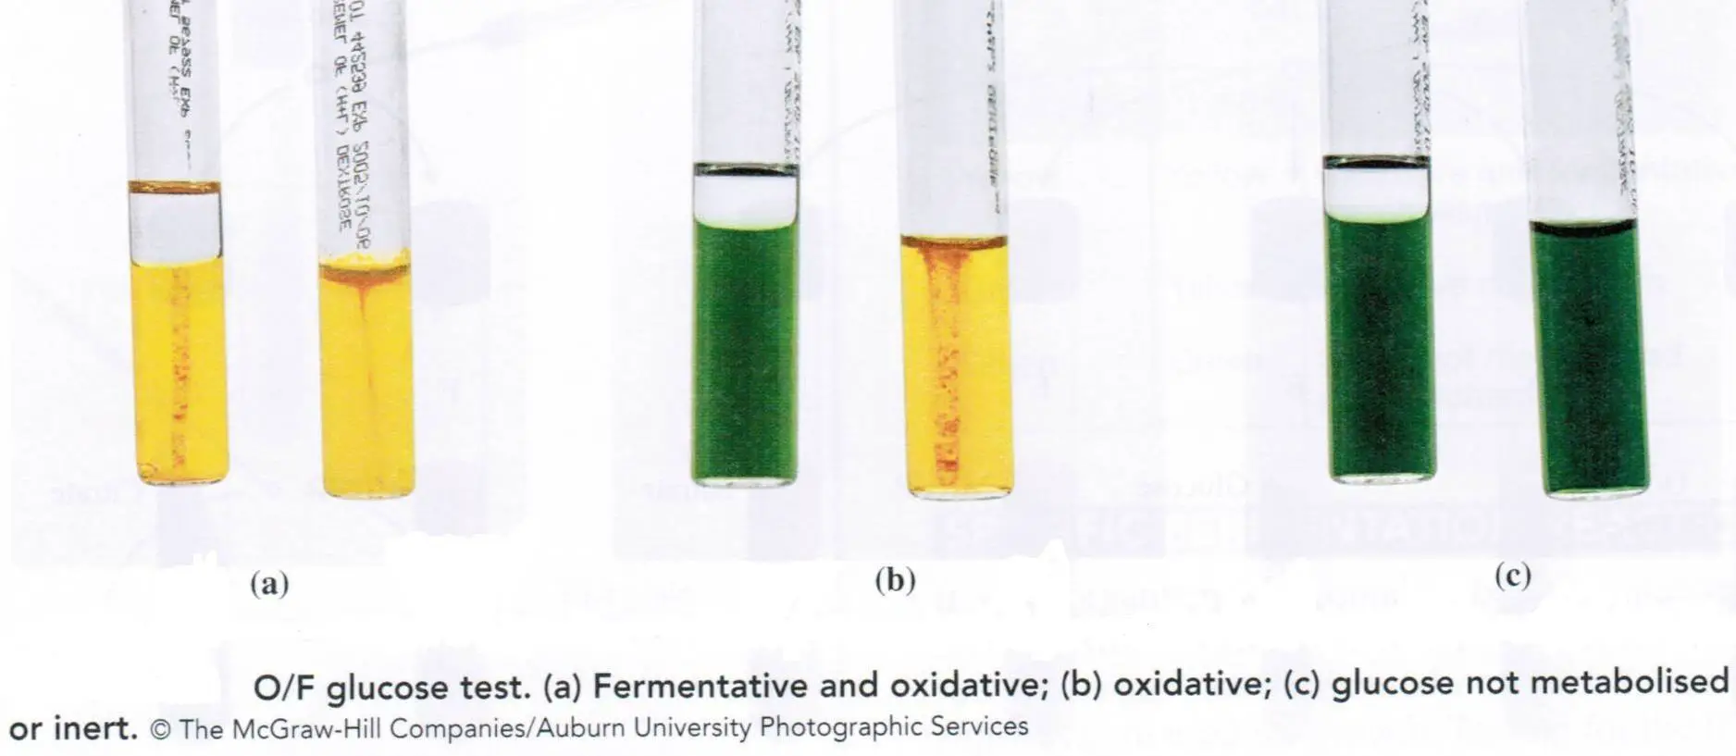
  2. Oxidative – fermentation test
  The oxidative-fermentative test is used to determine if bacteria metabolise carbohydrates oxidatively, or by fermentation, or are non-saccharolytic and therefore have no ability to use the carbohydrate in the media.
Using 2 test tube containing glucose media
1st cultivate microbe &seal tube with paraffin layer
2nd cultivate microbe &let the tube opened
After cultivation of the test tubes notice the glucose fermentation (media turn to yellow color)

Slide 6
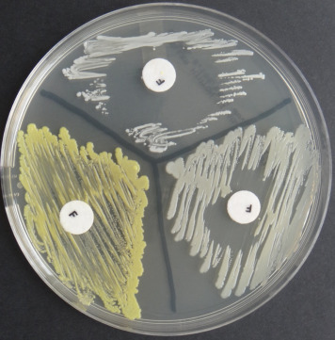
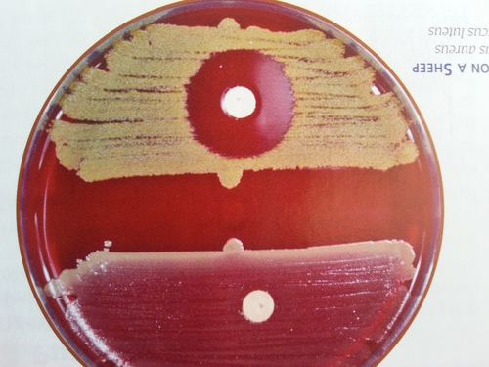
  3. Furazalidone sensitivity: FTO test
It is the ability of organism to grow in the presence of antibacterial agent termed furazolidone 20μg/ml
  4. Bacitracin inhibition test
Incubate of the microbe with bacitracin disc 0.04 micro disc
Furazalidone sensitivity: Staphylococci are sensitive, but micrococci are resistant
Bacitracin inhibition test:
micrococci are bacitracin-susceptible, staphylococci are resistant.

Slide 7
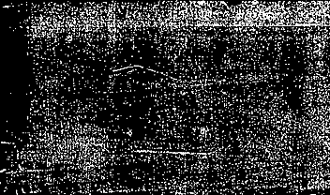
 | G:Staphylococcus | G:Streptococcus | G:Micrococcus
1-Type | Facultative anaerobic | Facultative anaerobic | Aerobic cocci
2-Morphology | Grapes like clusters | chain | tretrads
3- biochemical identification
catalase | + | - | +
Oxidative-fermentative test open fermentation close fermentation | + + | + + | + -
Furazalidone sensitivity | S(can't grow) | S/R | R
Bacitracin | R | S/R | S
Table 1

Slide 8
Staphylococci
General Characteristics
^{Gram-positive}
Cocci, which appears as grape-like clusters when viewed through a microscope.
^{Catalase-positive}
Grow at 15 % NaCl concentrations.
Facultative anaerobes (respiration or fermentation), fermentation of glucose produces mainly lactic acid.
Optimum temperature at 37°C, can grow at a temperature range (15 to 45 °C).
^{Non Fastidious}
^{Non motile}
^{Non spore forming.}
Either capsulated or non capsulated
Biochemical reaction as in table1

Slide 9
Classification of genus Staphylococcus
1-According to pigment produced by microorganism
S. aureus...........golden yellow
S. citrus.............yellow pigment
S. albus ............white pigment
This classification is old and failed because there is no strict demarcation between species where S. aureus may give white colonies
2-According to the pathogenicity of the species
Mostly pathogenic (S. aureus )
Cause disease in many organs invade it as osteomyelitis, Pneumonia, food poisoning within 6 hours.
Moderate pathogenic (S. epidermidis)
Universal skin pathogen and cause human acnes
Less pathogenic (S. saprophaticus)
Cause urinary tract infection (pyelonephritis , cystitis....).

Slide 10
 | S. aureus | S. epidermidis | S. saprophaticus
1-Coagulase -free -bound | + + | _ _ | _ _
2-Mannitol fermentation | + | - | Or different-
3-Tellurite reduction | + | - | -
4-Phosphatase Test | + | + | _
5-Hemolysis of blood agar | + | _ | _
6-cell wall composition-SPA | + | - | _
7-Novabiocin sensitivity | S | S | R

Slide 11
Medically Important Staphylococci Species
Coagulase Positive Staphylococci (CoPS)
S. aureus colonizes mainly nasal passage as normal flora, but it may be found in other sites (skin, mucous membranes, oral cavity & gastrointestinal tract).
always considered a potential pathogen.
causes nosocomial infections.
Coagulase Negative Staphylococci (CoNS)
are part of normal flora of human skin and mucous membranes.
relatively low virulence.
Frequently involved in nosocomial and opportunistic infections.
Cause clinically significant infection associated with endocarditis, joint infection, wound infections, Bacteremia, Urinary tract infections (UTI).
S. epidermidis is an inhabitant of the skin and mucous membranes, mostly
nonpathogenic and may play a protective role in humans as normal flora.
The production of biofilm, a significant determinant of virulence for S. epidermidis.
S. saprophyticus is a leading cause of cystitis in young women. And shares in urinary tract infection.

Slide 12
Staphylococcus aureus
General characteristics
Pathogenicity in human
The most common pyogenic organism
May cause abscess, pyemia or septicemia depending individual immunity-pneumonia – conjunctivitis- pyelonephritis- osteomyelitis- endocarditis – impetigo- food poisoning within 6 hours- Toxic shock syndrome )TSS(- nosocomial infection- Staphylococcal scalded skin syndrome (SSSS) or Ritter's disease.
S. aureus is a major cause of hospital acquired (nosocomial) infections, surgical wounds and infections associated with medical devices.
50% of normal individuals S. aureus present in the nose
Morphology
Gram positive
Cocci arranged (grape-like cluster)
Non motile organism
non sporulating.
Capsulated or not.

Slide 13
Culture characteristics
Facultative anaerobic
optimum temp.37○C
Produce golden yellow colonies
In broth media ; uniform turbidity
On blood agar; hemolysis
Selective media
- Mannitol salt agar (salt 7.5%)
- Phenol ethyl alcohol agar (PEA agar)
Biochemical reaction
Catalase test positive
Coagulase test positive
Mannitol fermentation.
Resistant character
  Resist dryness for a month.
  Highly sensitive to gentian violet so, it is used for selective isolation in case of mastitis.

Slide 14
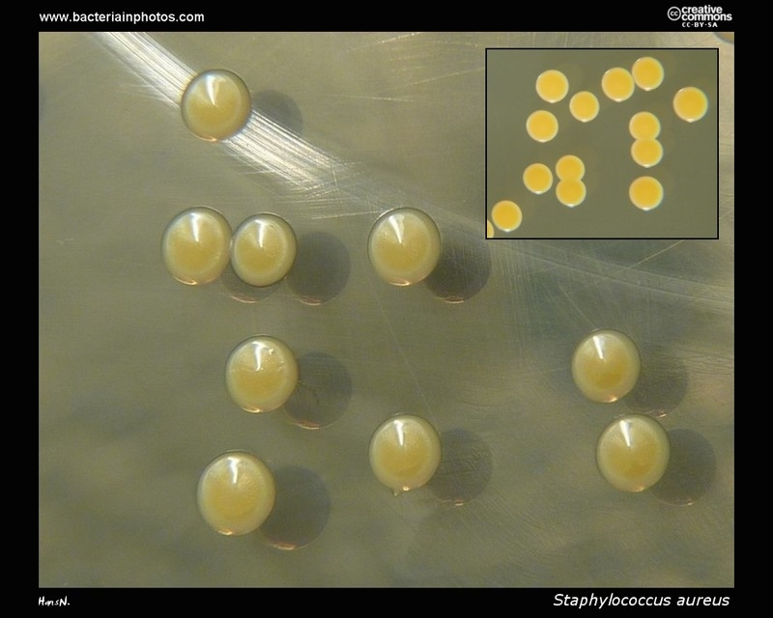
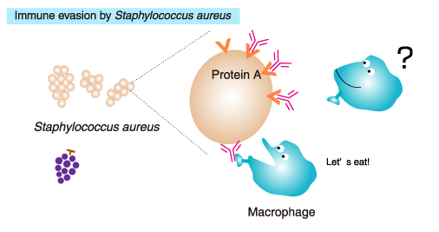
Virulence factors
Cell surface of protein (help adherence between S. aureus and host cell).
Capsules and protein A (anti-phagocytosis)
Staphyloxanthin: carotenoid pigment which responsible for golden colonies, and it has an antioxidant action.
Extracellular product e.g. Toxins , Enzyme
Toxins
Leucocidins Kill leucocytes, macrophages, pleomorphic cells
Heamolysin Cause lysis of RBCs
Enterotoxins
Produced by 30-50% of staphylococcus
Caused food poisoning
Resist boiling and digestive enzyme (trypsin ,pepsin)
Symptoms appear after 6-8 hours as diarrhea and vomiting
4. Exofoliatin or epidermolytic toxin
Causes lysis of the epidermis leading to Staphylococcus scalded skin syndrome (SSSS) also known as ritter's disease
5. Toxic shock syndrome toxin (TSST)
Systemic disturbance as heart failure, lower blood pressure with diarrhea and vomiting

Slide 15
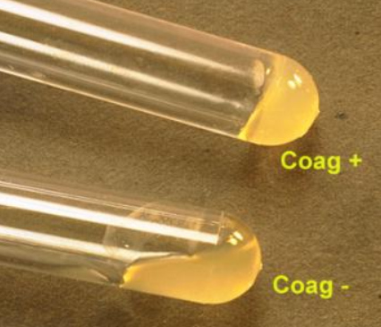
Enzyme
1. Hyaluridase
Known as spreading factor.
It cause lysis of the cement substance between cells helping spreading of infection.
2. Coagulase
Marker of pathogenic strains
Cause coagulation of plasma
Its two types free and bound coagulase lead to deposit of fibrin around the microorganism, so inhibit the ability of phagocytic cell to engulf it.
3. Staphylokinase (fibrinolysin )
Cause lysis of fibrin
Used for treatment of recent thrombi in the first 5 hrs after thrombus formation

Slide 16
4. DNase
Cause digestion of DNA leading to impairment the biological function of the leukocytes and polymorph cells.
Detection:
Using DNA agar media commercially prepared (straw yellow colour )
If DNase positive: digest DNA surrounding the colony (clear zone appear around the colony) and this is confirmed by flooding the plate with diluted HCL which cause precipitation of undigested DNA.
5. Phosphatase
Cause digestion of phosphate
Detection:
Detected by phenolphthalein phosphate agar
Some non-pathogenic strains are phosphatase test positive.
6. Pencillinase (β-lactamase )
Cause inactivation of penicillin
Called β-lactamase because of the destruction of β –lactam ring of the penicillin.

Slide 17
Laboratory diagnosis
  1. Sampling
According to the site of infection
e.g. Blood in cause of pyemia and septicemia , Abcess (pus)
2. Film preparation
(direct microscopic examination) See morphology
  3. Cultivation see culture character
4. Biochemical identification
5. Commercial kits using depending on SPA
6. Bacteriophage typing
Bacteriophage are group of virus attacking staph.
Due the high specific relation between the virus and the bacteria causing lysis of the colony.
There are 24 bacteriophage.
Uses of bacteriophage
1-used in epidemic causes such as food poisoning .
2-not important in lab. Diagnosis.
Method :
Using glass plate after bottom with 24 squares
Cultivat staph on the plate colony
Add drop of the bacteriophage of each type on the specific square
Then observe lysis after 24 hrs.

Slide 18
Staphylococcus protein A (SPA):
only restricted to the most pathogenic species of Staphylococci especially Staphylococcus aureus
SPA is a major cell component of Staph. aureus mainly human strains
Importance of SPA
1. Marking of antibodies
SPA+Ab ……... SPA is attached to the Fc portion of the antibody so it is important in marking appear in detection of infection
2. Has antitumor activity
SPA inhibit the growth of tumor through the inhibition of the immune complexes giving a chance for Ab to attach to tumor cell.
SPA antitumor activity nearly equal to that of the interferon
Detection of protein A
Protein A present in 95% of Staph. aureus
1. AGP test
White line of precipitation indicate positive result
2. Hemagglutination
If the sensitized RBCs which carry antibodies attached to the
Staphylococci it indicates positive result.
Types of protein A
Extracellular 1/3.
Bound SPA to cell wall 2/3

Slide 19
Treatment
Hospital acquired infection of S. aureus is often caused by antibiotic resistant strains (e.g. MRSA) and can be treated with vancomycin or an alternative.
The term MRSA refers to Methicillin resistant S. aureus and related beta-lactam antibiotics (e.g. penicillin, oxacillin, amoxacillin).
Some MRSA are resistant to vancomycin (VRSA). The infections have been treated with combination therapy using sulfa drugs (Sulfonamide) and or rifampin .
Coagulase Negative Staphylococci (CoNS); produce an enzyme called beta-lactamase that makes them resistant to methicillin. Vancomycin is the most common antibiotic used to treat infections caused by CoNS; if they not resistant. Rifampin and gentamicin may be added to prevent antibiotic resistance.

Slide 20


