Slide 1
460 MBIO
Medical Bacteria
Lecture 8
(Yersinia and Brucella)

Slide 2
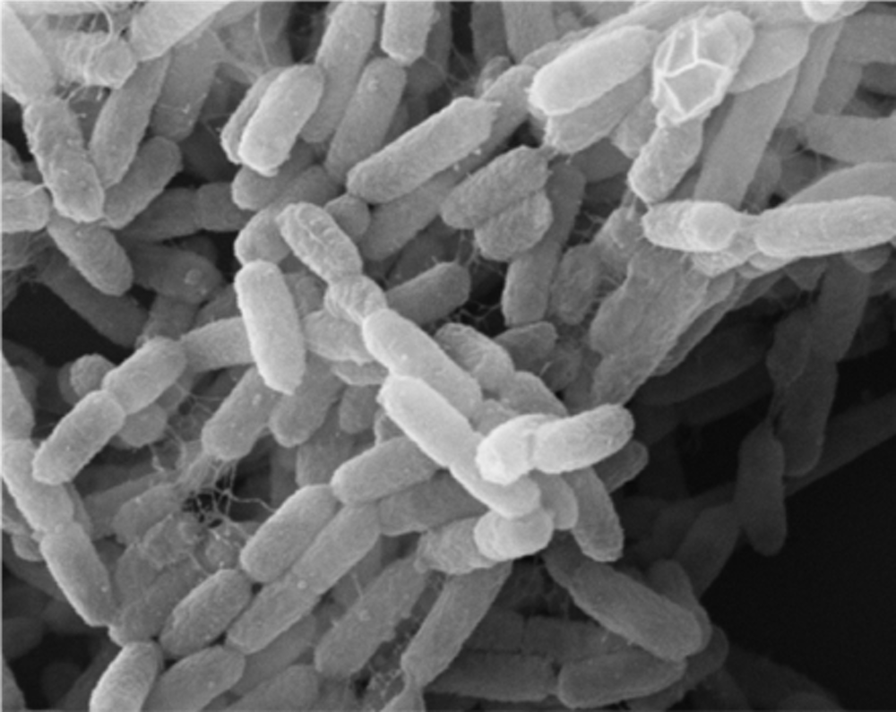
Yersinia
Morphology:
Short, pleomorphic coccobacilli
facultative intracellular
non motile
Culture character
non lactose fermenter
microaerophilic or facultative anaerobic
Bipolar staining is characteristic of Yersinia pestis
Urease and oxidase negative.
Catalase-positive
Species of medical importance:
Three species that are pathogenic for humans;
Y. pestis
Y. pseudotuberculosis
Y. enterocolitica
These are primarily animal pathogens, and humans are accidental hosts for infection.
bipolar staining
Scientific classification
Domain: | Bacteria
Phylum: | Pseudomonadota
Class: | Gammaproteobacteria
Order: | Enterobacterales
Family: | Yersiniaceae
Genus: | Yersinia

Slide 3
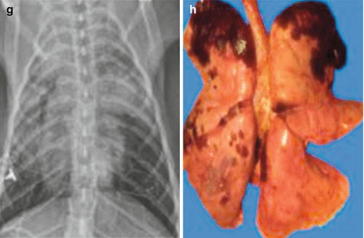
Yersinia pestis
Causes plague
A natural disease of rodents. Fleas that live on rodents transmit bacteria to human, in the bubonic form.
Three forms of clinical plague illness
Bubonic Plague (Black death):
cutaneous, characterized by high fever, painful lymph nodes.
60 % mortality if untreated.
2. Pneumonic Plague:
transmitted via aerosols , infection of lungs, painful in muscles, high fever, enlarged liver and spleen, bloody sputum.
High mortality rate (95-100%) during 24-36hrs of untreated.
3. Septicemic plague:
bloodborne organism, primary or secondary from bubonic or pneumonic.
100% mortality of untreated.
Diagnosis and treatment must be rapid due to the fast progression and deadliness of the plague .

Slide 4
Virulence Factors
Antigenic change at 37c.
Fraction 1 Antigen (Anti phagocytic ).
Protein (V) and Lipoprotein (W) (overwhelming septicemia).
Yersinia outer membranes (Yops); 11 different proteins, cytotoxic, inhibit phagocyte migration, engulfment and intracellular killing, inhibit platelets aggregation .
Hemolysin.
Coagulase, produce at 28 C but not at 32C (causes clotting and microthrombi formation).
Fibrinolysin (promotes dissemination).
Endotoxin.

Slide 5
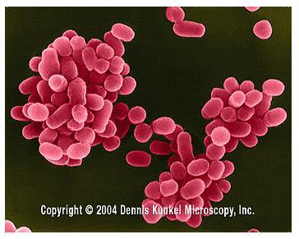
Brucella
pathogenic to animals from which they are transmitted to man causing brucellosis or undulant fever or Malta fever.
facultative intracellular.
Morphology:
short bacilli or coccobacilli.
non capsulated
non motile
non sporing.
Species of medical importance:
Brucella melitensis : causing infection in goats and sheep
Brucella abortus: causing infection in cattle
Brucella suis: causing infection in pig

Slide 6
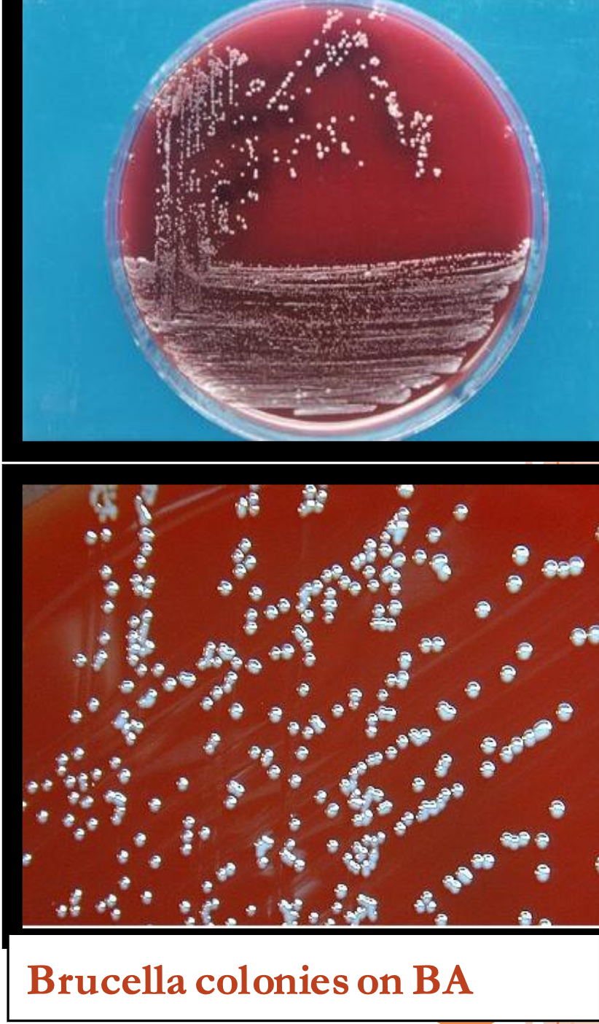
Culture characters:
Aerobic, requiring 5-10% CO₂
strongly positive to urease.
Grow slowly ( 7 days) at 37C.
Oxidase positive.
Non haemolytic.
they grow on ordinary media, and blood agar however, better growth is obtained on Liver – infusion or glucose serum agar & in the present of 10 - 20 % CO₂ or Brucella agar.
Brucella is weak acid fast, stained with:
    Modified Ziehl-Neelsen stain ( appear red)
    kosters stain ( orange red against blue black ground ).
Serological characters:
They all posses 2 antigens ( A & M ).
  A is dominant in Brucella abortus.
  M is doment in Brucella melitensis.
  A & M are mostly equally present in Brucella suis.

Slide 7
Laboratory diagnosis:
1- Isolation of the organism from the blood by repeated by blood culture (on the media previously mentioned). Blood culture should not be discarded as negative before 4 weeks incubation.
2-Serological identification: by specific antisera.
  Detection of Ab in the serum: these appear 10 days after the beginning of fever. By tube agglutination test.
  The serum may contain incomplete antibodies which are tested for by Coomb’s antiglobulin test.
3-Brucellin test: This is an intradermal allergic test similar to tuberculin test. A killed brucella suspension is used for intradermal infection.
Pathogenesis: (Malta or undulant fever)
Man is infected by consumption of infected cow meat or milk or goat milk.
Farmers and butchers are infected by coming in contact with sick or dead animal & their discharge.
The organism can enter through abrasions in the skin or by inhalation.
It is present in the blood stream during the febrile period.
This disease is characterized by undulant of fever that remains for 3-4 weeks.

Slide 8


