Slide 1
^{460 MBIO}
^{Medical Bacteria}
^{Lecture 3}
^{Family Bacillaceae}
(Spore-forming Gram-Positive Rods Bacilli )

Slide 2
Family Bacillaceae
Genus Bacillus
General Characteristics
- Gram positive
- Large rod.
- Arranged in chain
- Spore forming
- Aerobic or facultative anaerobic
- Found in soil habitats around the world
Forming rhizoid colonies
Important species
• Bacillus anthracis
• Bacillus cereus
• Bacillus subtilis
• Bacillus mycoides
• Bacillus thuringiensis

Slide 3
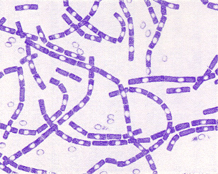
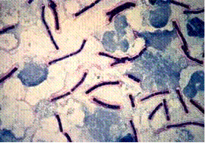
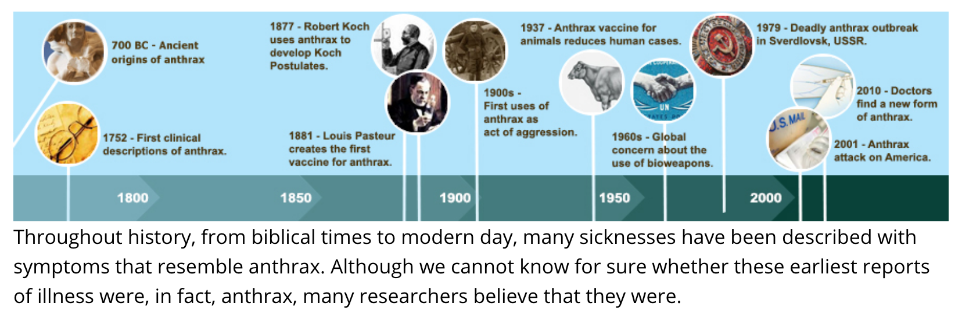
Bacillus anthracis
General Characteristics
Morphology:
-Large, square-ended rods in long chain (one of the largest size pathogenic microorganisms)
- Non motile
- Capsulated: The organism is stained violet and the capsule stained purple pinkish in colour.
- Spores are never seen in blood or tissue smears taken from infective animals
- Non hemolytic on blood agar

Slide 4
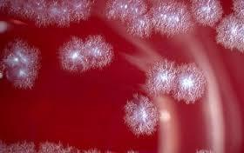
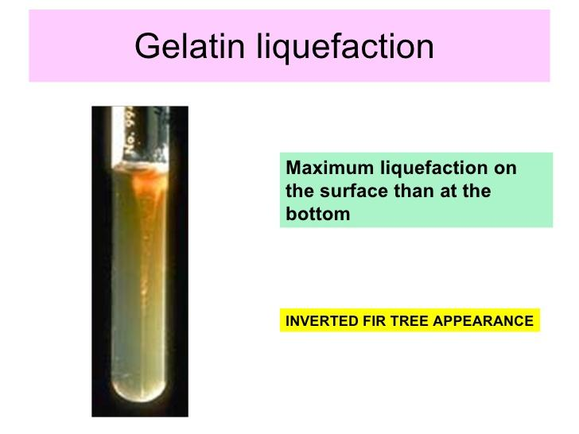
Culture character
Aerobic and facultative anaerobic grow on all ordinary media, at temp (12-43º C) with optimum temp = 37 o C.
Can be cultivated in ordinary nutrient medium (nonselective & selective media)
Colonies on nutrient agar media is very characteristic; the colonies appear rough creamy or greyish white in pigmentation, 2-3 mm in diameter with wavy or irregular margins resembling wavy curly hair with projection resembling what is known as medusa head.
Most of the strains is non haemolytic into blood agar media.
On 15 % gelatine stabbing culture, B. anthracis produced very characteristic type of liquefaction in which lateral line of growth produced from a central on the whole resemble inverted fir tree.
In broth there is neither turbidity nor pellicle formation but floccular deposit appears in the bottom of broth resembling fluffy cotton wool in appearance.

Slide 5
Biochemical reaction:
B. anthracis produces acid without gases in case of glucose – maltose – sucrose fermentation.
Catalase test +ve
Produce weak lecithinase activity ( Nagler's reaction +ve )
Virulence Factors:
1- Poly-D-glutamyl Capsule; antiphagocytic (major virulence factor).
2- Anthrax exotoxin is a three-protein exotoxin (Edema factor, Lethal factor, Protective antigen).

Slide 6
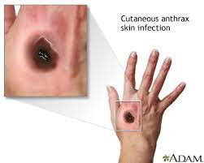
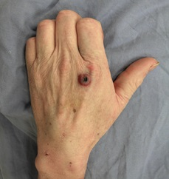
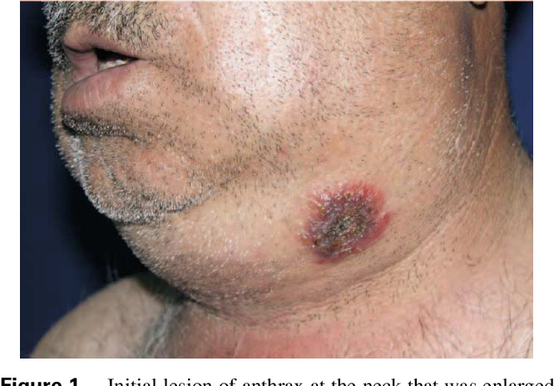
Pathogenesis:
B. anthracis Disease (Anthrax):
Anthrax is primarily zoonotic disease of domesticated and wild animals, such as cattle and sheep.
Transmitted to human after contact with infected animals or their products.
Anthrax
In animals: the infection most commonly occurs following ingestion of the organism, also can occur by acquisition of the organism in aerosols or via wounds.
In Human:The infection may occur in three forms of the disease :
1- Cutaneous anthrax (Skin)
through wounded skin and disease is called malignant pustules.
2- Pulmonary anthrax (Wool sorter's disease)
by inhalation of dust contaminated with the spores in the skin or hairs or wool. The disease is characterized by pulmonary lesion, enlargement of the spleen, also the disease is known as splenic fever
3- Gastrointestinal anthrax (contaminated food)

Slide 7
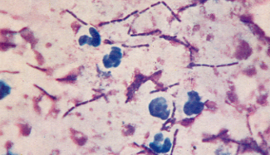
Laboratory diagnosis:
Direct smear from the blood are stained by polychrome methylene blue
The poly-D-glutamyl capsule can be detected by the McFadyean reaction which involves staining blood smears with polychrome methylene blue, can be used to distinguish B. anthracis from its closest relatives.
2. Culture character and biochemical reaction
3. Animal pathogenicity
Suspension from the suspected sample or pure culture of m.o 0,5ml of 24 hrs young broth culture is injected into guinea pig
death usually occurs within 48hr and many bacilli are seen in blood (Smears prepared from dead animals).
McFadyean's reaction showing short chains of B. anthracis (Blue rods )cells lying among amorphous, disintegrated capsular material(purple/pink-stained )

Slide 8
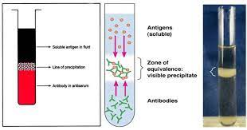
4. Ascoli's test (thermo precipitin test): Ag-Ab reaction test
This test is used on examined wools or hair on putrefied carcasses.
This test depends on the detection of polysaccharide Ag of Bacillus anthracis in the examined sample.
2cm of the suspected sample is boiled with 10ml of sterile saline containing a few drops of 0.5% acetic acid, boil for about 10min then filtered.
0.5ml of filtrate is put into a narrow or capillary test then add 0,5ml of anti-anthrax serum.
in the positive case: a white ring (precipitate) appears at the junction of two fluids.
Immunization against Anthrax
Passive immunity
Active immunity
Pasteur first vaccine
Pasteur second vaccine
Spore sterne vaccine

Slide 9
Bacillus cereus
Reservoir: found in nature.
Transmission: Foodborne, cause intoxication.
It can be isolated from foods such as grains and spices (cause fried rice syndrome).
Associated with food kept warm, not hot (buffets). Keeping rice warm results in germination of spores and enterotoxin formation.
Pathogenesis: two possible toxins:
Emetic toxin:
causing emetic (vomiting) syndrome
performed fast (1-6 hours).
It is similar to S. aureus food poisoning in its symptoms (vomiting and diarrhea)
associated with fried rice.
Diarrheal toxin
causing the diarrhoeal syndrome
The incubation period of ( 8 to 16 hours).
similar to E. coli.
produced in meats.

Slide 10
Difference between Anthrax Bacilli and Anthracoid Bacilli
 | Anthrax Bacilli B. anthracis | Anthracoid Bacilli B. Subtilis, B. cereus
Motility | Non motility | Motility
Capsule | Capsulated | Non capsulated
Shape | Grow in long chains | Grow in short chains
In nutrient broth (Turbidity) | Fluffy Cotton wool without pellicle (No Turbidity) | Turbidity and pellicle formation but no fluffy Cotton wool
Medusa Head Colony | Present | Not Present
Haemolysis | Haemolysis absent or weak. | beta haemolysis
Stabbing in gelatine | Inverted fir tree | No Inverted fir tree
liquefaction of gelatine | Occurs slowly from up to down | Liquefy gelatin rapidly
Salicin Fermentation | Ferment salicin slowly | Ferment it rapidly
Reduction of methylene blue in milk | Reduced methylen blue slowly | Rapidly reduce methylen blue
Penicillin agar media 10 mg\ml | No growth | Growth occurs rapidly
Pathogenicity | Highly pathogenic | Most of them are non pathogenic

Slide 11


