Slide 1
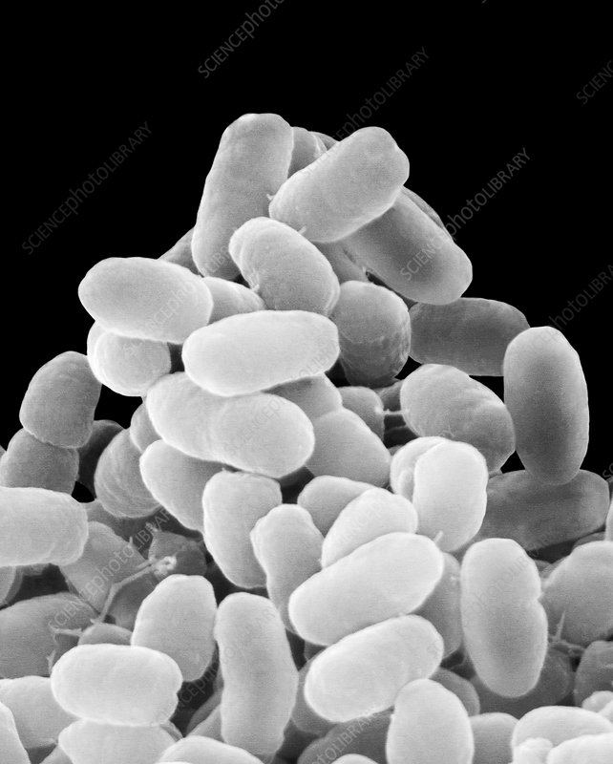
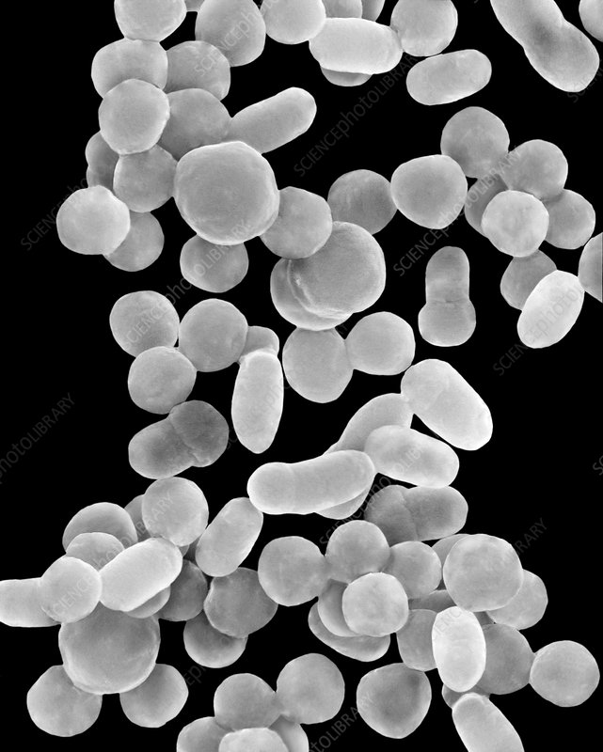
460 MBIO
Medical Bacteria
Lecture 11 Gram Negative Coccobacilli
(Haemophilus – Bordetella)

Slide 2
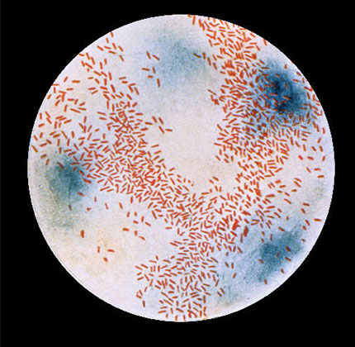
Haemophilus
General Characteristics
Present in upper respiratory tract as a normal flora in healthy people.
Medical importance species:
H. Influenzae H. parainfluenzae H. ducreyi
Morphology
Small gram-negative coccobacilli
Non-spore forming
Non-motile
some strain are capsulated
Culture character
aerobic and anaerobic growth.
Growth is enhanced in CO_{2.}
Fastidious.
Require enriched media for growth.
Requiring growth factors present in blood for isolation. The growth factors are:
X-factor (Hemin).
V-factor (Nicotinamide- adenine dinucleotide) (NAD).
Grown on chocolate blood agar (X and V factors released from the RBCs).
Requirement for growth factor helps for differentiate the species
Require X and V | Require v | Require x
* H. influenzae | * H. parainfluenzae | * H. ducreyi

Slide 3
Disease:
Extracellular pathogen (not invade into the cells).
It is an important secondary invader to the influenza virus.
causes disease commonly in young children (Acute pyogenic meningitis- Acute epiglottitis Pneumonia- Otitis media- Sinusitis- Cellulitis)
Encapsulated strains of H. influenzae isolated from CSF cerebrospinal fluid are coccobacilli similar in morphology to Bordetella pertussis, the agent of whooping cough.
Non encapsulated strains are less invasive, but they are able to induce an inflammatory response that causes disease.
Laboratory diagnosis:
Grows on ‘chocolate agar’ but not on blood agar (blood agar contains factor X but insufficient factor V. Heat treatment of blood before incorporation in agar produces a medium known as ‘chocolate agar’, which contains both factors for H. influenzae to grow).
Serotyping by agglutination tests can be carried out on capsulated strains.

Slide 4
Virulence Factors
Polyribosylribitol phosphate (PRP) capsule : most important virulence factor, resistant to phagocytosis.
M-protein
IgA protease
Fimbriae; increase the adherence to respiratory cells
Endotoxins
No produce exotoxins .

Slide 5
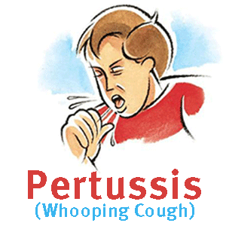
Bordetella pertussis
General Characteristics
Morphology
Very small gram-negative coccobacillus that appears singly or in pairs.
Non motile
Culture character
Strictly aerobic
Fastidious ( blood agar and other additives)
Disease:
Whooping cough (pertussis)
Airborne disease, spread through respiratory system secretions.
Highly contagious
Whooping cough is a relatively mild disease in adults but has a significant mortality rate in infants.

Slide 6
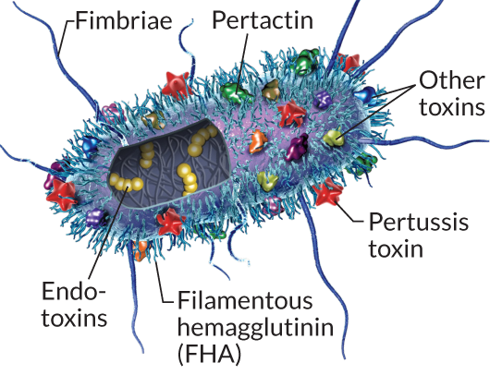
Laboratory diagnosis:
Culture on specialized agar, e.g. Bordet–Gengou (charcoal blood agar). Colonies may take 2–3 days to grow.
Virulence Factors
cytotoxins
haemolysins.
filamentous hemagglutinin ( adhesins).
Pertussis toxin, PTx: (a major component of acellular pertussis vaccine)
Endotoxin
Prevention: DPT vaccines.

