Slide 1
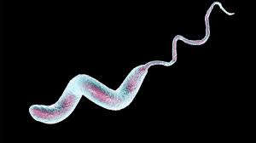
460 MBIO
Medical Bacteria
Lecture 10
Helicobacter , Campylobacter

Slide 2
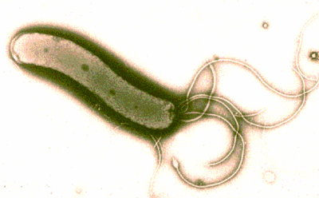
Helicobacter pylori
General Characteristics
colonizes the stomach of hosts (found on surface and deep mucous layers of gastric epithelium)
Morphology
Spiral-shaped ( curved)
highly motile with polar flagella
non-spore forming, non-capsulated
Culture character
Optimal growth in microaerophilic environments.
Biochemical test
Catalase positive
Oxidase positive
Urease positive ( strong producer)
Disease
Peptic ulcer disease (gastric and duodenal ulcer) Gastric cancer
Route of entry: Ingestion of contaminated food and drinks.
Symptoms: abdominal pain with burning sensation ( night time pain is often), poor appetite, weight loss, vomiting, blood in stool, belching.

Slide 3
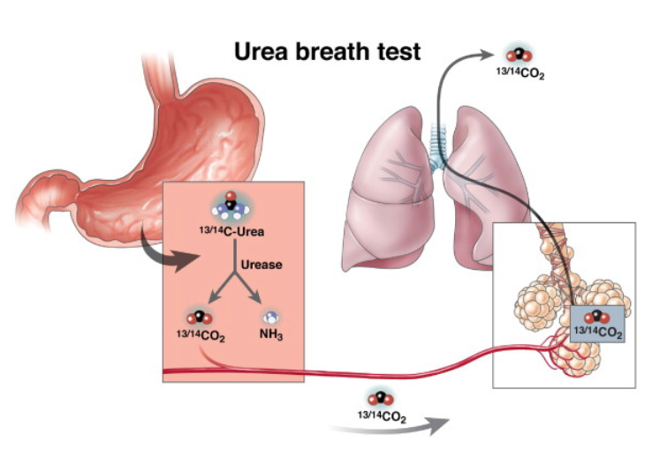
Virulence Factors
Urease ( major virulence factor), Urease produces ammonia that damages gastric mucosa, ammonia also neutralizes acid pH; which allows the organism to live in the stomach.
Flagella for adhesions.
Protease.
Exotoxins (inhibit stomach acid production).
LPS ( damage mucosal cells).
Laboratory diagnosis:
Urea breath test.
Serology:
    Detection of antibodies in the serum specific for H. Pylori
    Detection of H. pylori antigen in stool specimen

Slide 4
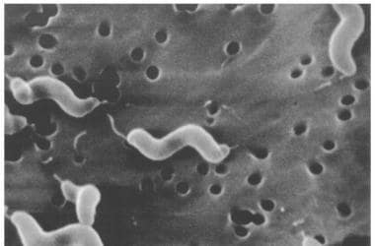
Campylobacter
General Characteristics
The infection is essentially a zoonosis with a wide range of reservoirs, including wild birds, poultry, cattle, sheep, pigs and pets.
Medical importance species:
Campylobacter jejuni
Morphology
Spirally curved
motile with single polar flagella
non-sporing
non-capsulated
Culture character
require microaerobic conditions with added CO₂.
Selective media containing specific antimicrobials.
Biochemical test
oxidase and catalase positive

Slide 5
Disease:
Campylobacter spp. are a leading cause of acute infective diarrhoea worldwide.
eating undercooked meat, raw milk and untreated water are sources of infection.
Laboratory diagnosis:
Culture of faeces on selective media at 42 C under microaerophilic conditions;
Campylobacter spp. are among the fastest moving bacteria. It is possible to recognise them in microscopic examinations of wet preparations of faeces from patients.
Serology: detect for serum antibodies
Virulence Factors
Endotoxins.
Cytopathic toxins
enterotoxins

Slide 6


