Slide 1
Java Examples

Slide 2
Mouse events
import javax.swing.*;
import java.awt.*;
import java.awt.event.*;
class Test extends JFrame implements MouseListener {
private Container contentPane;
private JTextField t1;

Slide 3
public Test() {
setTitle("Playing With The Mouse!");
setSize(400, 200);
setResizable(false);
setVisible(true);
addMouseListener(this);
setDefaultCloseOperation(EXIT_ON_CLOSE);
contentPane = getContentPane();
contentPane.setLayout(new FlowLayout());
t1=new JTextField (20);
contentPane.add(t1);
}

Slide 4
public void mouseEntered(MouseEvent me) {
t1.setText("Mouse entered at: ("+ me.getX() + ", " + me.getY() + ")");
}
public void mouseExited(MouseEvent me) {
t1.setText("Mouse exited at: ("
+ me.getX() + ", " + me.getY() + ")");
}
public void mouseClicked(MouseEvent me) {
t1.setText("Mouse clicked at: ("
+ me.getX() + ", " + me.getY() + ")");
}

Slide 5
public void mousePressed(MouseEvent me) {
t1.setText("Mouse pressed at: ("
+ me.getX() + ", " + me.getY() + ")");
}
public void mouseReleased(MouseEvent me) {
t1.setText("Mouse released at: ("
+ me.getX() + ", " + me.getY() + ")");
}
public static void main(String[] args) {
new Test();
}
} // End of Test class

Slide 6
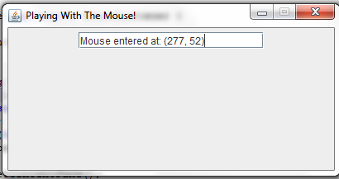
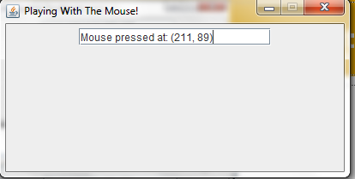
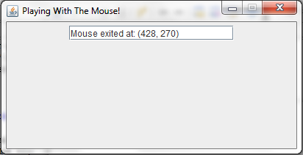
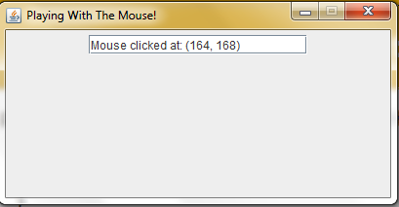

Slide 7
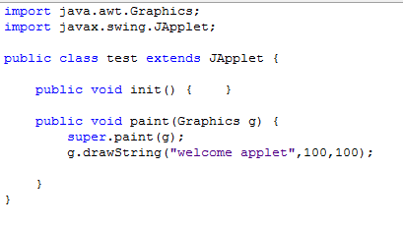
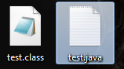
Getting started…
Create a new java class file
After that build the file … the you will get tow files

Slide 8
Getting started…
Now use the previous code in to a regular HTML document
<HTML> <HEAD> <TITLE> Welcome Applets </TITLE> </HEAD> <BODY> <OBJECT code="test.class" width="400" height="400" > </OBJECT> </BODY> </HTML>

Slide 9
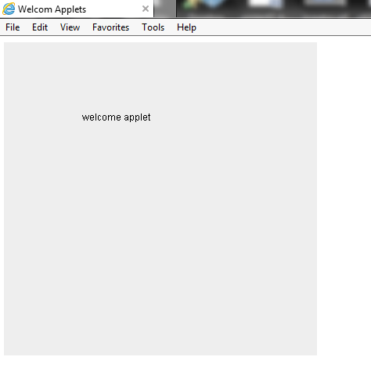

Slide 10
JAVA application VS. applets
Java applications and Applets share some common programming features although they differ in some aspects
GUI | Applets
Is derived from class Jframe | Is derived from class JApplet
Have “MAIN” method | Do not have main method instead It have init(), start(), stop(), paint(..)
Uses the class constructor to initialize the GUI component and data members | Uses the init() method to initialize the GUI component and data members
Uses setSize(),setTitle(), setVisible() methode | don not use the because the HTML document do the job.

Slide 11
converting JAVA application to applets
Change the extends from JFrame to JApplets.
Change the constructor to method init().
Remove method calls like setSize(),setTitle(), setVisible() .
Remove the method main

