Slide 1



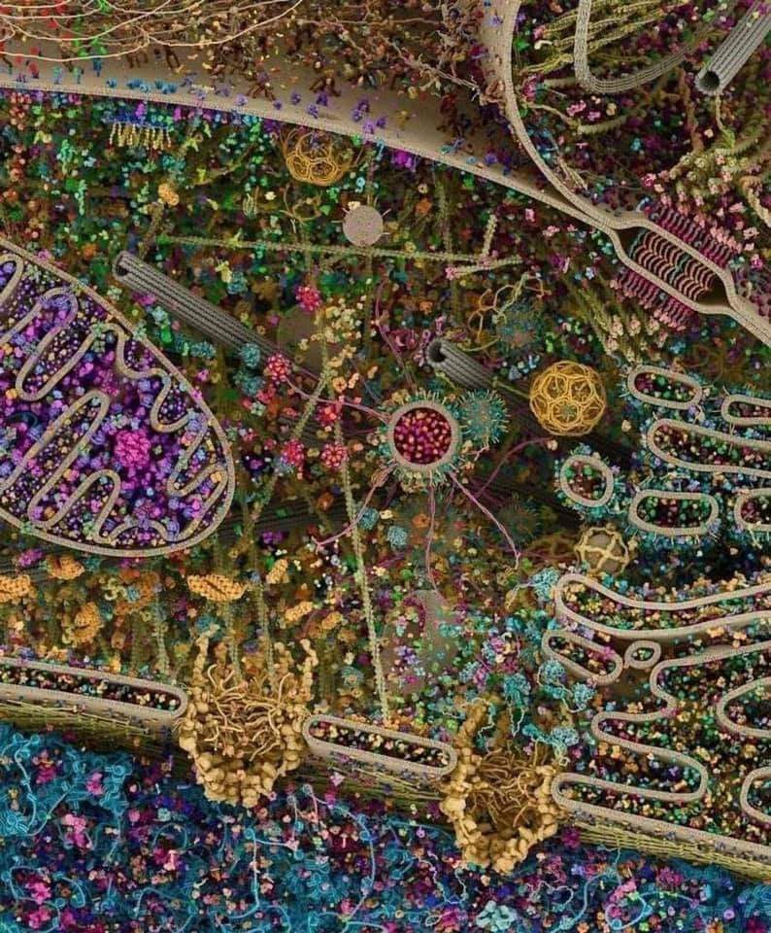
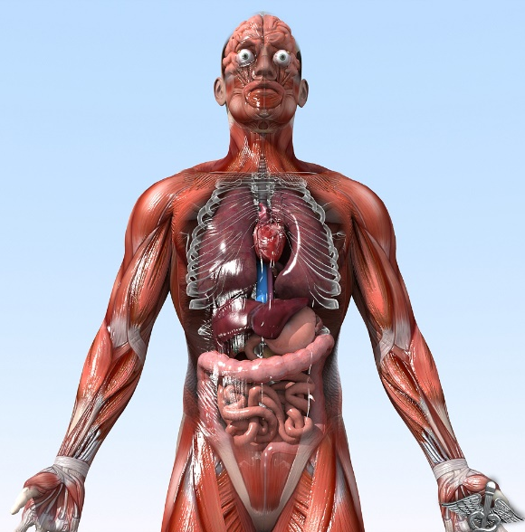

General Animal Biology
Zoo-109
علم الأحياء
109- حــيـن
College of Science,
Zoology Department
For Pre-Medical Students
Common First Year
السنة الأولى المشتركة - المسار الصحي
1447-H - 2025
Reference: Campbell, N. A. and Reece, J. B. (2014). Biology (10th edition). Pearson Education. Inc. USA.

Slide 2


Teaching Strategy
A)- Description:
أ)- الوصف:
Course Designation | Zoo-109 | 109 حين | رقم المقرر ورمزه
Course Name | General Animal Biol. | بيولوجيا الحيوان العام | اسم المقرر
No. of Credits | 3 (2 + 1) | 3 ساعات (2 + 1) | عدد الوحدات الدراسية المعتمدة
Prerequisites | None | لا يوجد | متطلب سابق
Co-requisite Course | None | لا يوجد | متطلب مصاحب
B)- Assessments Timetable
ب)- الجدول الزمني لمهام التقويم
Items | Assessment tasks | Weeks (approximate) | Assessments | Total marks
1 | 1st laboratory exam | Week 6/7 | 15/100 | 30 marks
2 | Final laboratory Exam | Week 10/11 | 15/100
3 | 1st Theoretical Exam | Week 5/6 | 15/100 | 15 marks | 30 Marks
4 | 2nd Theoretical Exam | Week 9/10 | 15/100 | 15 marks
5 | Final Theoretical Exam | Week 13/14 | 40/100 | 40 marks
Total |  |  | 100/100

Slide 3
Detailed Syllabus of Theoretical Zool-109
Macromolecules:
  Carbohydrates
  Lipids
  Proteins
  Nucleic acids
Viruses
Prokaryotes
Bacteria & Archaea
Eukaryotes (Basics of cell Biology):
  Cell types (plant & animal cell).
  Cell organelles (animal cell)
Cellular transport (active & passive)
Enzymes and metabolic control

Slide 4
Detailed Syllabus of Theoretical Zool-109
Cellular respiration (production of ATP)
Cell division (cell cycle)
  Mitotic division
  Meiotic division (and sexual life cycle)
Molecular Biology (information codes and genes):
  DNA and DNA-replication
  RNA and RNA-transcription
  From gene to protein (RNA translation)
Mendel and the gene idea:
  First low of Mendel
  Second low of Mendel
  The genetic diseases, sex-linked disorders and mutations
  The chromosomal bases of inheritance
Chemical signals in animals (endocrine system and hormonal regulation).

Slide 5


Campbell, N. A. and Reece, J. B. (2014). Biology (10th edition). Pearson Education. Inc. USA.

Slide 6
F)- Syllabus of Practical Zoo-109
Weeks | Description of exercise
1 | Microscope: To acquaint the student with the use and care of microscope. Preparation of slides to observe the animal and plant cells.
2 | Cell Structure: To familiarize the students with the general structure of the cell seen through the light microscope and acquaint them with some of the variations existing among cells (Size and shape).
3 | Mitosis: To aid the students in recognizing chromosomes and various stages in mitotic division.
4 | Meiosis: To study meiosis and compare it with meiosis with special emphasis on chromosome number and to explain the necessity for meiotic division in sexually reproducing organisms.
Histology
5 | Striated muscle, cardiac muscle, hyaline cartilage, neuron, T.S. in the spinal cord, artery and vein.
6 | Detail structure of: T.S. in the oesophagus stomach and liver of experimental rat.
7 | Detail histology of: T.S. in the testis ovary and kidney of experimental rat.
8 | FIRST EXAM
Dissection of the experimental rat and blood groups
9 | To introduce the student to blood group serology in determining the ABO and Rhesus blood group systems. Determine the genotypes of different blood groups.
10 | External features and general viscera with special reference to alimentary canal.
11 | The reproductive system (male and female) including supporting glands.
12 | The venous circulatory system.
13 | The arterial circulatory system.
14 | Nervous system & endocrine glands (if there is time)
15 | SECOND (Final) EXAM

Slide 7

College of Science,
Zoology Department
General Animal Biology
(Zoo-109)
Zoology Department

