Slide 1
BCH473: Biomarkers
An Introduction to Biomarkers

Slide 2
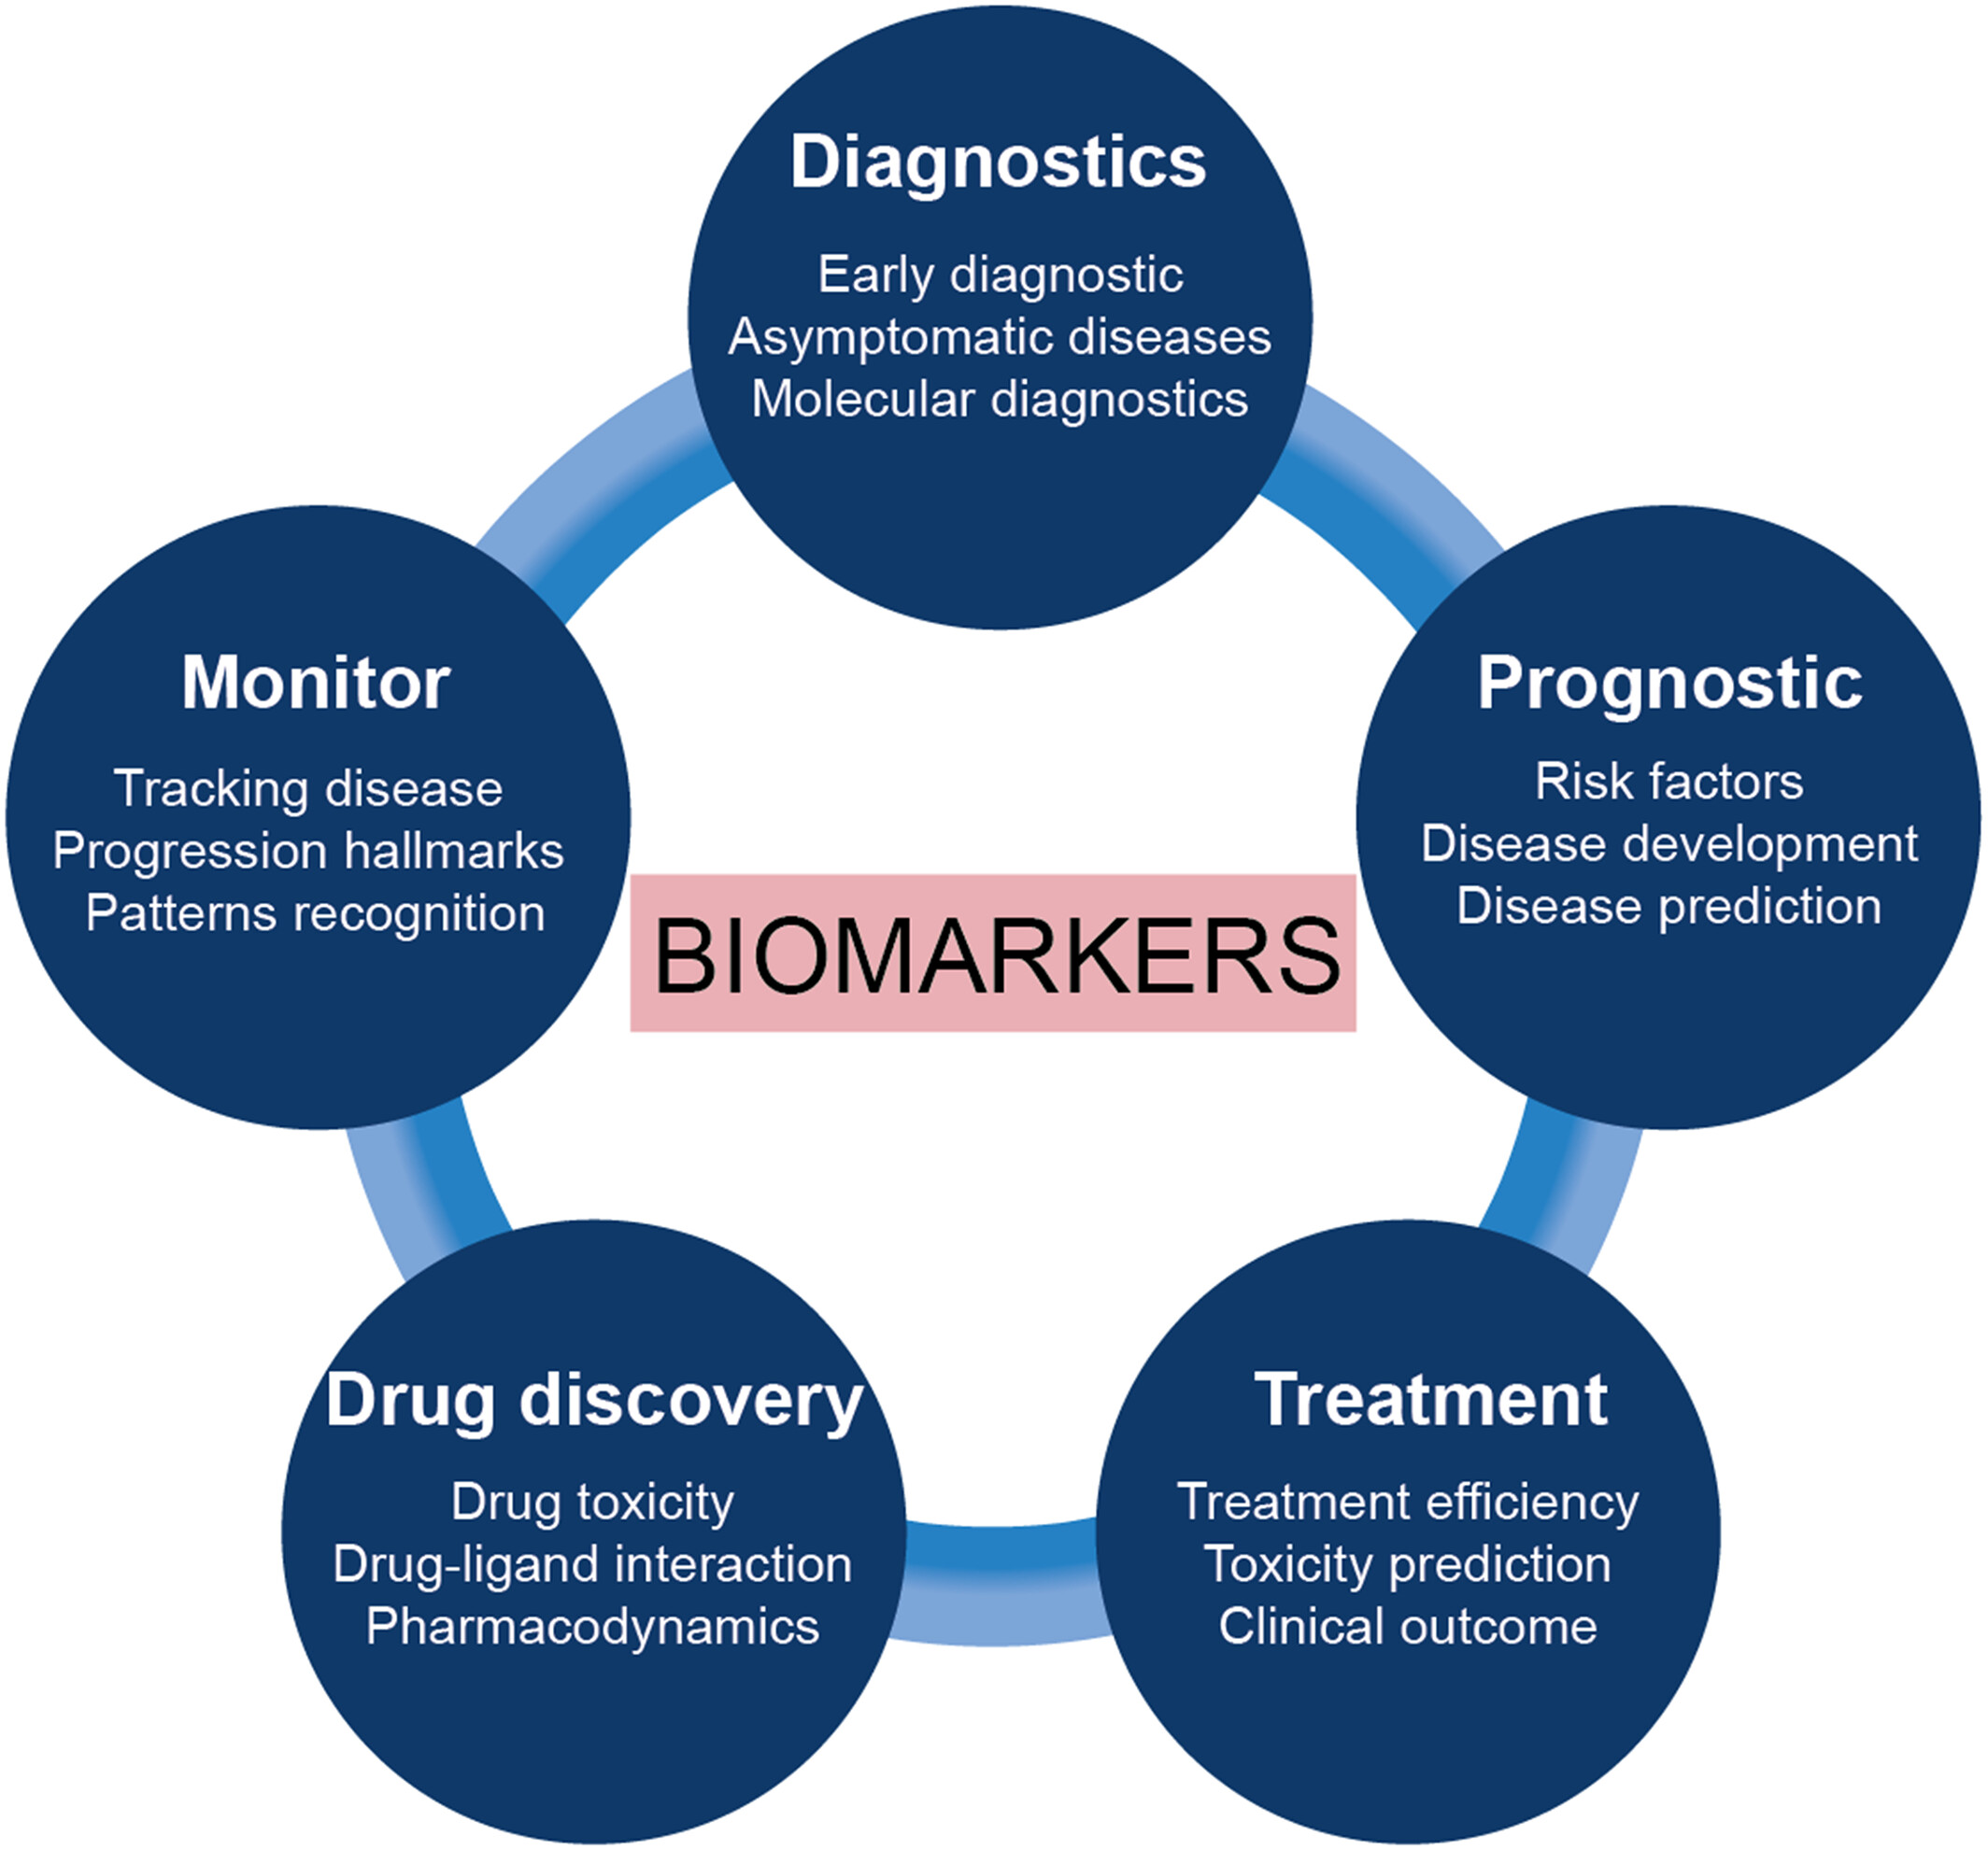
What are Biomarkers?
A biomarker is a substance used as an indicator of a biologic state.
An indicator of the following:
Existence of living organisms or biological process
A particular disease state
Below are some molecular biomarkers
Large molecule biomarkers
Proteins Nucleic acids Carbohydrate Lipids
Small molecule biomarkers
Glucose
Cholesterol

Slide 3
Definition
A biomarker is any sign of a biological process that can be measured, giving indication on the status of an organism in health and disease.
From simple examples like blood sugar, to more sophisticated markers like gene mutations in cancer cells, biomarkers play a fundamental role in drug discovery and are the cornerstone of personalized healthcare.

Slide 4
Uses of Biomarkers
Biological markers provide a window to evaluate the disease.
Biomarkers aid in monitoring for disease response either progression of regression due to intervention.

Slide 5
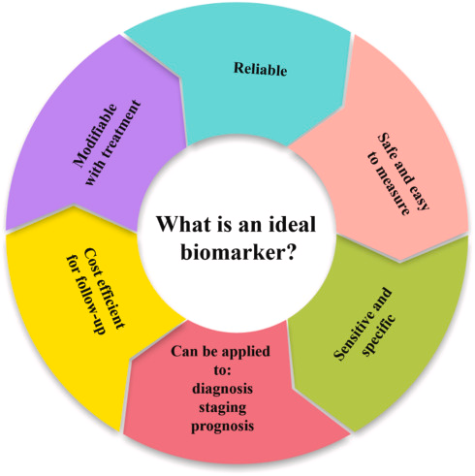
What is a useful biomarker?
A useful clinical marker should meet 2 criteria:
Can be measured reproducibly by means of a reliable and widely available assay
Conveys information to the physician about the disease that is meaningful.

Slide 6
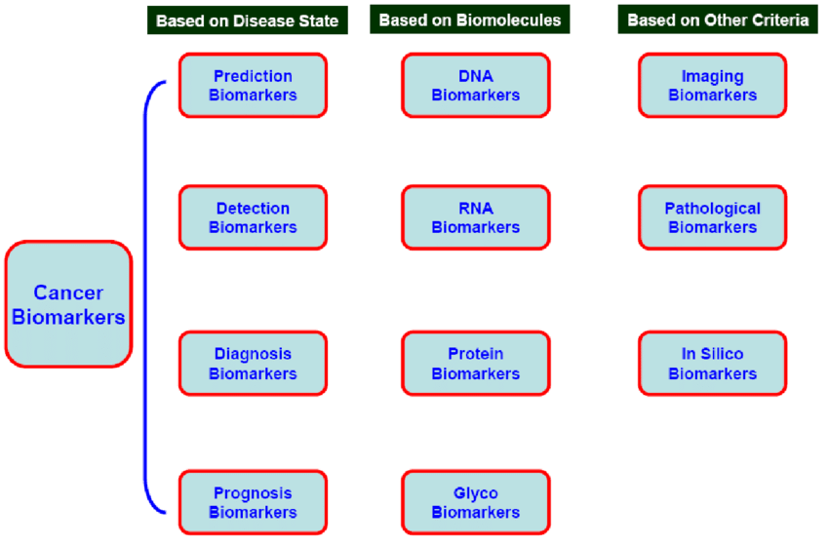
Biomarkers can be classified in different ways
➢Imaging biomarkers (Scanning and X-ray)
➢Molecular biomarkers (nucleic acids-mutations, SNPs,
gene expression, peptides, proteins, lipid metabolites)

Slide 7
Classification of Biomarkers
Antecedent biomarkers: These biomarkers are indicative of the risk of developing a disease later
e.g., Higher plasma levels of Aβ42 in normal individuals have been reported to confer greater risk for Alzheimer’s Disease five years later.
Screening biomarkers: These biomarkers are indicative of subclinical level of disease. They also indicate the level of disease risk.
e.g., Fasting blood glucose levels are used to screen people with Type 2 Diabetes
Diagnostic biomarkers: These biomarkers are obvious/direct indicators of an existing diseas; these biomarkers answers questions like do you have the disease? and what disease is it?
e.g., High level of plasma Alpha Feto Protein (AFP) is a diagnostic marker in hepatocellular carcinoma.
Staging biomarkers (cancer): These biomarkers are indicative of the severity /stage of the disease
e.g., Prostate specific antigen is highly sensitive for the presence of prostatic cancer. The elevation correlated with stage and tumor volume.
Predictive biomarkers: These biomarkers indicate the likelihood of outcome (tumour recurrence or patient survival) regardless of the specific treatment the patient receives; these answer questions like how difficult to treat? how long to live, how long to recover?
e.g., Patients with Estrogen Receptor and/or Progesterone Receptor positive tumours have a better survival than hormone receptor negative tumors

Slide 8
Detection and Estimation of Biomarkers
Qualitative: an association exists between a marker and disease
This is present or absent, yes or no, positive or negative
COVID-19 Rapid Antigen Test
Quantitative: a link between quantity of the marker and disease
Levels predict disease (How much?)

Slide 9
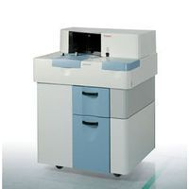
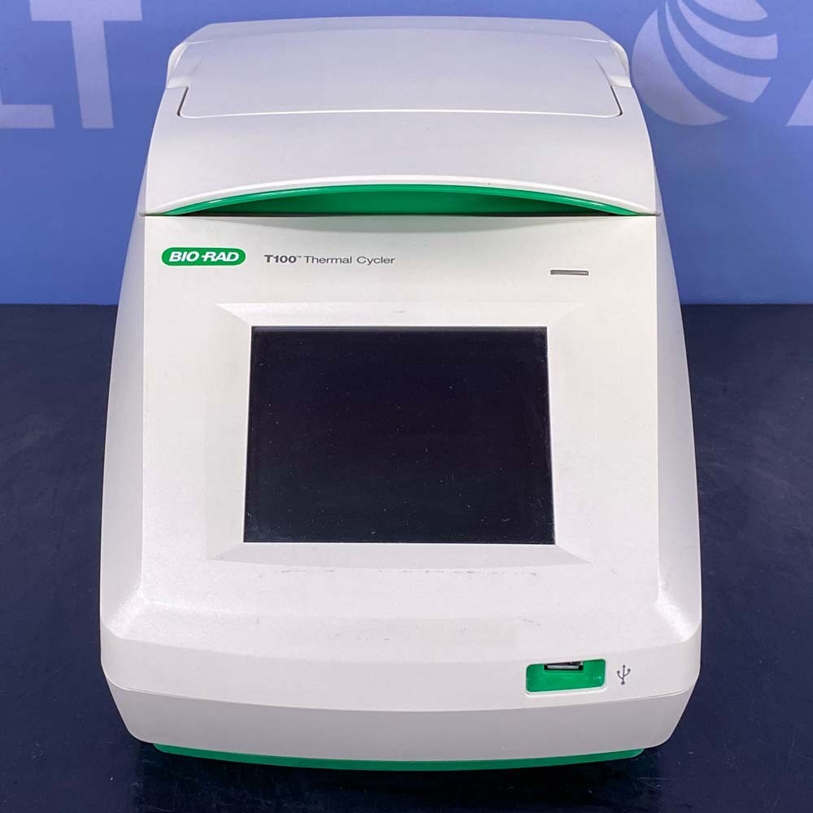
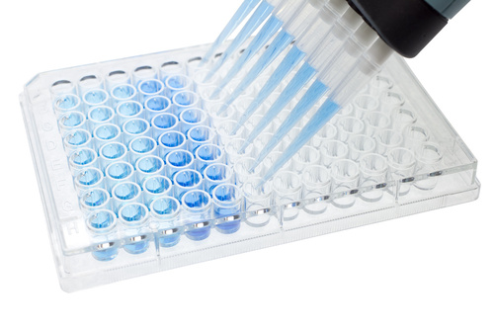
Common techniques used for detection of biomarkers
A) Biochemical assays – cholesterol, glucose estimation
B) Immunological techniques – ELISA
C) DNA techniques like PCR
Should have great sensitivity, specificity, and accuracy in reflecting total disease burden.

Slide 10
Biomarkers for Screening
The marker must be highly specific, minimize false positive and false negative
The marker must be able to clearly reflect the early stage of disease
The marker must be easily detected without complicated medical procedures
The disease markers released to serum and urine are good targets for application of early screening
The method for screening should be cost effective.
Samples for biomarker detection
Blood
Urine
other body fluids samples (saliva, CSF)
Tissue samples (tumor tissue biopsy)

Slide 11
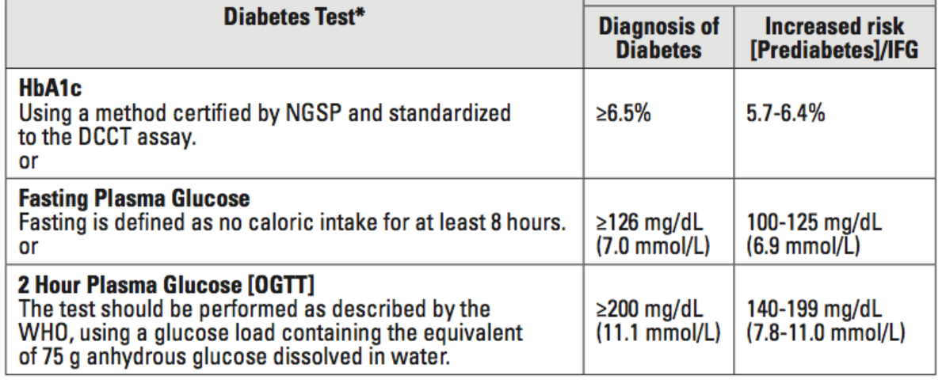
Type II Diabetes Biomarkers
Glycated hemoglobin (HbA1c) is a form of hemoglobin that is measured primarily to identify the average plasma glucose concentration over prolonged periods of time.
It is formed in a non-enzymatic glycation pathway by hemoglobin's exposure to plasma glucose.
Normal levels of glucose produce a normal amount of glycated hemoglobin.
As the average amount of plasma glucose increases, the fraction of glycated hemoglobin increases in a predictable way. This serves as a marker for average blood glucose levels over the previous 3 months prior to the measurement as this is the half life of red blood cells.

Slide 12
Why several markers are needed?
• No single marker can accurately reflect a disease.
• Not even a panel of markers.
Hence, in most cases we need analyses of a large number of disease markers!

Slide 13
Useful Links for Additional Learning
Videos:
Introduction: https://www.youtube.com/watch?v=gqG4cUMw6Og
Drug Discovery: https://www.youtube.com/watch?v=3D-umvwTg74
Biomarkers – Need for better understanding: https://www.youtube.com/watch?v=SEx8r1ABjhE

