Slide 1
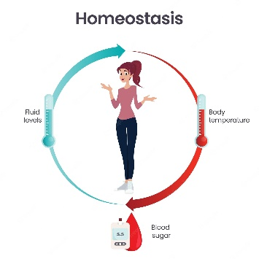
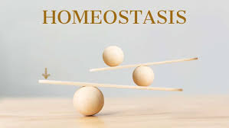
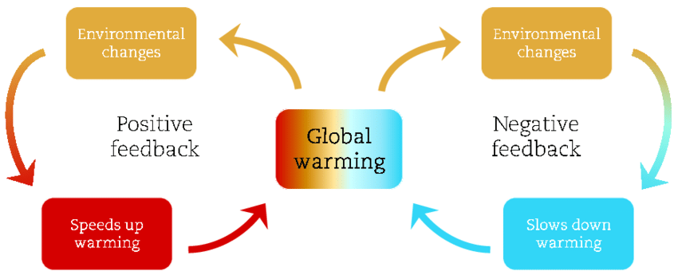
Homeostasis
531 ZOO Advanced physiology
First Semester 2025

Slide 2
Contents
Contents: The importance of metabolic activities control in living organisms, molecular, biological, neural, hormonal and homeostatic controlling mechanisms in living organisms, co-ordination of body functions: interaction of cardiovascular functions, control of respiration, renal regulation of extracellular volume and osmlarity, regulation of gastro-intestinal processes, regulation of reproductive processes.
وسائل التحكم في وظائف الكائن الحي وأهميتها. آلية التحكم الجزيئي أنظمة التحكم البيولوجية وآلية التحكم العصبي والهرموني واتزان الجسم. التنسيق بين وظائف الجسم عن طريق: دراسة التكامل في عمل الجهاز الدوري – التحكم في عملية التنفس – التنظيم الكلوي لحجم وأسمولارية سوائل الجسم تنظيم عمل الجهاز الهضمي– وتنظيم عملية التكاثر.

Slide 3
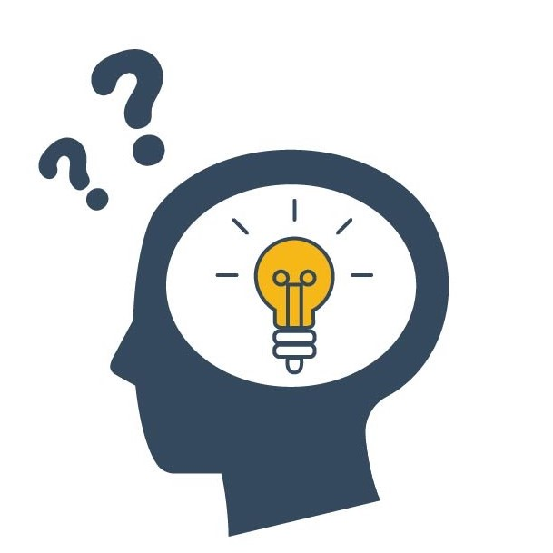
What you will learn in this lecture:
The meaning of Homeostasis?
Regulation of Homeostasis:
Receptor
Control center
Effector
Homeostasis Mechanism
Negative Feedback
Positive Feedback
Examples of Homeostasis

Slide 4
Assessment
Lecture
1 Midterm exams (20%)
Report or presentation (10%)
Cumulative final exam (40%)
70% of total grade
Laboratory
30% of total grade

Slide 5
References
Human physiology, Stuart Ira Fox.
Fundamentals of anatomy and physiology, Martini.

Slide 6
Missed / Late Exam Policy
No make-up exams, except with:
Medical documentation
Legal documentation
Make-up exams will be essaying form
If you arrive late to an exam, and even one exam has already been turned in, you will be given an essay test

Slide 7
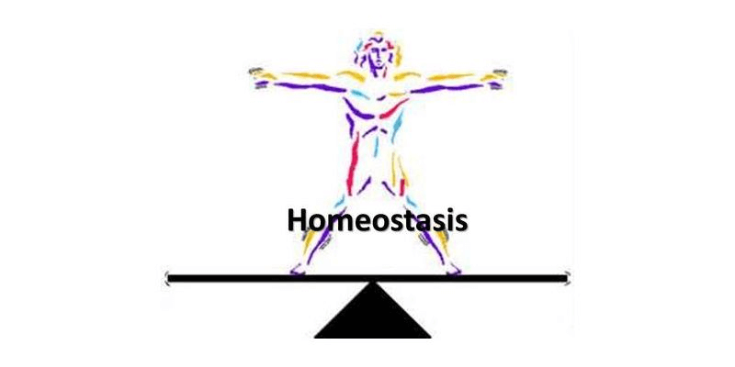
Homeostasis
Homeostasis has become the central unifying concept of physiology and is defined as a self-regulating process by which an organism can maintain internal stability while

Slide 8
Homeostasis Definition
Homeostasis definition is the ability or tendency of the body or a cell to seek and maintain a condition of equilibrium as it deals with external changes.
It makes use of feedback controls and other regulatory mechanisms in order to maintain a constant internal environment.
Thus, the word homeostasis entails multifarious physiological mechanisms in order to sustain and stabilize the functional, normal status of an organism.

Slide 9
Etymology
Etymology: The term homeostasis comes from the Ancient Greek ὅμοιος
(pronounced: hómoios) and ἵστημι (pronounced: hístēmi).
The combination of these words translates to “similar” and “standing still” respectively, refers to any process that living things use to actively maintain stable conditions necessary for survival
The concept of homeostasis was first described in 1865 by Claude Bernard, a French physiologist.

Slide 10
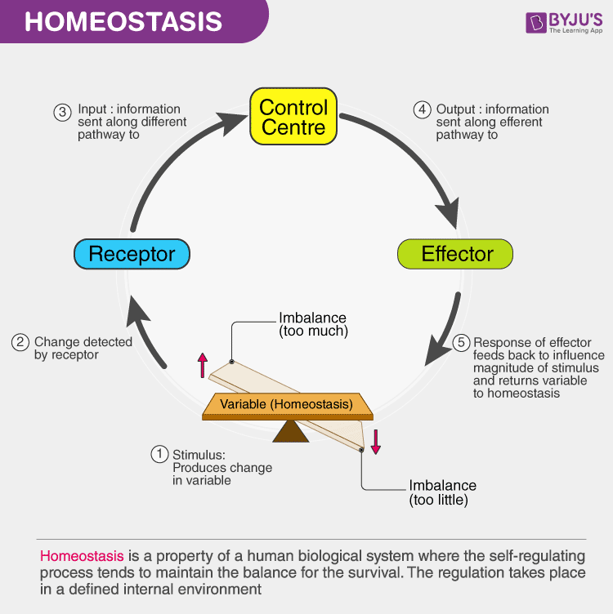

Slide 11
What is Homeostasis?
Homeostasis is quite crucial for the survival of organisms.
It is often seen as a resistance to changes in the external environment.
Furthermore, homeostasis is a self-regulating process that regulates internal variables necessary to sustain life.
In other words, homeostasis is a mechanism that maintains a stable internal environment despite the changes present in the external environment.
The body maintains homeostasis by controlling a host of variables ranging from body temperature, blood pH, blood glucose levels to fluid balance, sodium, potassium and calcium ion concentrations.

Slide 12
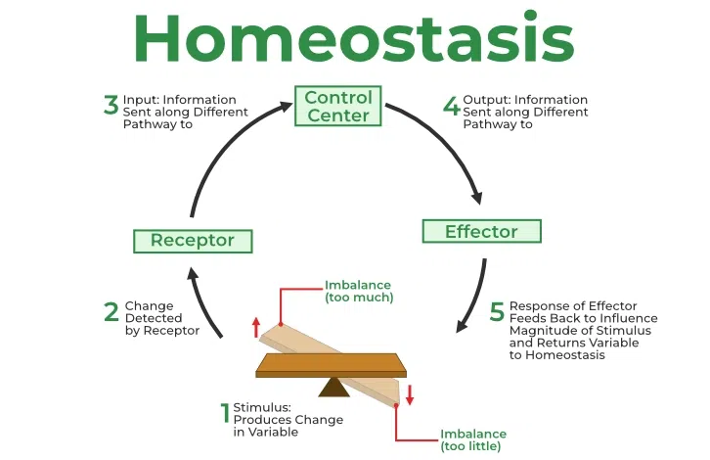
Regulation of Homeostasis
The regulation of homeostasis depends on three mechanisms:
Receptor.
Control Center.
Effector.
The entire process continuously works to maintain homeostasis regulation.

Slide 13
Regulation of Homeostasis
As the name suggests, the receptor is the sensing component responsible for monitoring and responding to changes in the external or internal environment.
The control center is also known as the integration center. It receives and processes information from the receptor.
The effector responds to the commands of the control center. It could either oppose or enhance the stimulus.
Receptor
Control Center
Effector

Slide 14
An Example of Homeostasis in Action
Receptor | Cutaneous receptors of the skin.
Control center | Brain.
Effector | Blood vessels and sweat glands in the skin.
The skin has receptors that detect changes in temperature. If the external temperature rises or drops below the equilibrium, the control center sends signals to the blood vessels and sweat glands in our skin to react accordingly. If the temperature is too hot, the blood vessels dilate (vasodilation) and cause a drop in the body temperature. Moreover, sweat glands produce sweat to accompany vasodilation. If the external temperature is too cold, the blood vessels constrict (vasoconstriction) and enable the body to retain heat

Slide 15
Feedback Regulation
Hormones regulate the activity of body cells. The release of hormones into the blood is controlled by a stimulus. The response to a stimulus changes the internal conditions and this self-adjusting mechanism by the internal system is called feedback regulation.
The feedback regulations are of 2 types:
1. Positive feedback regulation.
2. Negative feedback regulation.

Slide 16
Homeostasis mechanism
Maintaining homeostasis requires that the body continuously monitor its internal conditions.
From body temperature to blood pressure to levels of certain nutrients, each physiological condition has a particular set point.
A set point is the physiological value around which the normal range fluctuates. A normal range is the restricted set of values that is optimally healthful and stable.
For example, the set point for normal human body temperature is approximately 37°C (98.6°F) Physiological parameters, such as body temperature and blood pressure, tend to fluctuate within a normal range a few degrees above and below that point.

Slide 17
Homeostasis mechanism
Control centers in the brain and other parts of the body monitor and react to deviations from homeostasis using negative feedback.
Negative feedback is a mechanism that reverses a deviation from the set point. Therefore, negative feedback maintains body parameters within their normal range. The maintenance of homeostasis by negative feedback goes on throughout the body at all times, and an understanding of negative feedback is thus fundamental to an understanding of human physiology.

Slide 18
Negative Feedback
A negative feedback system has three basic components.
A sensor, also referred to a receptor, is a component of a feedback system that monitors a physiological value.
This value is reported to the control center.
The control center is the component in a feedback system that compares the value to the normal range.
If the value deviates too much from the set point, then the control center activates an effector.
An effector is the component in a feedback system that causes a change to reverse the situation and return the value to the normal range.

Slide 19
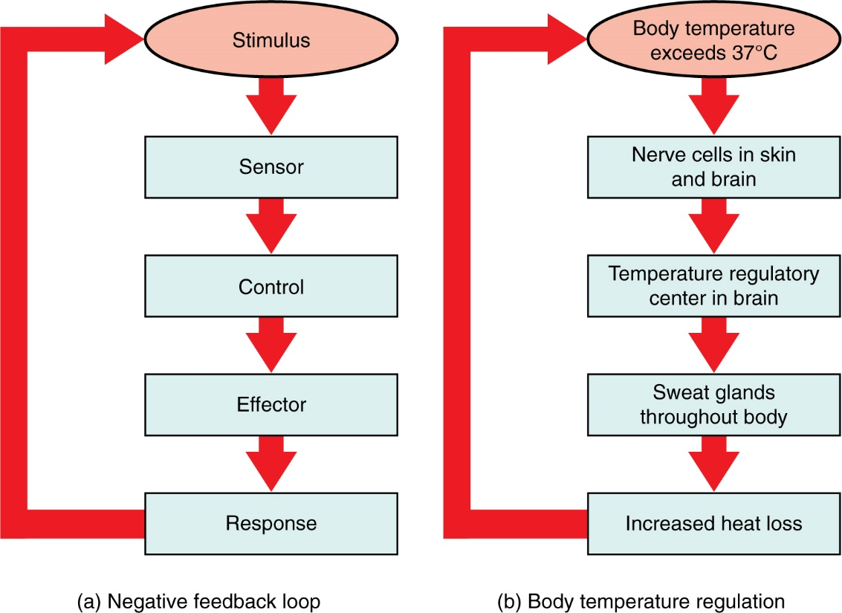
Figure 1.10 Negative Feedback System In a negative feedback system, a stimulus—a deviation from a set point—is resisted through a physiological process that returns the body to homeostasis. (a) A negative feedback system has five basic parts. (b) Body temperature is regulated by negative feedback.

Slide 20
Humans have a similar temperature regulation feedback system that works by promoting either heat loss or heat gain (Figure 1.10b). When the brain’s temperature regulation center receives data from the sensors indicating that the body’s temperature exceeds its normal range, it stimulates a cluster of brain cells referred to as the “heat-loss center.” This stimulation has three major effects:
Blood vessels in the skin begin to dilate allowing more blood from the body core to flow to the surface of the skin allowing the heat to radiate into the environment.
As blood flow to the skin increases, sweat glands are activated to increase their output. As the sweat evaporates from the skin surface into the surrounding air, it takes heat with it.
The depth of respiration increases, and a person may breathe through an open mouth instead of through the nasal passageways. This further increases heat loss from the lungs.

Slide 21
In contrast, activation of the brain’s heat-gain center by exposure to cold reduces blood flow to the skin, and blood returning from the limbs is diverted into a network of deep veins.
This arrangement traps heat closer to the body core and restricts heat loss. If heat loss is severe, the brain triggers an increase in random signals to skeletal muscles, causing them to contract and producing shivering.
The muscle contractions of shivering release heat while using up ATP. The brain triggers the thyroid gland in the endocrine system to release thyroid hormone, which increases metabolic activity and heat production in cells throughout the body.
The brain also signals the adrenal glands to release epinephrine (adrenaline), a hormone that causes the breakdown of glycogen into glucose, which can be used as an energy source. The breakdown of glycogen into glucose also results in increased metabolism and heat production.

Slide 22
Positive Feedback
Positive feedback intensifies a change in the body’s physiological condition rather than reversing it.
A deviation from the normal range results in more change, and the system moves farther away from the normal range.
Positive feedback in the body is normal only when there is a definite end point. Childbirth and the body’s response to blood loss are two examples of positive feedback loops that are normal but are activated only when needed.
The extreme muscular work of labor and delivery are the result of a positive feedback system (Figure 1.11).

Slide 23
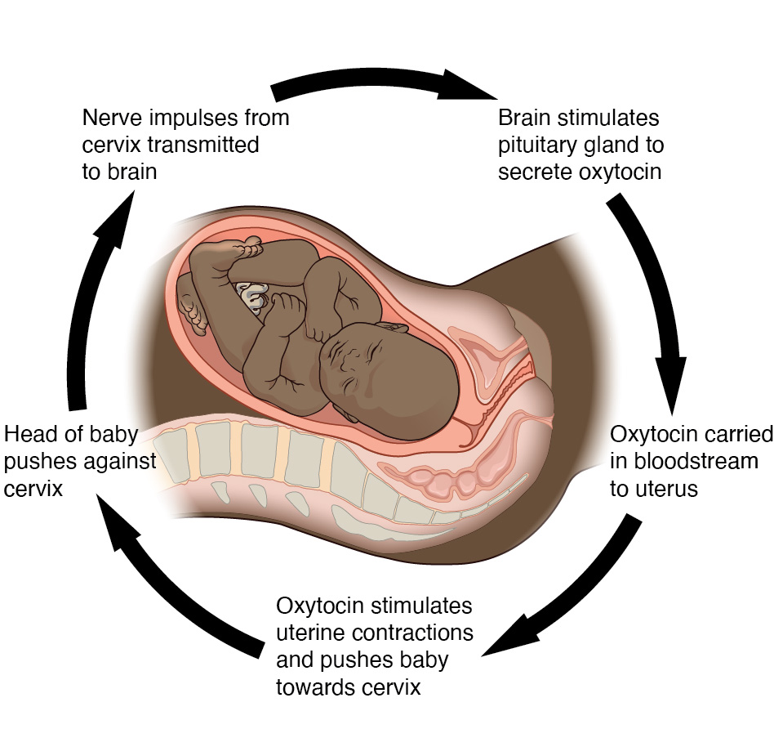
Figure 1.11 Positive Feedback Loop Normal childbirth is driven by a positive feedback loop. A positive feedback loop results in a change in the body’s status, rather than a return to homeostasis.

Slide 24
The first contractions of labor (the stimulus) push the baby toward the cervix (the lowest part of the uterus).
The cervix contains stretch-sensitive nerve cells that monitor the degree of stretching (the sensors).
These nerve cells send messages to the brain, which in turn causes the pituitary gland at the base of the brain to release the hormone oxytocin into the bloodstream.
Oxytocin causes stronger contractions of the smooth muscles in of the uterus (the effectors), pushing the baby further down the birth canal. This causes even greater stretching of the cervix.
The cycle of stretching, oxytocin release, and increasingly more forceful contractions stops only when the baby is born.
At this point, the stretching of the cervix halts, stopping the release of oxytocin.

Slide 25
Positive feedback regulation
Positive feedback is less common in biological systems. Positive feedback acts to speed up the direction of change.
e.g. Lactation (milk production).
The sucking(stimulus) activates receptors in and around nipple.
These signals are carried by nerve fibers through the spinal cord to the hypothalamus where changes in the electrical activity of the neurons that regulates the pituitary glands increase prolactin secretion.

Slide 26
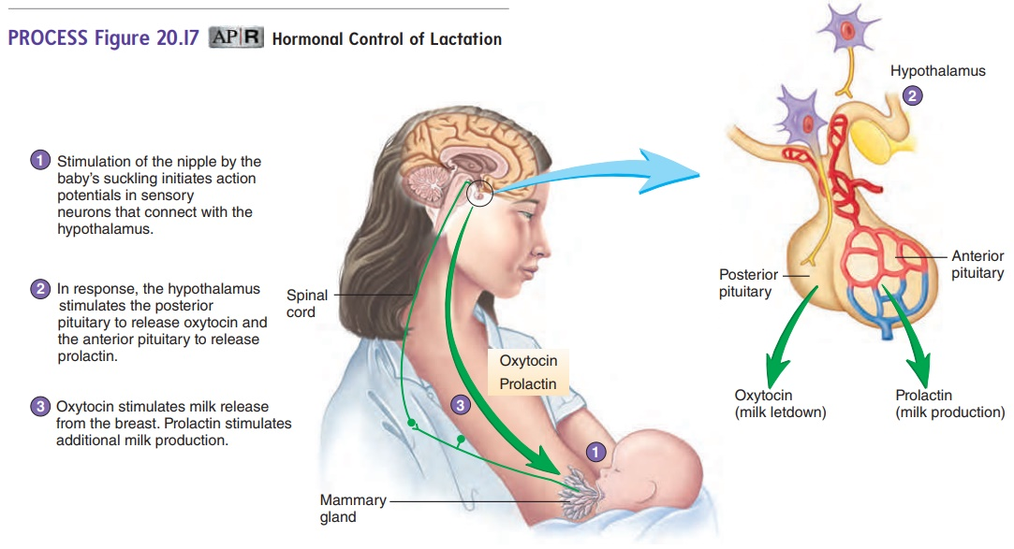

Slide 27
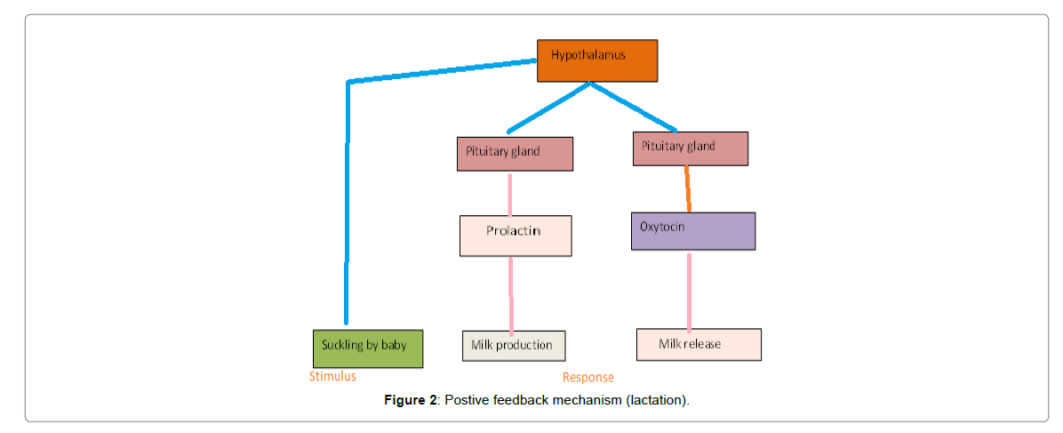

Slide 28
Other Examples of Homeostasis
Blood glucose homeostasis.
Blood oxygen content homeostasis.
Extracellular fluid pH homeostasis.
Plasma ionized calcium homeostasis.
Arterial blood pressure homeostasis.
Core body temperature homeostasis.
The volume of body water homeostasis.
Extracellular sodium concentration homeostasis.
Extracellular potassium concentration homeostasis.
Blood partial pressure of oxygen and carbon dioxide homeostasis.

Slide 29
Homeostasis Breakdown
The failure of homeostasis function in an internal environment will result in illnesses or diseases.
In severe cases, it can even lead to death and disability.
Many factors can affect homeostasis.
The most common are:
Genetics.
Physical condition.
Diet and nutrition.
Venoms and toxins.
Psychological health.
Side effects of medicines and medical procedures.

Slide 30
Body Systems and Homeostasis
The body system participates in maintaining homeostasis regulations. The purpose of the body system is to describe several controlling mechanisms where every system contributes to homeostasis.
Listed below are the tables which describe how different organs perform different functions to maintain the internal body environment.

Slide 31
Formed Elements
Name | Function
Platelets | It assists blood clotting.
Red blood cells | Helps in transporting hydrogen and oxygen ions.
White blood cells | It fights against infections.

Slide 32
Plasma
Component | Function
Nutrients | Required for cellular metabolism.
Proteins | Create osmotic pressure, aids clotting, and helps buffer blood.
Hormones | Known as chemical messengers.
Water | Provides fluid environment.
Salts | Helps in metabolic activity and aids the buffer in blood.
Wastes | Produced by cellular metabolism.

Slide 33
Nervous System
Central Nervous System
Cerebrum | Consciousness, creativity, thoughts, morals, memory, etc.
Lower portions | Reception of sensory data, coordination of muscular activity, homeostasis.
Spinal cord | Automatic reflex actions.
Peripheral Nervous System
Autonomic system | Cranial and spinal motor nerves that control internal organs.
Cranial nerves, spinal nerves | Carry sensory information to motor impulses from the CNS.

Slide 34
Major Endocrine Glands and Their Hormones
Hormone | Function
Adrenal medulla
Epinephrine and Norepinephrine | Stimulates fight or flight response
Adrenal cortex
Glucocorticoids (e.g., cortisol) | Promotes gluconeogenesis
Mineralocorticoids (e.g., aldosterone) | Promotes sodium re-absorption by kidneys
Anterior pituitary
Thyroid-stimulating hormones | Stimulates thyroid gland.
Adrenocorticotropic hormones | Stimulates adrenal cortex gland.
Gonadotropin hormones | Stimulates gonads.
Gonads
Androgen (male) Estrogen and progesterone (female) | Promotes secondary sexual characteristics.
Hypothalamus
Hypothalamic-releasing hormones | Regulates anterior pituitary hormones.
Posterior pituitary
Anti-diuretic hormone | Promotes water reabsorption by kidneys.
Parathyroid
Parathyroid hormone | Maintains blood calcium and phosphorus levels.
Thyroid
Thyroid hormones | Increases metabolic rates.
Pancreas
Insulin | Lowers blood sugar level.
Glucagon | Raises blood sugar level.

Slide 35
The endocrine and nervous systems have a regulatory effect on other organ systems in the human body.

Slide 36
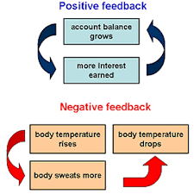

Slide 37


