Slide 1
HUMAN TRAITS
BLOOD GROUPS

Slide 2
What are the different blood groups?
The differences in human blood are due to the presence or absence of certain protein molecules called antigens and antibodies.
The antigens are located on the surface of the RBCs and the antibodies are in the blood plasma.
The blood group you belong to depends on what you have inherited from your parents.

Slide 3
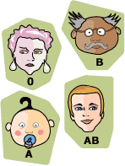
ABO blood grouping system
According to the ABO blood typing system there are four different kinds of blood types: A, B, AB or O (null).

Slide 4
AB0 blood grouping system

Slide 5
The ABO blood groups
The most important in assuring a safe blood transfusion.
The table shows the four ABO phenotypes ("blood groups") present in the human population and the genotypes that give rise to them.
Blood Group
Antigens on RBCs
Antibodies in Serum
Genotypes
A
A
Anti-B
AA or AO
B
B
Anti-A
BB or BO
AB
A and B
Neither
AB
O
Neither
Anti-A and anti-B
OO

Slide 6
Rh Blood Group and Rh Incompatibility
A person with Rh- blood does not have Rh antibodies naturally in the blood plasma
Blood Type
Genotype
Alleles Produced
Rh positive
RR
R
Rr
R or r
Rh negative
rr
r

Slide 7
HUMAN TRAITS

Slide 8
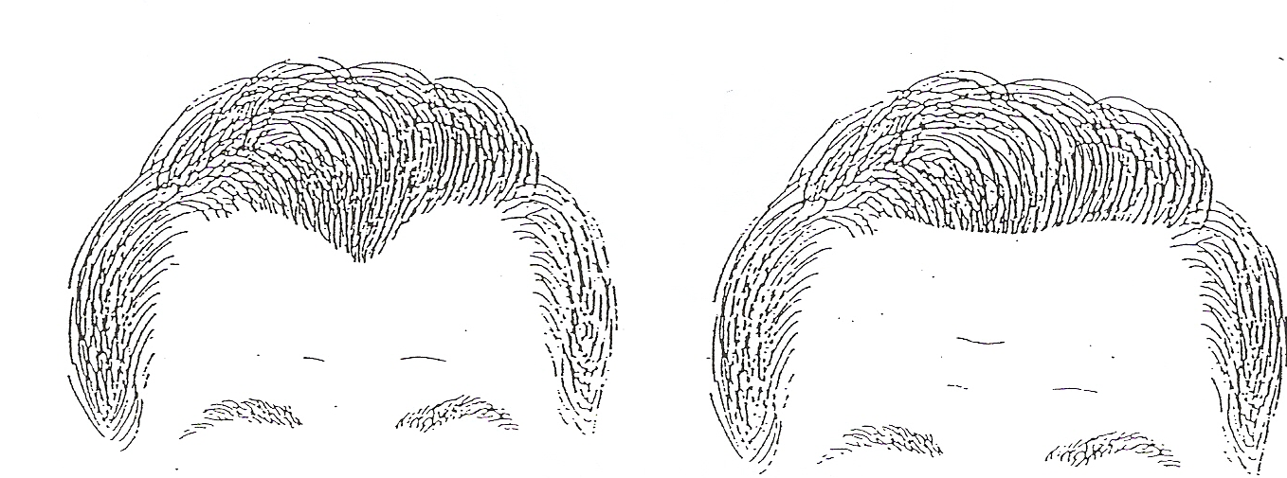
Widow's Peak
WW or Ww
Strait Hair Line
ww

Slide 9
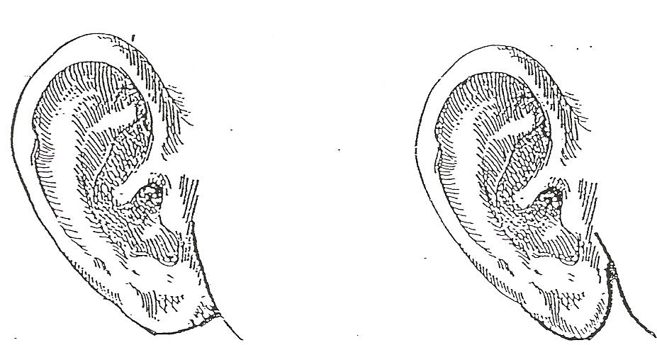
Attached Earlobe
ff
Free Earlobe
FF or Ff

Slide 10
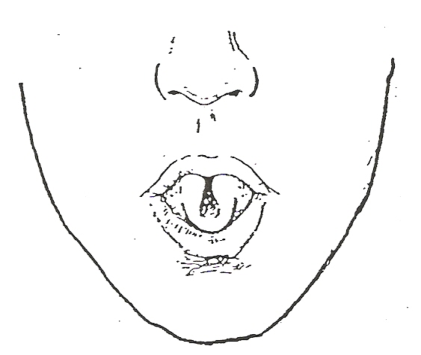
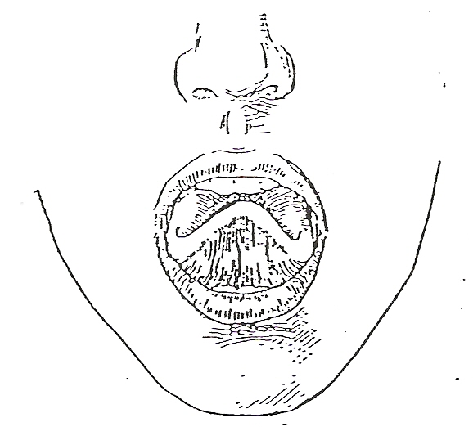
Tongue Rollong
RR or Rr
Tongue Folding
FF or Ff

Slide 11
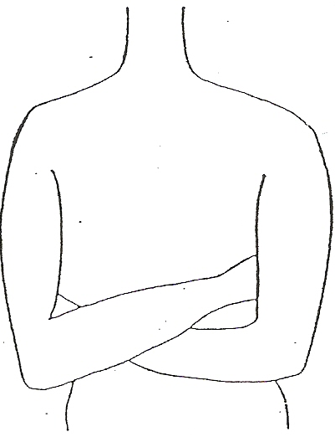
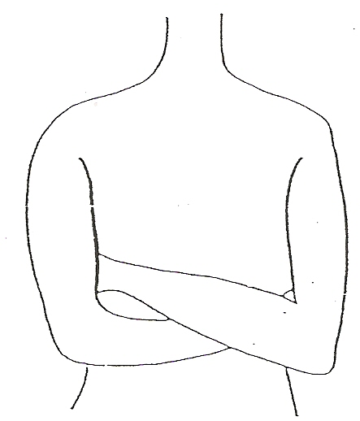
Right Handeness
RR or Rr
Left Handeness
rr

Slide 12
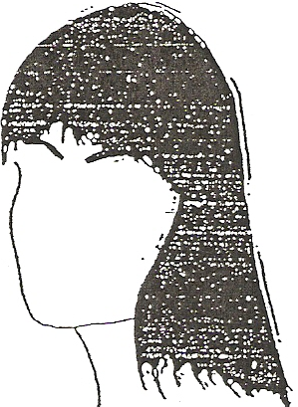
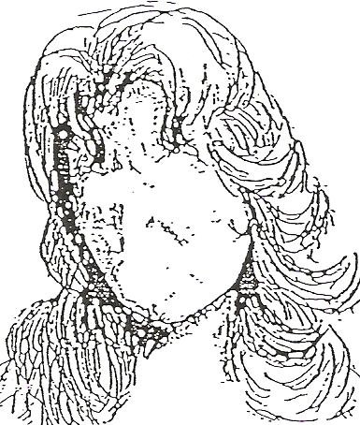
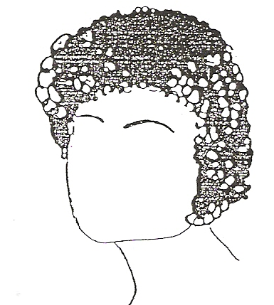
Straight Hair
cc
Curly Hair
CC
Wavy Hair
Cc

Slide 13
https://drive.google.com/a/sci.cu.edu.eg/file/d/1x4L5EwZ9CnhW0oLJwM8Tc4yaRTgrR9hs/view?usp=drive_web

