Slide 1
Growth Disturbance

Slide 2
GROWTH DISTURBANCE:
- Adaptive changes ,Change in structure, number, size and types of cells. e.g.
  -Atrophy
  -Hypertrophy
  -Hyperplasia
  -Metaplasia

Slide 3
Changed in structure:
1-Atrophy: Decrease in cell size.
2- Hypertrophy: Increase in cell size due to ↑ in functional demand.
3- Hyperplasia: Increase in number of cells capable of mitotic division.
4-Metaplasia: Conversion of one adult cell type to another within the same tissue

Slide 4
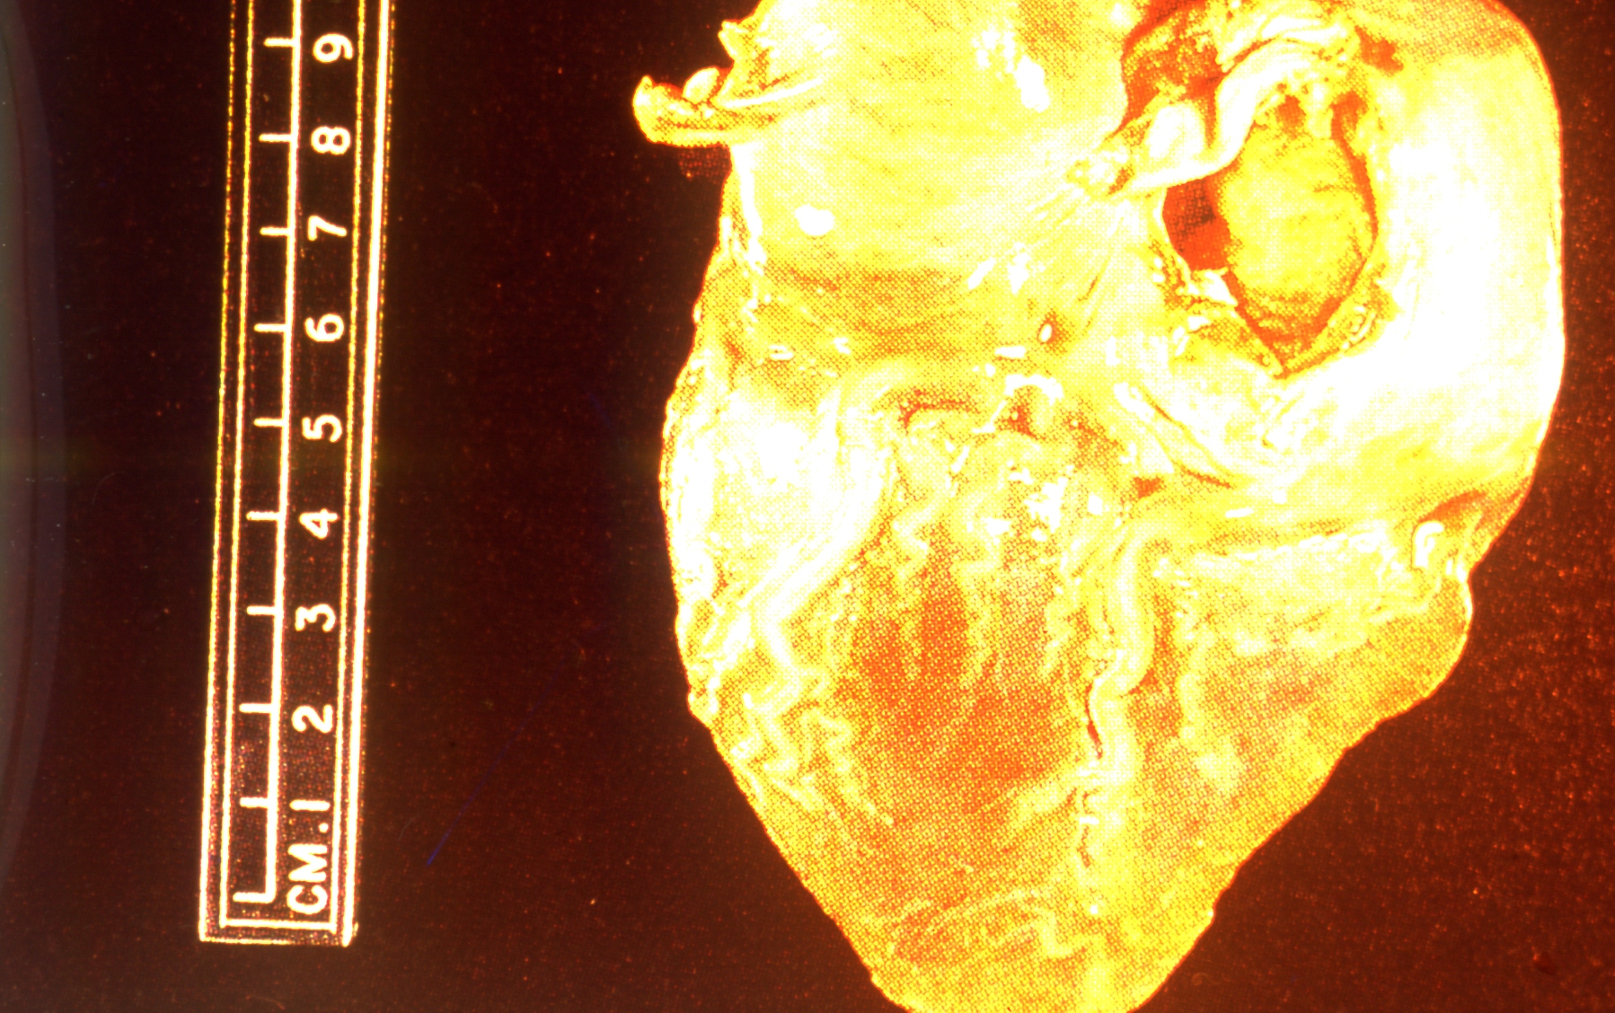
1- Brown atrophy in the heart “Gross pic.”
- Atrophy is decrease of the heart muscle (or myocardium) size ,
-It is described as brown because fibers become pigmented by intracellular lipofuscin deposits (mostly around the cell nucleus)[ a type of lipochrome granule

Slide 5
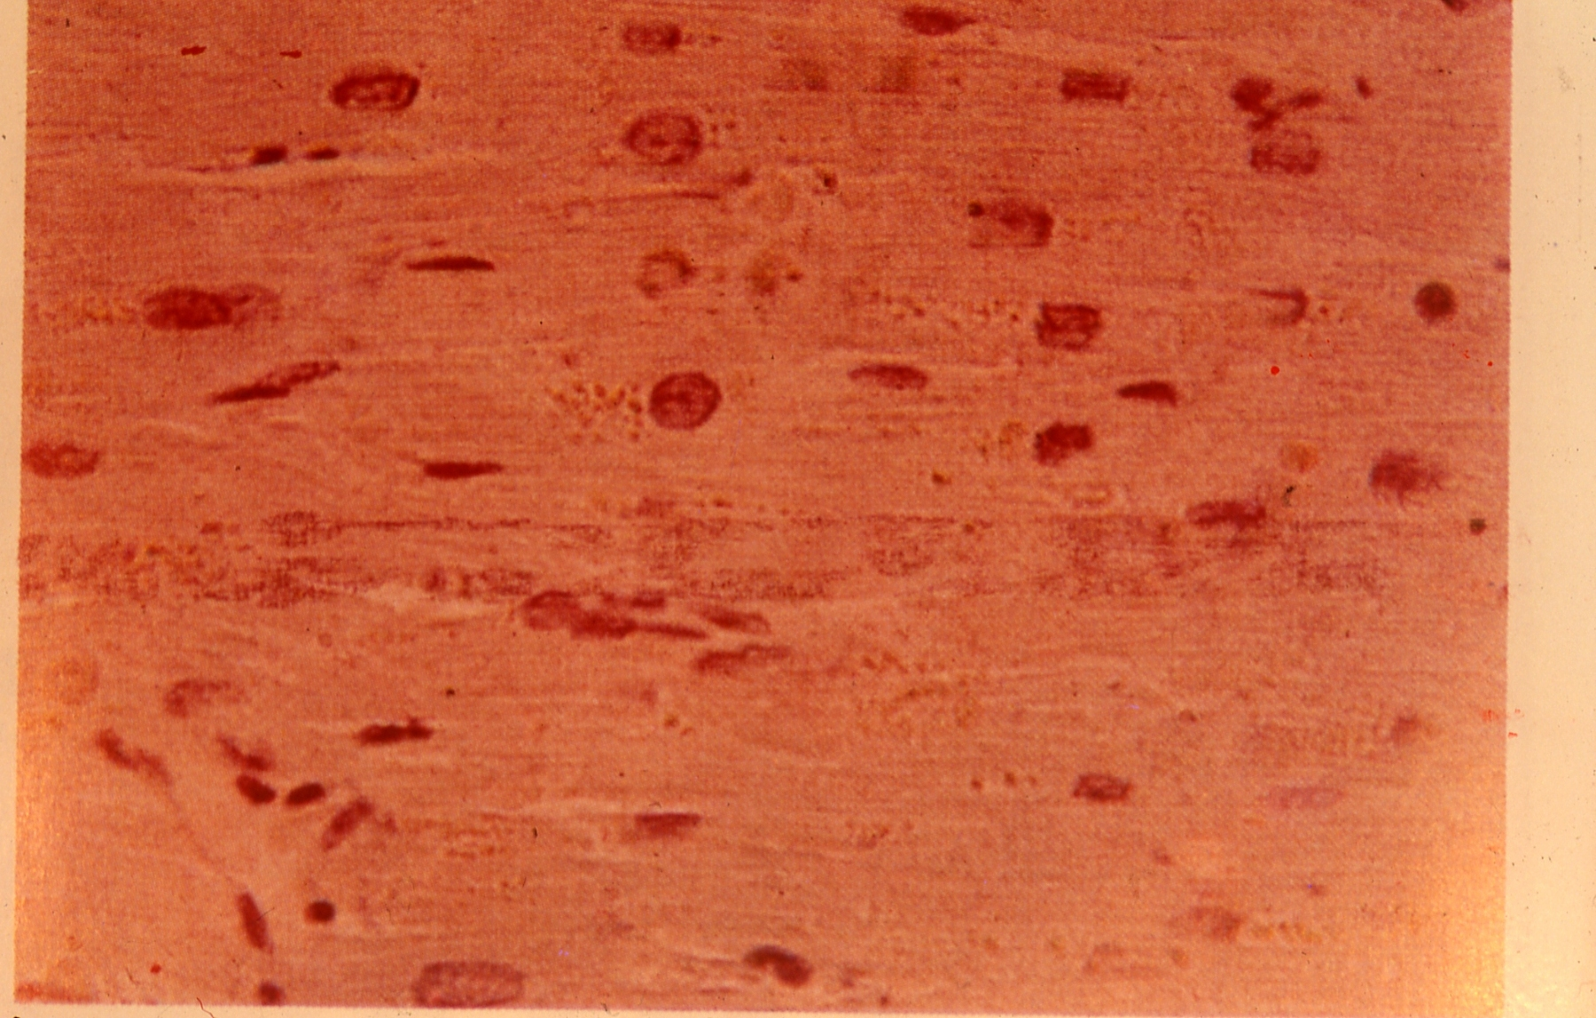
2- Brown atrophy in the heart “Microscopic pic.”
-thin atrophic muscle fibers with small pyknotic nuclei(cytoplasm stains bluish grey & the nuclei violet).
-Increase lipofusin granules at both poles of the nuclei , the granules are fine,refractile & brown.

Slide 6
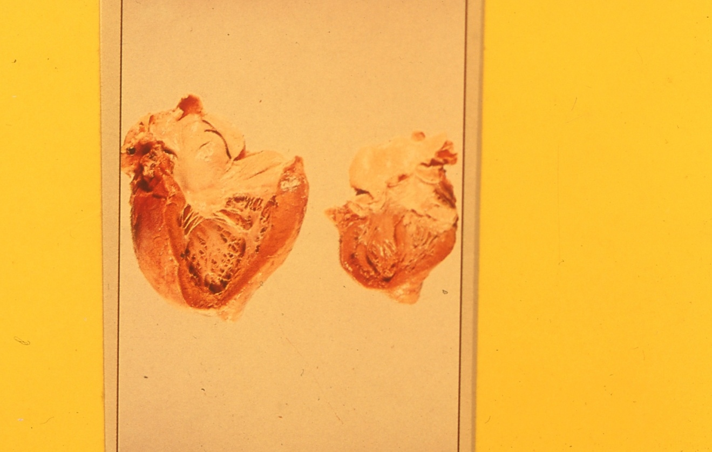
3- Normal and hypertrophic heart “Gross”
Hypertrophy of the heart is an enlargement of the organ, due to an increase in the volume of its muscular fibers, and usually also to dilatation of its cavities.
because of increased workload. (This increased workload can be due to heart valve disease or high blood pressure, for example.)

Slide 7
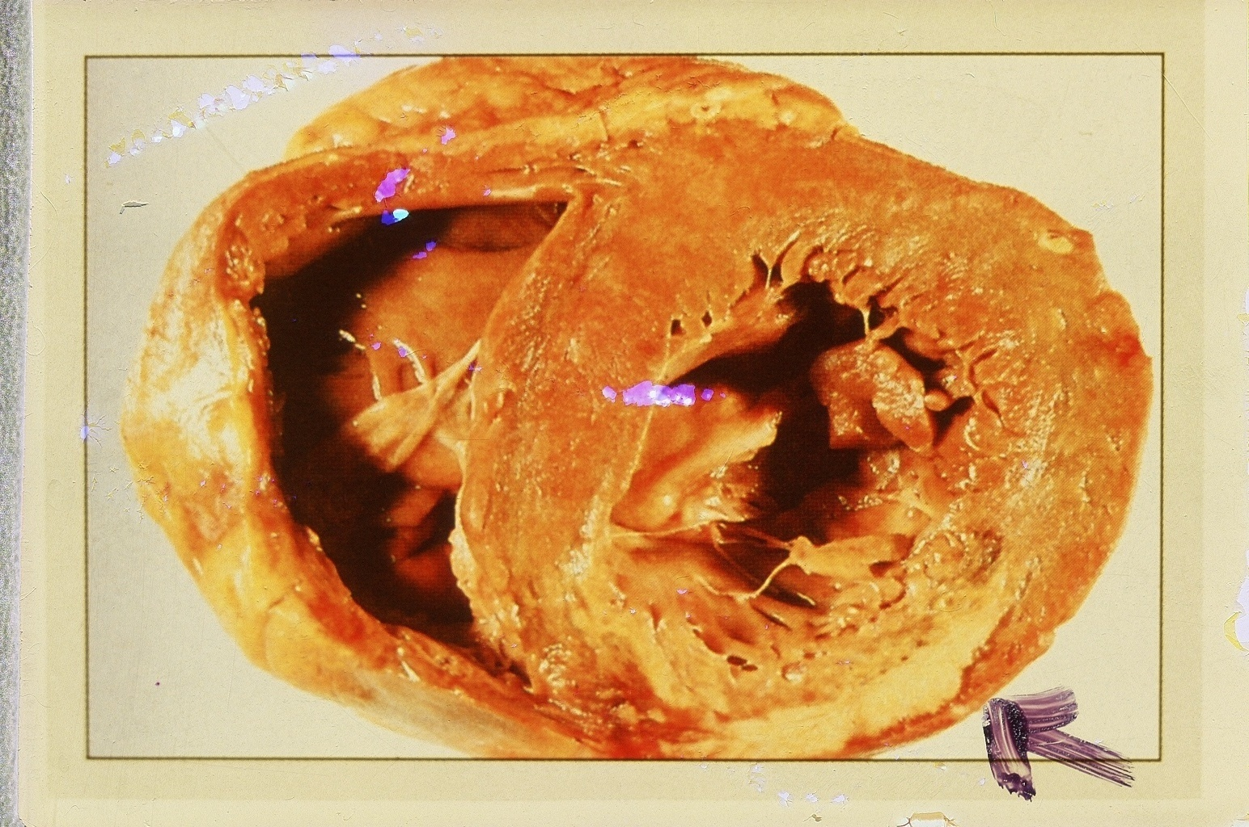
4- Left ventricle hypertrophy “Gross”
Ventricular hypertrophy is the enlargement of ventricles (lower chambers) in the heart. Although left ventricular hypertrophy is more common,

Slide 8
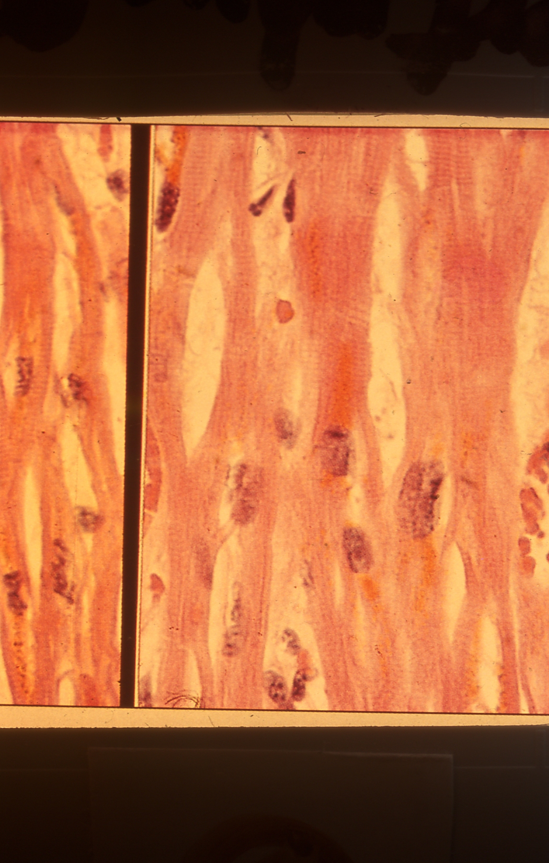
5- Atrophy and Hypertrophy of cardiac muscles:
Atrophy: thin atrophic muscle ,fibers dark color with small nuclei.
hypertrophy :Larger muscle. fine color of fiber& nucleus.

Slide 9
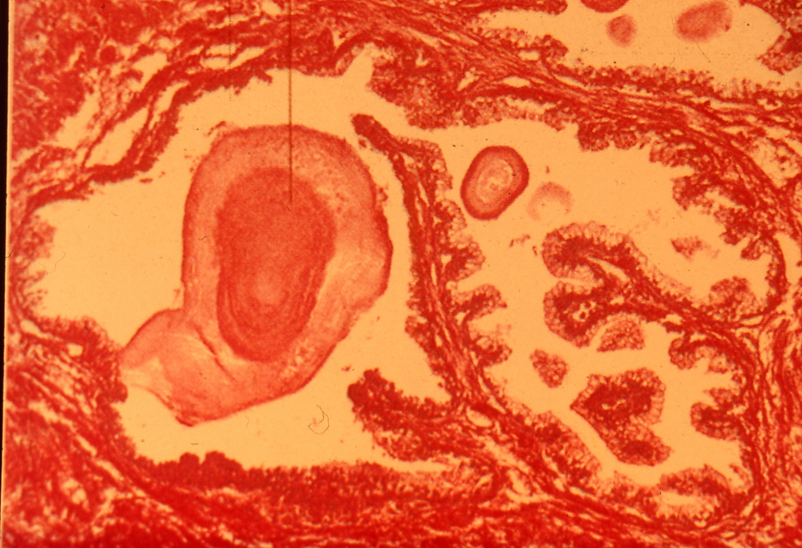
6- Senile hyperplasia in prostate:
Benign enlargement of the prostate usually occurs in men over 50 years of age.
The increase in size is reported to be the result of increased interstitial tissue with the overall amount of epithelium increasing in amount. The lumen of glands, however, increase in diameter

