Slide 1
Group 2 Chemistry

Slide 3
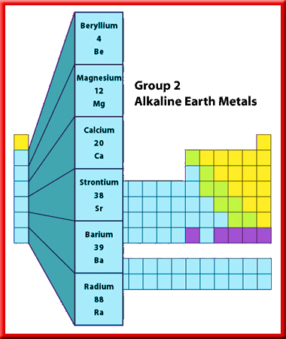
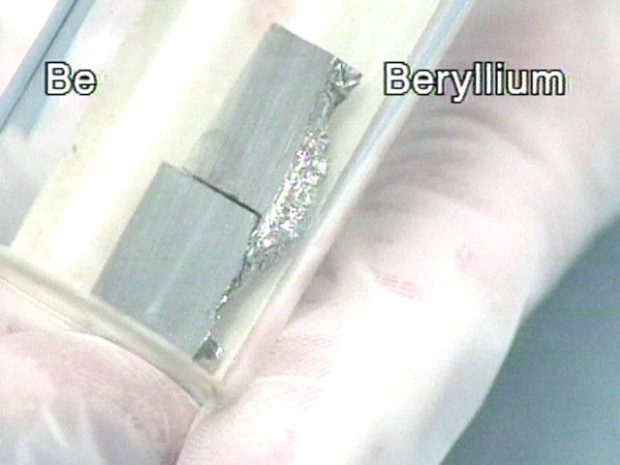
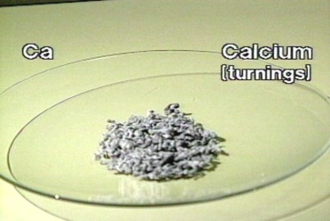
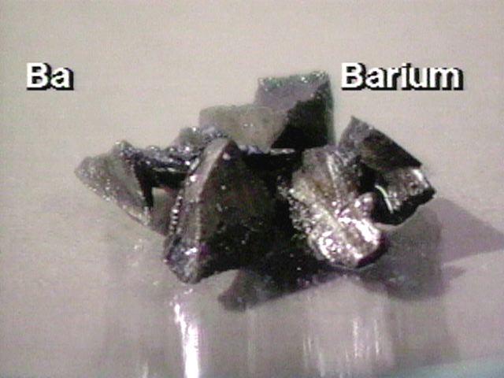
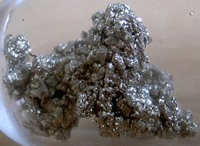
What are the second group ?

Slide 4
1) Called earth alkaline metals, same like group 1 metals (Reactivity) but different in
(Hardness, Color, Oxidation states+2,Size).Be is the
hardest
2) The electronic configuration, [Core]ns².isoelectronic to both noble gases and group 1 metals. They are smaller ions due to large charges.
3) Ionic potentials are higher for Be²⁺ and Mg²⁺ than for group 1 metals, ɸ= ,Hydrations higher five times, more covalent.
4)Be chemistry ,.BeCl₂ is linear (sp) in solid tetrahedral (sp³)
Be form complex ion[Be(H₂O)₄]^{2+,} BeF₄²⁻ , [Be(OH)₄]²⁻
5) Ba is the strongest reducing agent, Be is the least.

Slide 5
6) The solubility product K_{sp} of this group: Lattice + Hydration.
a) BeSO₄ is more soluble than BaSO_{4.}
b) Be(OH)₂ is less soluble than Ba(OH)₂
7) Reactions of group 2 metals; Table 25.6
8) Thermal decomposition of MCO₃ ;
Comparison BeCO₃ and CaCO₃
9) The Carbides; Be₂C + 4H₂O → 2Be(OH)₂ + CH₄
Al₄C₃ + 12H₂O → 4Al(OH)₃ + 3CH₄
MC₂ + 2H₂O → M(OH)₂ + C₂H₂

Slide 6
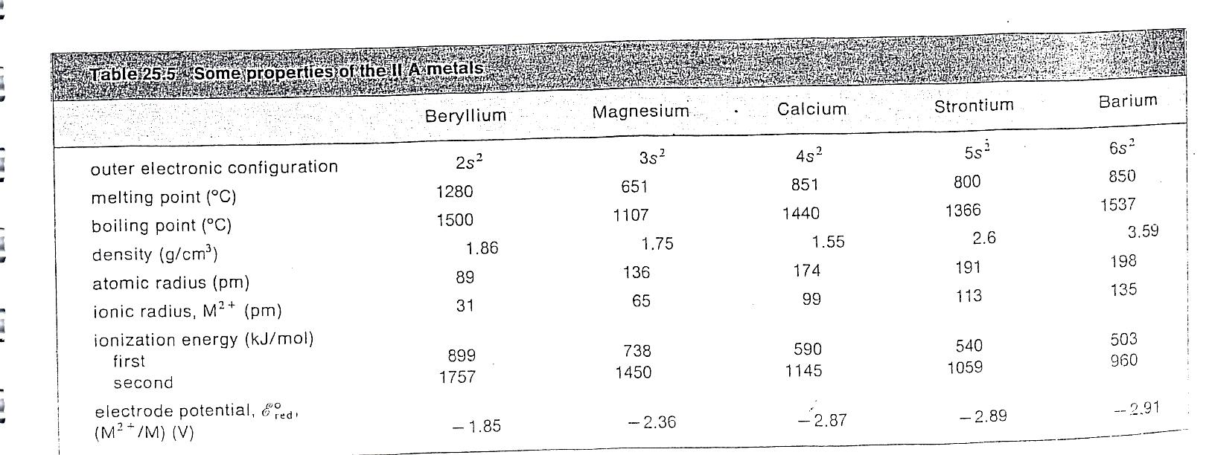
Table 25.5 Some properties of group 2 metals

Slide 8
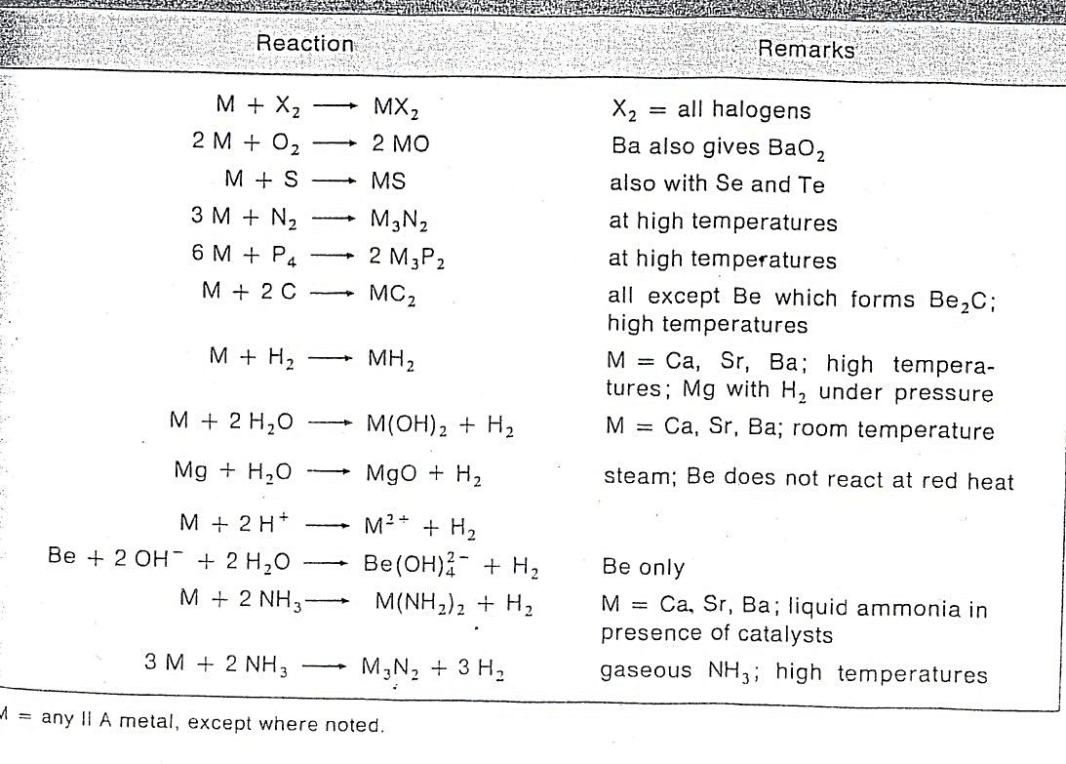
Chemistry of Group 2 metals

