Slide 1
Group 18 (0) Chemistry

Slide 2
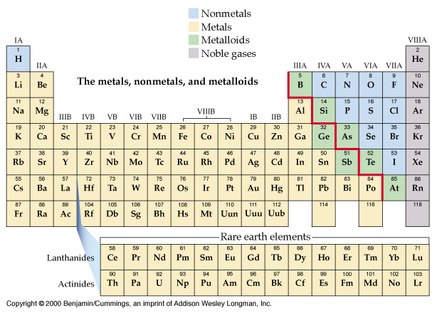
Nonmetals, Metals, Metalloids, Noble gases

Slide 3
http://www.youtube.com/watch?v=QLrofyj6a2s
http://www.youtube.com/watch?NR=1&v=ceQMs30D16E&feature=endscreen

Slide 4
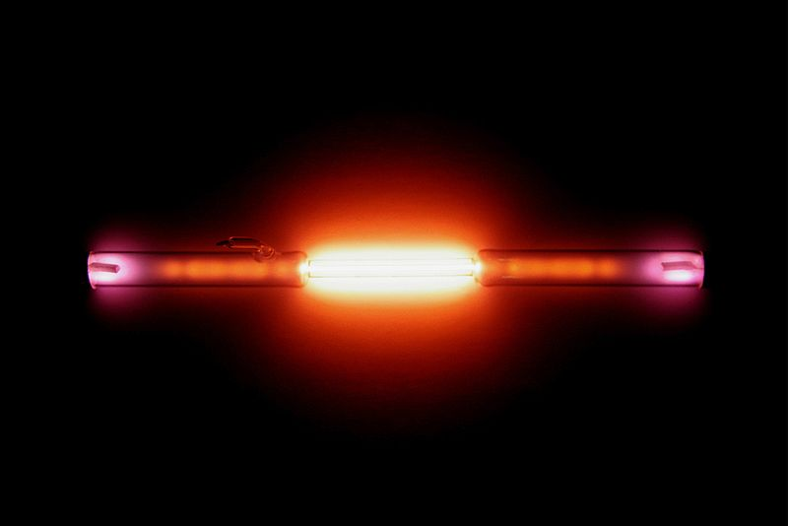
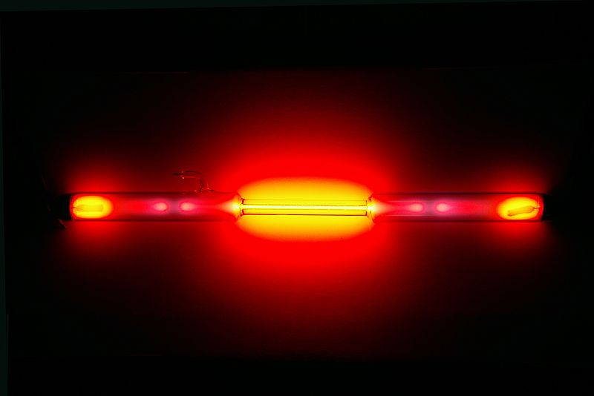
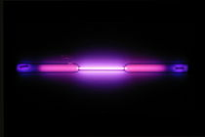
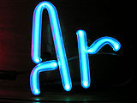
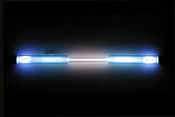
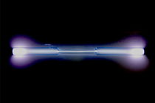
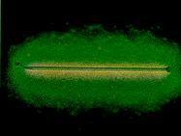
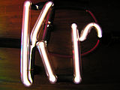
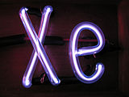

Slide 5
Symbol
Electron configuration
helium | He | 1s²
neon | Ne | [He]2s²2p⁶
argon | Ar | [Ne]3s²3p⁶
krypton | Kr | [Ar]3d¹⁰4s²4p⁶
xenon | Xe | [Kr]4d¹⁰5s²5p⁶
radon | Rn | [Xe]4f¹⁴5d¹⁰6s²6p⁶

Slide 6
The elements;
1) Group (0); low order of reactivity, no compounds till 1962, after that 30 compounds of heavier members.
6

Slide 7
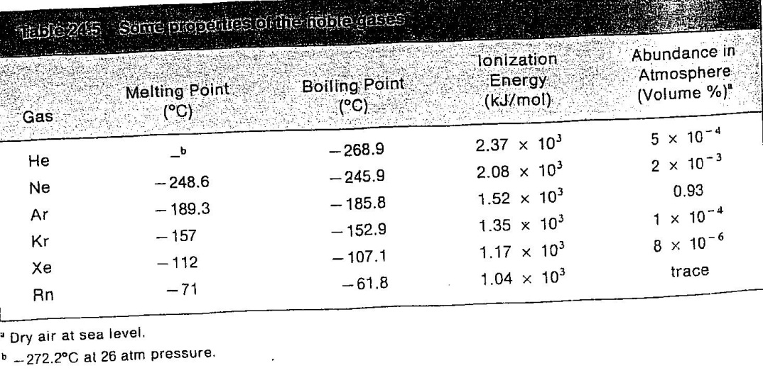
2) Properties; Table 24.5, atoms,
ionization energy, low m.p., and b.p.;

Slide 8
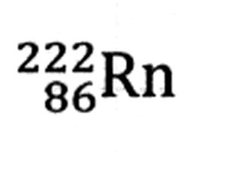
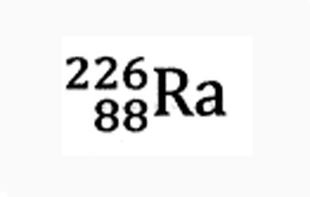
3) Exist in atmosphere, He as deposit, Isotopes of Radon(Rn) all from Radium (Ra)
t_{1/2} = 3.82 d, from
4) Ar in bulbs, no reaction with filaments but conduct heat away from it.

Slide 9
5) The first chemical reaction;
[Xe]⁺ [PtF₆]⁻ in 1962;
a) O₂ ⎯→ O₂⁺ + e ΔH = +1180 kJ
Xe ⎯→ Xe⁺ + e ΔH = +1170 kJ
So, it is possible to form [Xe]⁺[PtF₆]⁻ like [O₂⁺][PtF₆]⁻ ;solid, yellow orange.
9

Slide 10
b) XeF₂, XeF₄, XeF₆
Xe + mF₂ ⎯→ XeF_{m}
c) Oxygen containing compounds;
-By partial hydrolysis of;
XeF₆(s) + H₂O ⎯→ XeOF₄(l) + 2HF
-Complete hydrolysis:
XeF₆(s) + 3H₂O ⎯→ XeO₃(aq) + 6HF
XeOF₄(l) + 2H₂O ⎯→ XeO₃(aq) + 4HF
10

Slide 11
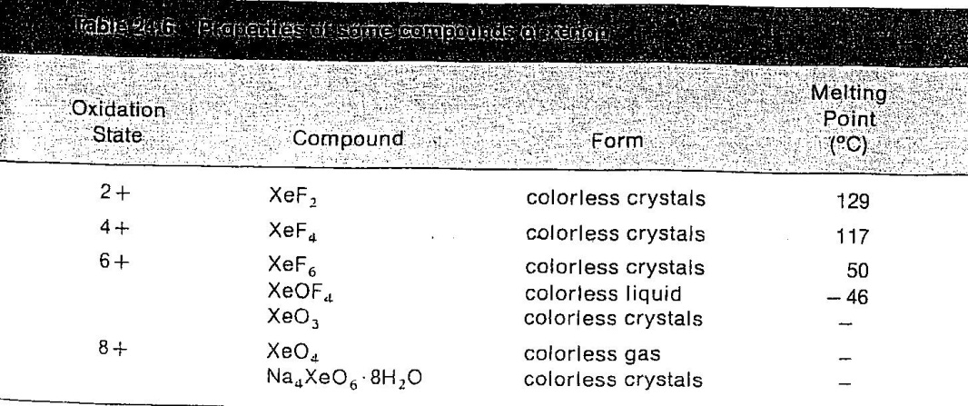

Slide 12
d) oxidation state (+8); XeO₄ or XeO₆⁴⁻ no H₄XeO₆ but salt yes.
Preparation of; XeO₆⁴⁻
12OH⁻ + 3XeO₃ + O₃ ⎯→ 3XeO₆⁴⁻ + 6H₂O
12

Slide 13
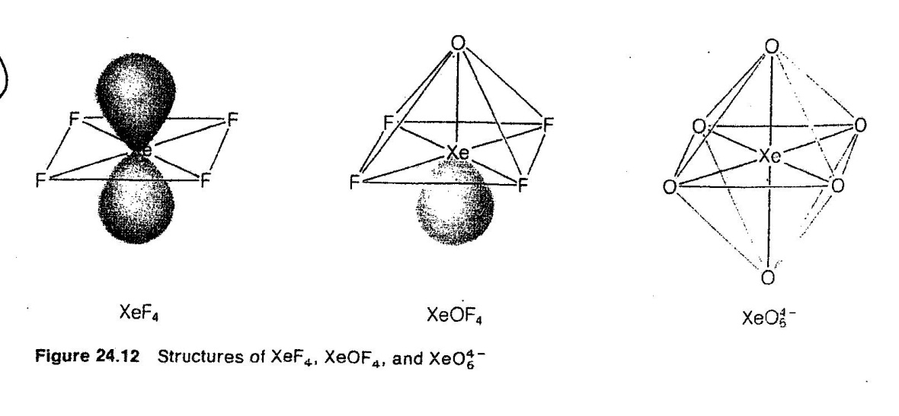
6)The structures of XeF₂, XeOF₄, XeO₆⁴⁻

Slide 14
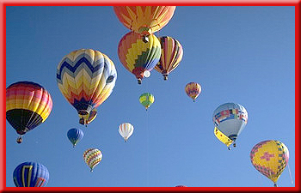
Even though hydrogen is lighter than helium, helium is preferred for these purposes
because helium will not burn.

Slide 15
Uses for the Noble Gases
The “neon” lights you see in advertising signs can contain any of the noble gases, not just neon.
Electricity is passed through the glass tubes that make up the sign.

Slide 16
Uses for the Noble Gases
The electricity causes the gas to glow.
Each noble gas produces a unique color.
Helium glows yellow, neon glows red-orange, and argon produces a bluish-violet color.

Slide 17
Uses for the Noble Gases
Argon, the most abundant of the noble gases on Earth, was first found in 1894.
Krypton is used with nitrogen in ordinary light bulbs because these gases keep the glowing filament from burning out.
Krypton lights are used to illuminate landing strips at airports, and xenon is used in strobe lights and was once used in photographic flash cubes.

Slide 18
Uses for the Noble Gases
At the bottom of the group is radon, a radioactive gas produced naturally as uranium decays in rocks and soil.
If radon seeps into a home, the gas can be harmful because it continues to emit radiation.
When people breathe the gas over a period of time, it can cause lung cancer.

