Slide 1
Group 17 Chemistry

Slide 2
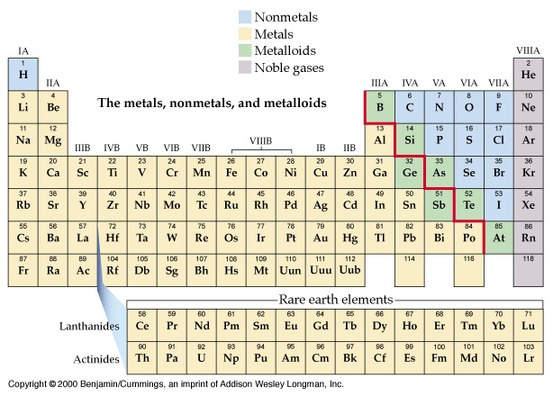
Nonmetals, Metals, Metalloids, Noble gases

Slide 3
Symbol
Electron configuration
fluorine | F | [He]2s²2p⁵
chlorine | Cl | [Ne]3s²3p⁵
bromine | Br | [Ar]3d¹⁰4s² 4p⁵
iodine | I | [Kr]4d¹⁰5s² 5p⁵
astatine | At | [Xe]4f¹⁴ 5d¹⁰6s² 6p⁵

Slide 4
Appearance;
Fluorine is a poisonous pale yellow gas.
chlorine is a poisonous pale green gas.
bromine is a toxic and caustic brown volatile liquid. (The only liquid nonmetal)
iodine is a shiny black solid which easily sublimes to form a violet vapor on heating.

Slide 5
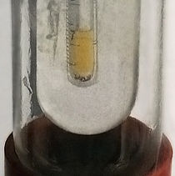
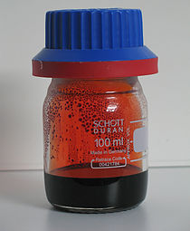
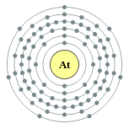
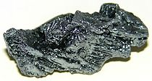
Fluorine
chlorine
bromine
Astatine t_{0.5} = 8.1 d
iodine

Slide 6
Hydrogen with halogen?!
B.P. −252.7⁰C; ¹H, ²D, ³T.
Facts; 15% of all atoms, 1% by mass, water, hydrocarbons, at STP 1L = 0.0899 g, colorless, odorless, tasteless
Industrial production of hydrogen:
a) Steam reformer process:
CH₄ + 2H₂O (g) ⎯→ CO₂ + 4H₂
CH₄ + H₂O(g) ⎯→ CO + 3H₂
H₂, CO, CO₂ ; into shift converter at 450⁰C
CO + H₂O ⎯→ CO₂ + H₂
CO₂ + H₂ ⎯→ cold water, high pressure ⎯→ CO_{2(aq)} + H₂
gas
6

Slide 7
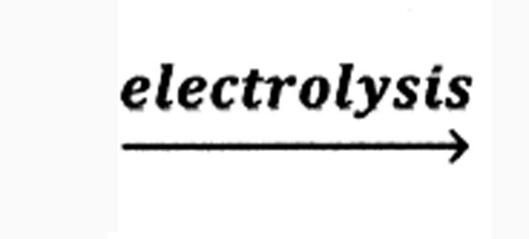
b) water gas; c) Fe and steam;
d) cracking; e) electrolysis NaCl brine;
f) 2NaCl + 2H₂O ⎯→ 2NaOH + Cl₂ + H₂
g) 2H₂O 2H₂ + O₂
3) H₂ from displacement reaction:
M + H₂O ⎯→ MOH + H₂
7

Slide 8
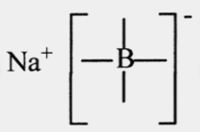
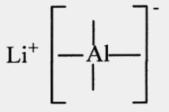
4) Reaction of hydrogen:
a) salt like hydride:
H-H bond energy 431 kJ/mol, High temp.
(very high and low electron affinity).
2Na(s) + H₂ ⎯→ 2NaH
(H⁻ like He, isoelectronic)
Ca(s) + H₂ ⎯→ CaH₂
H⁻ + H₂O ⎯→ H₂ + OH⁻
b) complex hydrides: NaBH₄, LiAlH₄
8

Slide 9
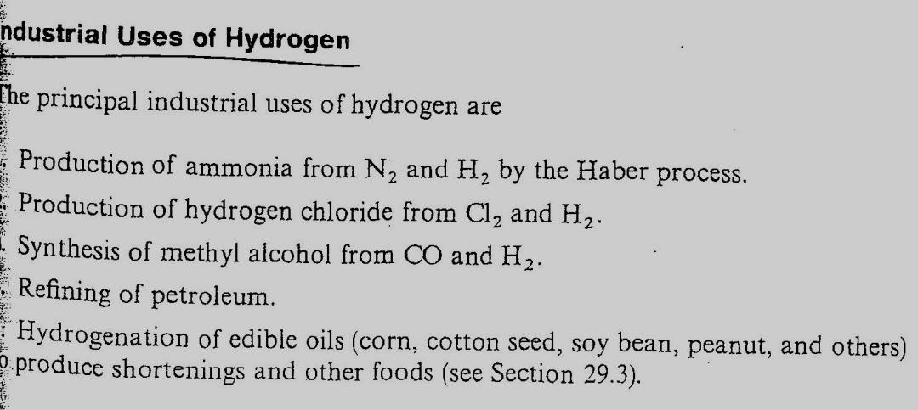
Industrial uses of hydrogen:
9

Slide 10
The halogen: (salt former)
1.Electronic configuration; [core]ns² np⁵
2. Physical state: gas, liquid, solid
(Intermolecular force).
3. 1st ionization energy: I₂⁺, … exist not I⁺.
4. Electronegativity: 4 to 2.7
5. Bond energy: F₂ is weak, but HF is the strongest, so it is very reactive.

Slide 11
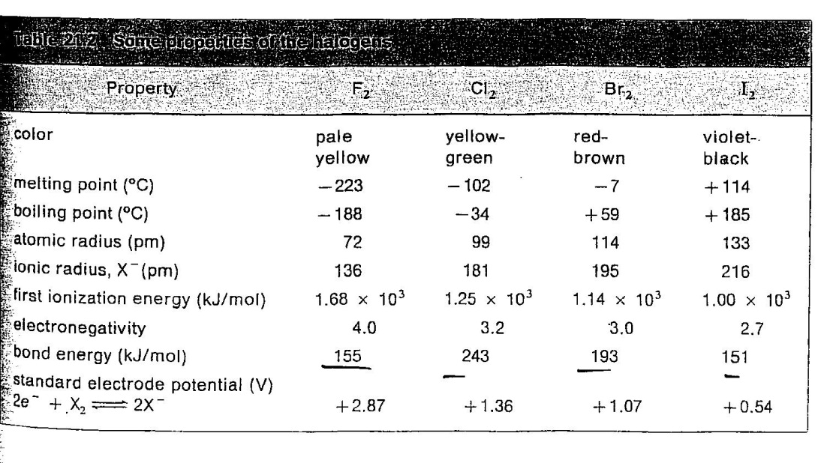

Slide 12
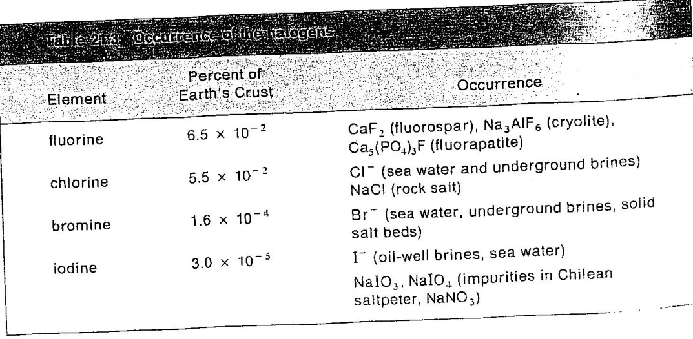
7) Occurrence
12

Slide 13
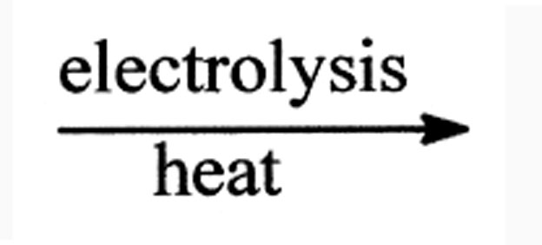
Industrial preparation of the halogen:
1. Fluorine: KF + HF ⎯→ KHF₂ (K⁺ HF₂⁻)
2KHF₂(l) H₂ + F₂ + 2KF(l)
2. Chlorine:
2Na⁺ + 2Cl⁻ + 2H₂O H₂ + Cl₂ + 2Na⁺ + 2OH⁻
3. Bromine: Cl₂ + 2Br⁻ ⎯→ 2Cl⁻ + Br₂(l)
4. Iodine: Cl₂ + 2I⁻ ⎯→ 2Cl⁻ + I₂(l)
In laboratory, oxidation of acids.

Slide 14
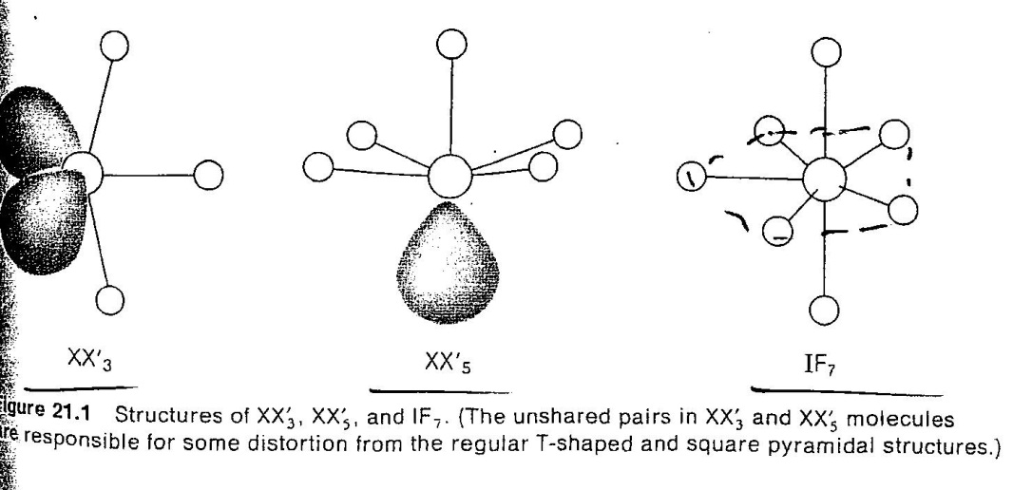
The inter halogen compounds:
XX' (BrCl) no IF
XX₃' (ClF₃, BrF₃ and IF₃)
XX₅' (ClF₅, BrF₅ and IF₅) only IF₇
14

Slide 15
9) The Metal Halides:
K₂CO₃ + 2HF(l) ⎯→ 2KF + CO₂ + H₂O
Some ionic KCl
Some covalent TiCl₄

Slide 16
Oxyacid's of the halogen:
HClO, HClO₂, HClO₃, HClO₄
(Table 21.5, p. 599)
Hypochlorous ← chloric acid → per
http://www.youtube.com/watch?v=usRGfhsnLUc&NR=1&feature=endscreen
16

Slide 19
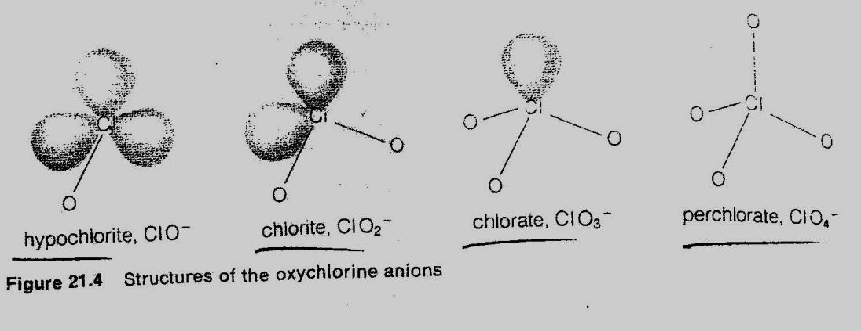

Slide 20
11) Industrial uses of the halogens:
(p. 604)

