Slide 1
Group 16 Chemistry

Slide 2
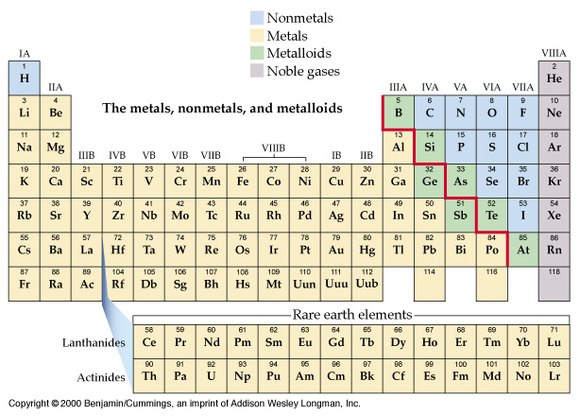
Nonmetals, Metals, Metalloids, Noble gases

Slide 3
The elements of Group 16 are:
 | symbol | electron configuration
oxygen | O | [He]2s²2p⁴
sulfur | S | [Ne]3s²3p⁴
selenium | Se | [Ar]3d¹⁰4s² 4p⁴
tellurium | Te | [Kr]4d¹⁰5s² 5p⁴
polonium | Po | [Xe]4f¹⁴ 5d¹⁰6s² 6p⁴

Slide 5
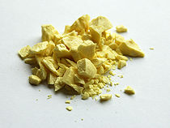
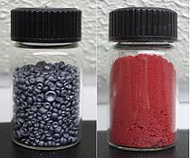
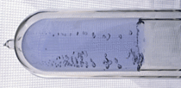
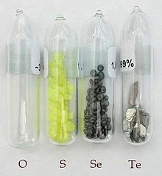
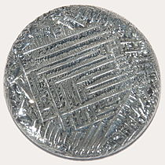
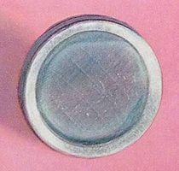
oxygen
sulfur
selenium
tellurium
polonium

Slide 6
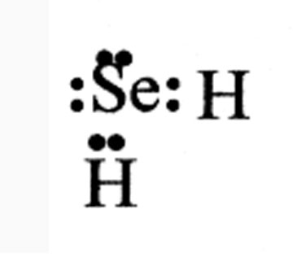
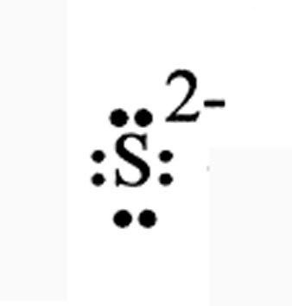
Oxygen is different and ₈₄Po is radioactive t_{1/2} = 138.7 d
2) The electronic configuration: Two short from noble gas.
2Na⁺ , S²⁻ and
Less active nonmetal than the halogen
SO₂ , SeO₂ and OF₂

Slide 7
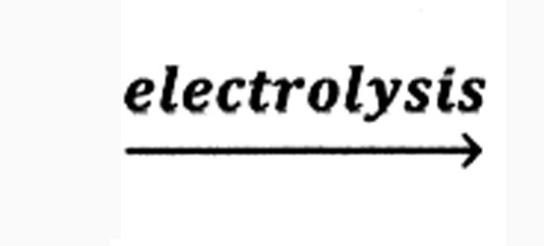
3) Occurrence and industrial production of oxygen.
21% by volume 23% by mass,
¹⁶O, ¹⁸O and ¹⁷O
99.759%, 0.204% and 0.037%
Preparation;
Commercially:
a) fractional distillation 99 ⁰C
b) 2H₂O 2H₂ + O₂

Slide 8
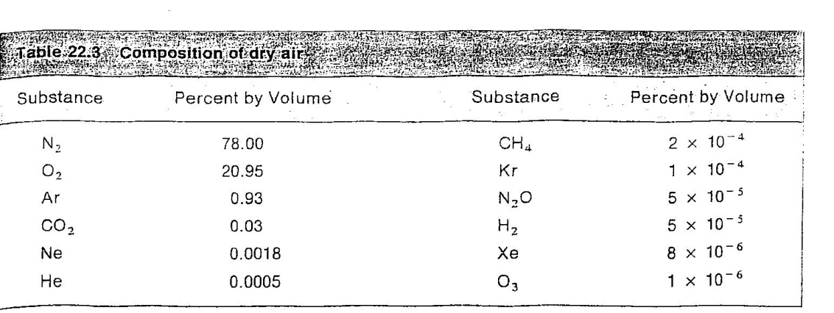

Slide 9
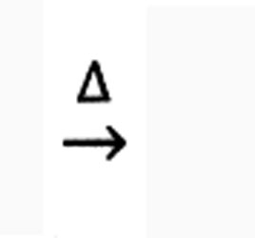
Laboratory:
a) 2HgO 2Hg + O₂ also Ag₂O, Au₂O₃
b) 2Na₂O₂ 2Na₂O + O₂
2BaO₂ 2BaO + O₂
9

Slide 10
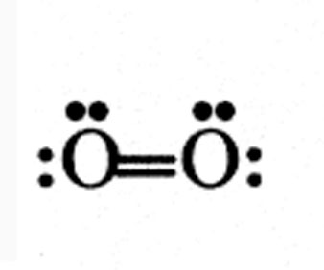
Reaction of oxygen:
At high temperature because of
We have O₂, O₂⁻, O₂²⁻ and O₃⁻
oxide, superoxide and ozonide ions
form oxides with most metals: Na₂O, MgO
form oxides with most nonmetals
CO, CO₂ and N₂O etc.
10

Slide 11
Industrial uses of oxygen:
Support combustion and sustain life
1. oxidizer for rocket fuels.
2. oxyacetylene tourch.
3. biological treatment of water.
4. life support in medicine.
11

Slide 12
Ozone: O₃ allotrope:
1/2O₂ ⎯→ O ΔH = +247 kJ
O + O₂ ⎯→ O₃ ΔH = −105 kJ
Overall endothermic
3/2O₂ ⎯→ O₃ ΔH_{f} = +142 kJ
12

Slide 13
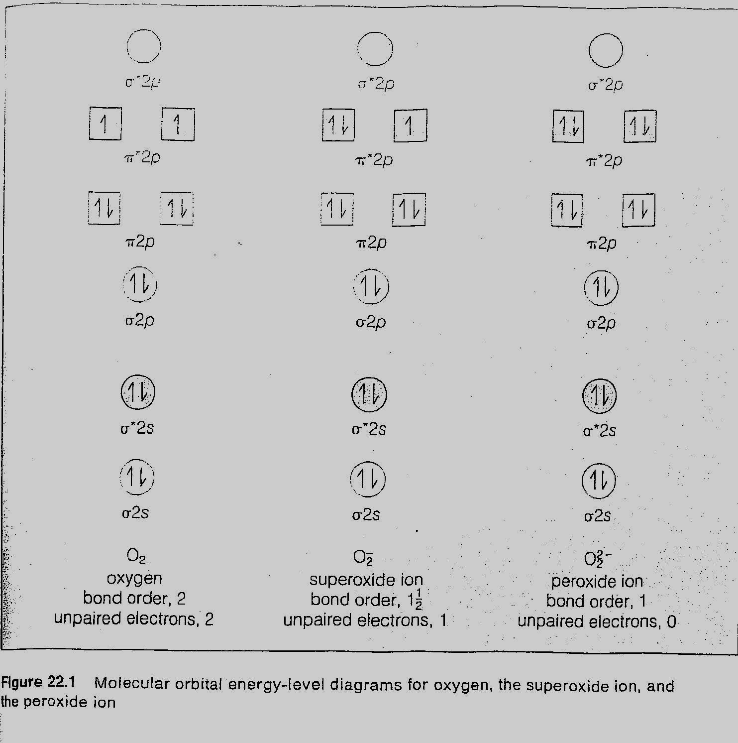

Slide 14
Air pollution: The air pollutants:
CO, (SO₂, SO₃), (NO, NO₂)
Poisonous, acid rain, with hydrocarbon
NO₂ NO + O
O + O₂ O₃
O₃ + hydrocarbon oxygen cont. H.C.
(photochemical smog)
Occurrence and preparation of S, Se and Te;
Table 22.4 for minerals sulfur from earth (The Frasch process) p. 620.
14

Slide 16
Hydrogen compounds of S, Se and Te:
Table 22.5
H₂S; FeS + 2H⁺ ⎯→ Fe²⁺ + H₂S
or from thioacetamide
H₂S, H₂Se, H₂Te are weak acids.
16

Slide 17
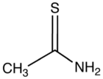
H₂O
+ H₂S
thioacetamide
acetamide

Slide 18
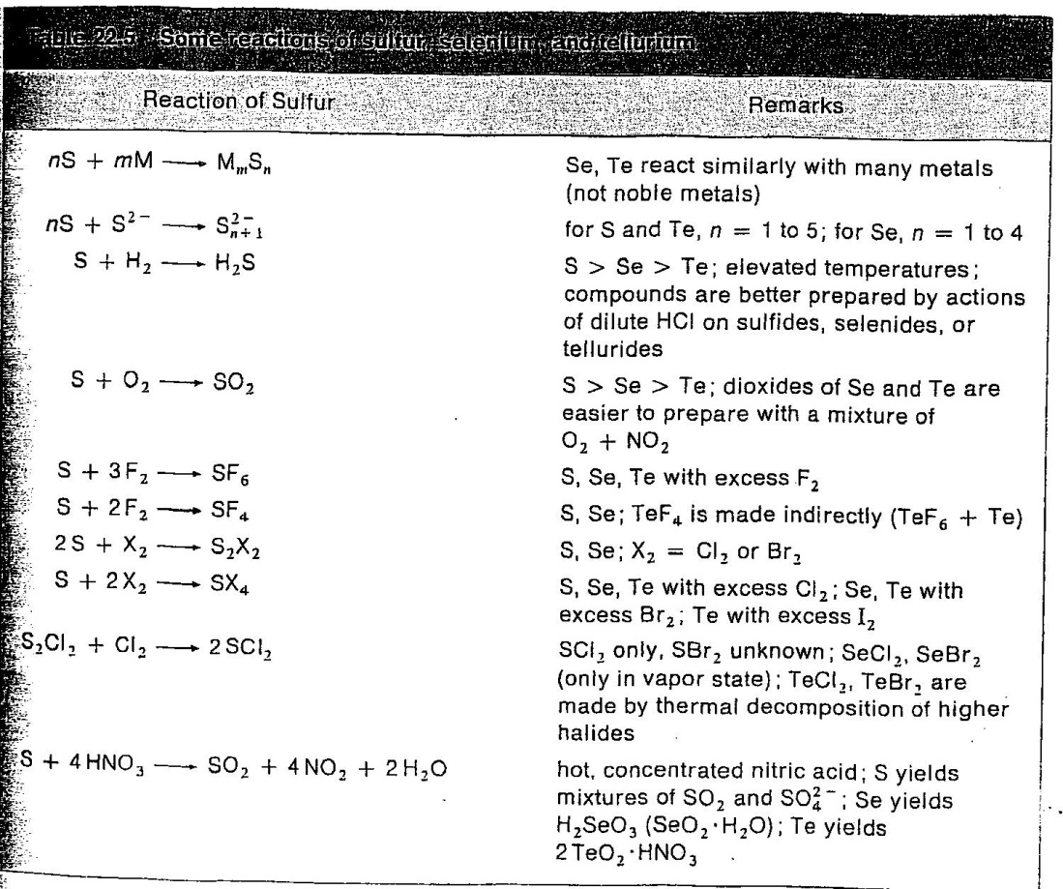

Slide 19
9) The 4+ of S, Se and Te:
Preparation:
a) S + O₂ ⎯→ SO₂ burning S
b) 2ZnS + 3O₂ ⎯→ 2ZnO + 2SO₂
(roasting ore)
There is H₂SeO₃ and H₂TeO₃
(selenous acid) (tellurous acid)
19

Slide 20
10) The 6+ of S, Se and Te:.
2SO₂ + O₂ ⎯→ 2SO₃
SO₃ + H₂O ⎯→ H₂SO₄
H₂SO₄ + SO₃ ⎯→ H₂S₂O₇
(pyrosulfuric acid)
H₂S₂O₇ + H₂O ⎯→ 2H₂SO₄
H₂SeO₄ , H₆TeO₆ and no H₂TeO₄
Selenic acid telluric acid
20

Slide 21
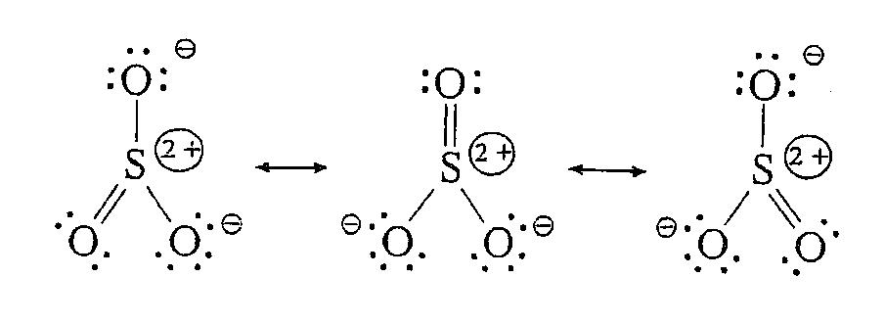

Slide 22
Industrial uses of S, Se and Te:
1. Sulfur: 80% of it as H₂SO₄ (p. 630)
in industry.
2. Selenium: p. 630.
3. Tellurium: few uses.
22

