Slide 1
Group 15 chemistry

Slide 2
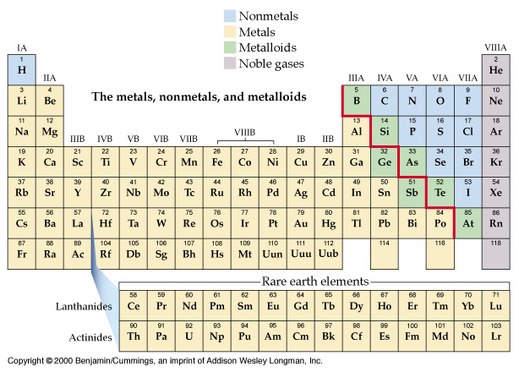
Nonmetals, Metals, Metalloids, Noble gases

Slide 3
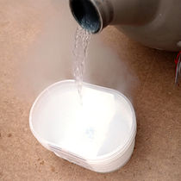
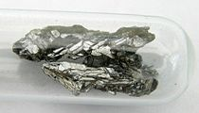
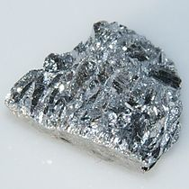
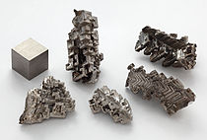
phosphorus
arsenic
Nitrogen (l)
antimony
bismuth

Slide 4
The elements of Group 15 are:
 | symbol | electron configuration
nitrogen | N | [He]2s²2p³
phosphorus | P | [Ne]3s²3p³
arsenic | As | [Ar]3d¹⁰4s² 4p³
antimony | Sb | [Kr]4d¹⁰5s² 5p³
bismuth | Bi | [Xe]4f¹⁴ 5d¹⁰6s² 6p³

Slide 5
1) Wider range of properties.
2) Metallic character and nonmetallic character.
The electronic configuration:
N³⁻ , P³⁻ to +5 also exist but covalent.
Sb³⁺, Bi³⁺ exist.
4) Oxides of N, P and As are acidic.
Ex.: N₂O₃, P₄O₆ and As₄O₆
but Sb₄O₆ amphoteric, Bi₂O₃ is basic.
5

Slide 7
:N≡N: is unreactive.
Empty d orbitals for others
P to Bi form six covalent bonds;
PCl₆⁻, SbCl₆⁻, BiCl₅²⁻.
7) Allotropes for P, As, Sb, (P; red, white and black) The white P₄ very toxic.
7

Slide 8
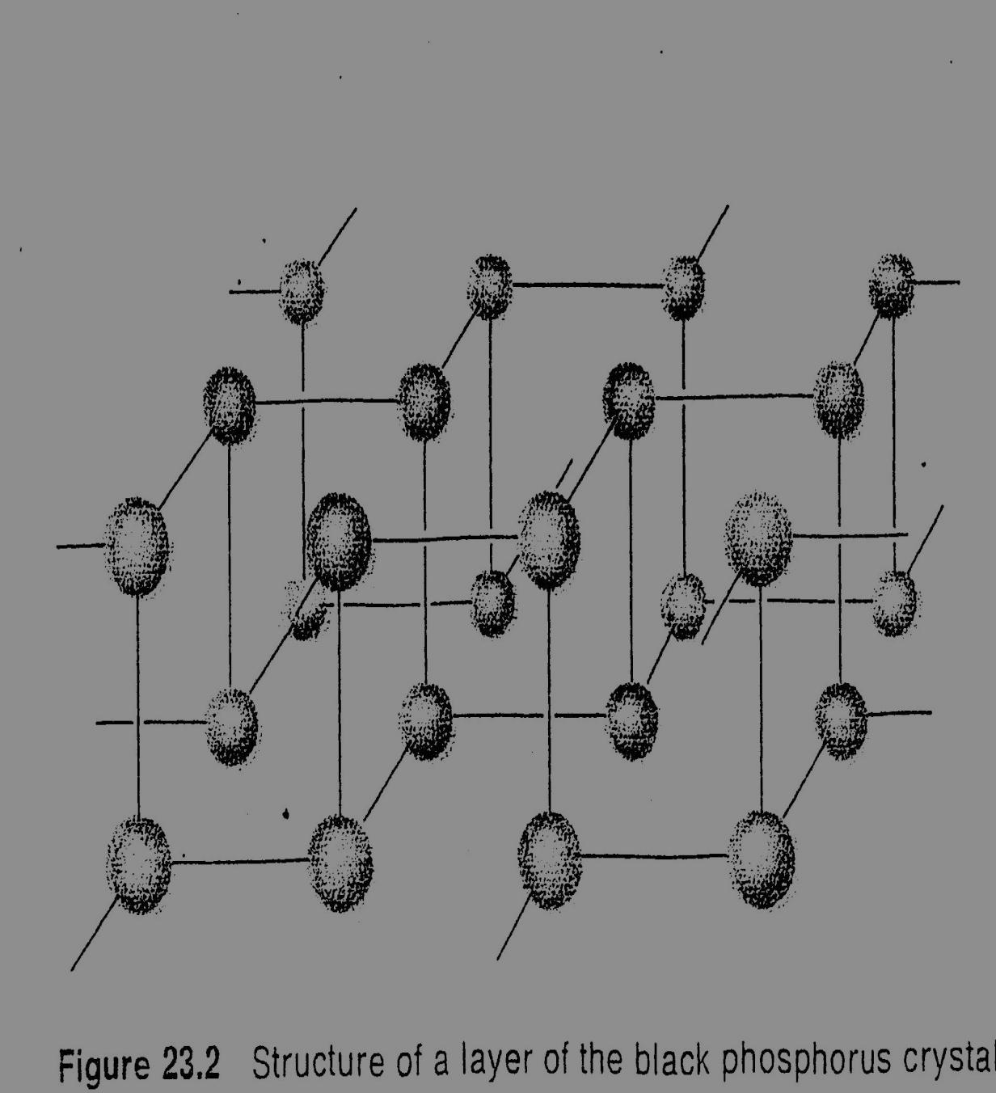
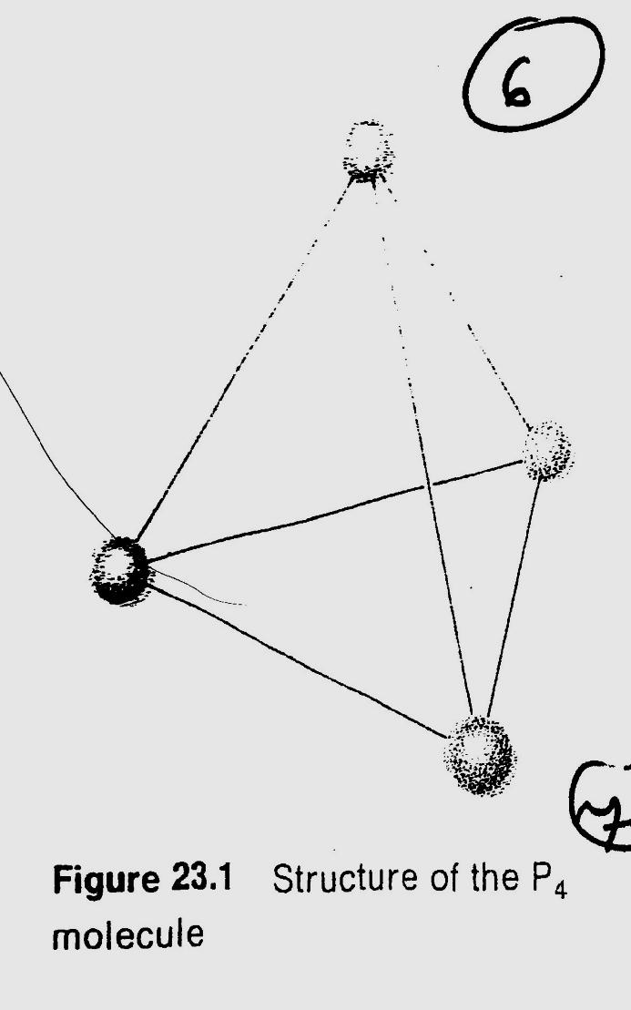

Slide 9
Red phosphorous
White (P₄)→ Red P
Heating to 250 ⁰C, not toxic, not soluble, not reactive.
*there are As₄ and Sb₄
Black phosphorous
White (P₄)→ Black P
High pressure, Hg catalyst, (covalent and London forces)

Slide 10
8) The nitrogen cycle; Part of protein, nitrogen-fixation.
a) N₂(g) + O₂(g) 2NO(g)
2NO + O₂ ⎯→ 2NO₂
3NO₂ + H₂O ⎯→ 2HNO₃(l ) + NO(g)
↓ nitrates→ nutrient
b) Industrially: N₂ + 3H₂ ⎯→ 2NH₃ (Haber process)
From plants and animals;
*The death of all will produce N₂ to the atmosphere.
10

Slide 11
Nitrogen Cycle;
https://www.classzone.com/books/ml_science_share/vis_sim/em05_pg20_nitrogen/em05_pg20_nitrogen.swf

Slide 12
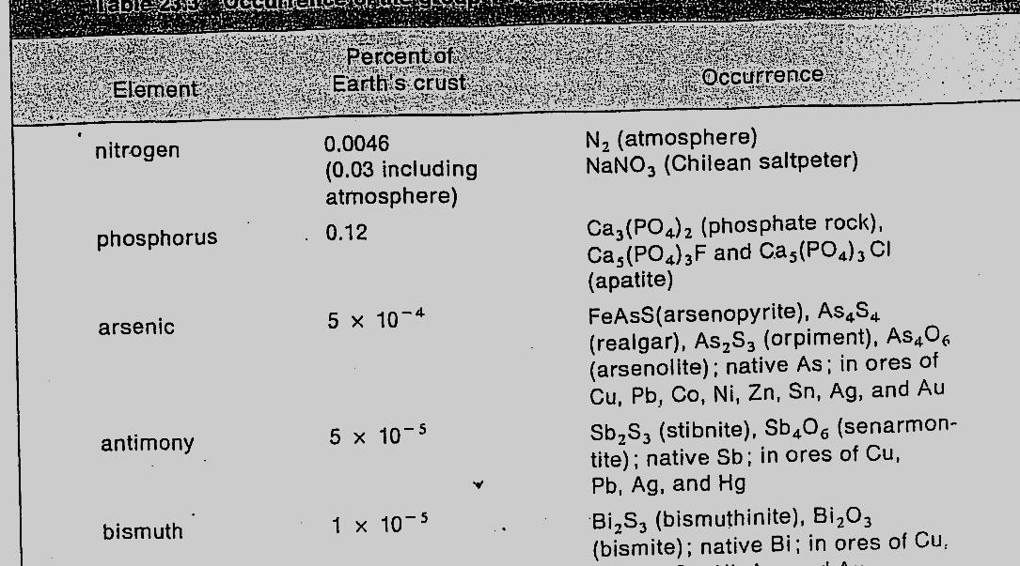

Slide 13
Occurrence and preparation:
Table 23.3
a) NH₄⁺ + NO₂⁻ ⎯→ N₂ + 2H₂O
b) As₄O₆ + 6C ⎯→ As(g) + 6CO(g)
c) Oxides by roasting sulfide in air;
2Sb₂S₃ + 9O₂ ⎯→ Sb₄O₆ + 6SO₂(g)
13

Slide 14
10) Nitrides and phosphides
N₃⁻; M₃N₂ (M = Be, Mg, Ca, Sr, …)
Ca₃N₂ + 6H₂O ⎯→ 3Ca²⁺ + 6OH⁻ + 2NH₃ (ionic nitride)
Some covalent nitride; P₃N₅, Si₃N₄
Phosphides;
a) Ionic phosphides; Li₃P, Ca₃P
b) covalent phosphides; BP, AlP

Slide 15
11) Hydrogen compounds:
NH₃; N₂ + 3H₂ ⎯→ 2NH₃ (commercially)
NH₄⁺ + OH⁻ ⎯→ NH₃ + H₂O (in Lab.)
Structure: NH₃ Trigonal pyramidal
Amphoteric;
NH₃ + H₂O ⎯→ NH₄⁺ + OH⁻
NH₃ + HCl ⎯→ NH₄Cl
NH₄⁺ is tetrahedral

Slide 16
N₂H₄ Hydrazine; NH₃-H + NH₂
PH₃ Phosphine;
P₄(s) + 3OH⁻ + 3H₂O ⎯→ PH₃(g) + 3H₂PO₂⁻
(hypophosphite ion)
PH₃ pyramidal, no hydrogen bonding
AsH₃; arsino, SbH₃; stibnite, BiH₃, Bismuthine are (poisonous gases)

Slide 17
Halogen compounds: The trihalides are known;
NCl₃(l ) + 3H₂O ⎯→ NH₃ + 3HOCl
-3 +1
PCl₃(l ) + 3H₂O ⎯→ H₃PO₄ + 3H⁺ + 3Cl⁻
+3 -1
*The pentahalides series is not complete because of lack of d orbital in nitrogen.
PCl₅ is Trigonal bipyramidal

Slide 18
13) Oxides and oxyacid's of nitrogen:
N₂O dinitrogen oxide
(laughing gas) +1
NO nitrogen oxide +2
N₂O₃ dinitrogen trioxide +3
N₂O₄ dinitrogen tetroxide
2NO₂ ⇌ N₂O₄ +4
N₂O₅ +5

Slide 19
Acids:
nitric acid HNO₃;
NaNO₃ + H₂SO₄ ⎯→ NaHSO₄ + HNO₃
HNO₂ +3 nitrous acid
P₄O₆ (+3); Phosphorous (III) oxide
P₄O₁₀ (+5); Phosphorous (V) oxide
(many acids)
H₃PO₄ (Phosphoric), H₃PO₃ (Phosphorous), H₂PO₂ (hypo phosphorous)

Slide 20
Industrial uses of the group:
N; ammonia ⎯→ nitric acid ⎯→ nitrates ⎯→ fertilizers
b) P; P₂O₅ ⎯→ phosphoric acid ⎯→ matches ⎯→ rodent poisons
c) As, Sb and Bi; no much uses, alloys.

