Slide 1
Group 14 Chemistry

Slide 2
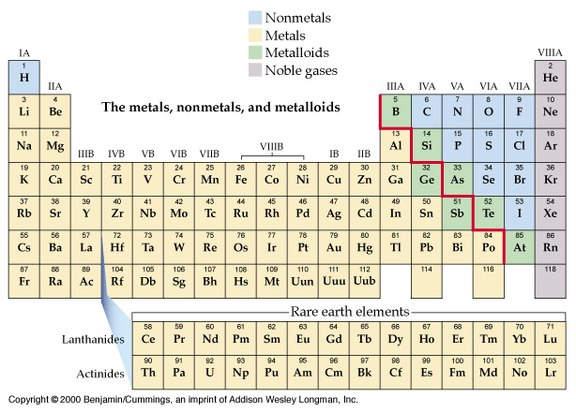
Nonmetals, Metals, Metalloids, Noble gases

Slide 3
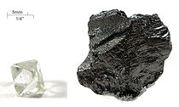
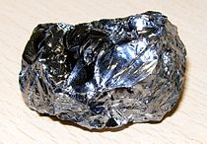
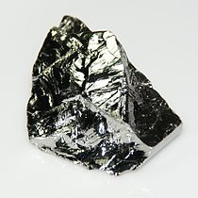
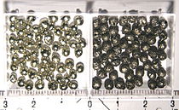
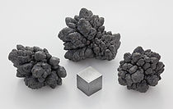
Carbon
Silicon
Germanium
Tin
Lead

Slide 4
The elements of Group 14 are:
 | symbol | electron configuration
carbon | C | [He]2s²2p²
silicon | Si | [Ne]3s²3p²
germanium | Ge | [Ar]3d¹⁰4s² 4p²
tin | Sn | [Kr]4d¹⁰5s² 5p²
lead | Pb | [Xe]4f¹⁴ 5d¹⁰6s² 6p²

Slide 5
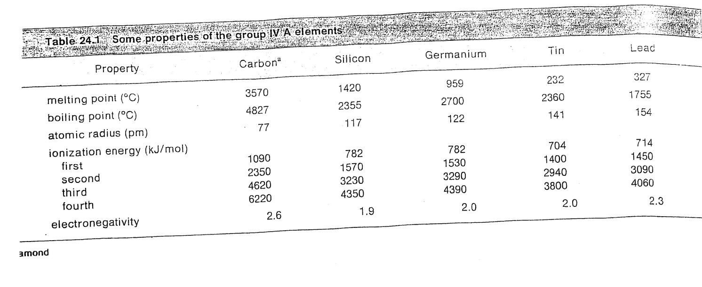

Slide 6
1) The elements of the group.*
2) C (nonmetal) graphite conductors;
Si (nonmetal) but semi metallic in properties.
Ge (semimetal), more metallic than nonmetallic.*
Sn and Pb are metallic.
3) The crystalline forms of Si and Ge like diamond but are semiconductors diamond is not.
6

Slide 7
4) Si and Ge used as impurity for transistors.
5) The electronic configuration:*
No 4- except for C; no 4+ for C due to high IE.
Ge, Sn and Pb can have 2+ (d¹⁰ s²)
Pb²⁺ (PbF₂, PbCl₂) are ionic
Ge²⁺, Sn²⁺ are covalent
7

Slide 8
6) The majority covalent, four bonds, attain noble gas configuration. AB₄ tetrahedral, PbF₄, PbCl₄, PbH₄ known. Last two thermally unstable.
7) Four bonds for carbon saturate the valence. The rest has empty (d), so they form, SiF₆²⁻, GeCl₆²⁻, SnBr₆²⁻ and Pb(OH)₆²⁻.
8) Catenation for C, B, Si, P, O, Ge and Sn.
8

Slide 9
9) Carbon from this group use p orbitals to form multiple bond (σ, π);
10) The chemistry of C and Si: Nonmetals.
9

Slide 10
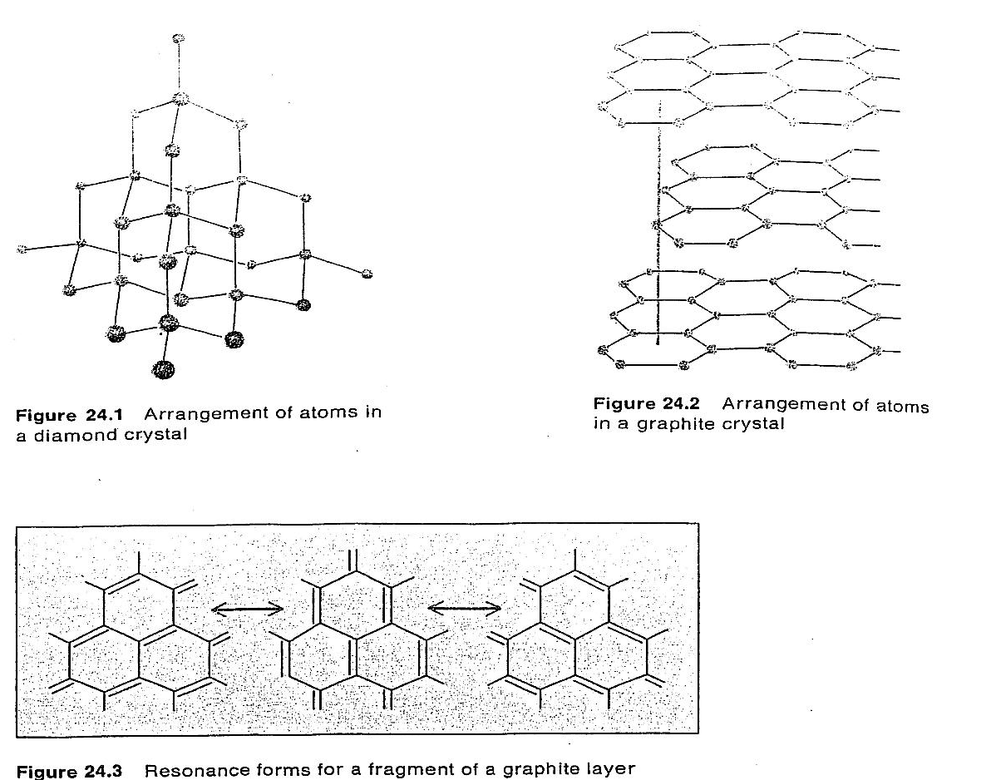
Occurrence and preparation of carbon and silicon
11) Three allotropes; diamond, graphite, and fullerene (C₆₀ in 1985)
10

Slide 11
For diamond; (154 pm, sp³ )
For graphite: (141 pm, 335 pm, resonance, layers, conductors)
For fullerene (heating graphite to 10,000 C⁰ )
Some minerals; Limestone, CaCO₃ , 0.03% crust.

Slide 12
a) Silicon; 28% of the crust; O₂ is number one then Si in the crust
b)Conductionband,semiconductor not like carbon.
c) preparation of pure silicon;
1) impure Si + 2Cl₂ ⎯→ SiCl₄
SiCl₄ + 2H₂ ⎯→ Si + 4HCl
2) SiO₂ + 2C ⎯→ Si + 2CO (reduction of SiO₂)
12

Slide 13
13) Carbides and Silicides
a) Carbon with G1 and G2 metal elements:
M or MO + C or CO ⎯→ MC₂
It may named acetylide because it gives acetylenes [:C≡C:]²⁻ when hydrolyzed;
CaC₂ + 2H₂O ⎯→ Ca(OH)₂ + C₂H₂
13

Slide 14
b) Si + molten metal ⎯→ Mg₂Si, Ca₂Si₂ (silicides)
Silicides + H₂O ⎯→ Silanes (Si_{n}H_{2n+2})
n = 1 – 6 (Alkanes)
Limited number of Si
14

Slide 15
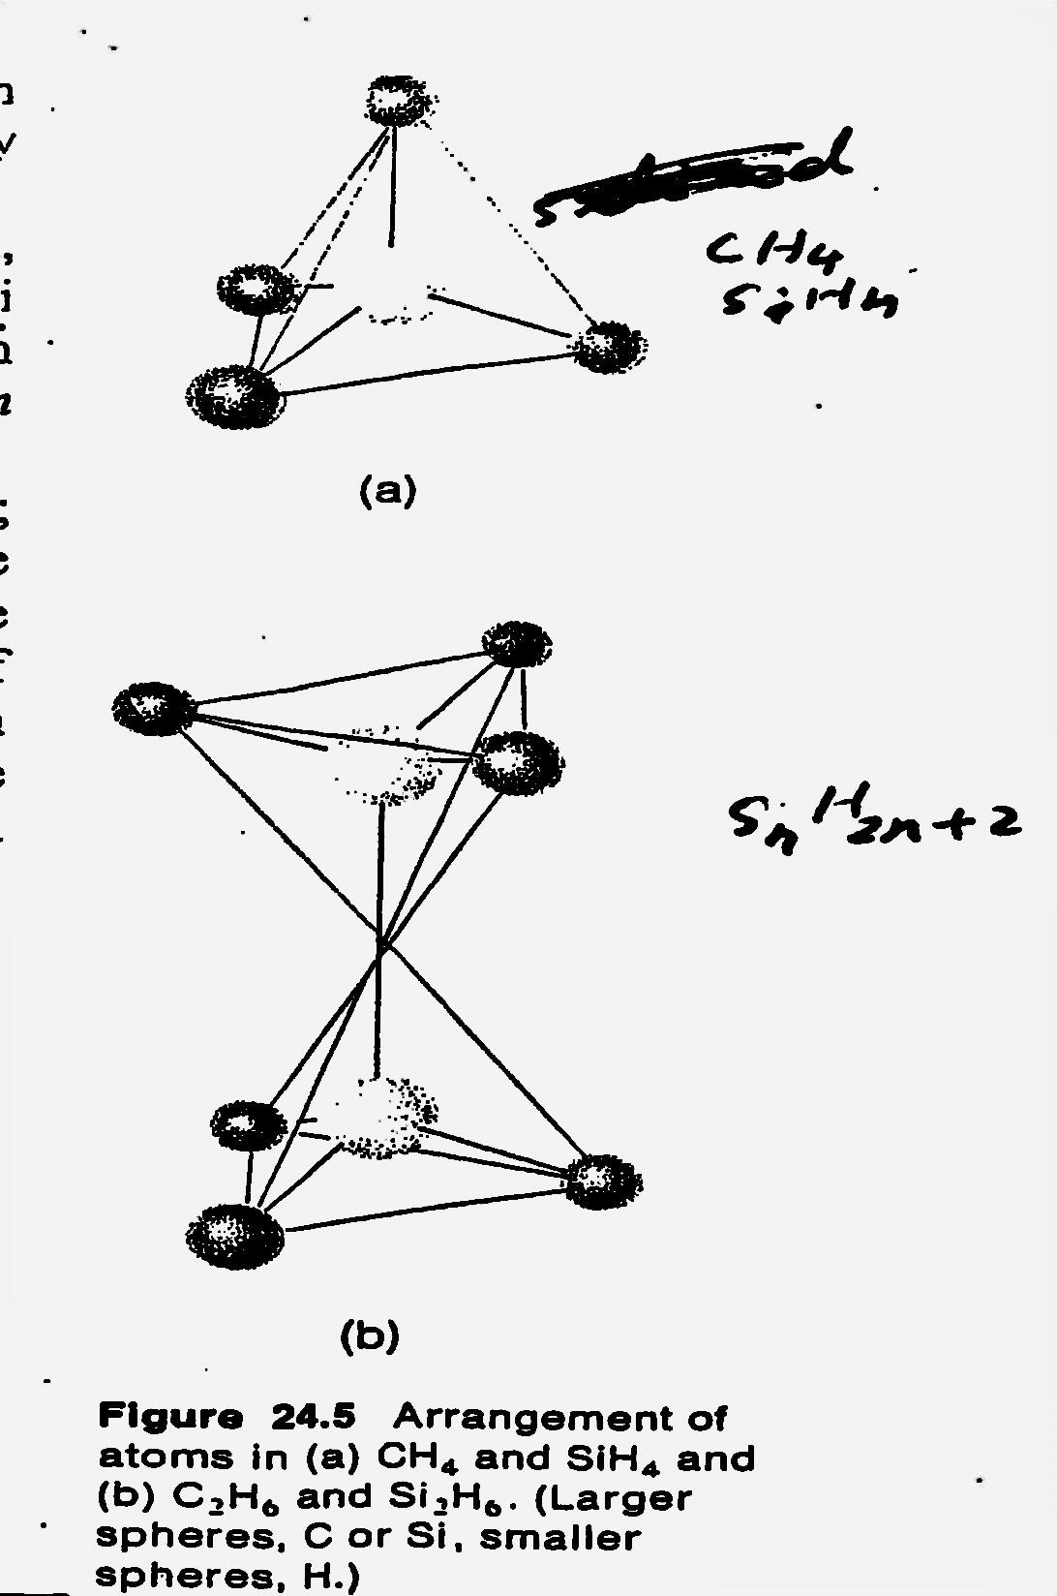

Slide 16
Oxides and oxyacids of C and Si
a) 2C + O₂ ⎯→ 2CO
:⁻C≡O⁺: is isoelectronic with :N≡N:
b) 2CO + O₂ ⎯→ 2CO₂
ΔH = -283 kJ used in fuel
c) FeO + CO ⎯→ CO₂ + Fe(l );
CO is reducing agent
16

Slide 17
16) a) Only one SiO₂ very stable (mp. 1700 ⁰C) compared to CO₂ (volatile, London forces)
b) The basic unit of all silicates SiO₄ group, like in ZrSiO₄ , fig. 24.6
17

Slide 18
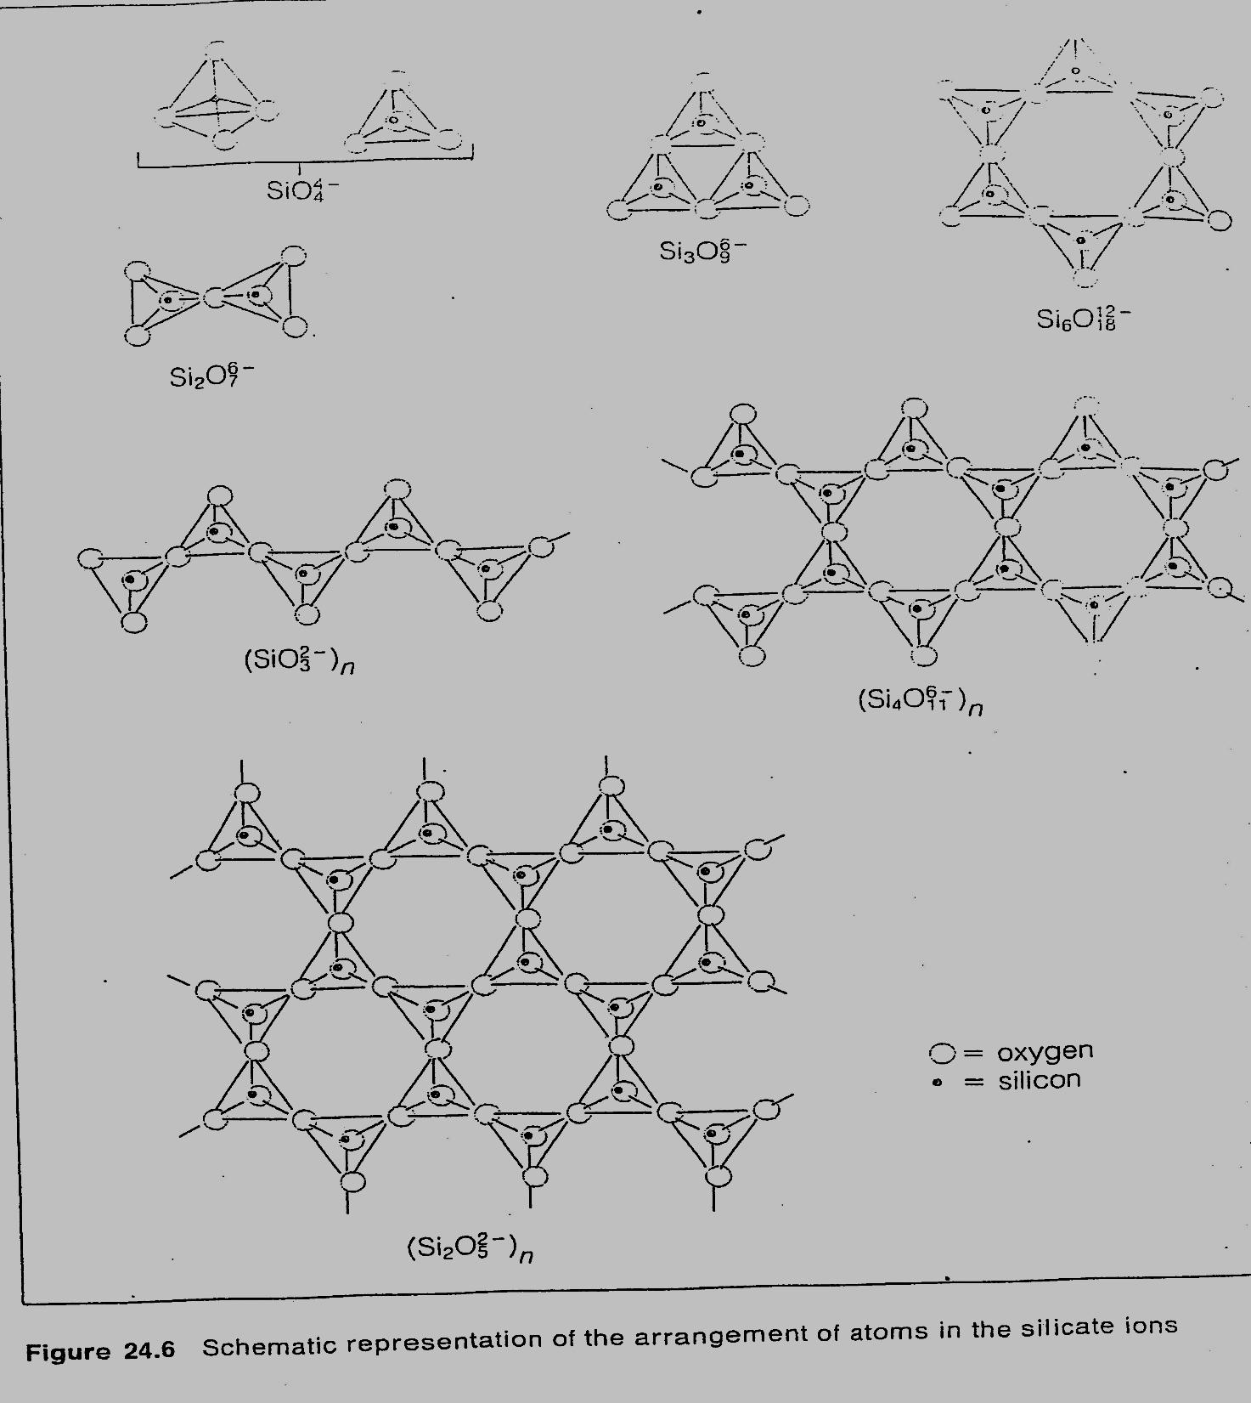

Slide 19
Sulfur, halogen and nitrogen compound of carbon
a) CS₂ , volatile, structure similar to CO_{2;} S=C=S, solvent for nonpolar comp. (waxes, grease) toxic flammable.
b) CCl₄ ; CS₂ + 3Cl₂ → CCl₄ + S₂Cl₂
Toxic not to be used as before (fire extinguishers, dry cleaning)
19

Slide 20
CF₄ ; any carbon compound + F₂ → CF₄
(very stable gas, CCl₂F₂ called “Freon” used as refrigerants.
CBr₄ and CI₄ are solids (unstable because carbon is small to hold four large atoms around itself)
C) HCN; 2CH₄ + 2NH₃ + 3O₂ 2HCN + 6H₂O
₍ poisonous) , [:C N:]⁻ , is isoelectronic to N₂ and CO .

