Slide 1
Group 13 Chemistry

Slide 2
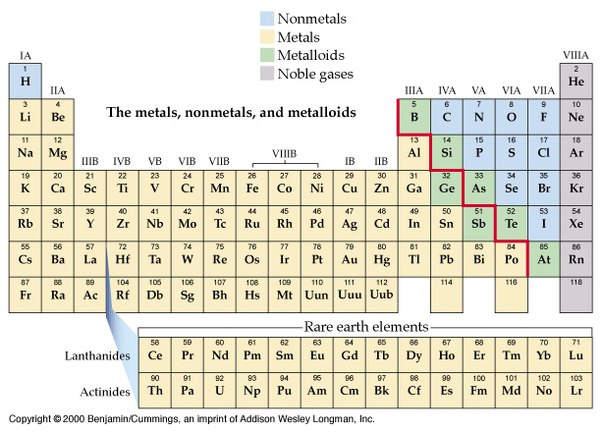

Slide 3
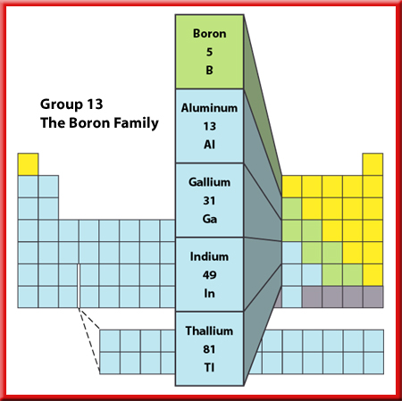
Groups 13 through 18
The elements in Groups 13-18 are not all solid metals like the elements of Groups 1 and 2. In
fact, a single group can contain metals, nonmetals, and metalloids and have members that are solids, liquids, and gases.

Slide 4
The elements of Group 13 are;
 | *symbol | electron configuration
boron | B | [He]2s²2p¹
aluminium | Al | [Ne]3s²3p¹
gallium | Ga | [Ar]3d¹⁰4s² 4p¹
indium | In | [Kr]4d¹⁰5s² 5p¹
thallium | Tl | [Xe]4f¹⁴ 5d¹⁰6s² 6p¹

Slide 5
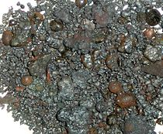
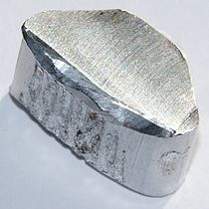
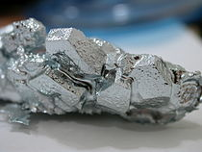
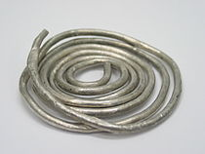
Boron
Aluminium
Gallium
Indium
Thallium

Slide 6
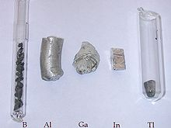

Slide 7
1)Name of the group elements, Boron is nonmetal.
2)Electronic configuration: according to the table 24.3, Ga, In and Tl have special electronic configuration, they come after the transition metal. The ionic radius will not increase that much as the previous groups.

Slide 8
3) B₂O₃, B(OH)₃ and H₃BO₃ acidic, (Al and Ga) are amphoteric, In₂O₃ and Tl₂O₃ are basic. Boron can catenate; B₂Cl₄ (Cl₂BBCl₂).
4) Boron exist as borates (Na₂B₄O₇.4H₂O)
The new type of bonding BBB
5) 2B + 3X₂ ⎯→ 2BX₃
BF₃, BCl₃ (gases); BBr₃ liquid and BI₃ solid.

Slide 9
6) +3 is the normal oxidation state, for B very high, so no B³⁺ , therefore no ionic compounds, all covalent others can be ionic and covalent.
7) Ga, In and Tl can have +1 (d¹⁰ s²). For Ga and In +3 more important than +1. For Tl, +1 is most important and have compound similar to group I.*

Slide 10
8) As Lewis acid;
NH₃ + BF₃ ⎯→ H₃N:BF₃
F⁻ + BF₃ ⎯→ BF₄⁻
Boric acid is monobasic:
B(OH)₃ + H₂O ⇌ H⁺ + B(OH)₄⁻ (aq)
Toxic

