Slide 1
GC415 – Ajax-Enabled Rich Internet Applications with XML and JSON
Internet & World Wide Web How to Program, 5/e

Slide 2
Outline
Traditional vs Ajax Web Applications
What is Ajax?
Ajax Basic Process
Ajax methods
Ajax properties
Rich Internet Applications with Ajax

Slide 3
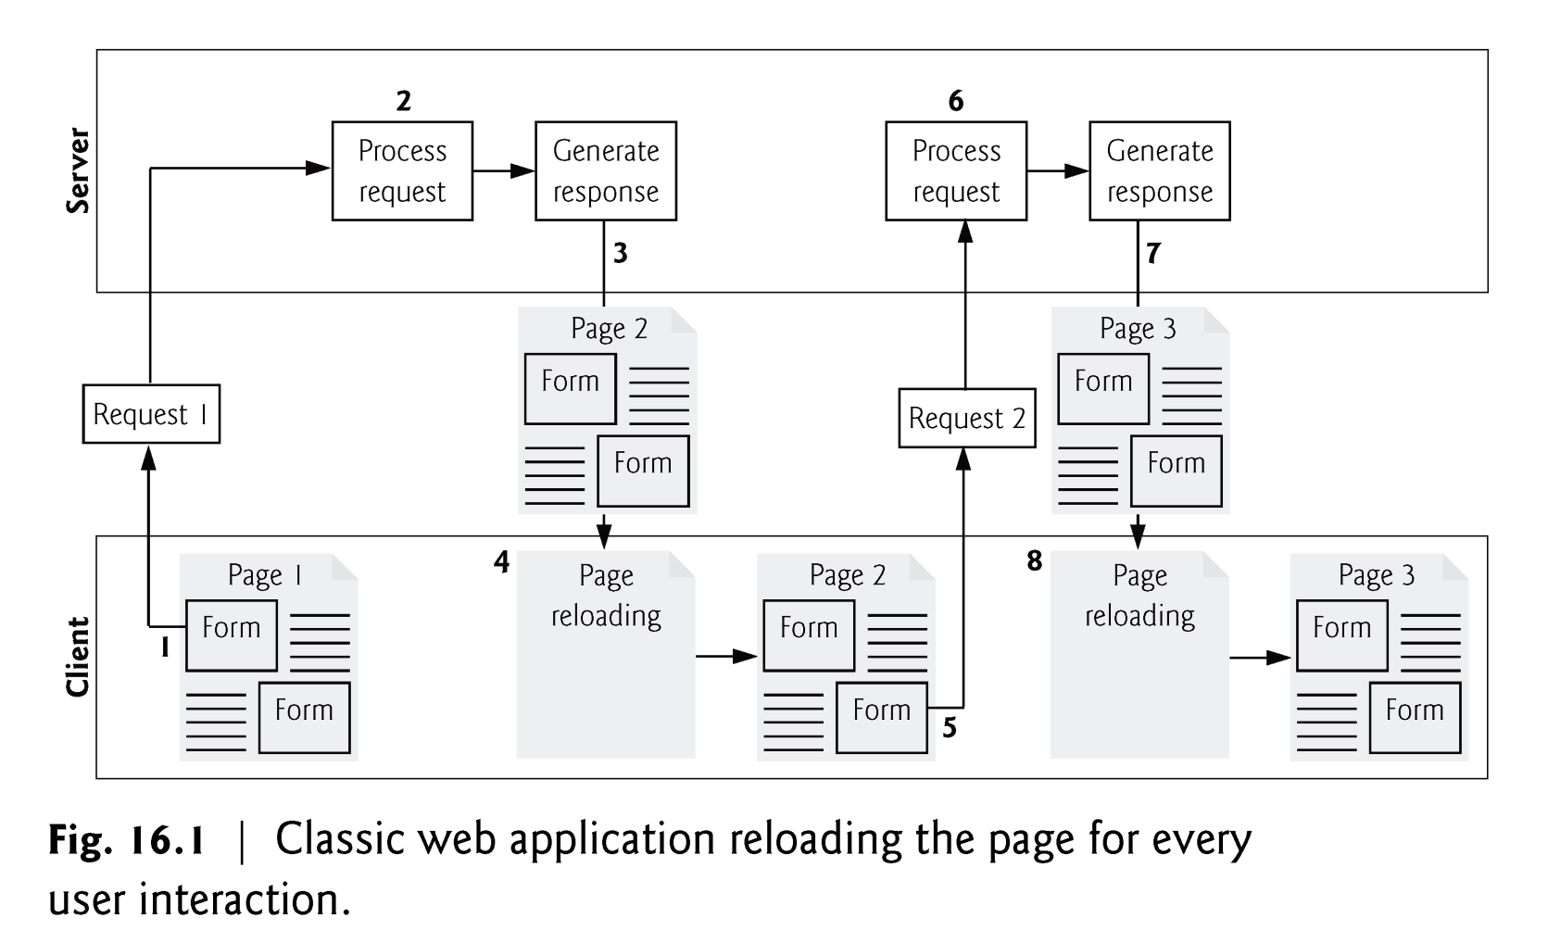
Traditional Web Applications
Traditional web applications
User fills in the form’s fields, then submits the form
Browser generates a request to the server, which receives the request and processes it
Server generates and sends a response containing the exact page that the browser will render
Browser loads the new page and temporarily makes the browser window blank
Client waits for the server to respond and reloads the entire page with the data from the response
While a synchronous request is being processed on the server, the user cannot interact with the client web browser
The synchronous model was originally designed for a web of hypertext documents

Slide 4
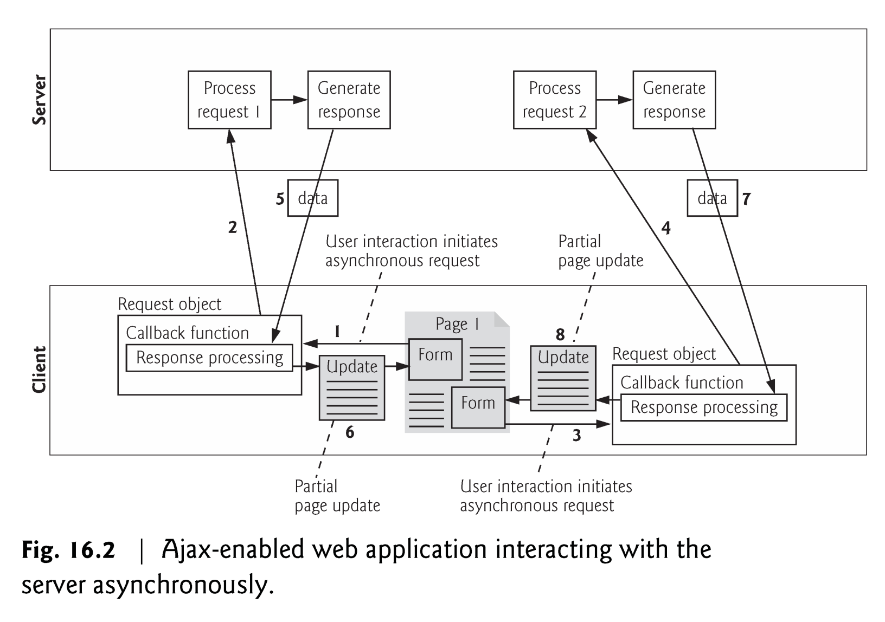
Ajax Web Applications
In an Ajax application, when the user interacts with a page
Client creates an XMLHttpRequest object to manage a request
XMLHttpRequest object sends the request to and awaits the response from the server
Requests are asynchronous, allowing the user to continue interacting with the client web browser while the server processes the request concurrently
When the server responds, the XMLHttpRequest object that issued the request invokes a callback function, which typically uses partial page updates to display the returned data in the existing web page without reloading the entire page
Callback function updates only a designated part of the page
Partial page updates help make web applications more responsive, making them feel more like desktop applications

Slide 5
*What is an Ajax?
AJAX = Asynchronous JavaScript And XML.
is not a programming language.
it just a technique that uses a combination of:
A browser built-in XMLHttpRequest object (to request data from a web server)
JavaScript and HTML DOM (to display or use the data)
it is a developer's dream, because you can:
Update a web page without reloading the page
Request data from a server - after the page has loaded
Receive data from a server - after the page has loaded
Send data to a server - in the background

Slide 6
*What is an Ajax? (Cont.)
An excellent example of this technology is Google Maps, in which new sections of a map are downloaded from the server when needed, without requiring a page refresh.
Using Ajax not only substantially reduces the amount of data that must be sent back and forth, but also makes web pages seamlessly dynamic—allowing them to behave more like self-contained applications. The results are a much improved user interface and better responsiveness.
AJAX applications might use XML to transport data, but it is equally common to transport data as plain text or JSON (JavaScript Object Notation) text.

Slide 7
Basic AJAX Process
JavaScript
– Define an object for sending HTTP requests; the XMLHttpRequest object
– Initiate request
• Get request object
• Designate a request handler function
– Supply as onreadystatechange attribute of request
• Initiate a GET or POST request
• Send data
– Handle response
• Wait for readyState of 4 and HTTP status of 200
• Extract return text with responseText or responseXML
• Do something with result
HTML
– Loads JavaScript
– Designates control that initiates request
– Gives ids to input elements that will be read/updated by script

Slide 8
*Let’s Explain it Through an Example
Note that this in a JavaScript code can refers to different things read here for explanation. However, in this example this refers to the object that invoked the function which is (xhttp).

Slide 9
XMLHttpRequest Object
All modern browsers support the XMLHttpRequest object.
XMLHttpRequest
The Ajax component that manages interaction with the server
Commonly abbreviated as XHR.
With AJAX, your JavaScript can communicate directly with the server, using the JavaScript XMLHttpRequest object. With this object, your JavaScript can trade data with a web server, without reloading the page. The user will stay on the same page, and he or she will not notice that scripts request pages, or send data to a server in the background.

Slide 10
XMLHttpRequest Object Event, Properties and Methods
The following figures summarize some of the XMLHttpRequest object’s properties and methods, respectively.
The properties are crucial to interacting with asynchronous requests.
The methods initialize, configure and send asynchronous requests.

Slide 11
*XMLHttpRequest Object Properties
Property | Description
onload | Defines a function to be called when the request is recieved (loaded)
onreadystatechange | Defines a function to be called when the readyState property changes
readyState | Holds the status of the XMLHttpRequest. 0: request not initialized 1: server connection established 2: request received 3: processing request 4: request finished and response is ready
responseText | Returns the response data as a string
responseXML | Returns the response data as XML data
status | Returns the status-number of a request 200: "OK" 403: "Forbidden" 404: "Not Found" For a complete list go to the Http Messages Reference
statusText | Returns the status-text (e.g. "OK" or "Not Found")
XML stands for eXtensible Markup Language.
that was designed to store and transport data
and to be both human- and machine-readable. Learn more about XML here

Slide 12
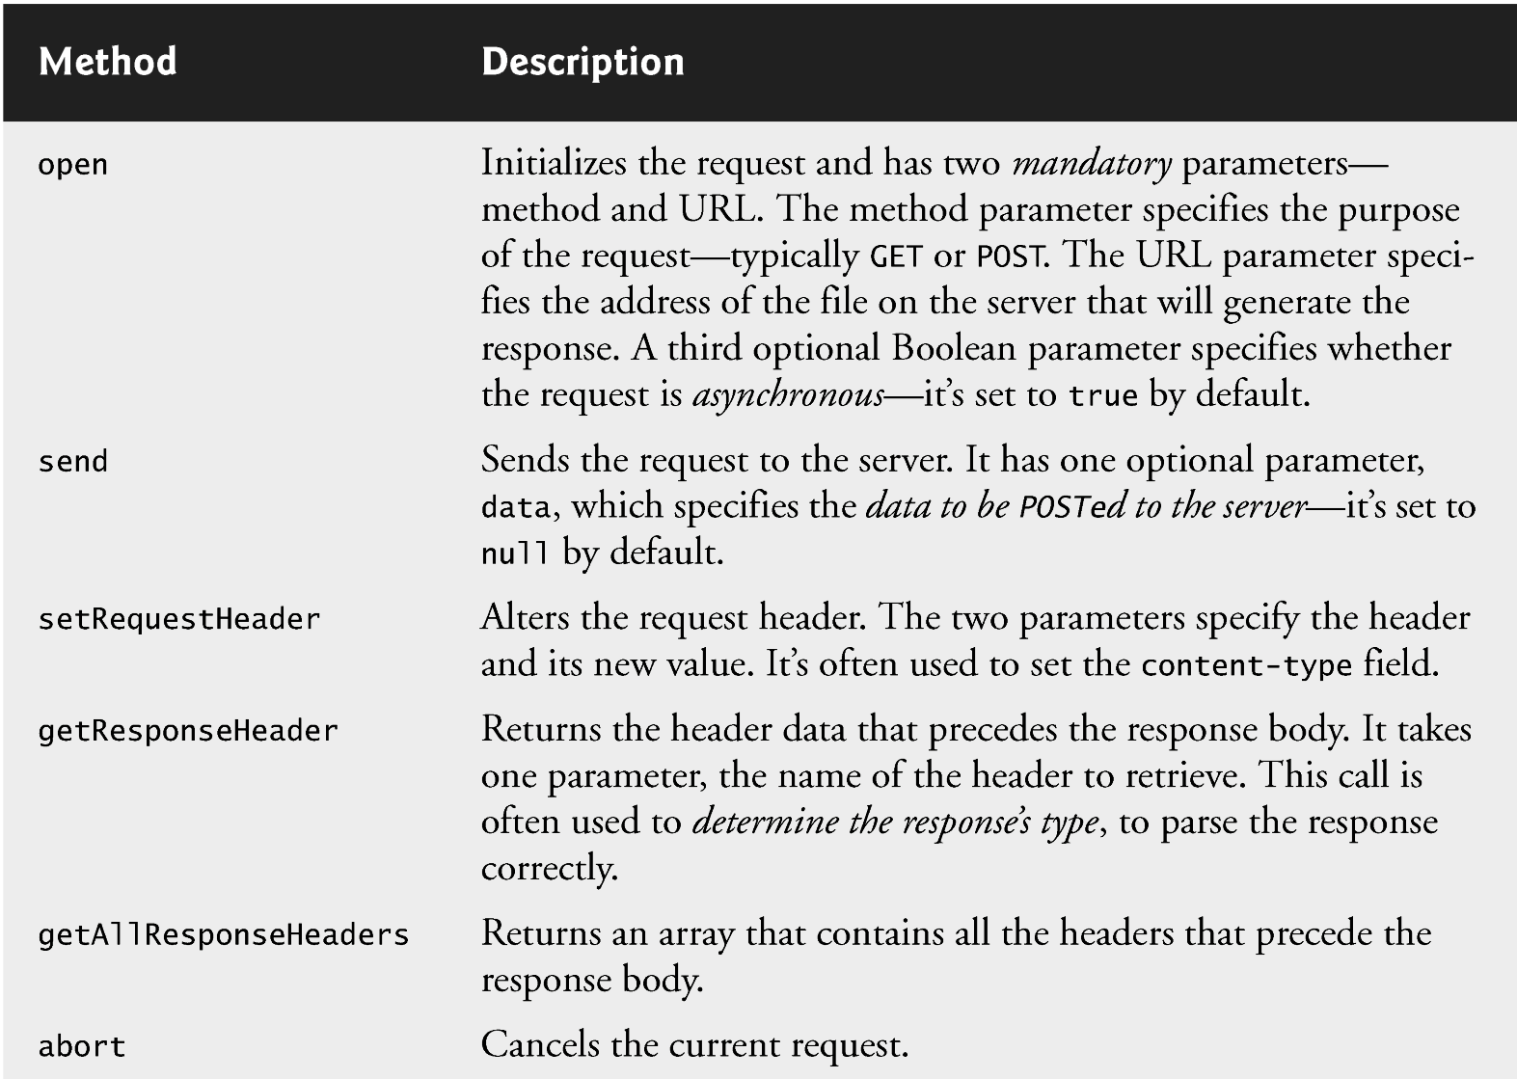
XMLHttpRequest Object Methods

Slide 13
Open() method: GET vs POST
GET is simpler and faster than POST, and can be used in most cases.
A Simple GET example (demo)
If you want to send information with the GET method, add the information to the URL: (demo)
However, always use POST requests when:
A cached file is not an option (update a file or database on the server).
Sending a large amount of data to the server (POST has no size limitations).
Sending user input (which can contain unknown characters), POST is more robust and secure than GET.

Slide 14
Open()method: URL
The url parameter of the open() method, is an address to a file on a server: like .txt and .xml, or server scripting files like .asp and .php (which can perform actions on the server before sending the response back).

Slide 15
Open() method: Asynchronous - True or False?
To send the request asynchronously, the async parameter of the open() method has to be set to true:
xhttp.open("GET", "ajax_test.asp", true);
By sending asynchronously, the JavaScript does not have to wait for the server response, but can instead:
execute other scripts while waiting for server response
deal with the response when the response ready
When using async = true, specify a function to execute when the response is ready in the onreadystatechange event

Slide 16
Callback Functions
A callback function is registered as the event handler for the XMLHttpRequest object’s readystatechange event
Whenever the request makes progress, the XMLHttpRequest calls the readystatechange event handler.
Progress is monitored by the readyState property, which has a value from 0 to 4
The value 0 indicates that the request is not initialized and the value 4 indicates that the request is complete.

Slide 17
Rich Internet Applications (RIAs) with Ajax
Classic HTML registration form
Sends all of the data to be validated to the server when the user clicks the Register button
While the server is validating the data, the user cannot interact with the page
Server finds invalid data, generates a new page identifying the errors in the form and sends it back to the client—which renders the page in the browser
User fixes the errors and clicks the Register button again
Cycle repeats until no errors are found, then the data is stored on the server
Entire page reloads every time the user submits invalid data
Ajax-enabled forms are more interactive
Entries are validated individually, dynamically as the user enters data into the fields
If a problem is found, the server sends an error message that is asynchronously displayed to inform the user of the problem
Sending each entry asynchronously allows the user to address invalid entries quickly, rather than making edits and resubmitting the entire form repeatedly until all entries are valid
Asynchronous requests could also be used to fill some fields based on previous fields’ values (e.g., city based on zip code)

Slide 18
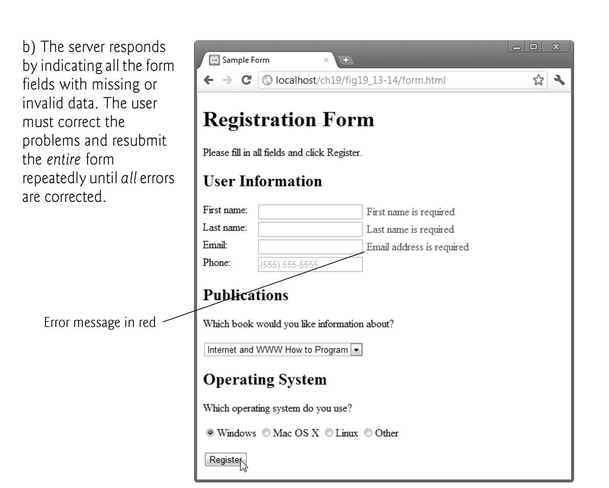
Classic HTML Form

Slide 19
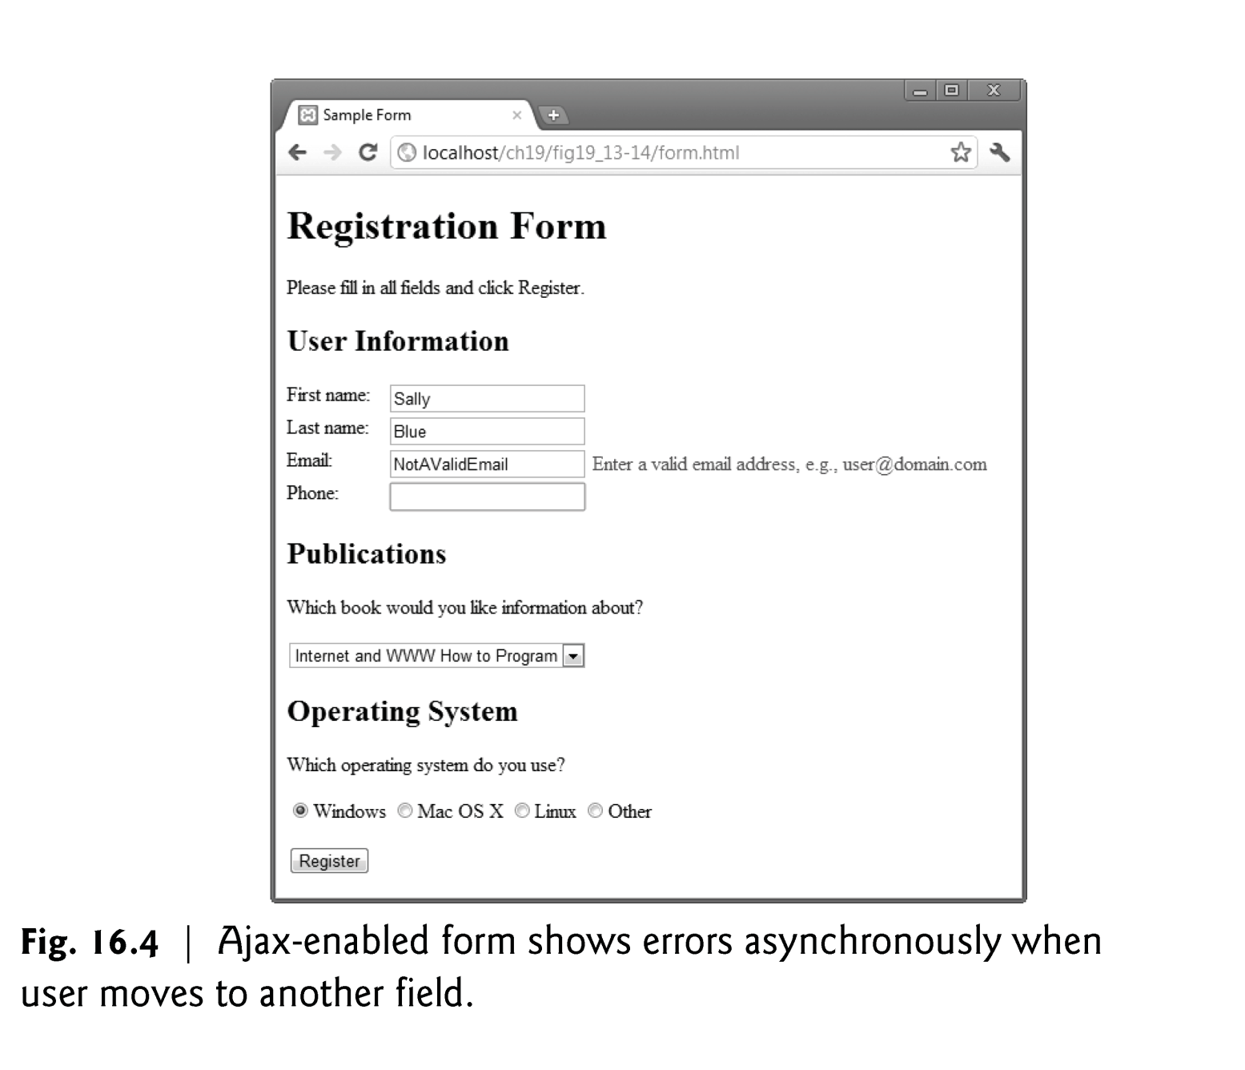
Ajax-enabled Form

Slide 20
Exception Handling
An exception is an indication of a problem that occurs during a program’s execution
Exception handling enables you to create applications that can resolve (or handle) exceptions—in some cases allowing a program to continue executing as if no problem had been encountered.
try block
Encloses code that might cause an exception and code that should not execute if an exception occurs
Consists of the keyword try followed by a block of code enclosed in curly braces ({})
When an exception occurs
try block terminates immediately
catch block catches (i.e., receives) and handles an exception
catch(…) block
Begins with the keyword catch
Followed by an exception parameter in parentheses and a block of code enclosed in curly braces
Exception parameter’s name e.g. catch(err)
Enables the catch block to interact with a caught exception object, which contains name and message properties. See examples on next slides.

Slide 21
try..catch

Slide 22
Using XML and JSON for passing data
When passing structured data between the server and the client, Ajax applications often use XML because it consumes little bandwidth and is easy to parse
XMLHttpRequest object responseXML property
contains the parsed XML returned by the server

Slide 23
Using XML and JSON for passing data
When passing structured data between the server and the client, Ajax applications often use XML because it consumes little bandwidth and is easy to parse
XMLHttpRequest object responseXML property
contains the parsed XML returned by the server

Slide 24
Using XML and JSON for passing data
JSON (JavaScript Object Notation)
Simple way to represent JavaScript objects as strings
A simpler alternative to XML for passing data between the client and the server
JSON object
Represented as a list of property names and values contained in curly braces
Array
Represented in JSON with square brackets containing a comma-separated list of values
Each value in a JSON array can be a string, a number, a JSON representation of an object, true, false or null
JSON strings
Easier to create and parse than XML
Require fewer bytes
For these reasons, JSON is commonly used to communicate in client/server interaction

Slide 25
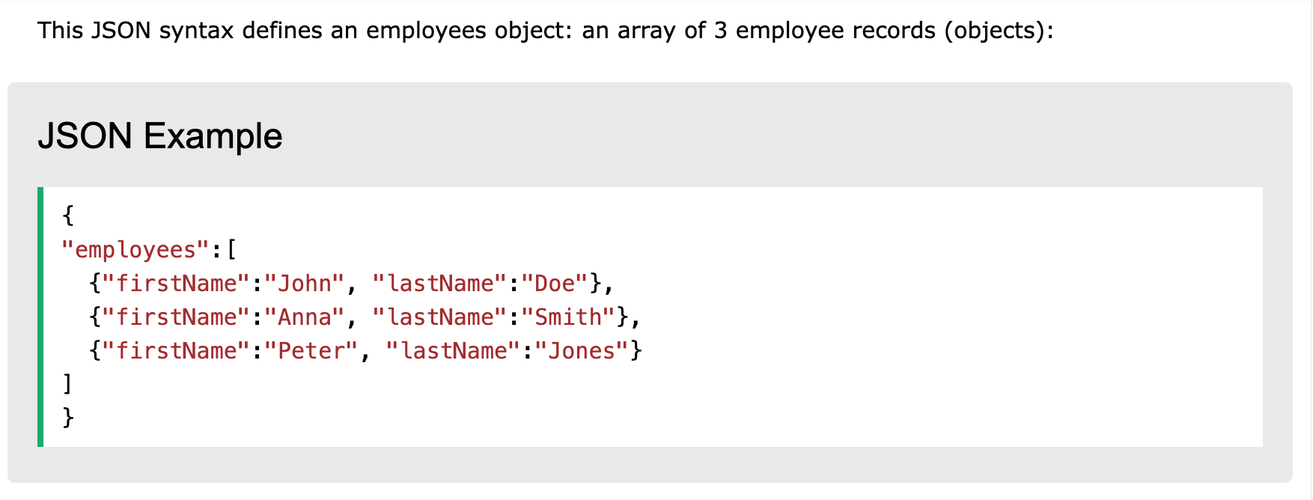
Using XML and JSON for passing data

