Slide 1

GC415 – Forms & Events
Notes in this slides are based on www.w3schools.com explination of HTML forms:
https://www.w3schools.com/html/html_form_elements.asp

Slide 2
Forms

Slide 3
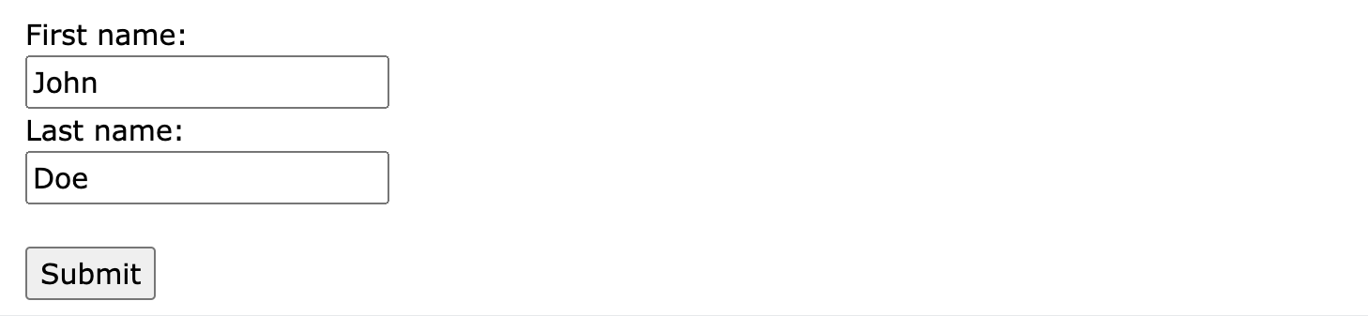
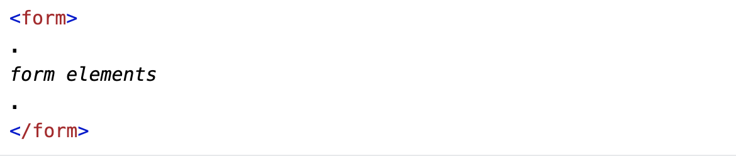
Forms
An HTML form is used to collect user input. The user input is most often sent to a server for processing.
The HTML <form> element is used to create an HTML form for user input:

Slide 4
Forms: attributes
The <form> element, as any other element, has a number of attributes including:
  The action attribute defines the action to be performed when the form is submitted. Normally we provide a .php file
  The target attribute specifies where to display the response that is received after submitting the form.
  The method attribute specifies the HTTP method to be used when submitting the form data.
  The autocomplete attribute specifies whether a form should have autocomplete on or off.
  The novalidate attribute is a boolean attribute. When present, it specifies that the form-data (input) should not be validated when submitted.
Value | Description
_blank | The response is displayed in a new window or tab
_self | The response is displayed in the current window
_parent | The response is displayed in the parent frame
_top | The response is displayed in the full body of the window

Slide 5
Forms: nested elements
The <form> element is a container for different types of input elements, such as: text fields, checkboxes, radio buttons, submit buttons, etc.
The HTML <form> element can contain one or more of the following form elements depending on the design of your form:
  <input>
  <label>
  <select>
  <textarea>
  <button>
  <fieldset>
  <legend>
  <datalist>
  <output>
  <option>
  <optgroup>

Slide 6
The <input> Element
The HTML <input> element is the most used form element.
An <input> element can be displayed in many ways, depending on the type attribute. Here are some examples (click here for full list):
Type | Description | Example
<input type="text"> | Displays a single-line text input field | Here
<input type="password"> | Displays a single-line password field | Here
<input type="radio"> | Displays a radio button (for selecting one of many choices) | Here
<input type="checkbox"> | Displays a checkbox (for selecting zero or more of many choices) | Here
<input type="submit"> | Displays a submit button (for submitting the form) | Here
<input type=”reset"> | Displays a reset button (for resetting the form) | Here
<input type="button"> | Displays a clickable button | Here
<input type="email"> | used for input fields that should contain an e-mail address. | Here

Slide 7
The <input> Element
Notice that each input field must have a name attribute to be submitted.
If the name attribute is omitted, the value of the input field will not be sent at all.

Slide 8
The <label> Element
The <label> tag defines a label for many form elements.
The for attribute of the <label> tag should be equal to the id attribute of the <input> element to bind them together.
See next Example

Slide 9
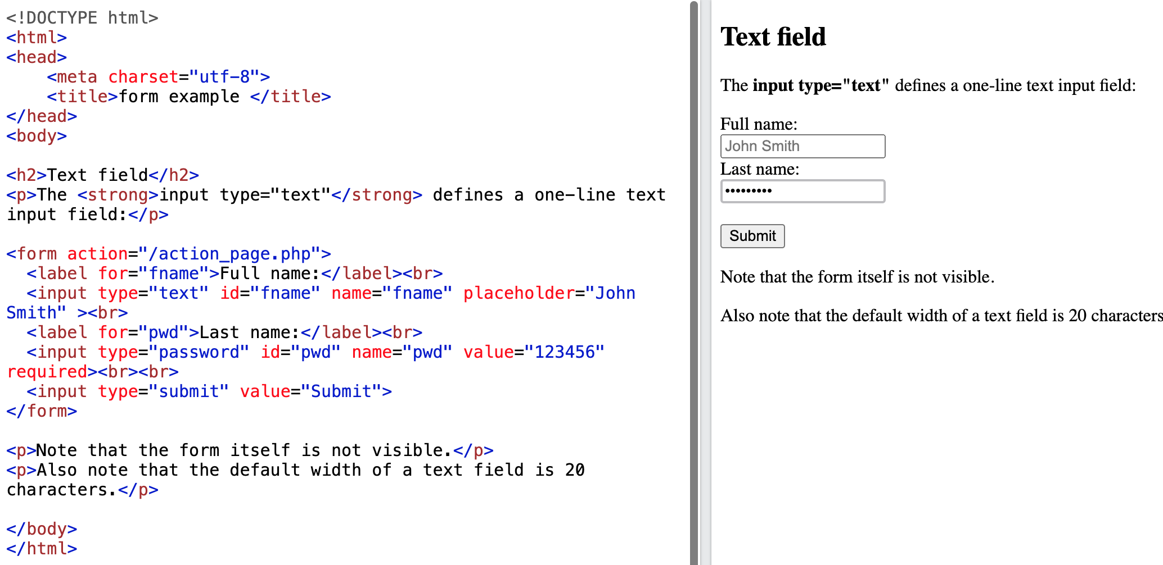


Example 3
Note: The placeholder attribute specifies a short hint that describes the expected value (type of value) of an input field. The value attribute specifies the default value of an input field.

Slide 10
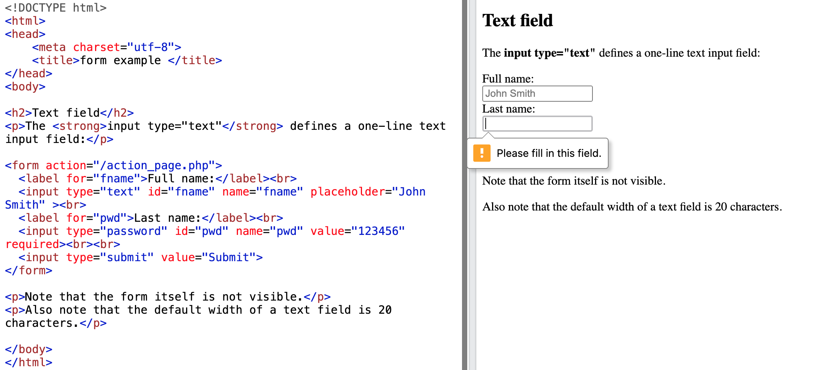
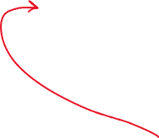
Example 3
Note: The required attribute specifies that field should not be left empty

Slide 11
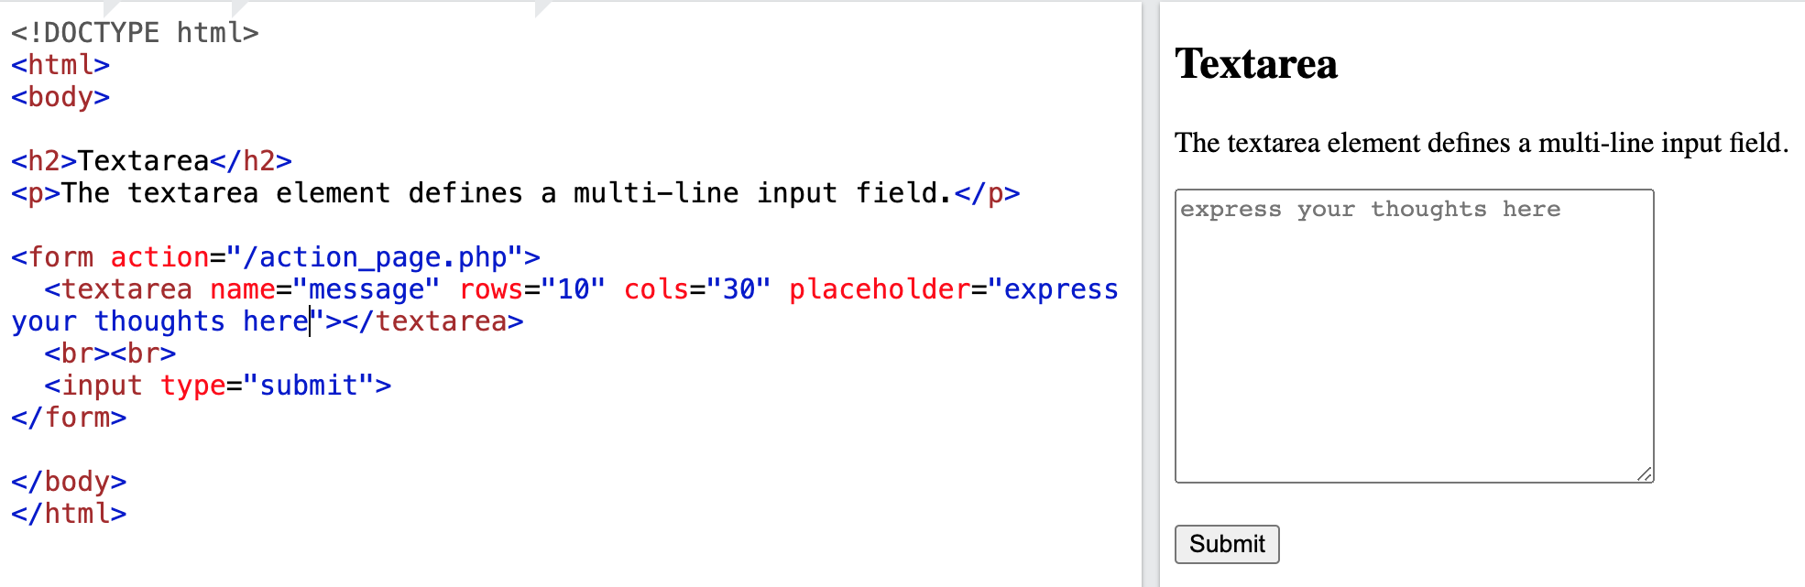

Example 4
Note: The textarea element has other specific attributes such as rows and cols.

Slide 12
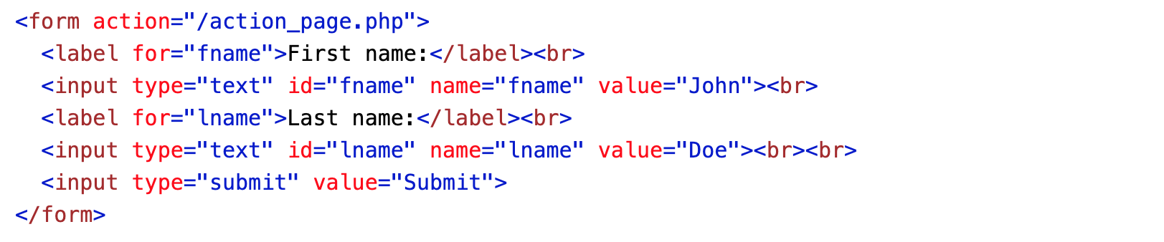

Difference between input element of type “submit” and a button element
The <input type="submit"> defines a button for submitting the form data to a form-handler.
The form-handler is typically a file on the server with a script for processing input data.
The form-handler is specified in the form's action attribute.

Slide 13
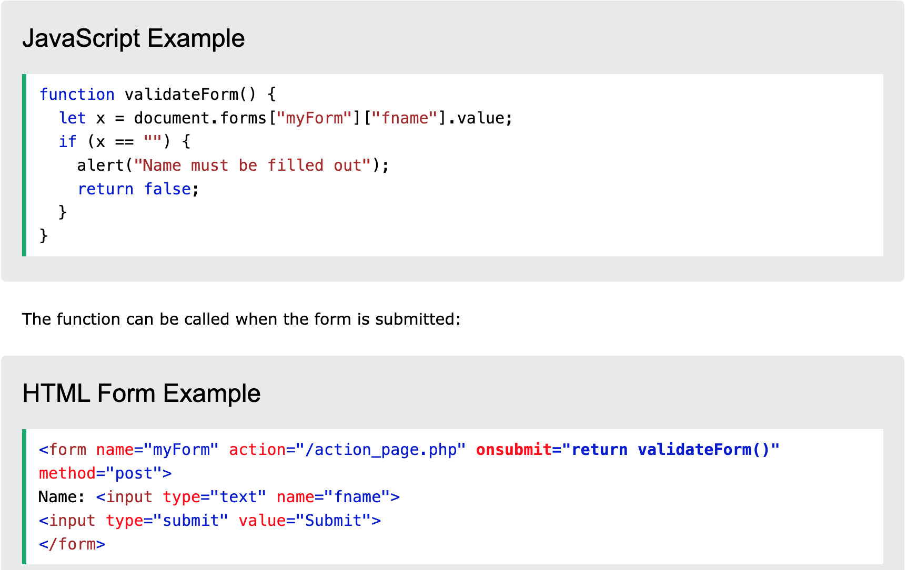
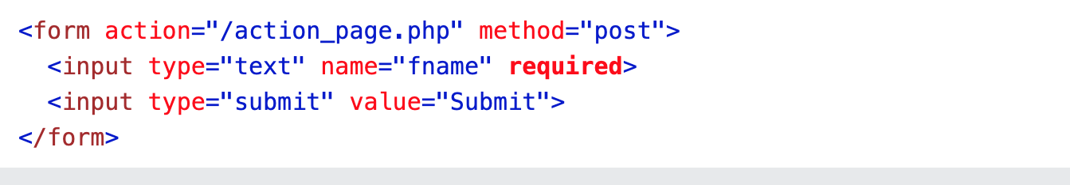
Form validation examples
specify some conditions
Automatic

Slide 14
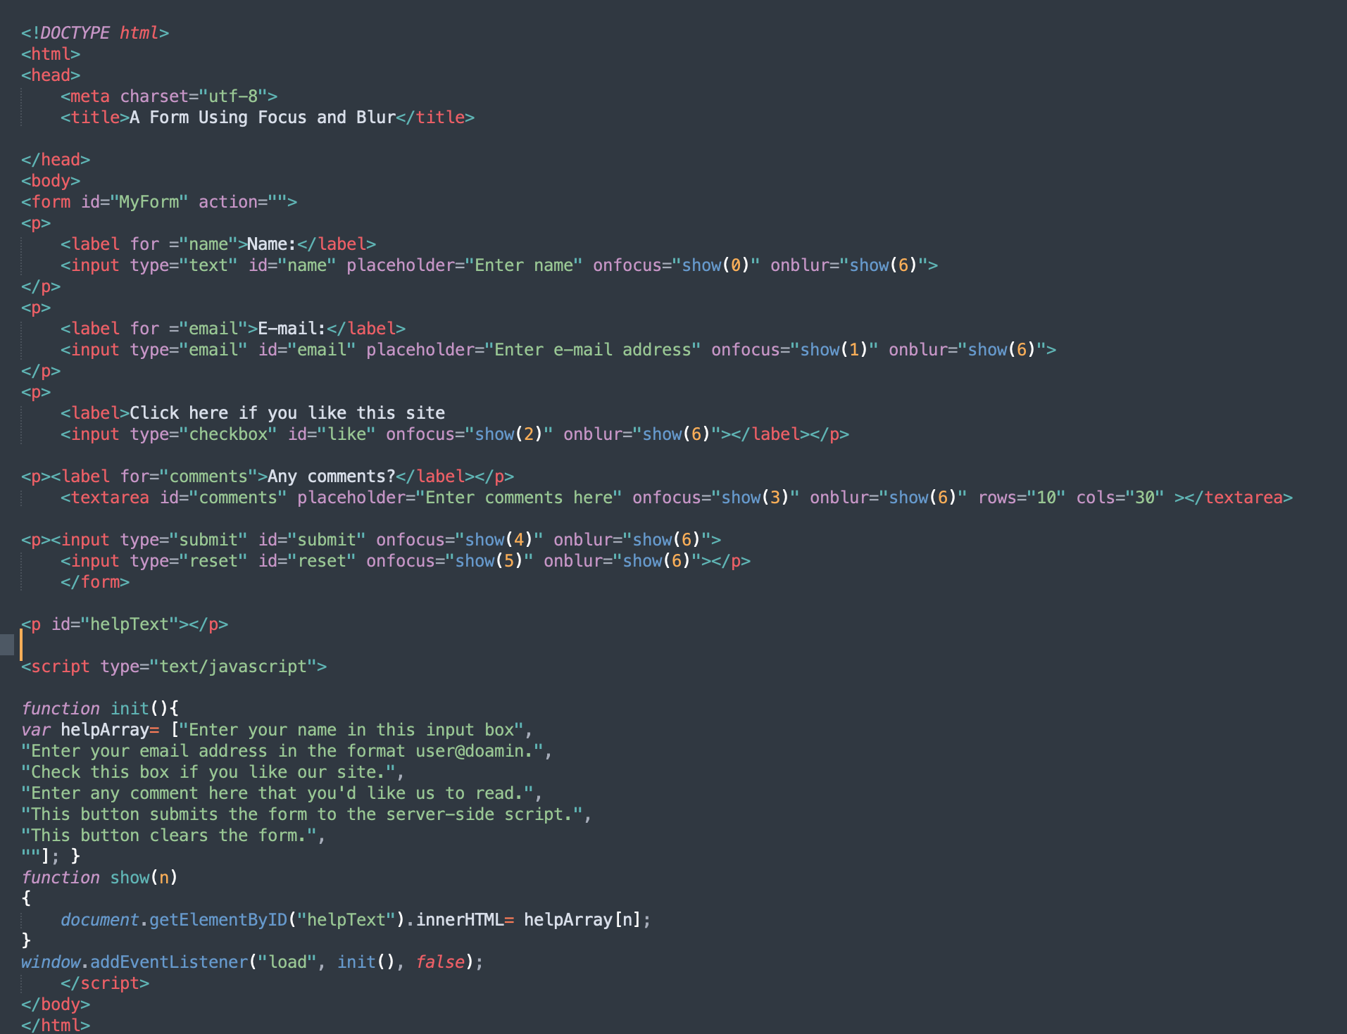
Example 1
Note: The placeholder attribute specifies a short hint that describes the expected value (type of value) of an input field. The value attribute specifies the default value of an input field.

Slide 15
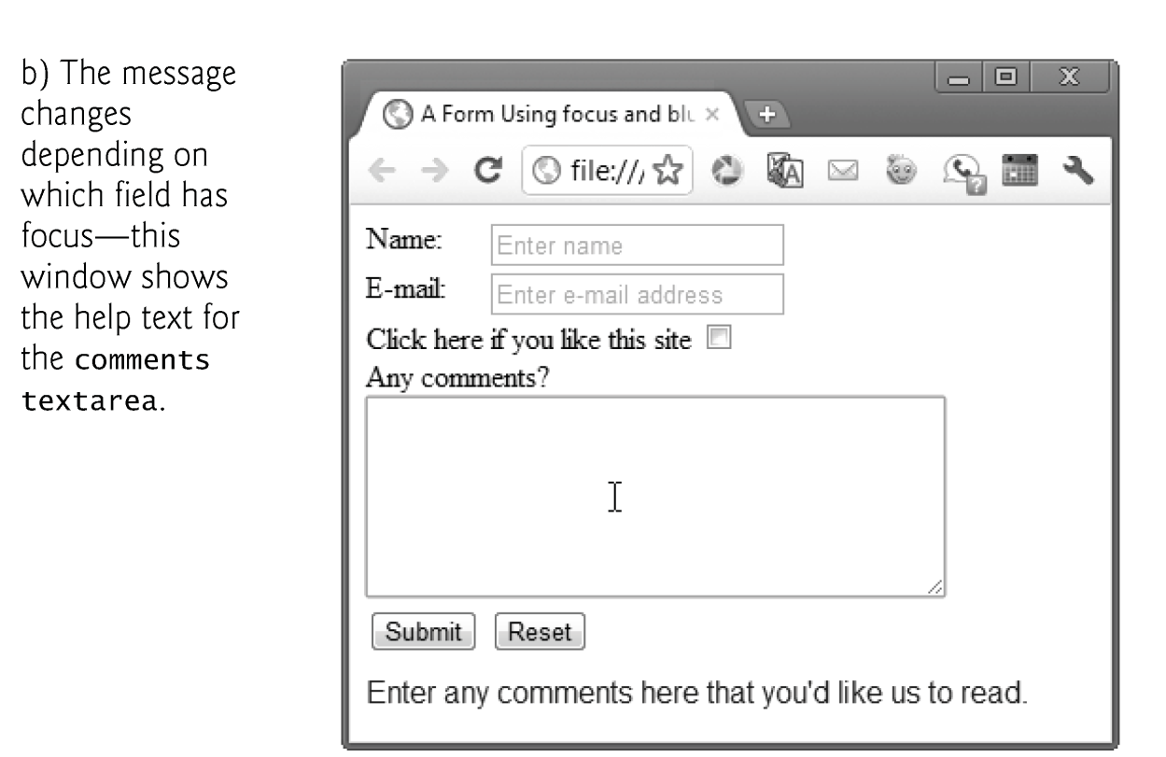

Slide 16
EVENTS

Slide 17
Events
JavaScript's interaction with HTML is handled through events that occur when the user or the browser manipulates a page
Here are some examples of HTML events:
  An HTML web page has finished loading
  An HTML input field was changed
  An HTML button was clicked
Often, when events happen, you may want to do something. Thus, events are normally used in combination with functions (see next slides), and the function will not be executed before the event occurs (such as when a user clicks a button). Such function are often called event handlers
Assigning an event handler to an event on a DOM node (a.k.a event target) is called registering an event handler.

Slide 18
Events (Cont.)
The following slide lists some common events and their descriptions.
The actual DOM event names begin with "on” (e.g. “onload”, “onclick”,etc), but depending on the way you register an event handler you might use them as they are or without the “on” (see slide 7) i.e.:
  inline registering uses the version with “on” : onload, onclick, etc.
  registering with the method addEventListener uses the version without the “on”: load, click, etc.

Slide 19
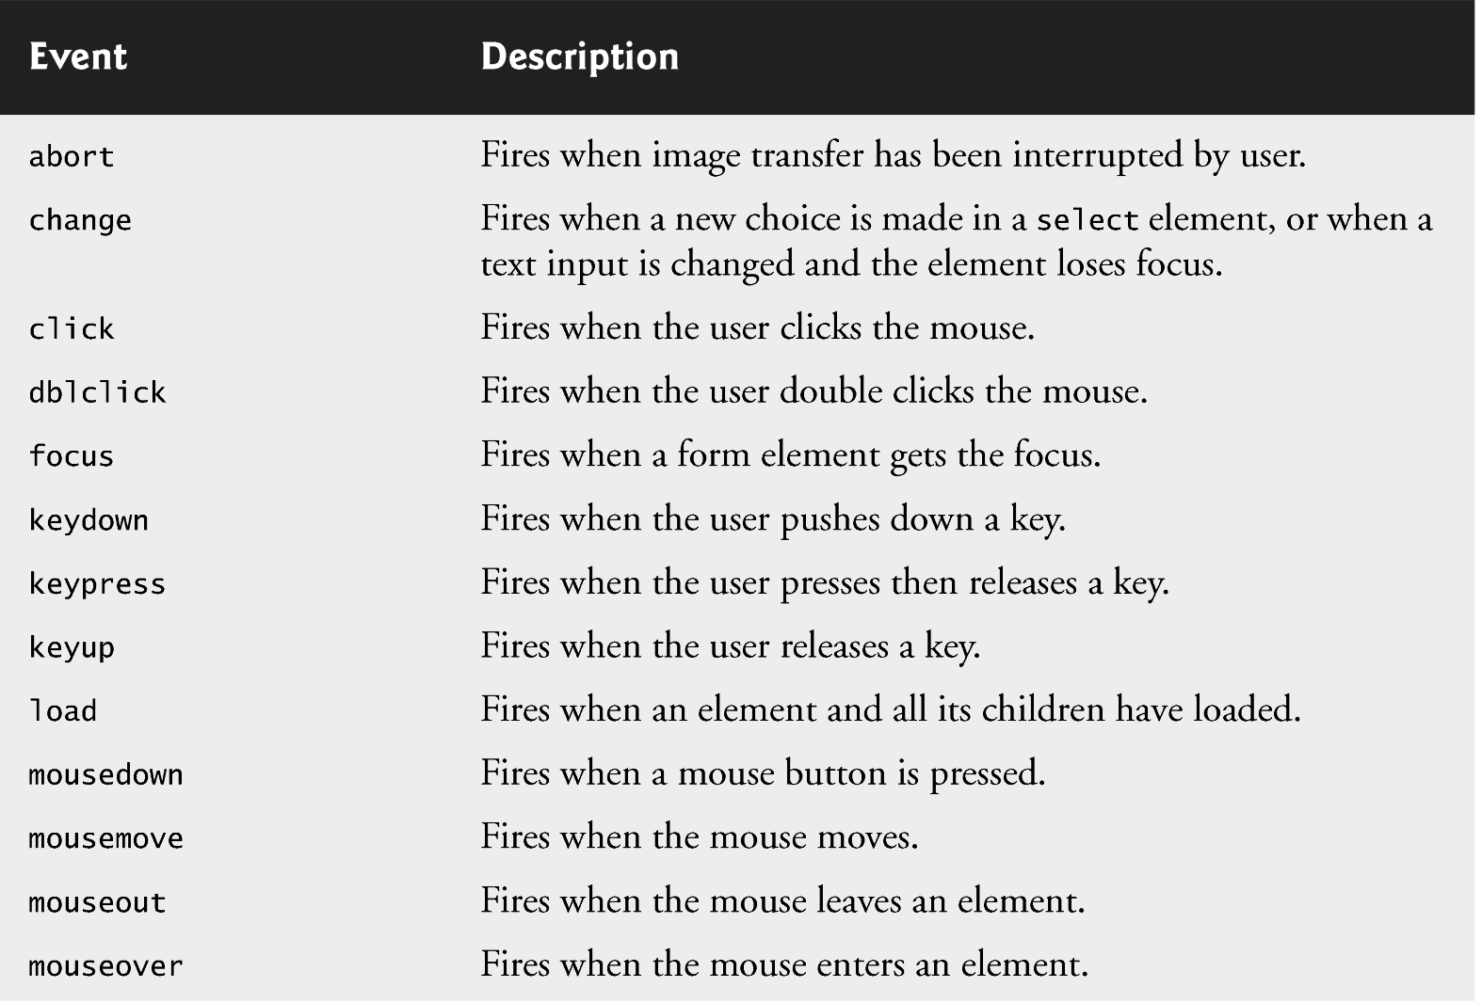
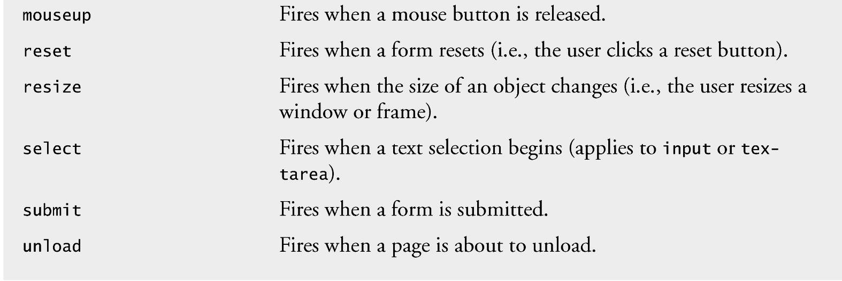

Slide 20
Events’ Targets
Events targets are most commonly DOM nodes, e.g. document, window, button, etc.

Slide 21
Assigning an event handler
To add an event on a DOM node, we assign it an event handler.
Two models for registering event handlers
  1 Inline model that treats events as attributes of HTML elements and their values are the event handler.
  e.g.
  <body onload = “. . .” >
  <button onclick= “. . .” id=“ok_button”>
  2 Part of the script model using the addEventListener method where events and event handlers are passed as parameters
  e.g.
  document.addEventListener(“load”, ...);
  document.getElementById(“ok_button”).addEventListener(“click”, ...);
target DOM node
event
event handler

Slide 22

Event handler
A handler can be some JavaScript code (See Example 1):
  e.g.
  <button onclick= ‘window.alert(“Hello World”)’ id=“ok_button”>
Or, a function (see Example 2):
  e.g.
  <button onclick= “sayHello()” id=“ok_button”>
  ….
  <script ..>
  function sayHello() {
  window.alert("Hello World");
  }
  </script>
target DOM node
event
event handler script

Slide 23
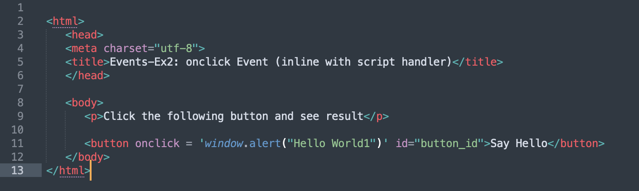
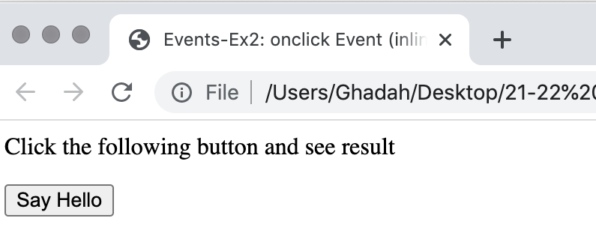
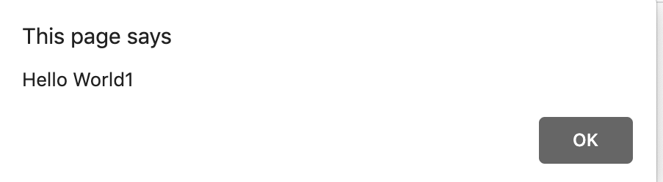

Example 1

Slide 24
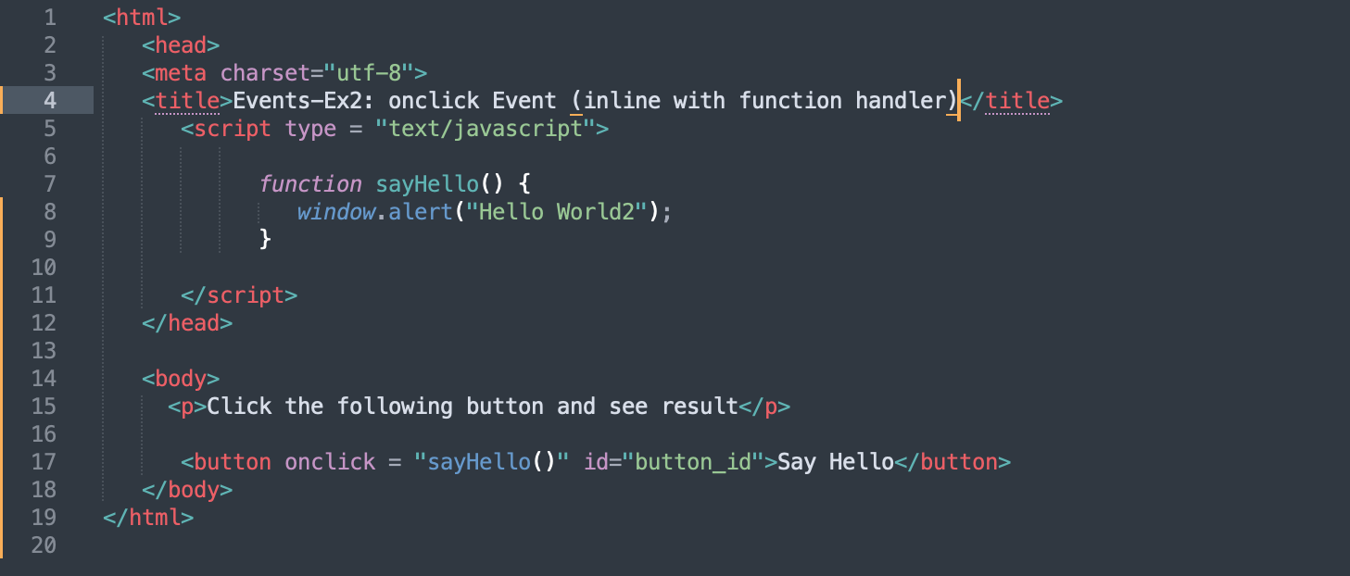
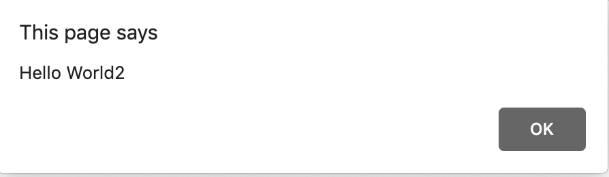

Example 2

Slide 25
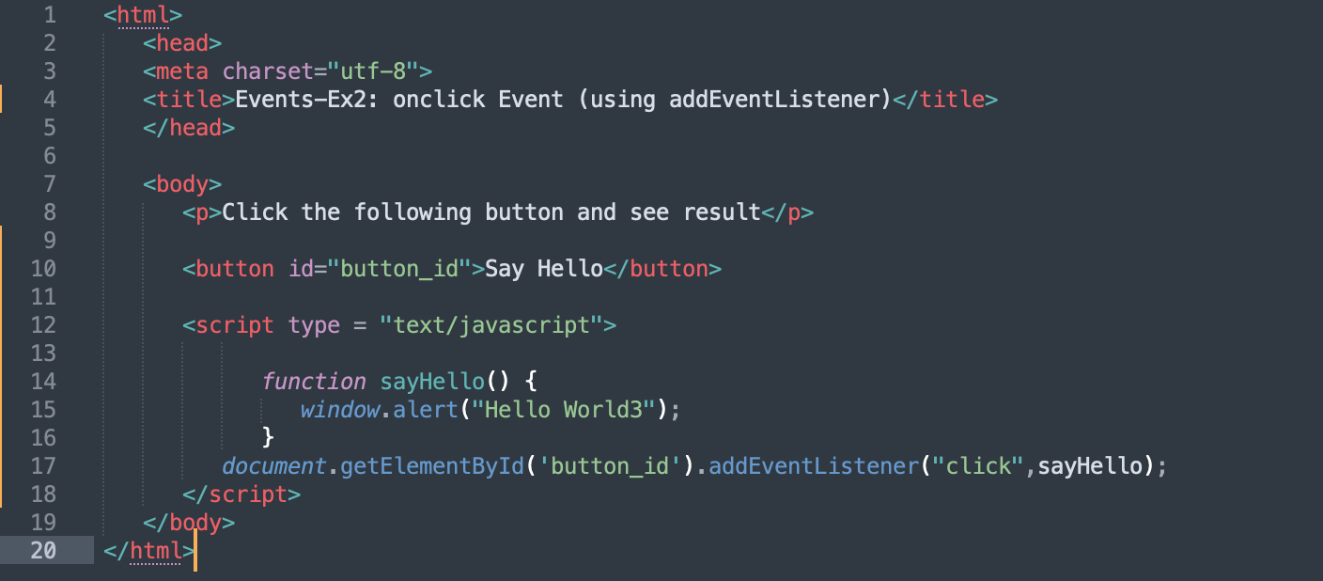
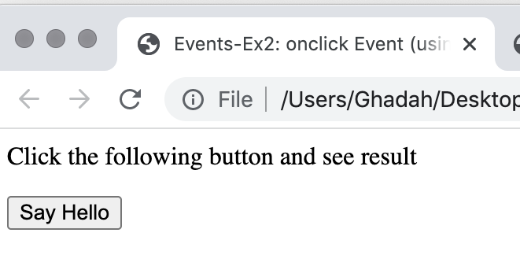
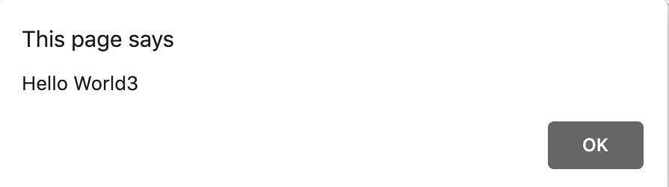
Example 3
Note :It’s possible to remove an event listener by calling removeEventListener with the same arguments that you passed to addEventListener to register the event handler.

Slide 26
JavaScript Functions*
A JavaScript function is a block of code designed to perform a particular task.
A JavaScript function is executed when "something" invokes it (calls it).
Example:
function myFunction(p1, p2) {
return p1 * p2; // The function returns the product of p1 and p2
}

Slide 27
JavaScript Functions Syntax*
A JavaScript function is defined with the function keyword, followed by a name, followed by parentheses ( ).
Function names follow the same naming rules as variables.
The parentheses may include parameter names separated by commas:
e.g. (parameter1, parameter2, ...)
The code to be executed, by the function, is placed inside curly brackets: { }
function name(parameter1, parameter2, parameter3) {
// code to be executed
}

Slide 28
JavaScript Functions Parameters vs Arguments*
Function parameters are listed inside the parentheses () in the function definition.
Function arguments are the values received by the function when it is invoked.
Inside the function, the arguments (the parameters) behave as local variables.

Slide 29
JavaScript Functions Call and Return*
The code inside the function will execute when "something" (calls) the function:
  When an event occurs (when a user clicks a button)
  When it is invoked (called) from JavaScript code
  Automatically (self invoked)
When JavaScript reaches a return statement, the function will stop executing.
If the function was called by a statement, JavaScript will "return" to execute the code after the invoking statement.
Functions often compute a return value. The return value is "returned" back to the "caller"

Slide 30
Reviewing the load Event
The window object’s load event fires when the window finishes loading successfully (i.e. all its children are loaded and all external files referenced by the page are loaded)
Every DOM element has a load event, but it’s most commonly used on the window object.
The next example, Example 4, reviews the load event.
The load event’s handler creates an interval timer that updates a span with the number of seconds that have elapsed since the document was loaded. The document’s paragraph contains the span.

Slide 31
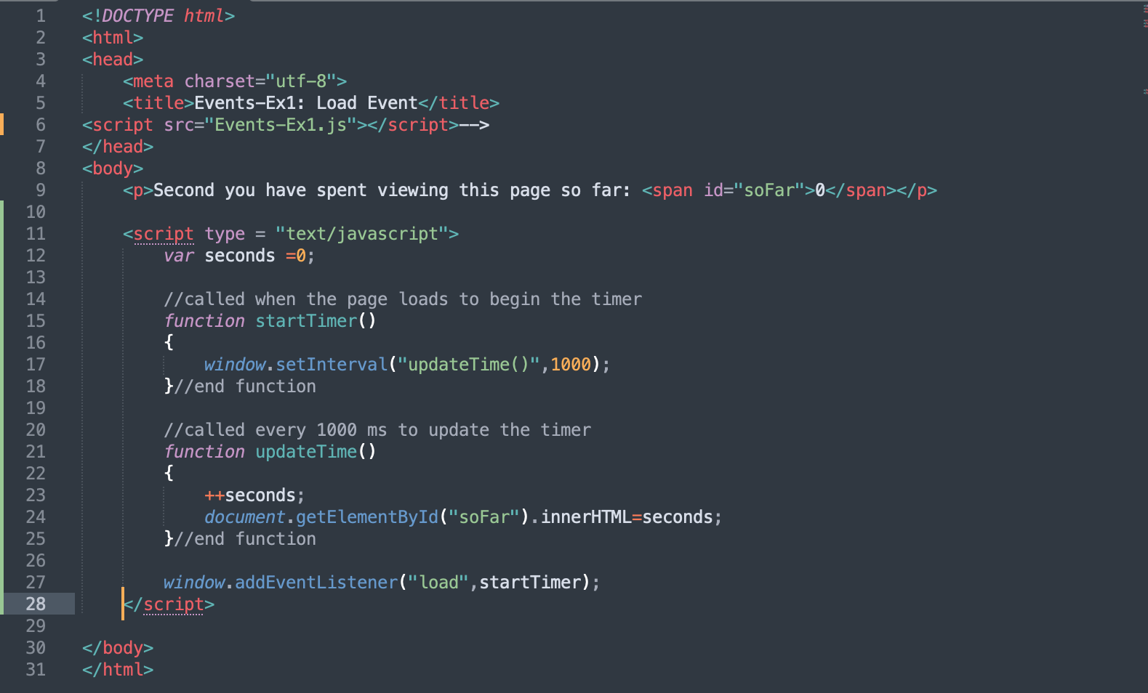
Example 4

Slide 32
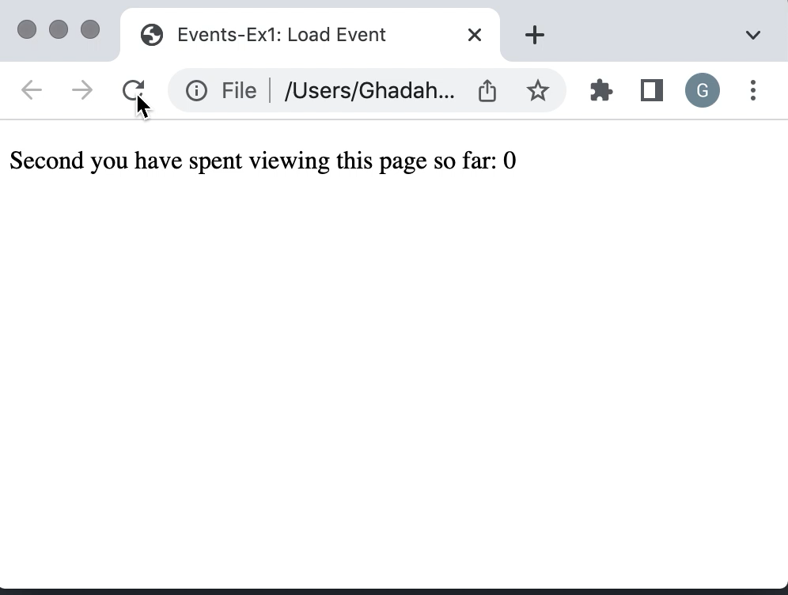
Example 4

Slide 33
Rollovers with mouseover and mouseout events
When the mouse cursor enters an element, an mouseover event occurs for that element
When the mouse cursor leaves the element, a mouseout event occurs for that element
Creating an Image object and setting its src property preloads the image

Slide 34
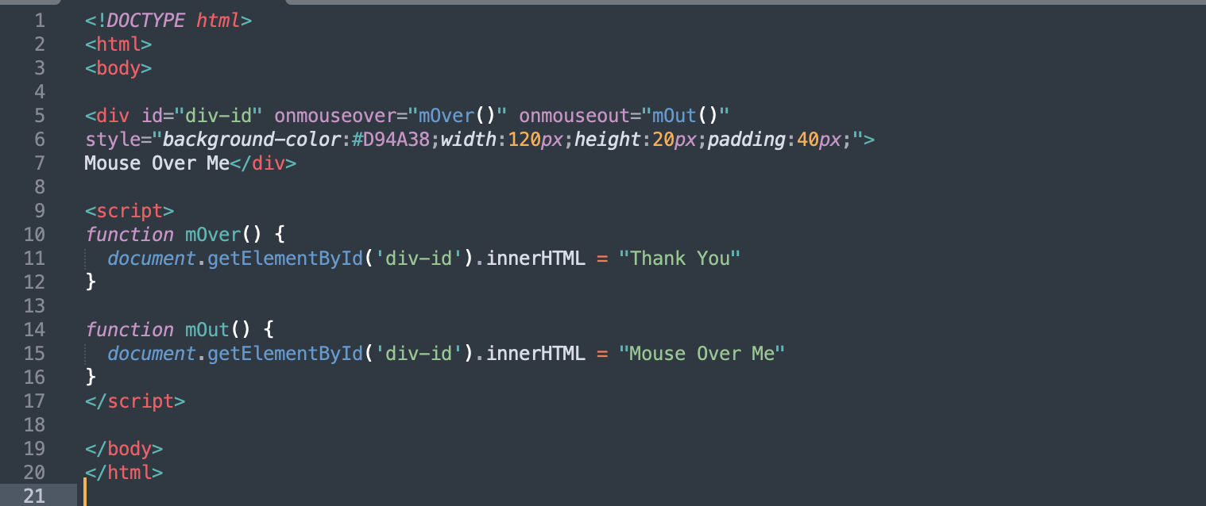
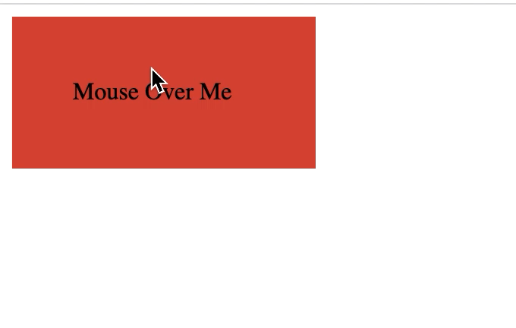
Example 5
Example’s link

Slide 35
Form Processing with focus and blur
focus event fires when an element gains focus
  i.e., when the user clicks a form field or uses the Tab key to move between form elements
blur fires when an element loses focus
  i.e., when another control gains the focus
See Example 6

Slide 36
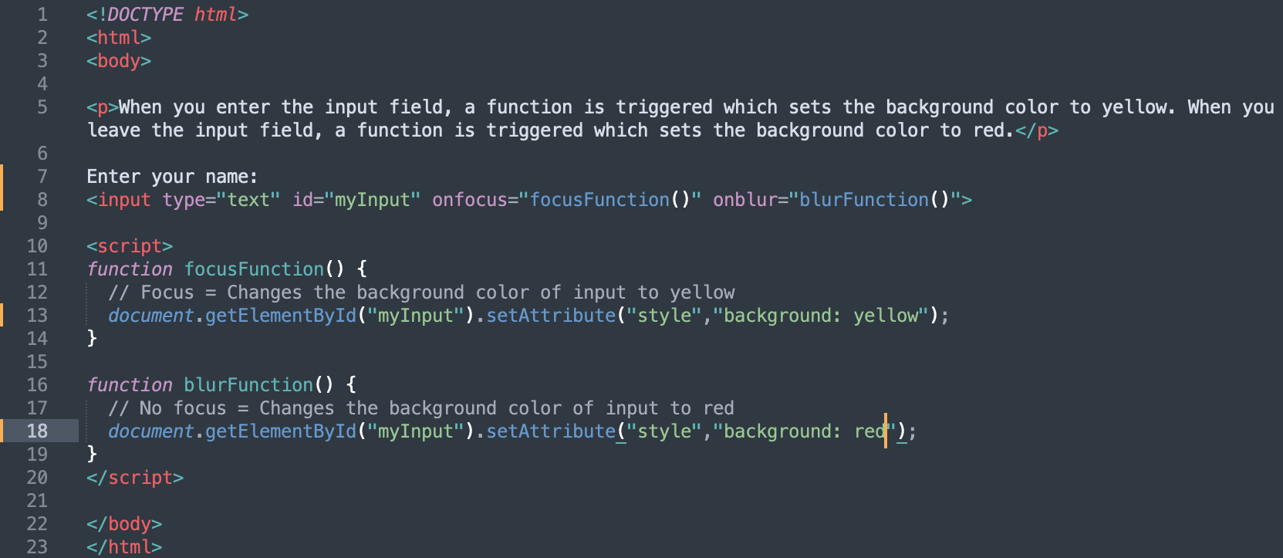
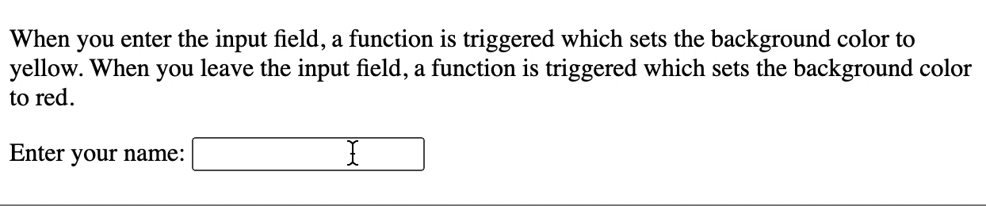
Example 6
Example’s link

