Slide 1

GC415 – Javascript: Document Object Model (DOM): Objects and Collections
Internet & World Wide Web
How to Program, 5/e

Slide 2
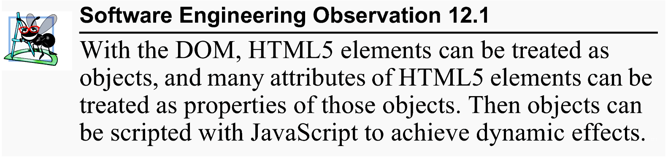
Introduction
The Document Object Model (DOM) gives you scripting access to all the elements on a web page. Thus, using JavaScript, you can create, modify and remove elements in the page dynamically.

Slide 3
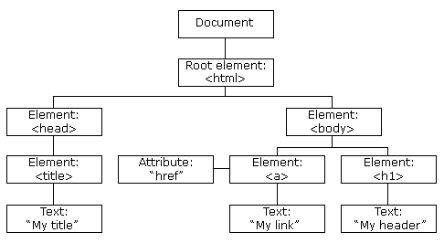
Introduction (Cont.)
When a web page is loaded, the browser creates its DOM.
The HTML DOM model is constructed as a tree of Objects.

Slide 4
Introduction (Cont.)
Every piece of an HTML5 page (elements, attributes, text, etc.) is modeled in the web browser by a DOM node
The nodes in a document make up the page’s DOM tree, which describes the relationships among elements
Nodes are related to each other through child-parent relationships
A node can have multiple children, but only one parent
Nodes with the same parent node are referred to as siblings
The html node in a DOM tree is called the root node, because it has no parent

Slide 5
Traversing and Modifying a DOM Tree
*getElementById method:
the Document method getElementById() returns an Element object representing the element whose id property matches the specified string.
Since element IDs are required to be unique if specified, they're a useful way to get access to a specific element quickly.
For instance, one can use the innerHTML property with getElementById() to set (as in Example 1) or return the HTML content (inner HTML) of an element.

Slide 6
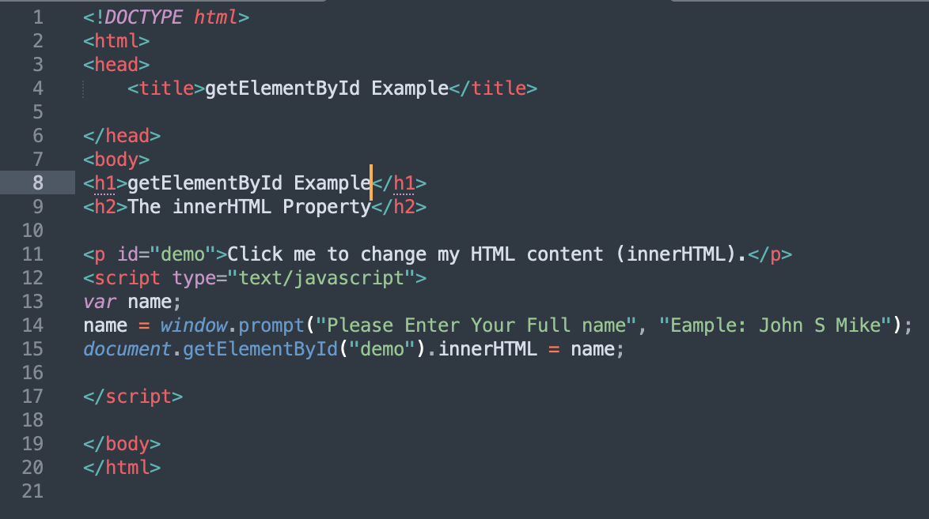
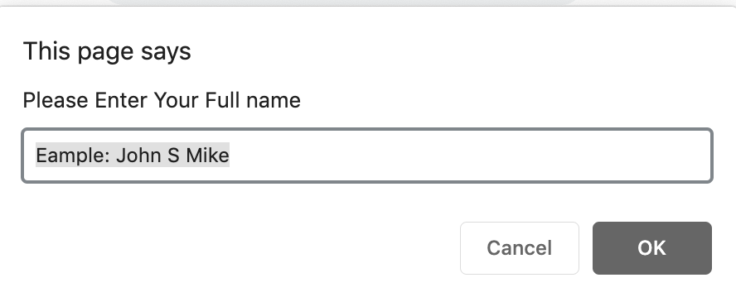
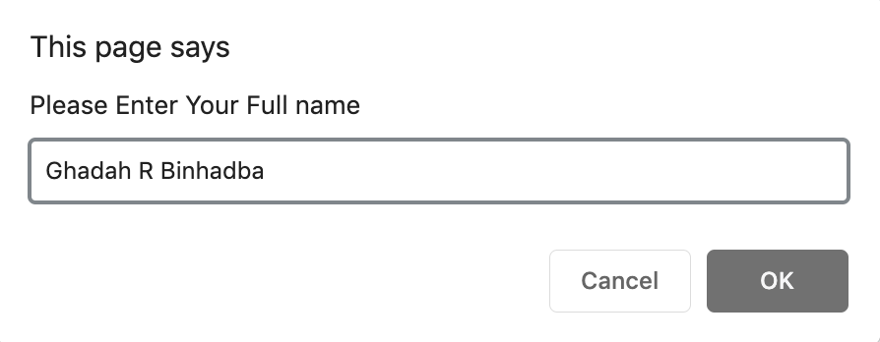
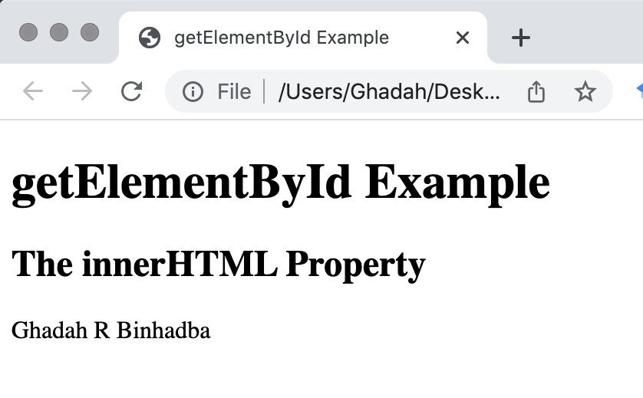
Example 1
Note:
setting the HTML content of an element using innerHTML requires your script to be in the body of an HTML not the head (why?)

Slide 7
Traversing and Modifying a DOM Tree (Cont.)
Moreover, the DOM element methods setAttribute and getAttribute allow you to modify an attribute value and get an attribute value, respectively.
*setAttribute(attributeName,Value) sets the value of an attribute on the specified element. If the attribute already exists, the value is updated; otherwise a new attribute is added with the specified name and value.
*getAttribute(attributeName) returns the value of a specified attribute on the element. If the given attribute does not exist, the value returned will either be null or ”” (empty string)

Slide 8
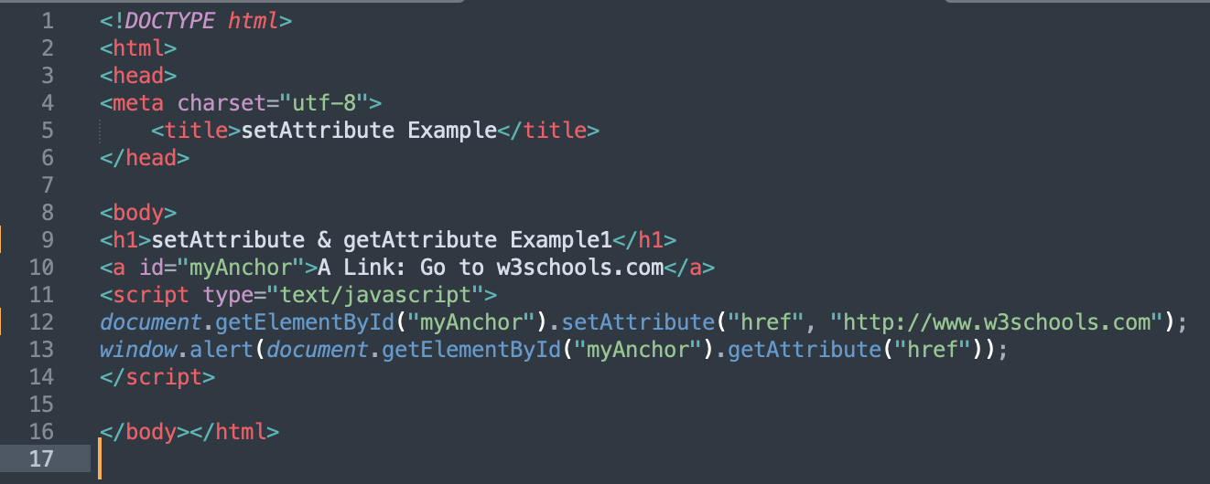
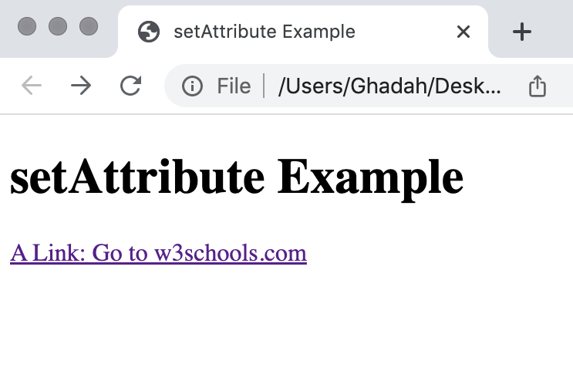

Example 2

Slide 9
Traversing and Modifying a DOM Tree (Cont.)
document object createElement(tagName) method
  Creates a new DOM node, taking the tag name as an argument.
  It does not insert the element on the page.
document object createTextNode(stringArg) method
  Creates a DOM node that contains only text.
  Given a string argument, createTextNode inserts the string into the text node.
Method appendChild(node)
  Inserts a child node (passed as an argument) after any existing children of the node on which it’s called
Property parentNode contains the node’s parent
insertBefore method
  Inserts a node as a child, right before an existing child, which you specify.
  node.insertBefore(newnode,existingnode)
replaceChild method
  Receives as its first argument the new node to insert and as its second argument the node to replace. node.replaceChild(newnode,oldnode)
removeChild method
  removes a specified child node of the specified element. Returns the removed node as a Node object, or null if the node does not exist. node.removeChild(child)

Slide 10
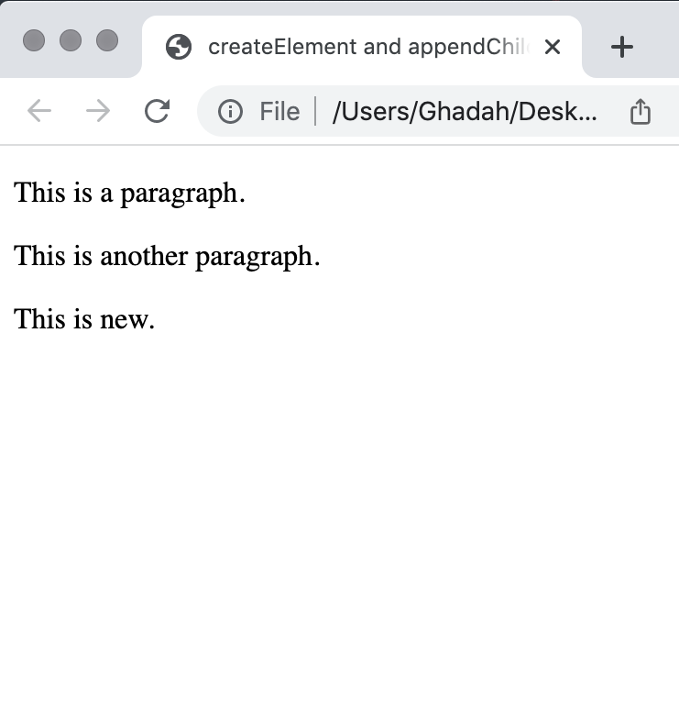
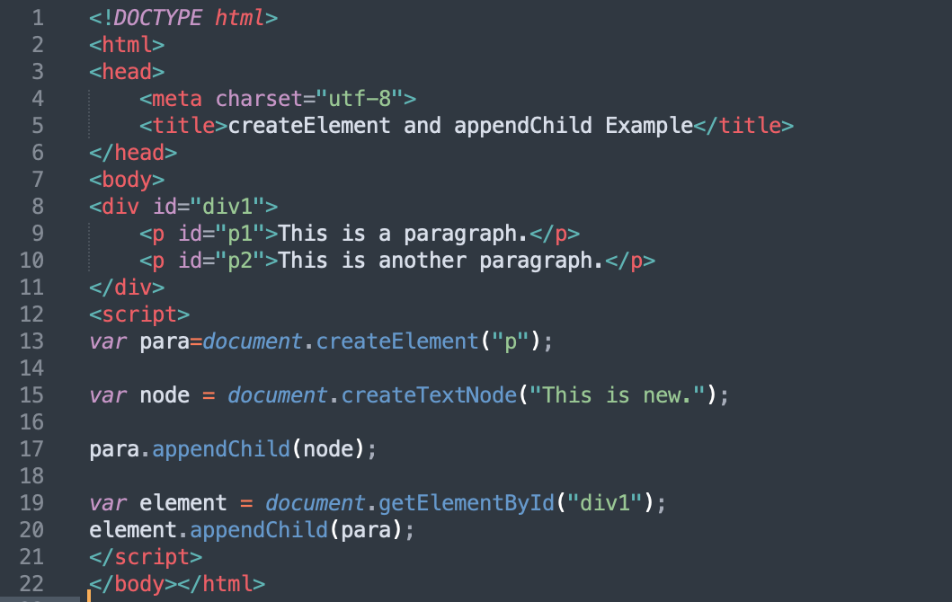
Example 3

Slide 11
DOM Collections
DOM collections are groups of related objects on a page
The document object has properties containing the images collection, links collection, forms collection and anchors collection
  Contain all the elements of the corresponding type on the page
The collection’s length property specifies the number of items in the collection

Slide 12
DOM Collections (Cont.)
Collections allow easy access to all elements of a single type in a page
  Useful for gathering elements into one place and for applying changes across an entire page
You access the elements of the collection using indices in square brackets
item method of a DOM collection
  An alternative to the square bracketed indices
  Receives an integer argument and returns the corresponding item in the collection.
namedItem method
  receives an element id as an argument and finds the element with that id in the collection.
href property of a DOM link node
  Refers to the link’s href attribute

Slide 13
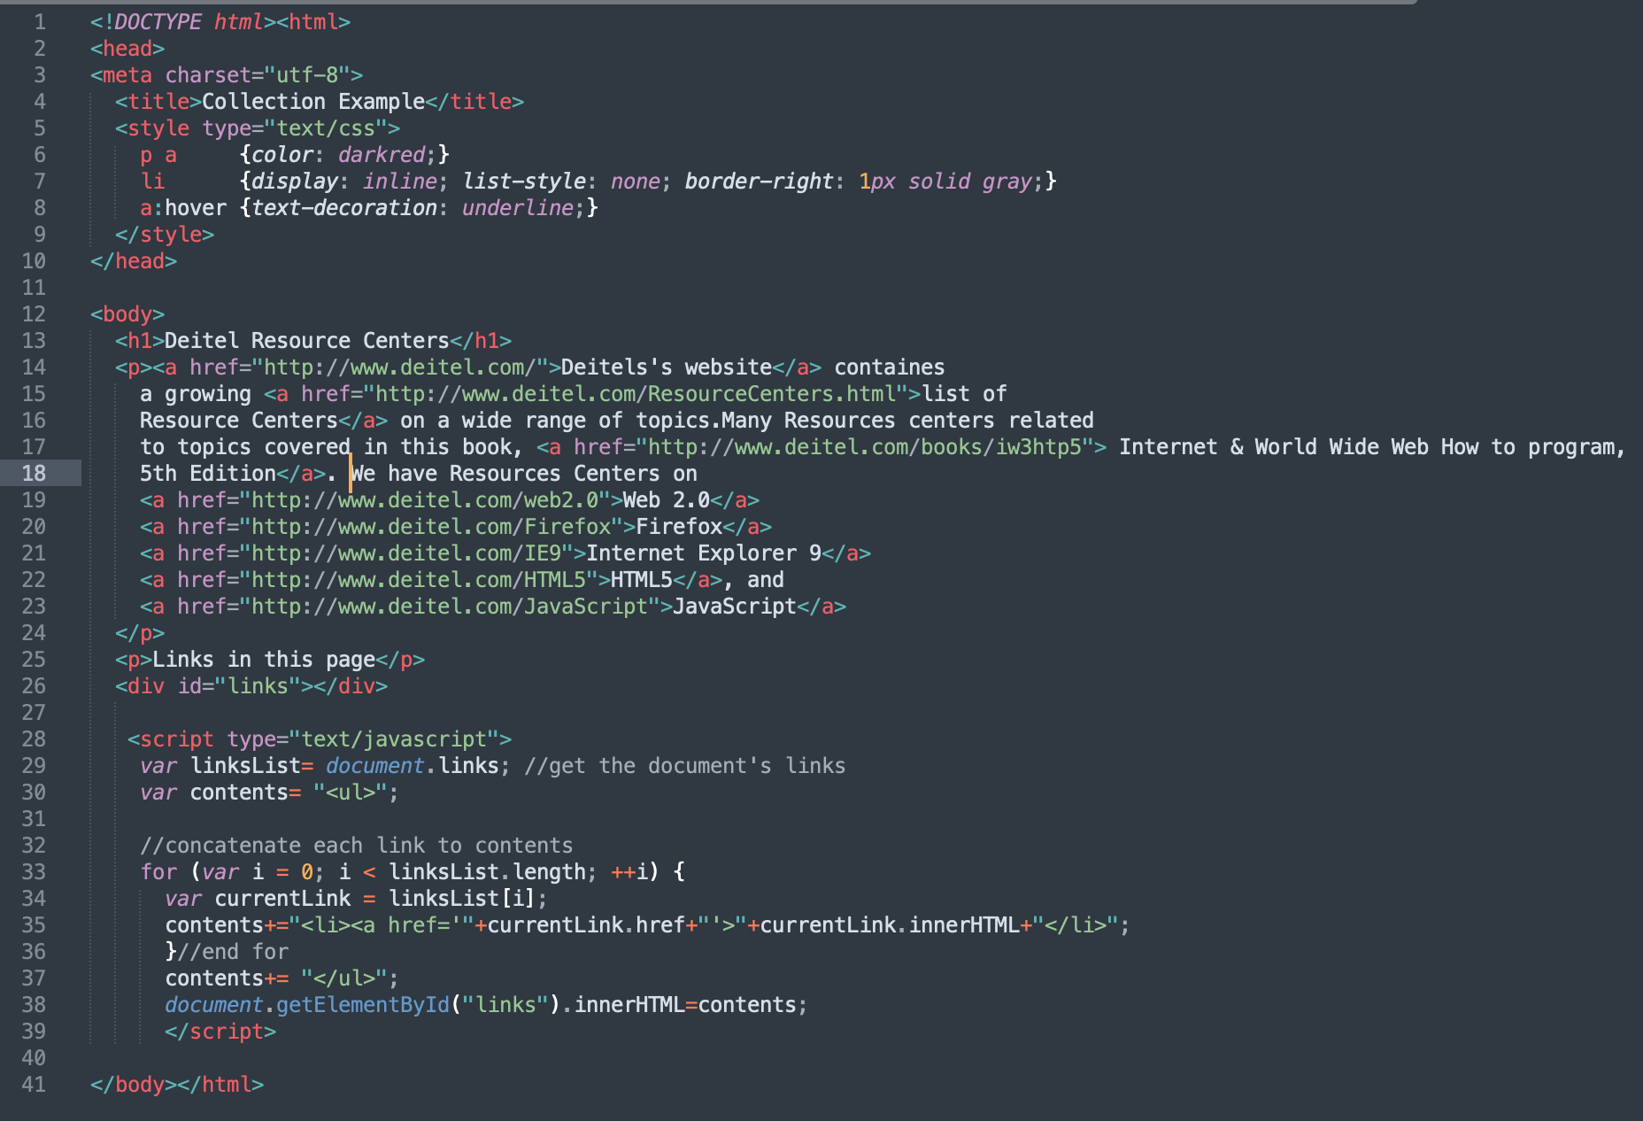
Example 4

Slide 14
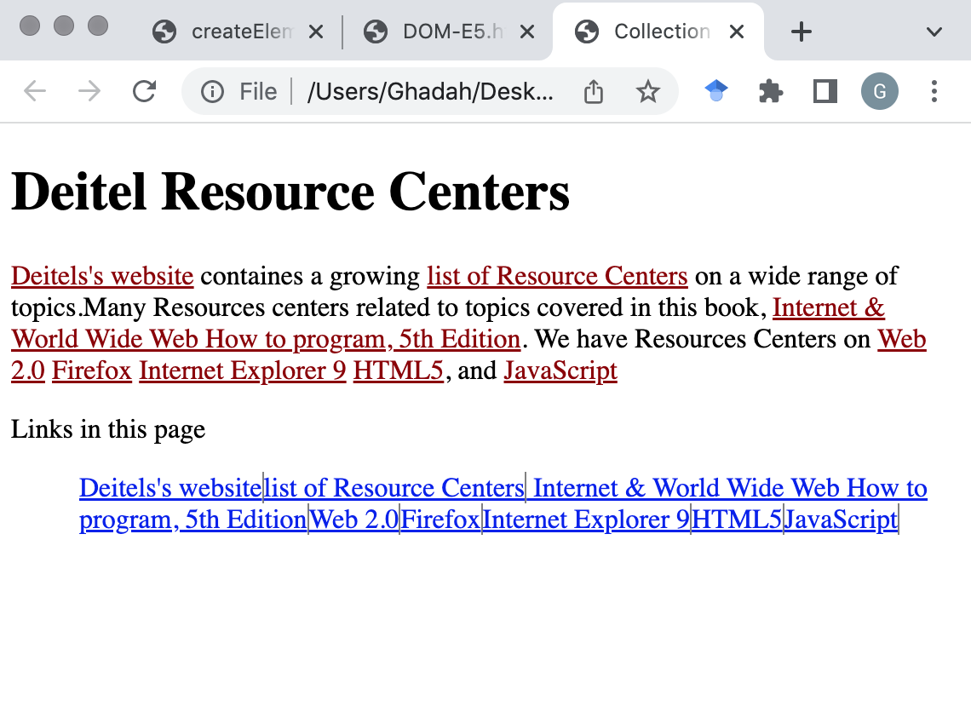
Example 4

Slide 15
Dynamic Styles
An element’s style can be changed dynamically
  E.g., in response to user events
  Can create mouse-hover effects, interactive menus and animations
Or, by using the setAttribute method set the style attribute for an element.
Example 5 sets style of the paragraph element to fixed size and a user-specified color.
If you have predefined CSS style classes defined for your document, you can also use the setAttribute method to set the class attribute (see Example 6).

Slide 16
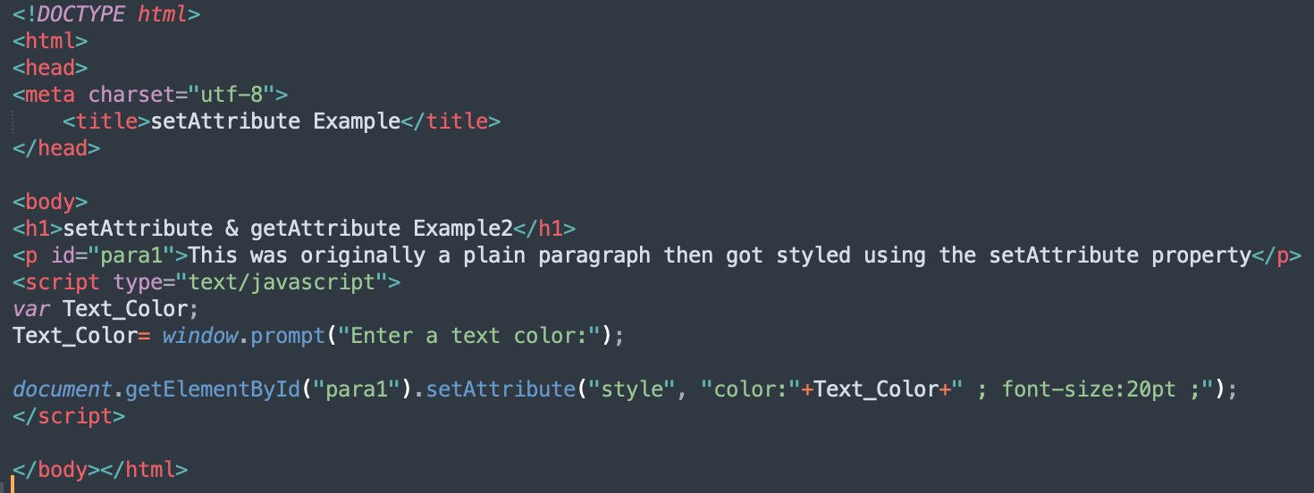
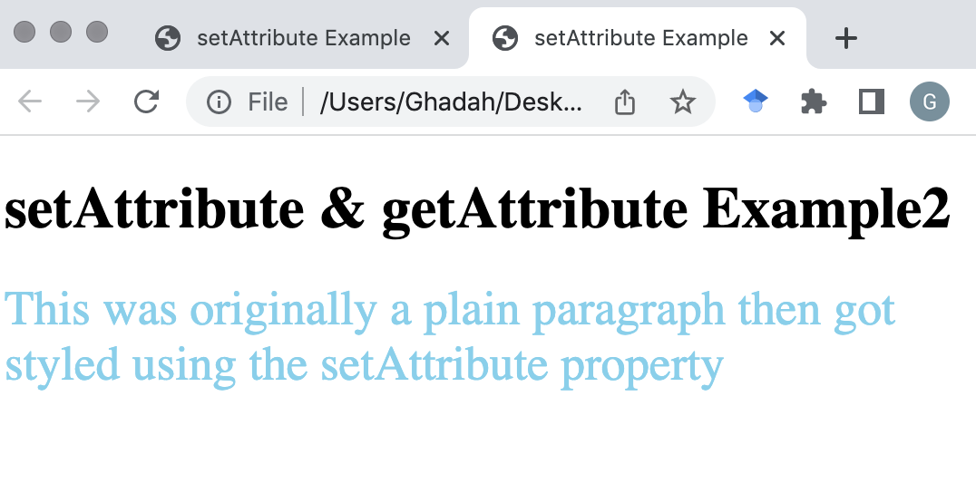
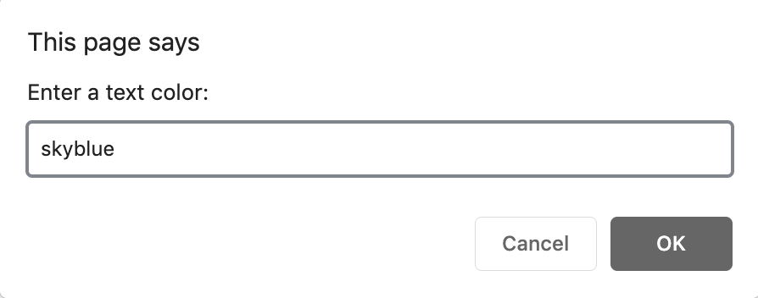
Example 5

Slide 17
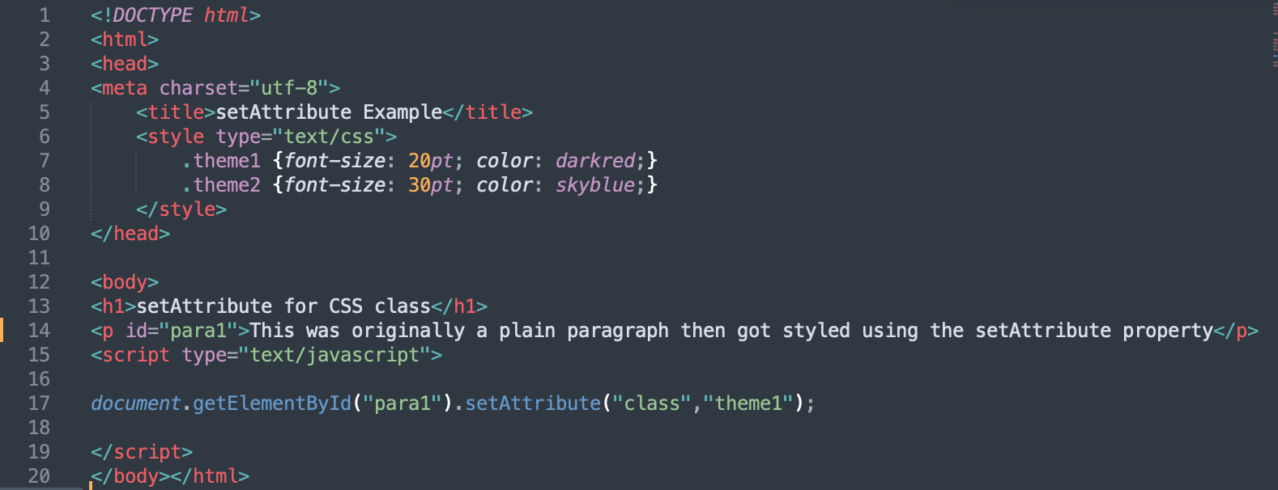
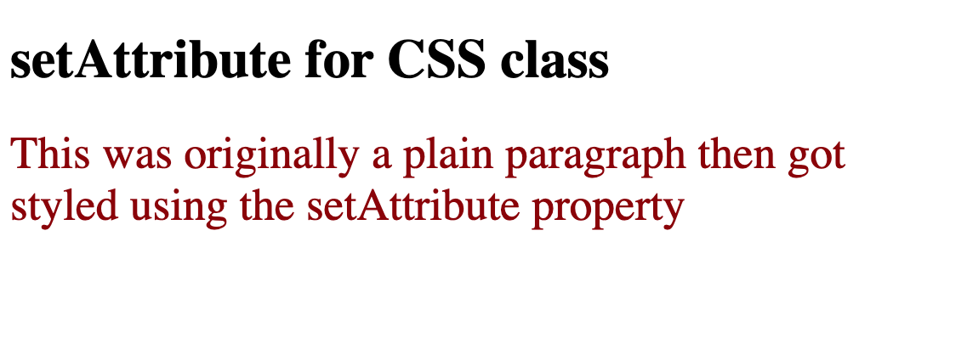
Example 6

Slide 18
More objects

Slide 19
Math object
Math object methods enable you to conveniently perform many common mathematical calculations.
An object’s methods are called by writing the name of the object followed by a dot operator (.) and the name of the method
In parentheses following the method name is are arguments to the method

Slide 20
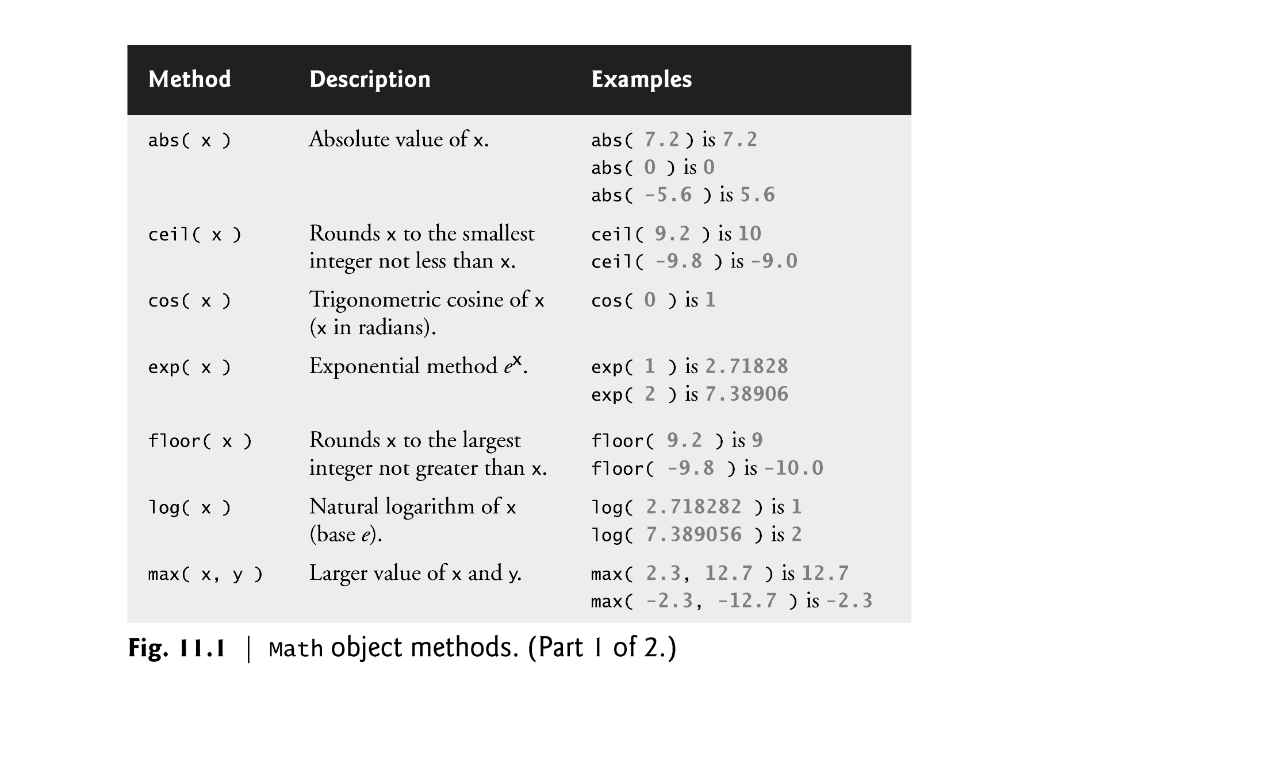

Slide 21
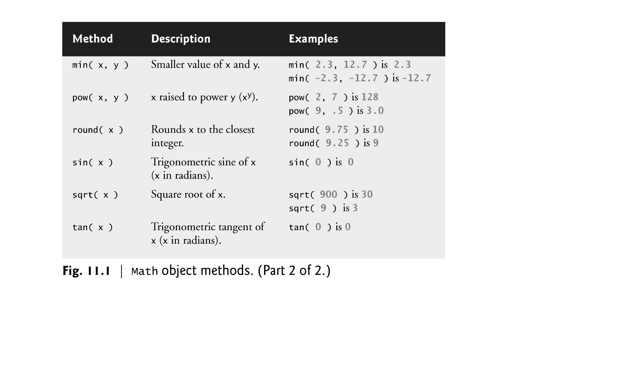

Slide 22
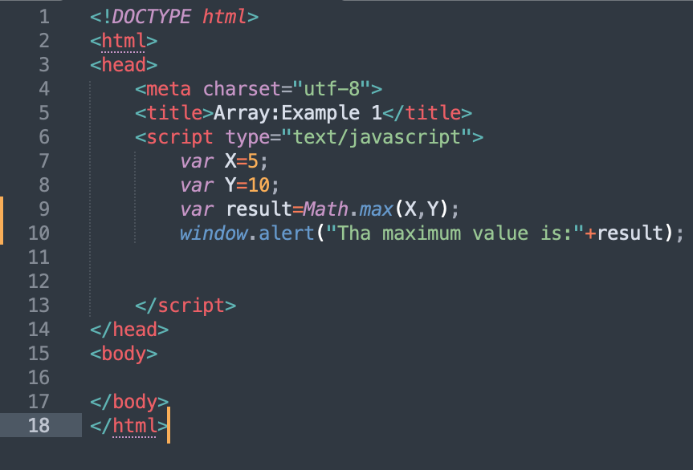
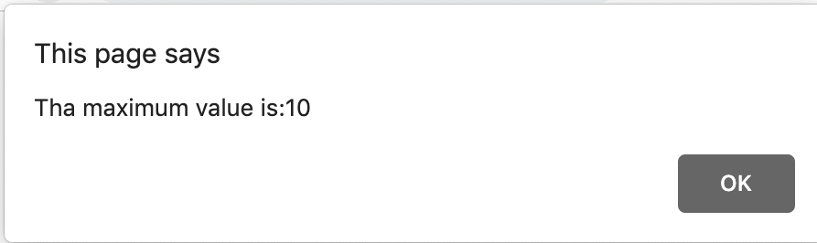
Example 7

Slide 23
String object
Characters are the building blocks of JavaScript programs
Every program is composed of a sequence of characters grouped together meaningfully that is interpreted by the computer as a series of instructions used to accomplish a task
A string is a series of characters treated as a single unit
A string may include letters, digits and various special characters, such as +, -, *, /, and $
JavaScript supports Unicode, which represents a large portion of the world’s languages
String literals or string constants are written as a sequence of characters in double or single quotation marks

Slide 24
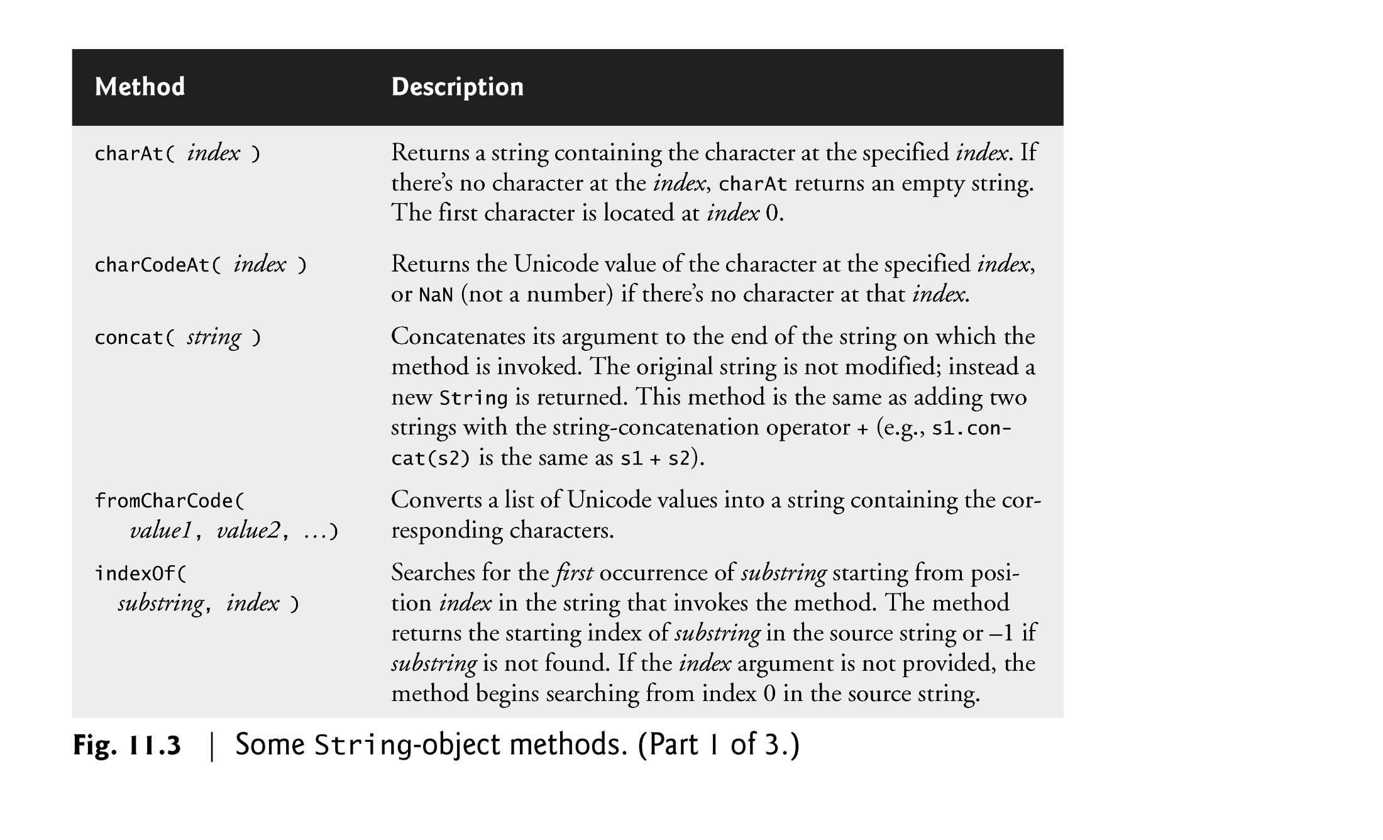

Slide 25
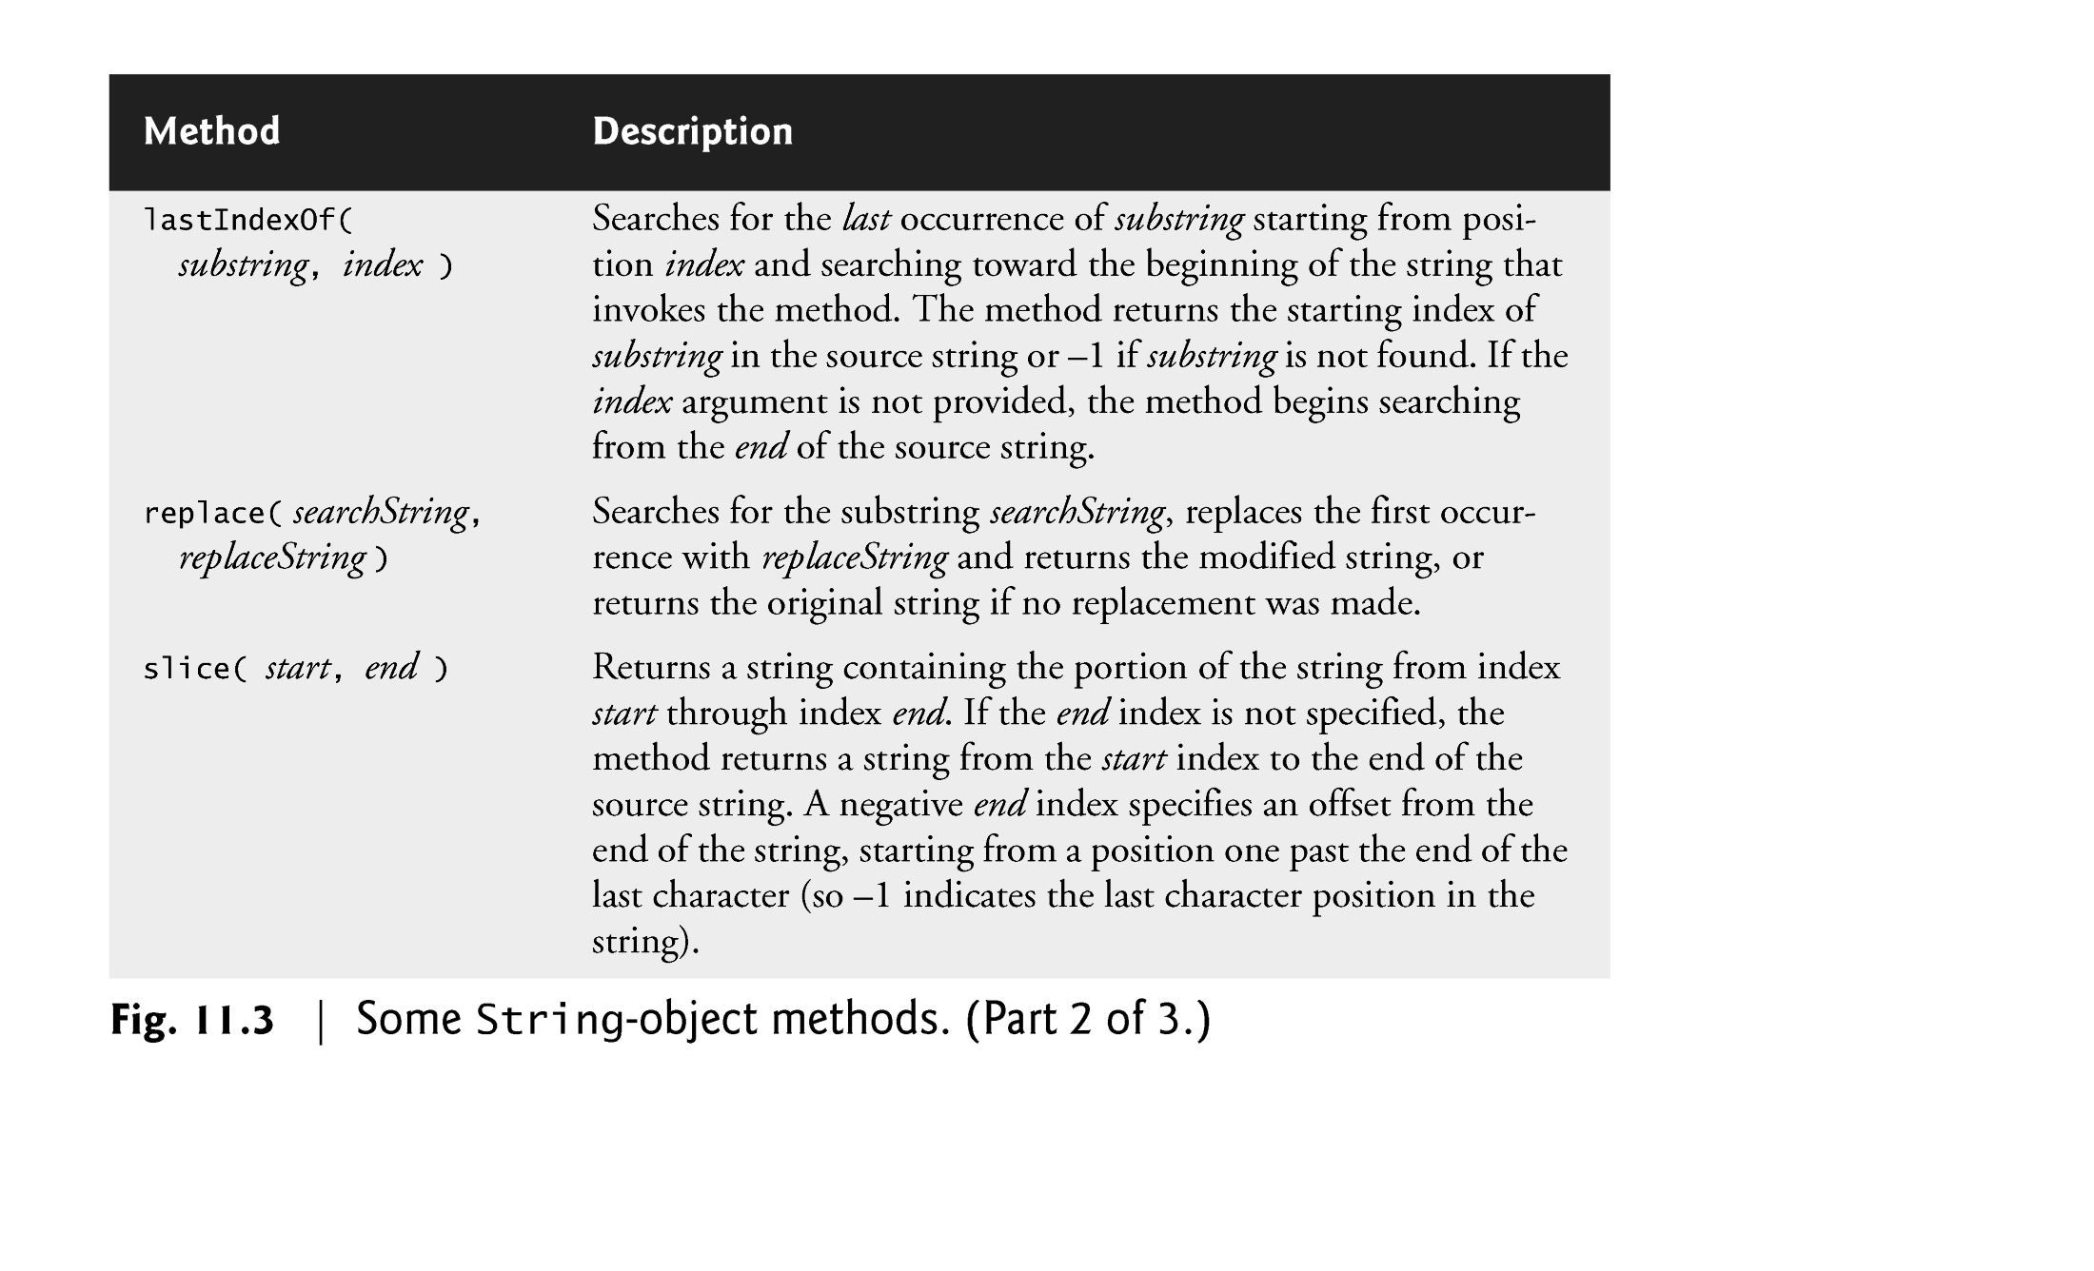

Slide 26
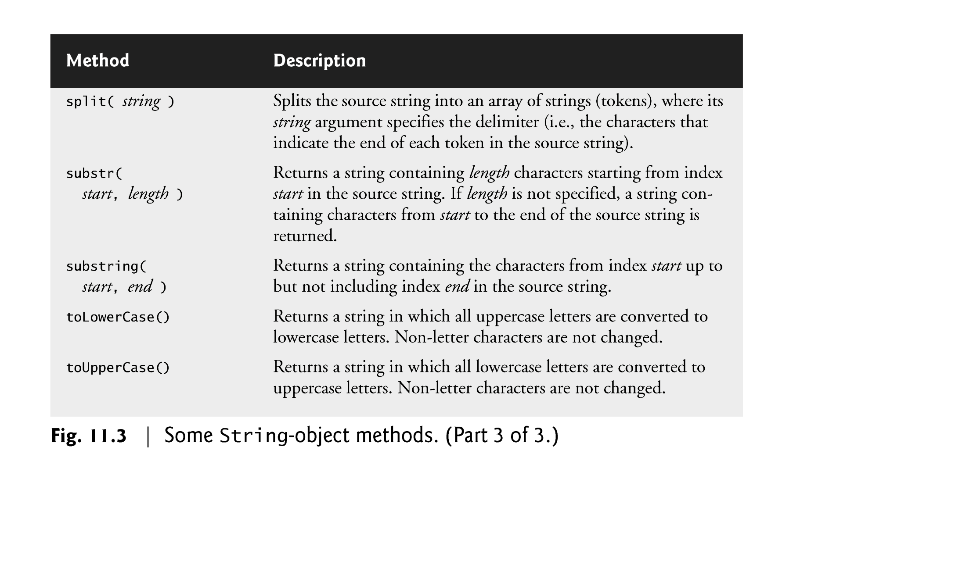

Slide 27
Date object
Date object provides methods for date and time manipulations
  Based either on the computer’s local time zone or on World Time Standard’s Coordinated Universal Time (abbreviated UTC)
Most methods have a local time zone and a UTC version
Empty parentheses after an object name indicate a call to the object’s constructor with no arguments
  A constructor is an initializer method for an object
  Called automatically when an object is allocated with new
  The Date constructor with no arguments initializes the Date object with the local computer’s current date and time
  A new Date object can be initialized by passing the number of milliseconds since midnight, January 1, 1970, to the Date constructor
  Can also create a new Date object by supplying arguments to the Date constructor for year, month, date, hours, minutes, seconds and milliseconds.
    Hours, minutes, seconds and milliseconds arguments are all optional
    If any one of these arguments is not specified, a zero is supplied in its place
    If an argument is specified, all arguments to its left must be specified

Slide 28
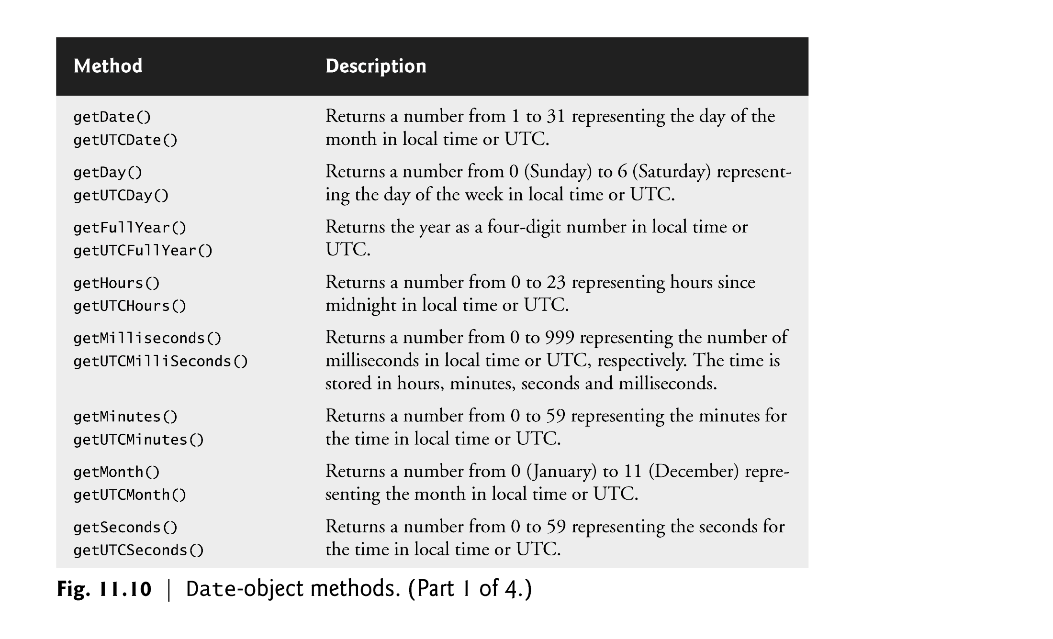

Slide 29
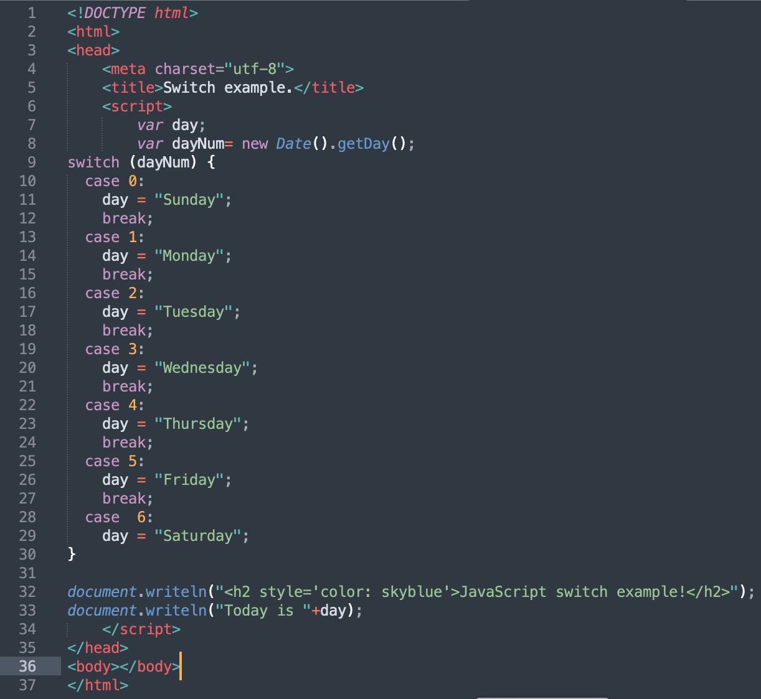
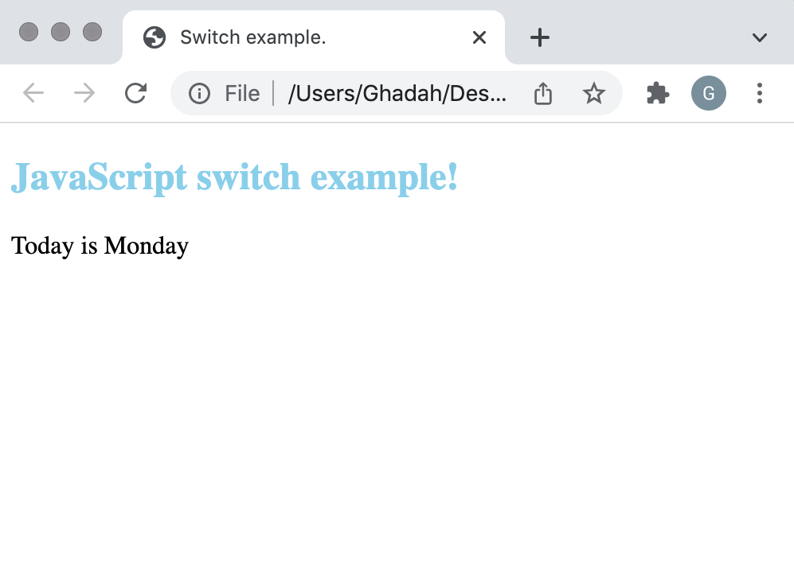
old example
Again, Date object acquire the current local time, and getDay() method returns the weekday as a number between 0 and 6:
(Sunday=0, Monday=1, Tuesday=2 ..)

