Slide 1
GC415 - Introduction to Cascading Style Sheets (CSS): Part 1
Internet & World Wide Web How to Program, 5/e

Slide 3
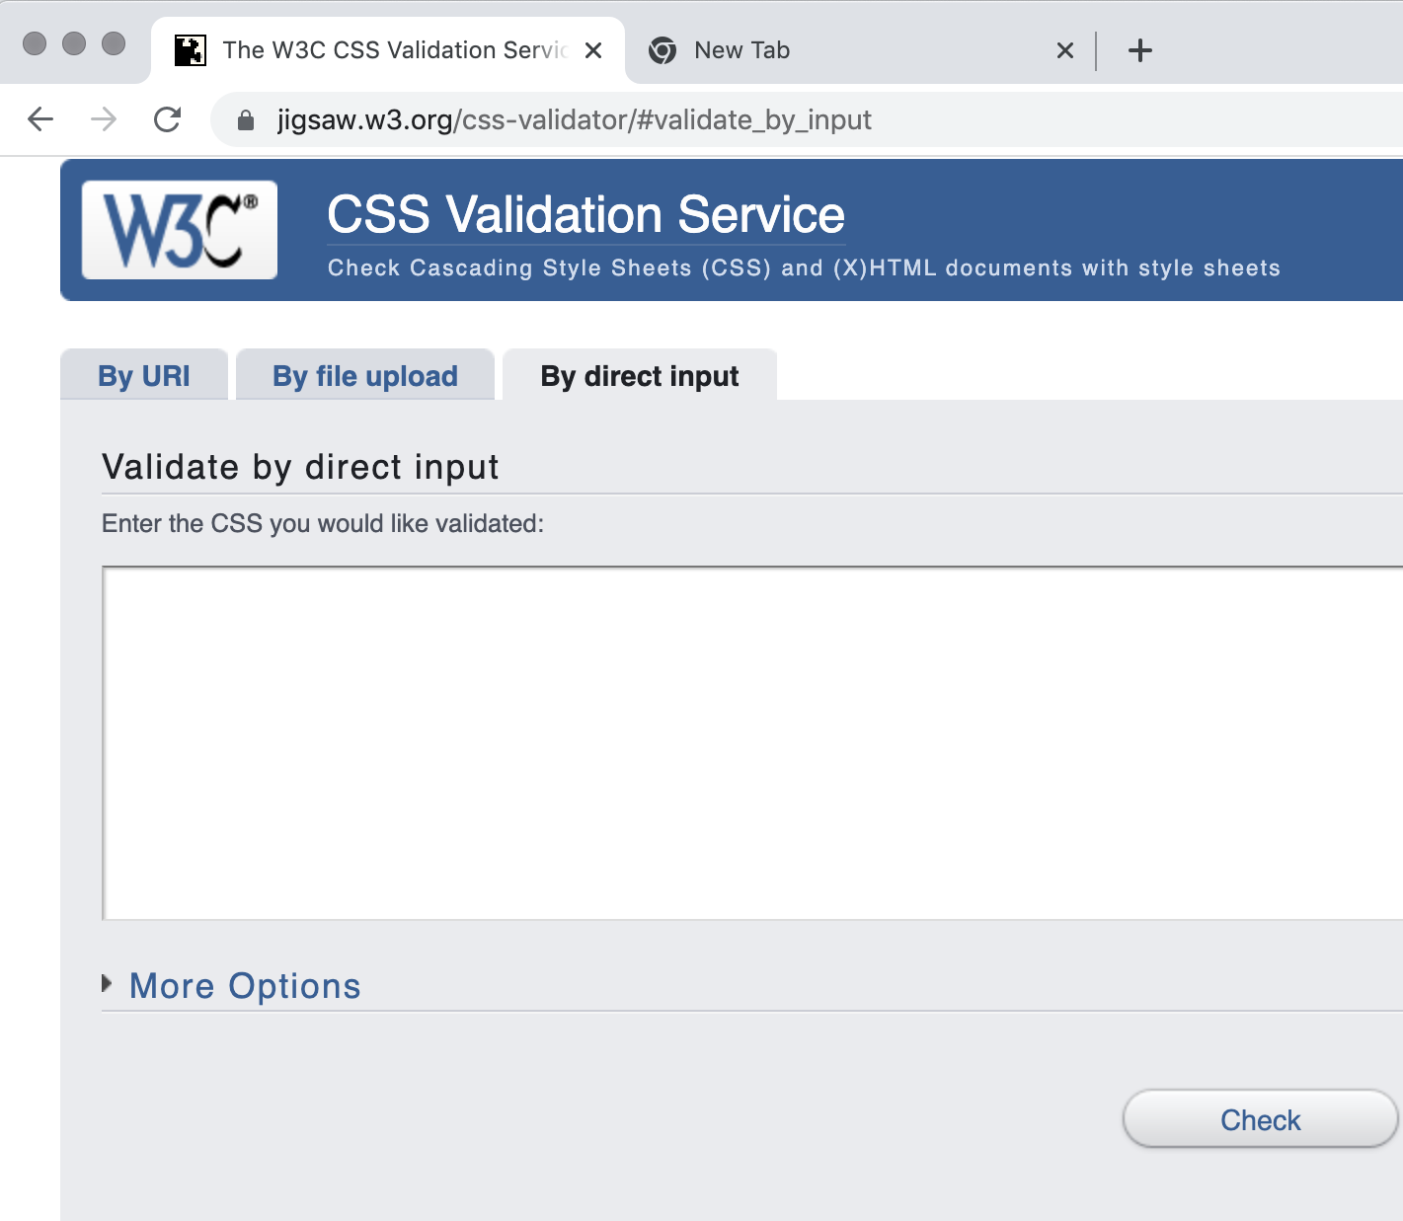
Introduction
Cascading Style Sheets 3 (CSS3)
is used to format the layout of a webpage
CSS can be added to HTML documents in 3 ways:
Inline - by using the style attribute inside HTML elements
Internal - by using a <style> element in the <head> section
External - by using a <link> element to link to an external CSS file
CSS validator
jigsaw.w3.org/css-validator/
This tool can help you make sure that your code is correct and will work on CSS3-compliant browsers.

Slide 4
Inline Styles
Inline style
declare an individual element’s format using the HTML5 attribute style.
Each CSS property is followed by a colon and the value of the attribute
Multiple property declarations are separated by a semicolon
style=“property1: vlaue1 ; property2: value2 …”
Example 1 (next slide) applies inline styles to p elements to alter their font size and color.

Slide 5
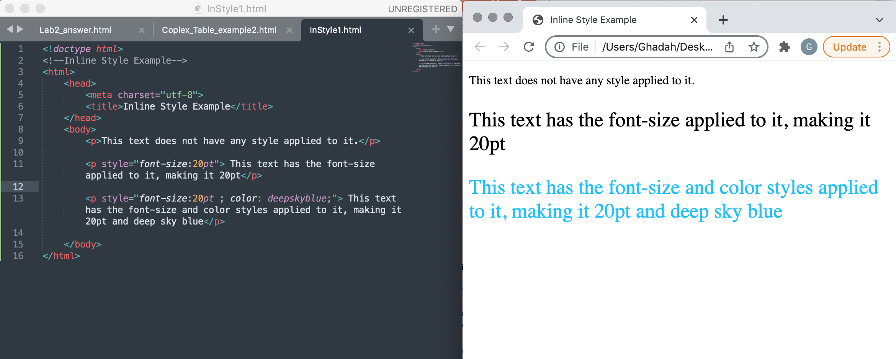
Inline Styles: Example 1

Slide 6
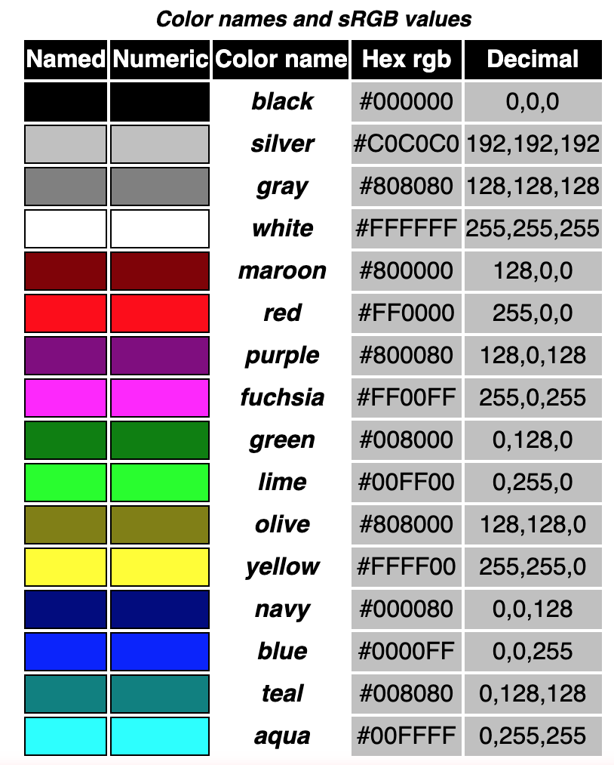
Inline Styles (Cont.)
color property sets text color
Color names and hexadecimal or decimal RGB codes may be used as the color property value.
The table on the right contains the HTML standard color set, however you can find a complete list of HTML standard and extended colors at
www.w3.org/TR/css3-color/

Slide 8
Embedded Style Sheets
A second technique for using style sheets is embedded style sheets, which enable you to embed a CSS3 document in an HTML5 document’s head section.
Example 2 (next slide) creates an embedded style sheet containing four styles (four CSS rules).
<head>
….
<style type=“…”>
CSS rules
</style>
</head>

Slide 10
(1) Style element and MIME type
(2) CSS rules/styles

Slide 11
Embedded Style Sheets (cont.)
(1) The style Element and MIME Types
Multipurpose Internet Mail Extensions (MIME) is an Internet standard that extends the format of email messages to support text in character sets other than ASCII, as well as attachments of audio, video, images, and application programs.*
style element type attribute specifies the MIME type (the specific encoding format) of the style sheet. Style sheets use text/css.
The following table lists most common MIME types, with corresponding document types:

Slide 12
Embedded Style Sheets (cont.)
(2) The style sheet’s body declares the CSS rules for the style sheet.
Each CSS rule/style that is placed in the style element has:
selector:
it is the first part of a CSS rule e.g. h1 {…….}
to achieve the separation between the CSS code and the HTML5 that it styles, CSS selector is used to specify the elements that will be styled according to a rule.
in its simplest form a selector can be an element such as (h1 and p), a class such as (.special), or an id (#id).
rule body; enclosed in curly braces { and }.

Slide 13
Embedded Style Sheets (Cont.):selectors
Style element
They define styles that can be applied to specific element(s) only.
In Example 2, em sets color to black and font to bold.

Slide 14
Embedded Style Sheets (Cont.):selectors
Style Classes
Style-class declarations are preceded by a period (.)
They define styles that can be applied to any element.
In Example 2, class special sets color to purple.

Slide 15
Embedded Style Sheets (Cont.):selectors
Style id
If an element in your page has an id you can define a CSS rule whose selector is #id
They define styles that can be applied to specific element only; the element that has that id.

Slide 16
Embedded Style Sheets (Cont.): properties
font-weight property specifies the “boldness” of text. Possible values are:
bold
normal (the default)
bolder (bolder than bold text)
lighter (lighter than normal text)
Boldness also can be specified with multiples of 100, from 100 to 900 (e.g., 100, 200, …, 900). Text specified as normal is equivalent to 400, and bold text is equivalent to 700

Slide 17
Embedded Style Sheets (Cont.): properties
font-family Property
font-family property specifies the name of the font to use.
The font-family property should hold several font names as a "fallback" system, to ensure maximum compatibility between browsers/operating systems.*
Generic font families allow authors to specify a type of font instead of a specific font, in case a browser does not support a specific font.

Slide 18
Embedded Style Sheets (Cont.): properties
font-size Property
font-size property specifies the size used to render the font.
You can specify a point size or a relative value such as xx-small, x-small, small, smaller, medium, large, larger, x-large and xx-large.
Relative font-size values are preferred over points, because an author does not know the specific measurements of each client’s display.
Relative values permit more flexible viewing of web pages.
For example, users can change font sizes the browser displays for readability.

Slide 19
Embedded Style Sheets (Cont.): properties
text-decoration property applies decorations to text in an element
underline
overline
line-through
blink
background-color set the background of an element to a certain color whose value is either a color name, hexadecimal or decimal RGB.

Slide 20
Conflicting Styles
ed for parent elements are also inherited by child (nested) elements.

Slide 21
Conflicting Styles (Cont.)
Example 3 (next slide) contains an example of inheritance in which a child em element inherits the font-size property from its parent p element.
However, in same example, the child em element has a color property that conflicts with (i.e., has a different value than) the color property of its parent p element.
Properties defined for child and descendant elements have a higher specificity than properties defined for parent and ancestor elements.
Conflicts are resolved in favor of properties with a higher specificity, so the child’s styles take precedence.
Example 3 illustrates examples of inheritance and specificity.

