Slide 1
GC415 – PHP Hypertext preprocessor
Internet & World Wide Web How to Program, 5/e

Slide 2
Outline
Client-side vs Server-side development.
About PHP
Using server-side scripting language (PHP) for the tasks:
Form processing.
Accessing/manipulating Database information.

Slide 3
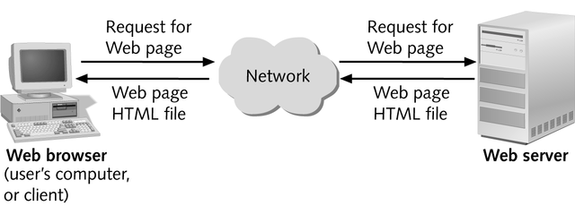
*Client-side vs Server-side development
*Link

Slide 4
On Client-side
Client-side development:
involves programs that run on a client or user's device
developers focus on creating the part of a website that the user can interact with. Thus:
They focus on completing a variety of tasks, including:
Creating website layouts
Designing user interfaces
Adding form validation
Adding visual elements like colors and fonts
Using some common client-side languages include:
HTML
CSS
JavaScript

Slide 5
On Server-side
Server-side development:
involves programs that run on a server.
This type of programming is important because web browsers, or clients, interact with web servers to retrieve information.
Common server-side tasks include:
Coding dynamic websites.
Processing forms information
Connecting websites to databases
Using some common server-side languages include:
PHP
SQL
Java
Python

Slide 6
PHP: Introduction
For making advanced dynamic web sites, you need some kind of server side scripting. Server side scripts are programs that are executed on the server, and can be used in many clients.
PHP (PHP Hypertext Preprocessor), has become the most popular server-side scripting language for creating dynamic web pages.
PHP is open source and platform independent— implementations exist for all major UNIX, Linux, Mac and Windows operating systems. PHP also supports a large number of databases.

Slide 7
What is a PHP file ?
PHP files can contain text, HTML, CSS, JavaScript, and PHP code
PHP code are executed on the server, and the result is returned to the browser as plain HTML.
PHP files have extension ".php"

Slide 8
What can PHP Do?
PHP can generate dynamic page content.
PHP can add, delete, modify data in your database.
PHP can create, open, read, write, delete, and close files on the server.
PHP can collect form data.
PHP can be used to control user-access.
PHP can encrypt data.
PHP can send and receive cookies.

Slide 9
A Simple PHP Program
 PHP code is embedded directly into text-based documents,such as HTML, though these script segments are interpreted by a server before being delivered to the client.
PHP script file names end with .php.
In PHP, code is inserted between the scripting delimiters
<?php
…
?>.
PHP code can be placed anywhere in HTML5 markup, as long as the code is enclosed in these delimiters.
See Example 1.

Slide 10
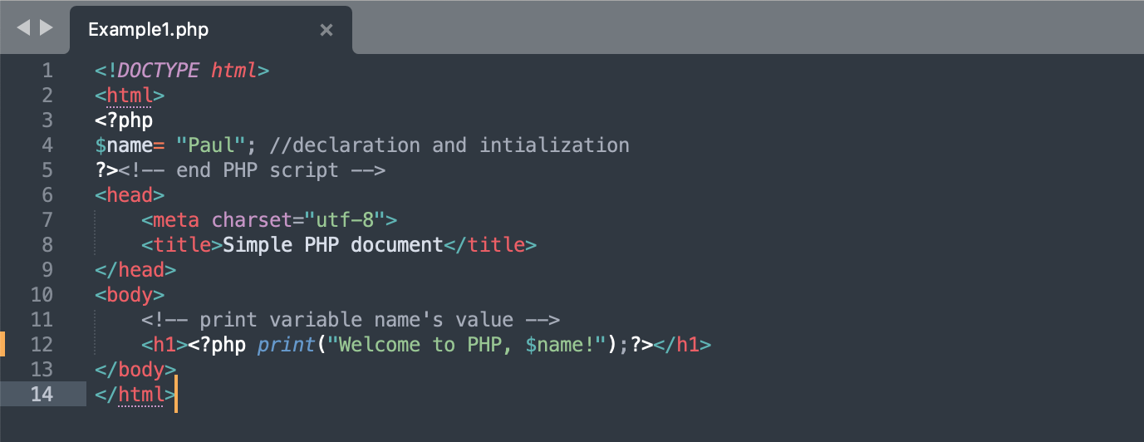
Example 1

Slide 11
A Simple PHP Program (Cont.)
Variables are preceded by a $ and are created the first time they’re encountered.
PHP statements terminate with a semicolon (;).
Single-line comments which begin with two forward slashes (//) or a pound sign (#). Multiline comments begin with delimiter /* and end with delimiter */.
When a variable is encountered inside a double-quoted ("") string, PHP interpolates the variable. In other words, PHP inserts the variable’s value where the variable name appears in the string.
All operations requiring PHP interpolation execute on the server before the HTML5 document is sent to the client.
PHP variables are loosely typed—they can contain different
types of data at different times.

Slide 12
Variables naming conventions
A variable starts with the $ sign, followed by the name of the variable
A variable name must start with a letter or the
underscore character
A variable name cannot start with a number
A variable name can only contain alpha-numeric characters and underscores (A-z, 0-9, and _ )
Variable names are case-sensitive ($age and $AGE are
two different variables)

Slide 13
A constant is an identifier (name) for a simple value. The value cannot be changed during the script. A valid constant name starts with a letter or underscore (no $ sign before the constant name). To create a constant, use the define() function. It takes two arguments—the name and value of the constant. An optional third argument accepts a boolean value that specifies whether the constant is case insensitive—constants are case sensitive by default. E.g. define(name, value, case-insensitive); define("GREETING", "Welcome to W3Schools.com!");
PHP Constants

Slide 14
Form Processing

Slide 16
PHP for Forms Processing
HTML Forms are used to collect different kinds of user input and pass them to server.
Typically, you specify the server’s script that is going to process the form in the forms action attribute while in method you determine how data are passed to server. E.g.
<form action=“script.php” method=“post”>
post: causes it to be passed invisibly to the http header and has no limits on the amount of information to send.
get: causes it to be passed in the URL string and has limits on the amount of information to send. The limitation is about 2000 characters.

Slide 17
PHP for Forms Processing (Cont.)
As learned before, forms are made up of several input elements each of which has number of attributes, including name and value attributes. E.g.
<input type=“text” name=“fname” value=“John”>
<input type=“text” name=“fname”>
name: (e.g. fname) reflects the information your are collecting from the user
value: (e.g. Binhadba) what the user actually types in.
When the user fills in a form and hits the submit button, the browser transmits each forms element as name/value pair (as part of a superglobal array-see next slides):
Thus, make sure that you name each form field that you want to process as these names will be available to the server’s processing script as variables.

Slide 18
PHP for Forms Processing (Cont.)
Superglobal arrays are associative arrays predefined by PHP that hold variables acquired from user input, the environment or the web server and are accessible in any variable scope.
The arrays $_GET and $_POST retrieve information sent to the server by HTTP get and post requests, respectively.
These are superglobals, which means that they are always accessible, regardless of scope - and you can access them from any function, class or file without having to do anything special.
Some other global variables:

Slide 19
Example 2: Client-side (form.html)

Slide 22
Example 2: Server-side (form.php)

Slide 23
Function die terminates script execution. The function’s optional argument is a string, which is printed as the script exits.

Slide 24
Note that: the displayed page in slide 24 and here are both on the side server.

Slide 25
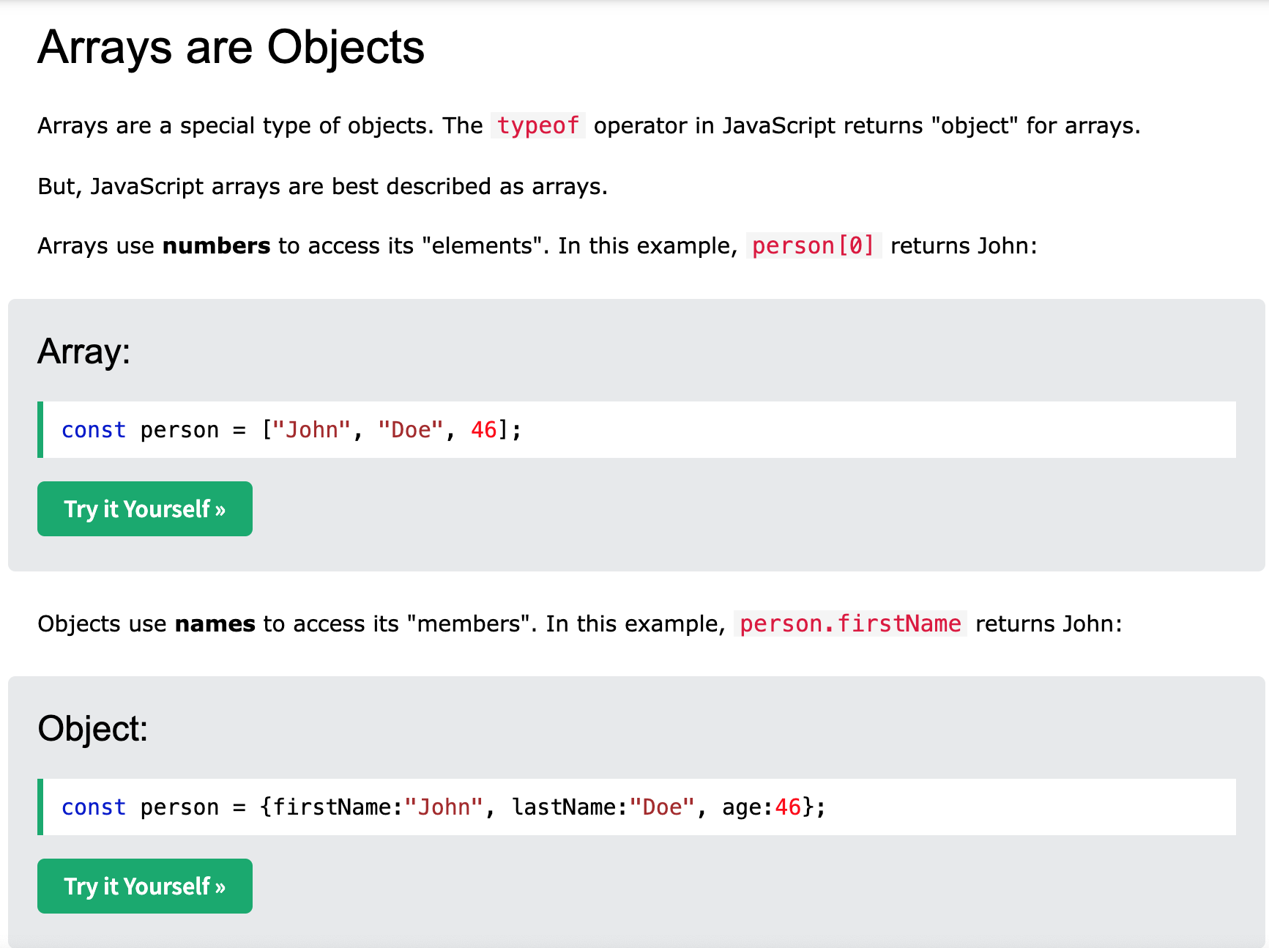
or person[firstName]
*https://www.w3schools.com/js/js_arrays.asp

Slide 26
Accessing database

Slide 27
PHP for Accessing Database
Function mysql_connect connects to the MySQL database. It takes three arguments:
the server’s hostname
a username
a password
and returns a database handle—a representation of PHP’s connection to the database, or false if the connection fails.
Function mysql_select_db selects and opens the database to be queried.
The function returns true on success or false on failure.

Slide 28
PHP for Accessing Database (Cont.)
To query the database, we call function mysql_query, specifying the query string and the database to query.
This returns a resource containing the result of the query, or false if the query fails.
It can also execute SQL statements such as INSERT or DELETE that do not return results.
The mysql_error function returns any error strings from the database.
mysql_close closes the connection to the database specified in its argument.
The mysql_fetch_row function returns an array containing the values for each column in the current row of the query result ($result).

Slide 34
More on PHP
To learn more about PHP syntax, functions, etc. Explore the following page:
https://www.w3schools.com/php/default.asp

