Slide 1
Basics of Web Technologies

Slide 2
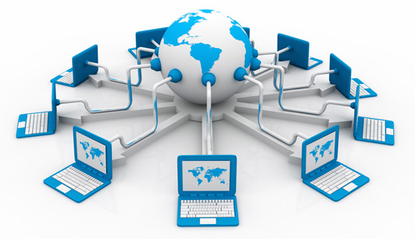
The Internet
Interconnected network of computer networks.
Internet is composed of collection of networks connecting millions of computers together.
Internet consists of hardware and software infrastructure that enables computers to communicate and exchange information.

Slide 3
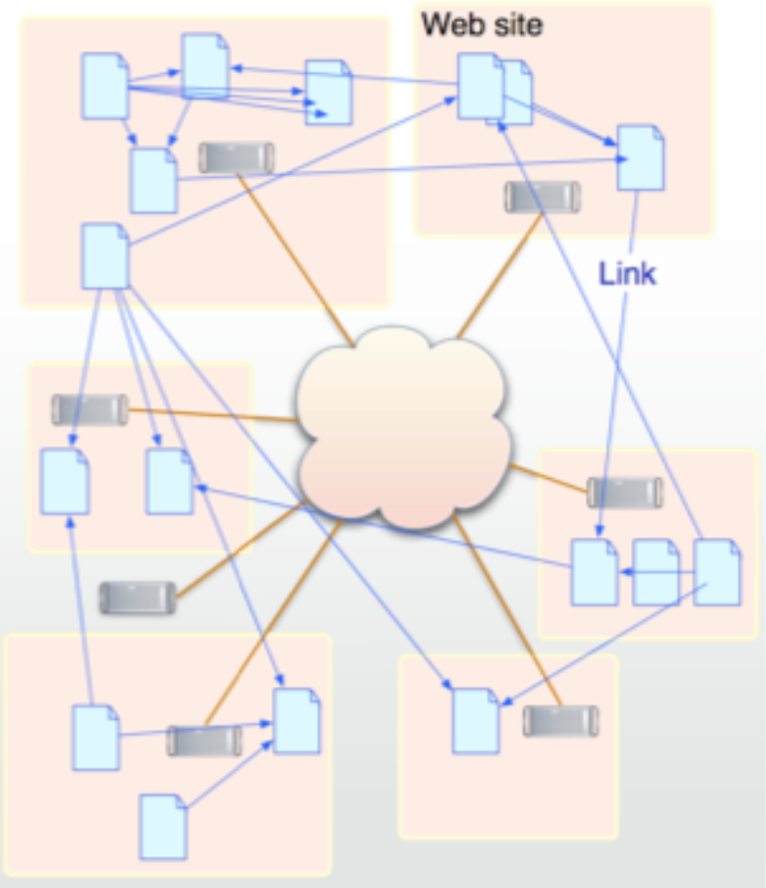
The World Wide Web (WWW)
The World Wide Web (WWW) is a system of interlinked hypertext documents accessed via the Internet.
Internet

Slide 4
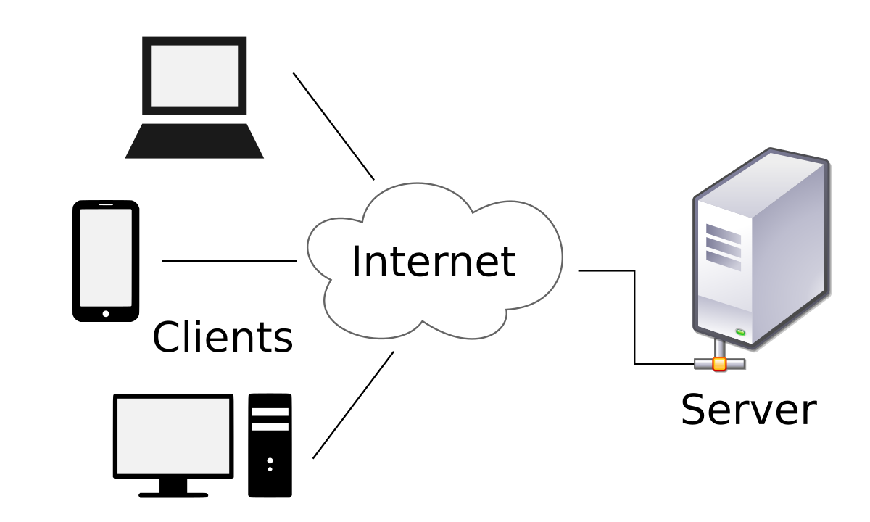
WWW: client-server model
WWW is a client-server model and uses TCP connections to transfer information or web pages from server to client (web browser).

Slide 5
WWW: Hyperlinks (or links)
Using a web browser:
one can view web documents (pages) that may contain text, images, videos, and other multimedia; and
navigate between them by using hyperlinks.
i.e. documents contains links (pointers) to other documents
Initial page for a group of interlinked documents is called a home page.
Note that web documents can be:
Non-distributed – all documents stored locally (e.g on CD-Rom).
Distributed – documents stored at remote servers on the Internet.

Slide 6
WWW: Hyperlinks (or links)
The link represented by "active area" on screen
Graphic – e.g.
Text – e.g.
By selecting a particular link, the client fetches the referenced document from a server for display.
Links may become invalid.

Slide 7
WWW: Document Representation
Again…
Each WWW document is called a page
A page can contain many different types of information:
Content – The actual information (which can be in the form of texts, pictures, etc.)
Links to other documents (if any)

Slide 8
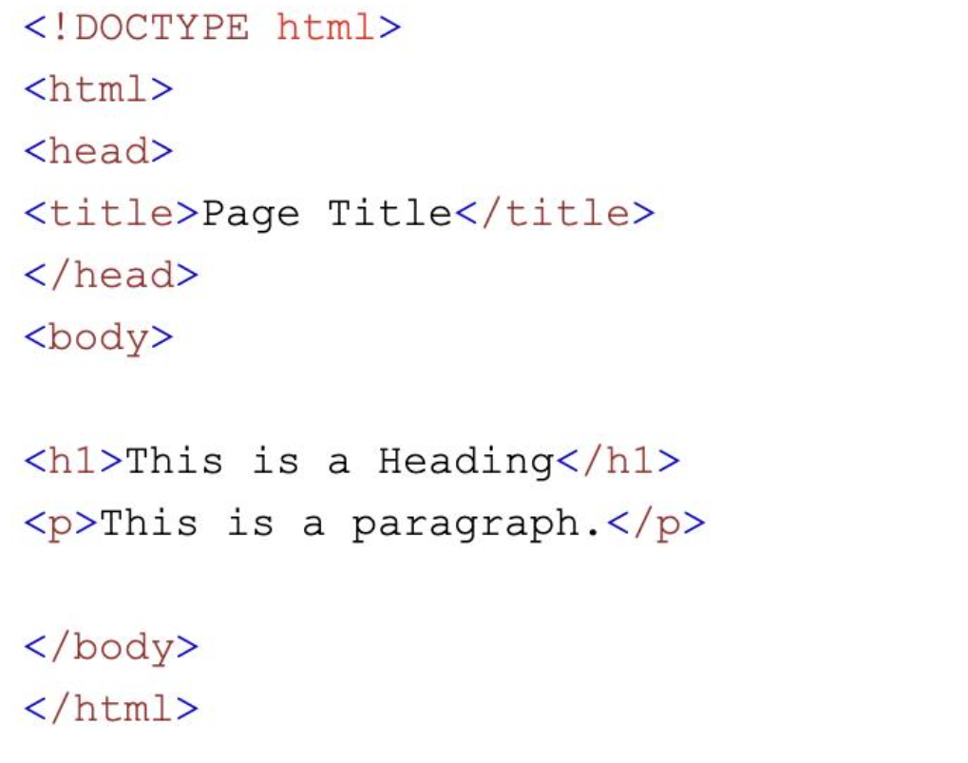
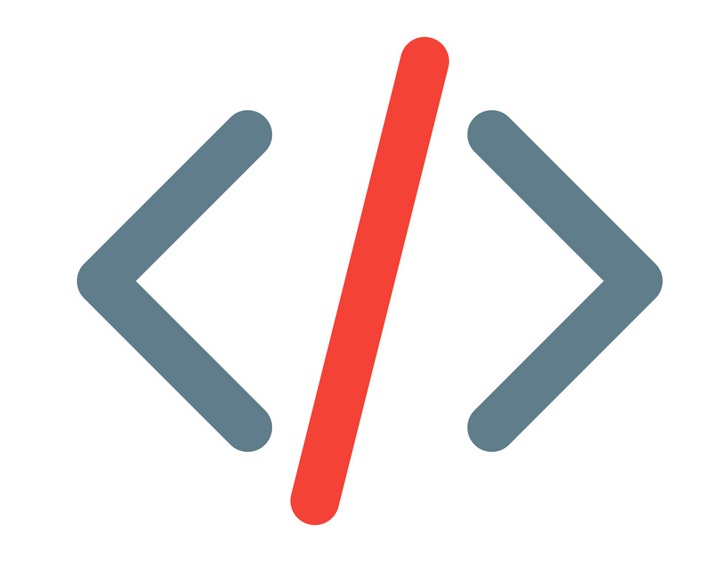
WWW: Document Representation(Cont.)
Rather than having a fixed representation for every browser, pages are formatted with a mark up language. This allows browser to format page to fit display
Among several exiting markup languages; HyperText Markup Language (HTML) is what is mainly used for building up webpages.
“A markup language is a computer language that uses tags to define elements within a document. It is human-readable, meaning markup files contain standard words, rather than typical programming syntax. ”*
*E.g.
*https://techterms.com/definition/markup_language
* https://cssc.utm.utoronto.ca/resources/html

Slide 9
Web Documents – Static Documents
Fixed-content documents that are created and stored in a server.
The content of the file is determined when the file is created, not when it is used.
When a client accesses the document, a copy of the document is sent. The user can then use a browsing program to display the document

Slide 10
Web Documents – Dynamic Documents
Created by a web server whenever a browser requests the document.
When a request arrives, the web server runs an application program or a script that creates a dynamic document.
The server returns the output of the program or script as a response to the browser that requested the document.

Slide 11
Web Documents – Uniform Resource Locator (URL)
In order to access web resources (including web pages) one needs to know their address.
The Uniform Resource Locator (URL) is the standard responsible for specifying web resources’ locations.
A URL has a specific syntax in which it defines four things: protocol, host computer, port and path which is:
E.g.
http://www.yahoo.com/Recreation/Sports/Soccer/index.html
://
:
/
Protocol
Host
Port
Path

Slide 12
Web Documents – Uniform Resource Locator (URL)(Cont.)
The Protocol is what is used to access a web page and it can be http, UDP, SMTP, FTP, or mailto.
The host is the server computer on which the web page is stored and is usually identified by its domain name or IP address.
The TCP port is what the server is listening on to allow a client to access the web page. It is optional (http uses port 80 as its default port).
The path is the directory pathname of web page on server (the file where the information is located).

Slide 13
Web Documents – Uniform Resource Locator (URL)(Cont.)
E.g.
http://www.yahoo.com/Recreation/Sports/Soccer/index.html
Protocol: http
Computer name or domain name: www.yahoo.com
Port number: is the default port for http which is 80.
Document path: /Recreation/Sports/Soccer/index.html

Slide 14
What is http?
Is a HyperText Transport Protocol that specifies requests that the client (browser) issues to the server (web server) and the responses that the server sends back to the client.

Slide 15
What is Doamin Name?
What is “Domain Name”?
It is a unique name for your website.E.g.: www.google.com
To get a domain name you have to register the name from domain name registration companies like web.com.
What is “Domain Name System (DNS)”?
It is a hierarchical decentralized naming system for computers, services, or any resource connected to the Internet or a private network.
It associates various information with domain names , including IP addresses.

Slide 16
Top-Level Domain (TLD) Name
A top-level domain (TLD) name identifies the right-most label of the domain name.
E.g.: www.google.com
That label reflects on the nature of the website: e.g.
.com commercial , .gov government, .edu educational, etc.
Current generic TLDs:
.com, .org, .net, .mil, .gov, .edu, .int, .aero, .asia, .cat, .jobs, .name, .biz, .mobi, .museum, .info, .coop, .post, .pro, .tel, .travel.

Slide 17
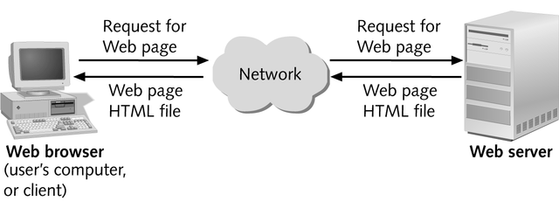
Getting back to: WWW – Client Server Model
A client clicks on a link in a browser or request a web page by typing its URL.
The browser communicates with a web server using HTTP.
The server responds by sending the requested HTML document back.
The browser displays the document.
Request
Response

Slide 18
Web Server Basics
Web servers are continually connected to the Internet
All communications between browsers and servers use HTTP protocol.
When a client is connected. The server reads the HTTP request, performs some lookup function and sends HTTP response and the requested data.
Server responses to browser requests can be either existing documents or dynamically built documents.

Slide 19
Web Browser Architecture
Browser has more components than a server:
Display driver for painting screen.
HTML interpreter for formatting HTML documents.
Plugins to display different content (e.g. Real Audio content)
HTTP client to fetch HTML documents from WWW server.
Other clients for other protocols (e.g., ftp, mail)
Controller also must accept input from the computer user through the mouse or keyboard.

Slide 20
An example of:
How request and response actually happen

Slide 21
User of client machine types in a URL

Slide 22
Server domain name is translated to an IP address via DNS
client
server
(Netscape)
(Apache)
http://
www.smallco.com
/index.html
192.22.107.5

Slide 23
Client connects to server using IP address and port number

Slide 24
Client determines path and file to request

Slide 25
Client sends HTTP request to server

Slide 26
Server determines which file to send

Slide 27
Server sends response code and the document

Slide 28
Connection is broken

Slide 29
Client-side vs Server-side development

Slide 30
On Client-side
Client-side development:
involves programs that run on a client or user's device
developers focus on creating the part of a website that the user can interact with. Thus:
They focus on completing a variety of tasks, including:
Creating website layouts
Designing user interfaces
Adding form validation
Adding visual elements like colors and fonts
Using some common client-side languages include:
HTML
CSS
JavaScript

Slide 31
On Server-side
Server-side development:
involves programs that run on a server.
This type of programming is important because web browsers, or clients, interact with web servers to retrieve information.
Common server-side tasks include:
Coding dynamic websites.
Processing forms information
Connecting websites to databases
Using some common server-side languages include:
PHP
SQL
Java
Python

