Slide 1
Management Of Engineering Projects (GE 402)
بسم الله الرحمن الرحيم
Tutorial # 2
Activity on Node
Notes:
This is a title slide.

Slide 2
Activity on Node
ADVANTAGES:
Precedence relationships
Time calculation
large projects
more efficient

Slide 3
EXAMPLE 1:
Draw activity on node diagram for the following project
Activity | Predecessor | Duration (weeks)
A | - | 12
B | A | 16
C | A | 8
D | A | 18
E | B , C | 8
F | D , E | 10
B
A
C
E
F
ES | D | EF
 | Act | FF
LS | TF | LF
D
 | 16
 | B
 | 12
 | A
 | 8
 | C
 | 8
 | E
 | 10
 | F
 | 18
 | D

Slide 4
Times Calculations
3- Total float (TF) = LS - ES = LF - EF
ES | D | EF
 | Act | FF
LS | TF | LF
1- EF = ES + D
4- Free Float (FF_{i} ) = Min. (ES_{j}) - EF_{i}
2- LS = LF - D
12 | 16 | 28
 | B | 0
12 | 0 | 28
12 | 16 | 28
 | B | 0
Largest EF
36 | 10 | 46
 | F | 0
36 | 0 | 46
0 | 12 | 12
 | A | 0
36 | 10 | 46
 | F | 0
0 | 12 | 12
 | A | 0
0 | 0 | 12
12 | 8 | 20
 | C | 8
20 | 8 | 28
12 | 8 | 20
 | C | 8
28 | 8 | 36
 | E | 0
28 | 0 | 36
28 | 8 | 36
 | E | 0
12 | 18 | 30
 | D | 6
18 | 6 | 36
Smallest LSj
12 | 18 | 30
 | D | 6
Project Duration: 46 weeks
Critical Path : A-B-E-F

Slide 5
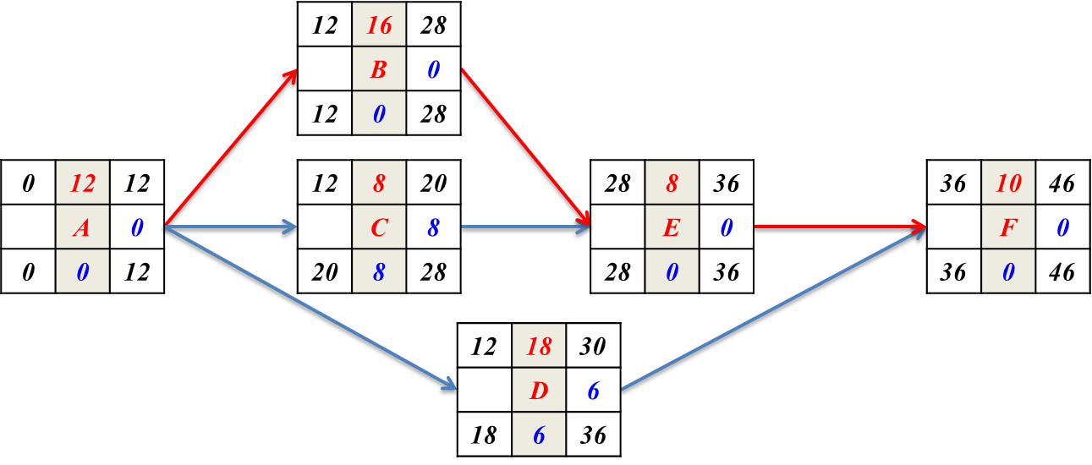
Times Calculations Summary
ES | D | EF
 | Act | FF
LS | TF | LF
Activity | Predecessor | Duration (weeks) | ES | EF | LS | LF | FF | TF
A | - | 12 | 0 | 12 | 0 | 12 | 0 | 0
B | A | 16 | 12 | 28 | 12 | 28 | 0 | 0
C | A | 8 | 12 | 20 | 20 | 28 | 8 | 8
D | A | 18 | 12 | 30 | 18 | 36 | 6 | 6
E | B , C | 8 | 28 | 36 | 28 | 36 | 0 | 0
F | D , E | 10 | 36 | 46 | 36 | 46 | 0 | 0

Slide 6
Example 2:
Draw activity on node diagram for the following project
Activity | Predecessor | Duration(weeks)
A | - | 20
B | A | 8
C | A | 6
D | B | 12
E | C | 16
F | C | 18
G | D | 16
H | D , E, F | 8
I | F | 10
J | G , H , I | 10
B
D
G
A
C
E
H
J
F
I

Slide 7
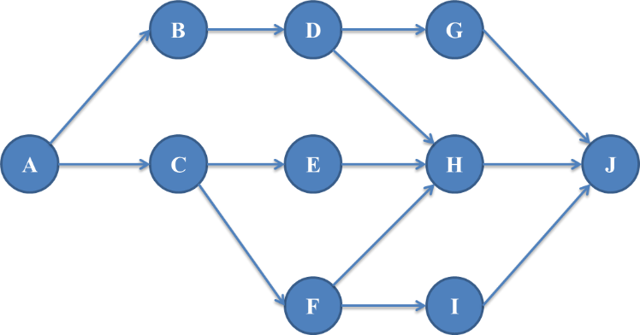
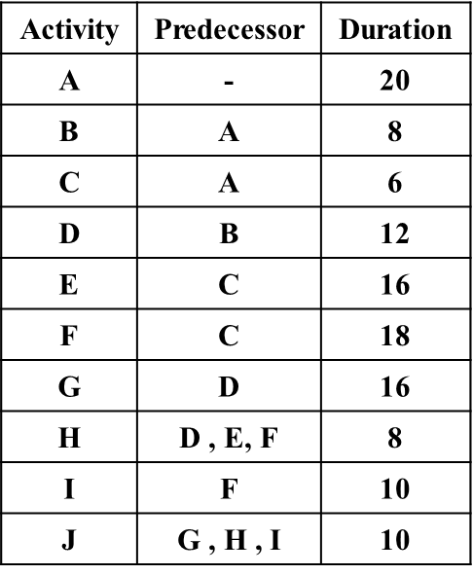
ES | D | EF
 | Act | FF
LS | TF | LF
 | 8
 | B
 | 12
 | D
 | 16
 | G
 | 20
 | A
 | 6
 | C
 | 16
 | E
 | 8
 | H
 | 10
 | J
 | 18
 | F
 | 10
 | I

Slide 8
Times Calculations
3- Total float (TF) = LS - ES = LF - EF
ES | D | EF
 | Act | FF
LS | TF | LF
1- EF = ES + D
4- Free Float (FF_{i} ) = Min. (ES_{j}) - EF_{i}
2- LS = LF - D
20 | 8 | 28
 | B | 0
20 | 0 | 28
28 | 12 | 40
 | D | 0
28 | 0 | 40
40 | 16 | 56
 | G | 0
40 | 0 | 56
0 | 20 | 20
 | A | 0
0 | 0 | 20
20 | 6 | 26
 | C | 0
22 | 2 | 28
26 | 16 | 42
 | E | 2
32 | 6 | 48
44 | 8 | 52
 | H | 4
48 | 4 | 56
56 | 10 | 66
 | J | 0
56 | 0 | 66
26 | 18 | 44
 | F | 0
28 | 2 | 46
44 | 10 | 54
 | I | 2
46 | 2 | 56
PROJECT DURATIN: 66 weeks
CRITAL PATH : A-B-D-G-J

Slide 9
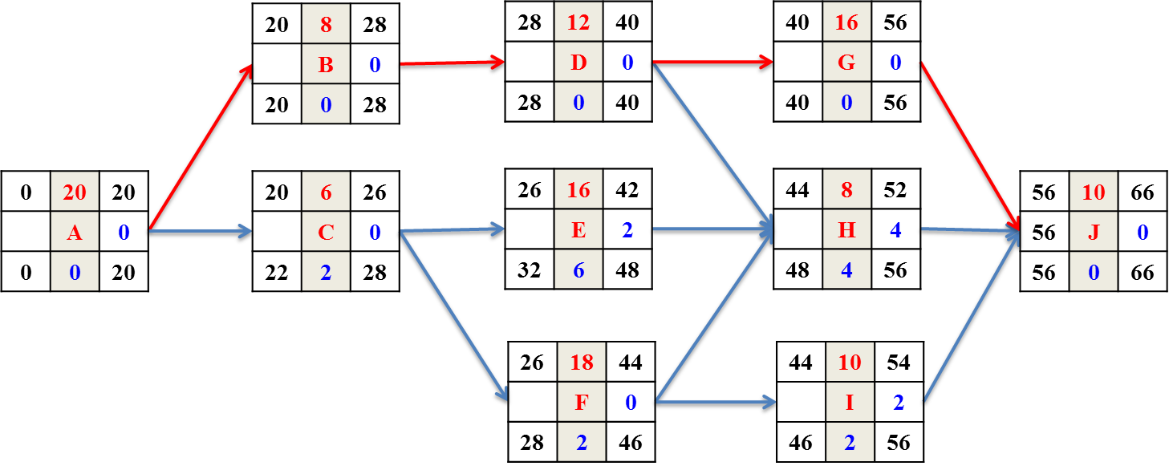
Times Calculations Summary
ES | D | EF
 | Act | FF
LS | TF | LF
Activity | Predecessor | Duration (weeks) | ES | EF | LS | LF | FF | TF
A | - | 20 | 0 | 20 | 0 | 20 | 0 | 0
B | A | 8 | 20 | 28 | 20 | 28 | 0 | 0
C | A | 6 | 20 | 26 | 22 | 28 | 0 | 6
D | B | 12 | 28 | 40 | 28 | 40 | 0 | 0
E | C | 16 | 26 | 42 | 32 | 48 | 2 | 6
F | C | 18 | 26 | 44 | 28 | 46 | 0 | 2
G | D | 16 | 40 | 56 | 40 | 56 | 0 | 0
H | D , E, F | 8 | 44 | 52 | 48 | 56 | 4 | 4
I | F | 10 | 44 | 54 | 46 | 56 | 2 | 2
J | G , H , I | 10 | 56 | 66 | 56 | 66 | 0 | 0

Slide 10
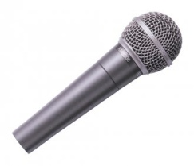
Thank You
Questions Please

