Slide 1
XAMPP

Slide 2
What is XAMPP?
XAMPP is the most popular PHP development environment
XAMPP is a completely free, easy to install Apache distribution containing MariaDB, PHP, and Perl. The XAMPP open source package has been set up to be incredibly easy to install and to use.

Slide 3
XAMPP Website
https://www.apachefriends.org/index.html

Slide 4
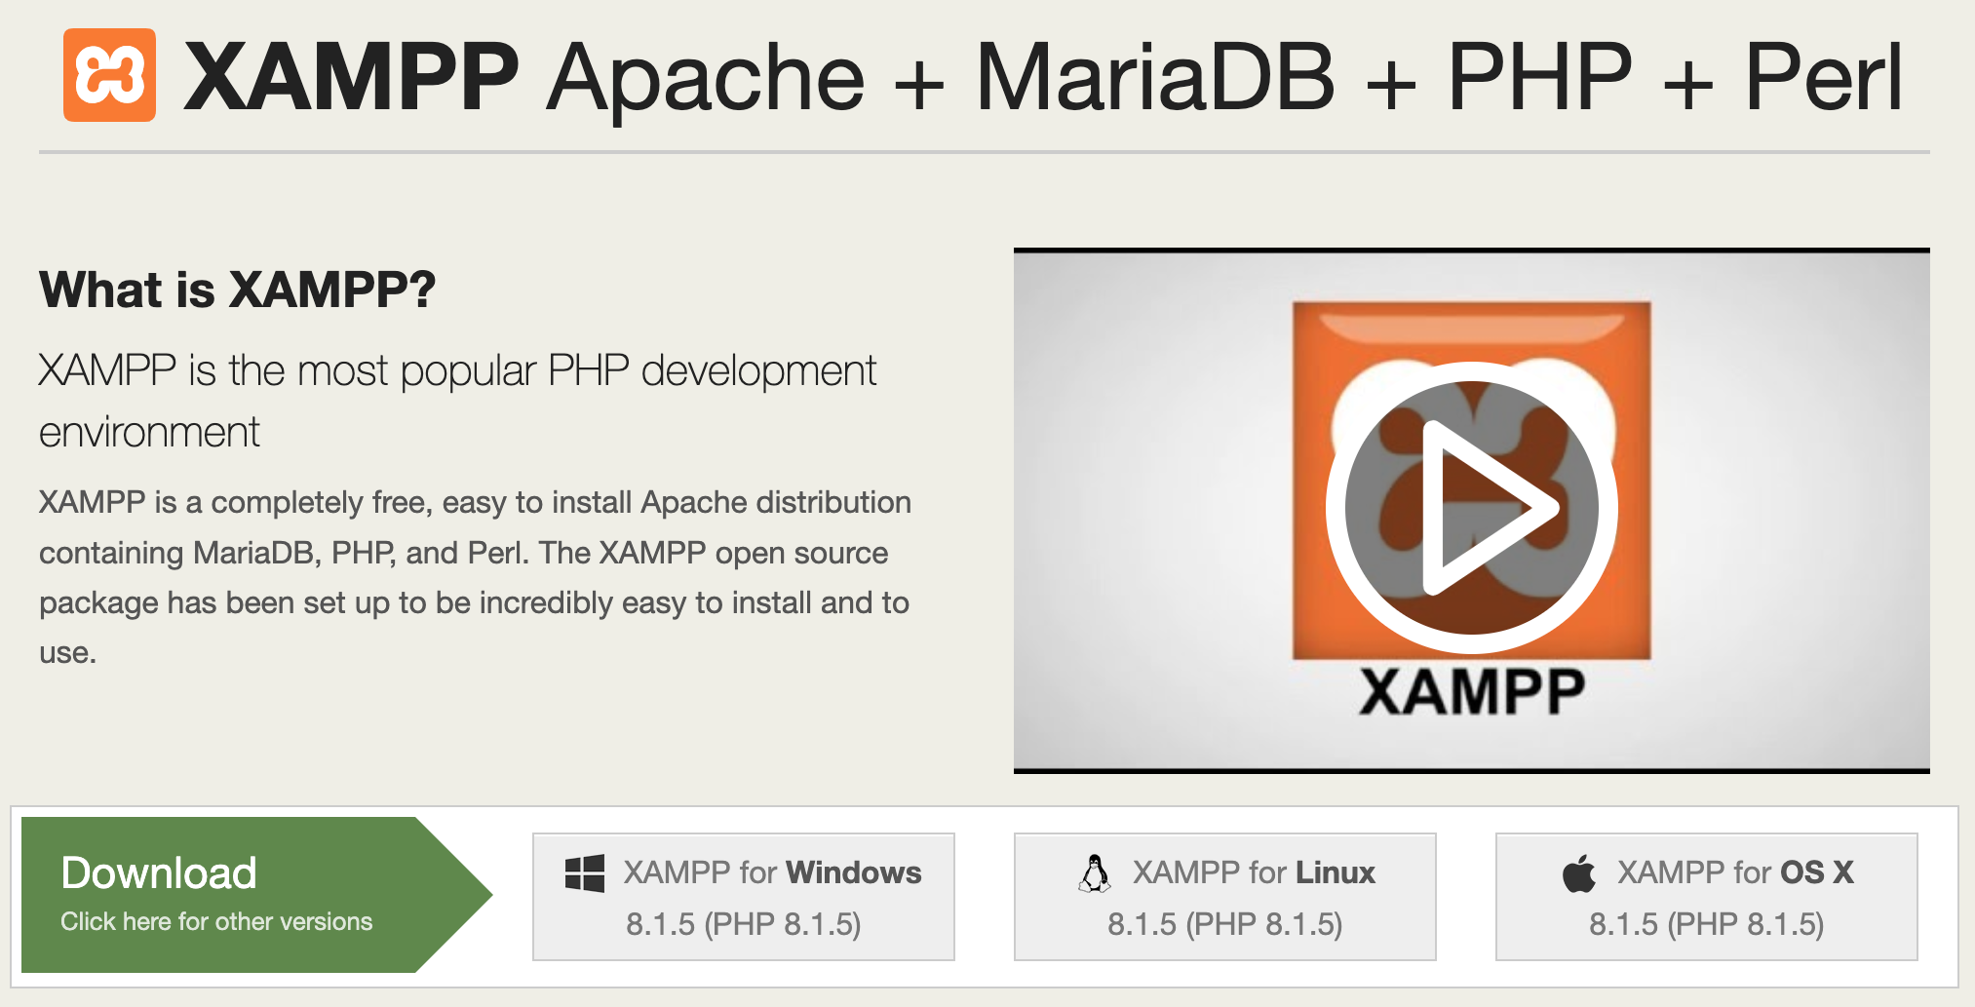
Download
Download a version that is compatible with your operating system from

Slide 5
Starting your server and running your saved PHP page
For mac OS watch this video.
For windows, search YouTube for “how to run a php file in xampp windows” you will find many results.

