Slide 1
Sublim text
for creating web pages

Slide 2
Sublim text website
https://www.sublimetext.com/

Slide 3
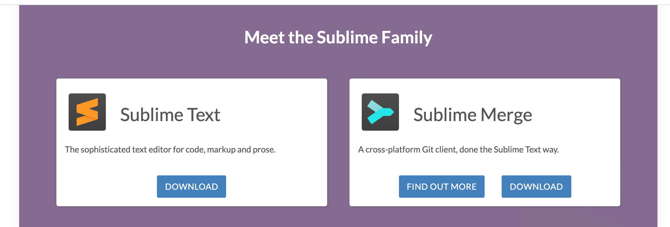
Download
Go to:
https://www.sublimetext.com/download ; or
the bottom of the page you will find:

Slide 4
Download
Download a version that is compatible with your operating system from:

Slide 5
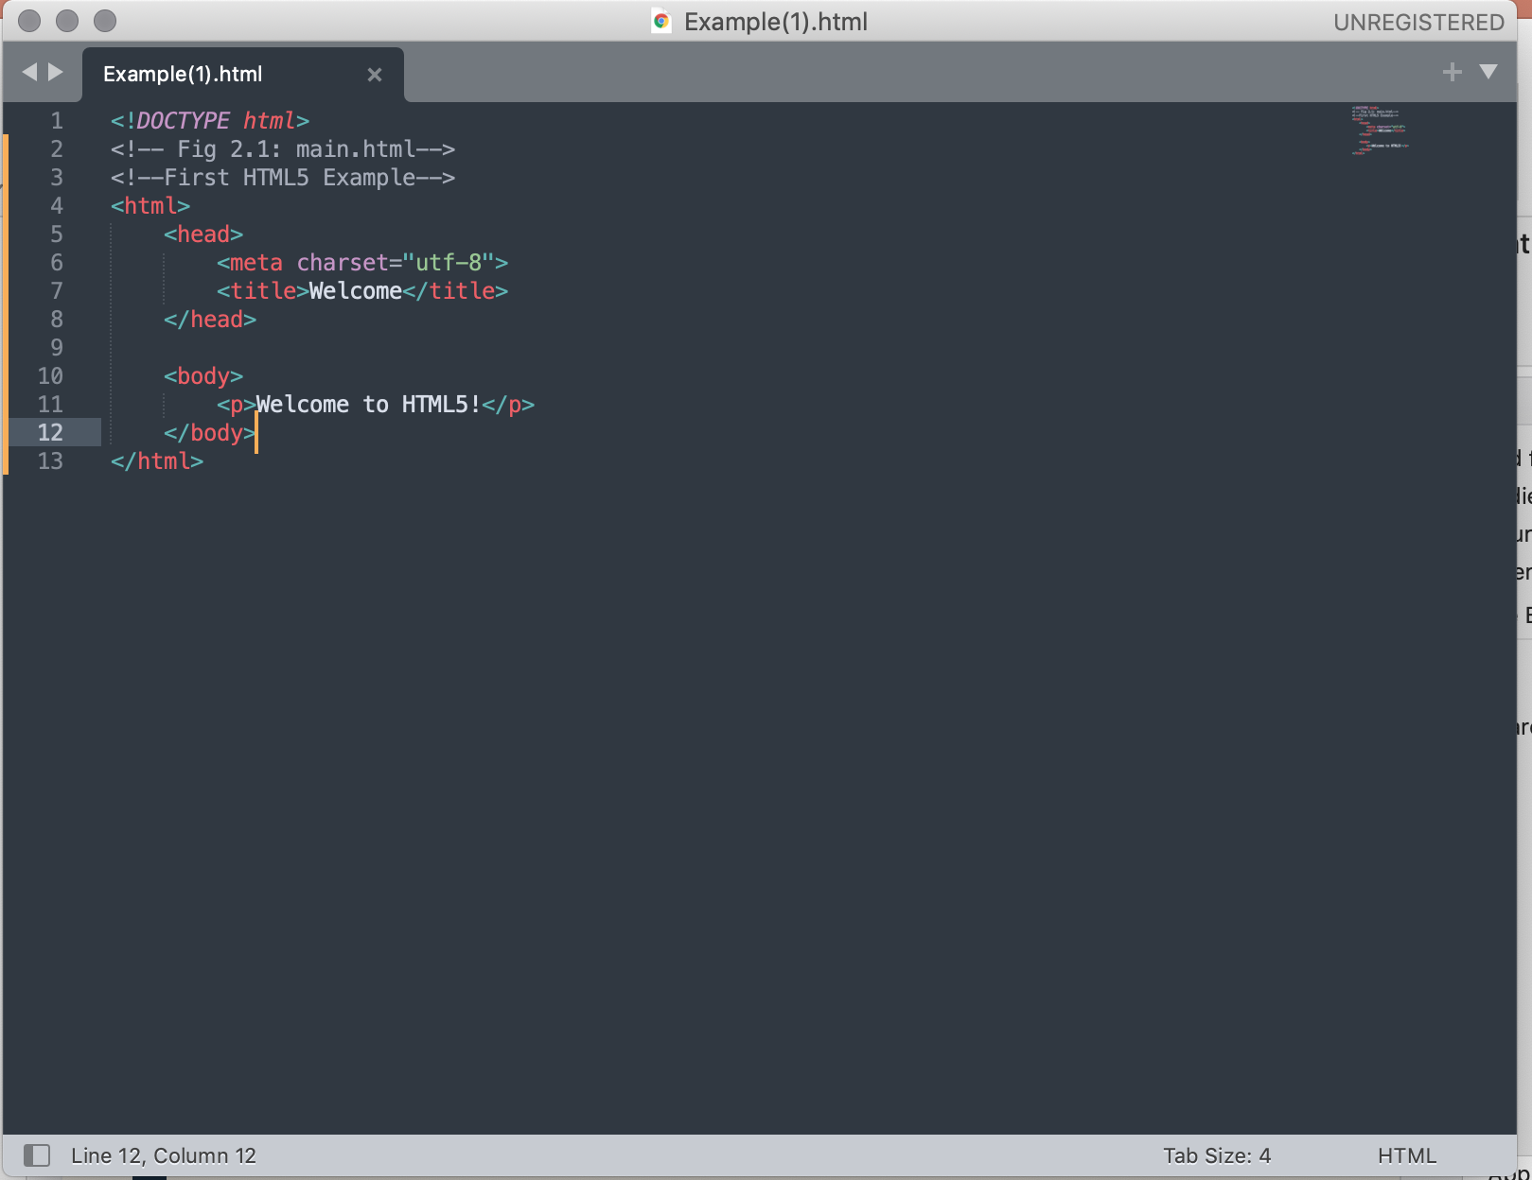
Getting Started
Write your HTML markup text.
save the document as .html file

Slide 6
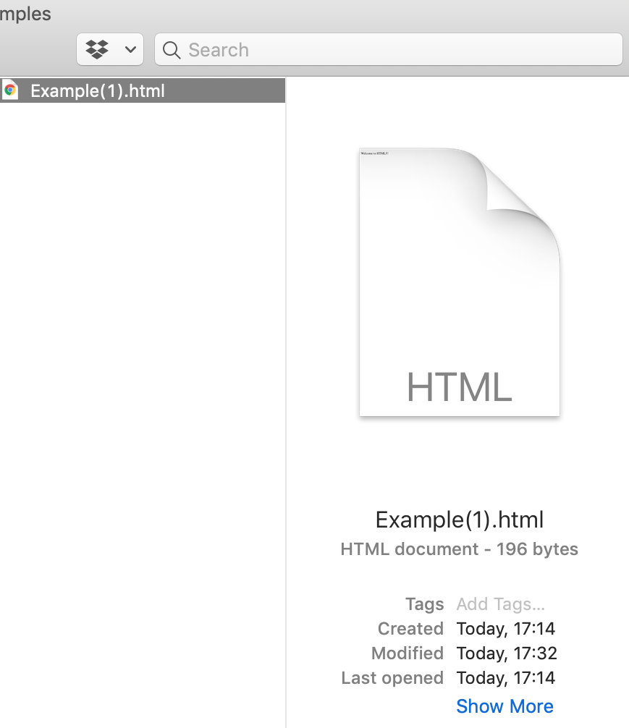
Running your saved html page
find your html file in your save location
try to open it by double-clicking the file
it will open in your browser

Slide 7
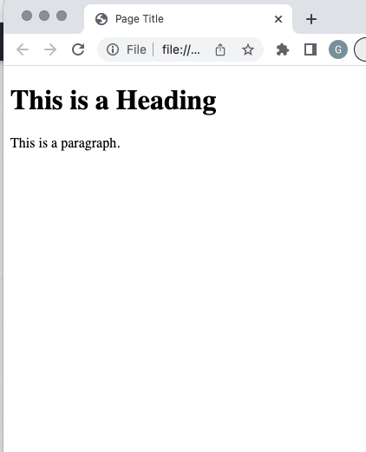
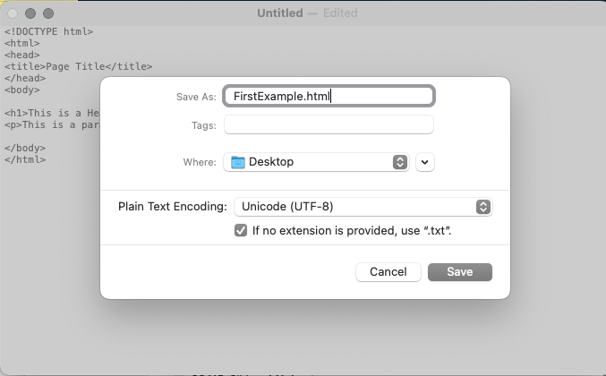
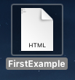
Other Options
You can use either Notpad (windows OS) or Textedit (Mac OS) to write your html file.
E.g.

Slide 8
Other Options
Read more about this in: https://www.w3schools.com/html/html_editors.asp

