Slide 1
General Tests for Chemistry 101
CLS 101: Chemistry For Nursing

Slide 2
Proteins Tests

Slide 3
1. Ninhydrin Test to Detect Amino Acids
All amino acids with free α-Amino group will react with ninhydrin to give deep Blue-purple colored product except proline, it gives yellow colored product.
Amino Acid + Ninhydrin Reduced Ninhydrin
(Blue-purple Color)

Slide 4
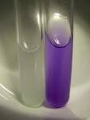
2. Biuret Test to Detect Proteins
The biuret test is a chemical test used for detecting the presence of peptide bonds. In the presence of peptides, a copper(II) ion forms a violet-colored complex in an alkaline solution
Peptide bond + Biuret Reagent Reduced Product
(violet Color)

Slide 5
Carbohydrates Tests

Slide 6
1. Reducing Properties of Monosaccharides and Disaccharides
Hexose sugars with a free or potentially free aldehyde or ketone group have reducing properties in alkaline solutions. These reducing sugars can reduce cupric ions (Cu+2) into cuprous ions (Cu+1).
Reducing + Benedict’s Cu2O + Oxidation
Sugar Reagent Product
(Cu+2) Brick Red ppt.
heat
pH 10.5

Slide 7
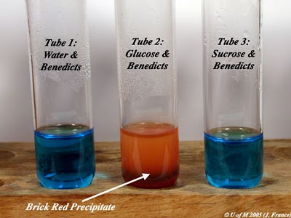

Slide 8
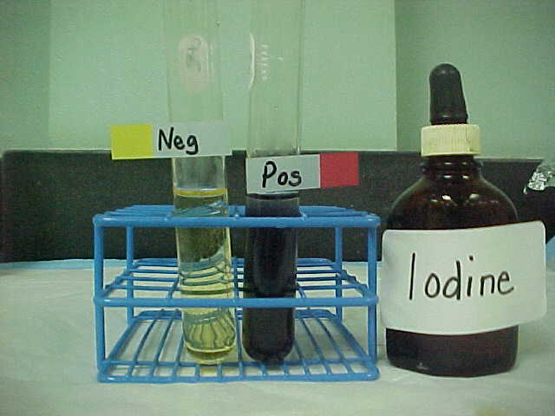
2. Iodine Test to Detect Polysaccharides
Starch will react with Iodine to produce a deep Blue color. This test will detect even small amounts of starch in a sample.
Starch + Iodine Deep Blue Color

Slide 9
Electrophoresis and Chromatography

Slide 10
Electrophoresis
The movement of a charged particle through a liquid under the influence of an applied electric current.
It is used to separate different molecules based on the charge and size e.g. Amino acids, nucleic acids, proteins,..
In electrophoresis, when molecules are subjected to electrical field:
Positively charged molecules move towards the cathode (cations).
Negatively charged molecules move towards the anode (anions).
Natural molecules stay stationary (do not move).

Slide 11
Types of Electrophoresis
Paper Electrophoresis.
Capillary Electrophoresis.
Gel Electrophoresis:
Agarose Gel Electrophoresis.
Starch Gel Electrophoresis.
Fulsed Field Gel Electrophoresis.
Polyacrelamide Gel Electrophoresis.
SDS-PAGE.

Slide 12
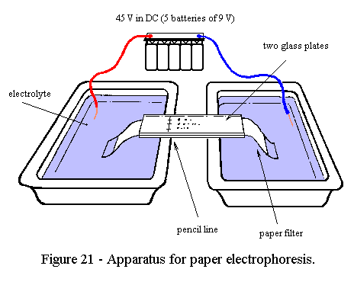
Paper Electrophoresis
This technique is useful for the separation of small charged molecules such as amino acids and small proteins. A strip of filter paper is moistened with buffer and the ends of the strip are immersed into buffer reservoirs containing the electrodes.

Slide 13
Paper Electrophoresis
The samples are spotted in the center of the paper, high voltage is applied, and the spots migrate according to their charges. After electrophoresis, the separated components can be detected by a variety of staining techniques, depending upon their chemical identity.

Slide 15
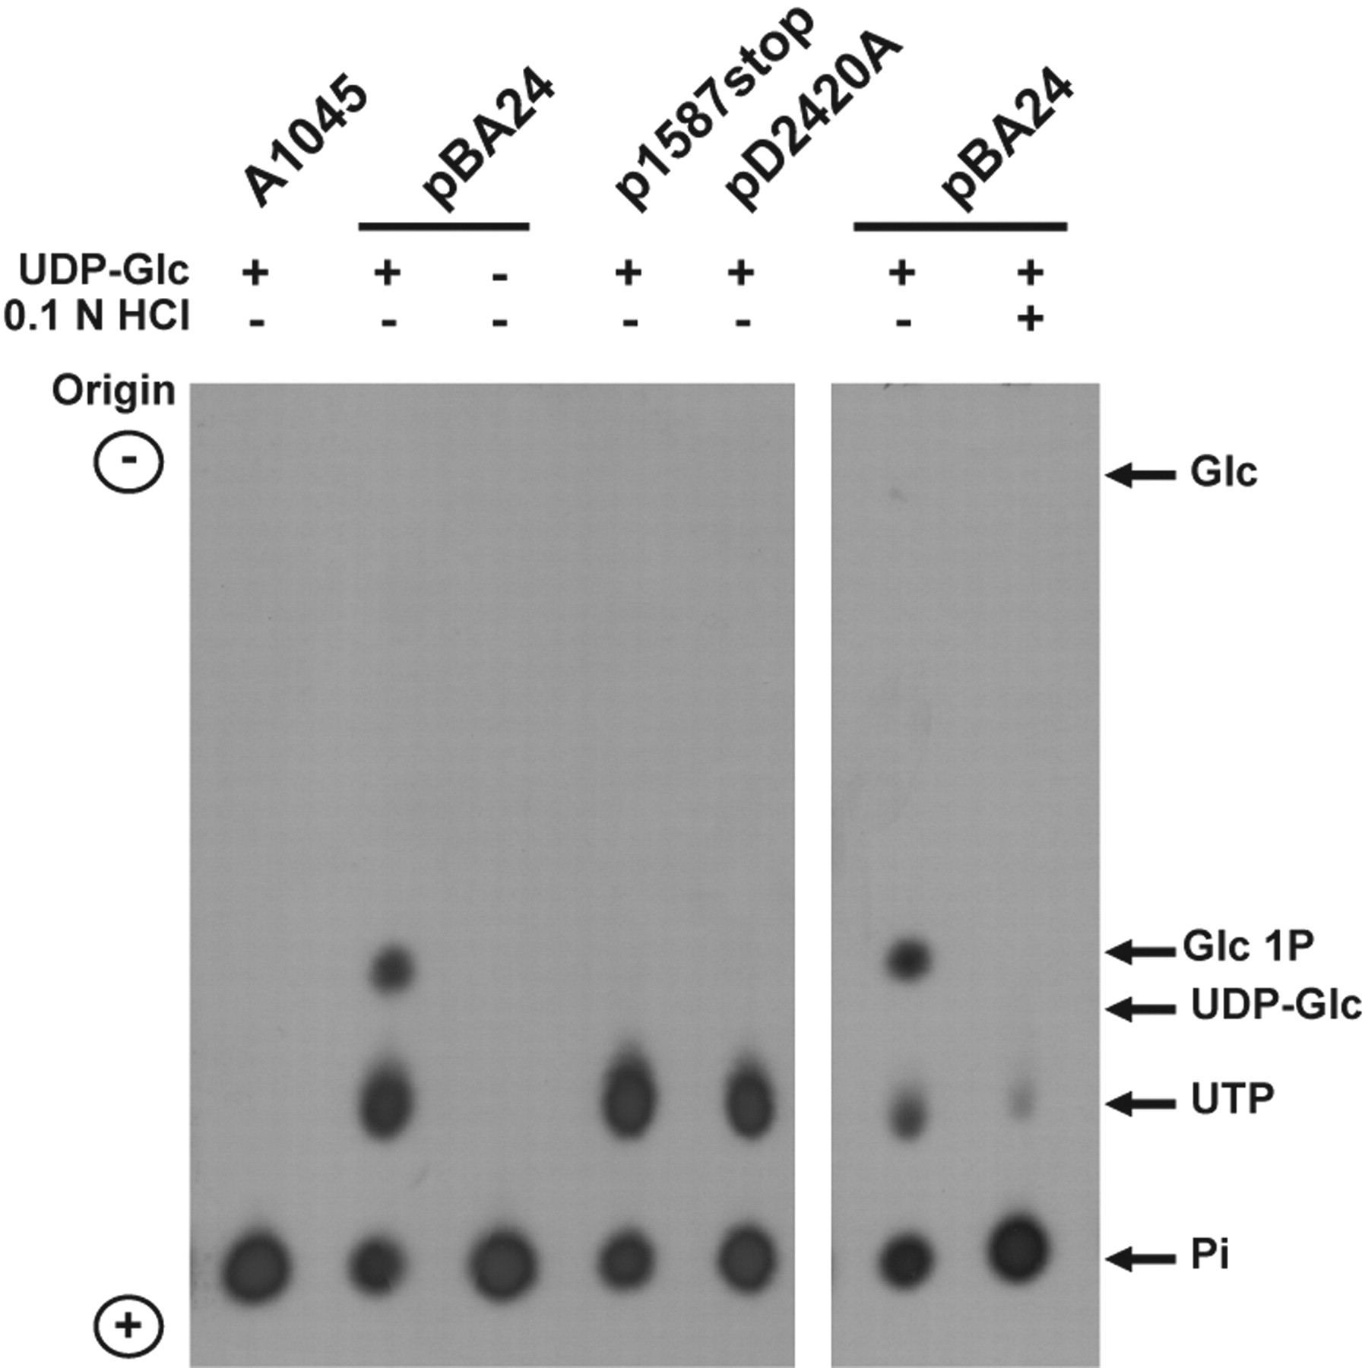

Slide 16
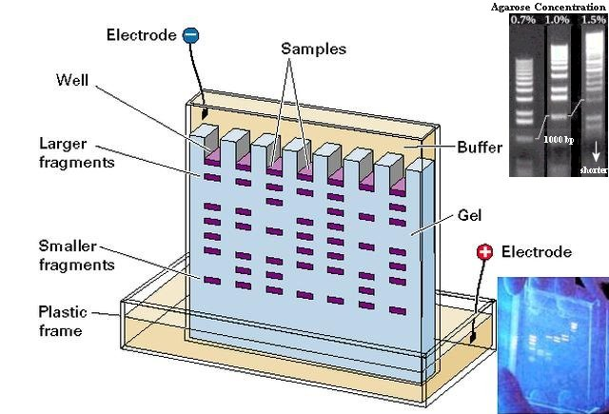
Gel Electrophoresis

Slide 17
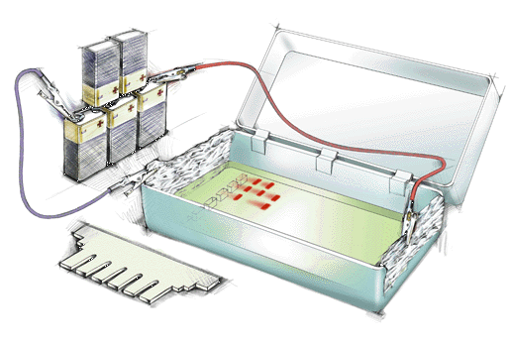
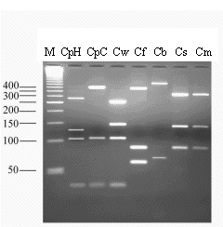
Gel Electrophoresis

Slide 18
SDS-PAGE
Sodium Dodecyl Sulfate Polyacrylamide Gel Electrophoresis, is a technique used in biochemistry, genetics and molecular biology to separate proteins.

Slide 19
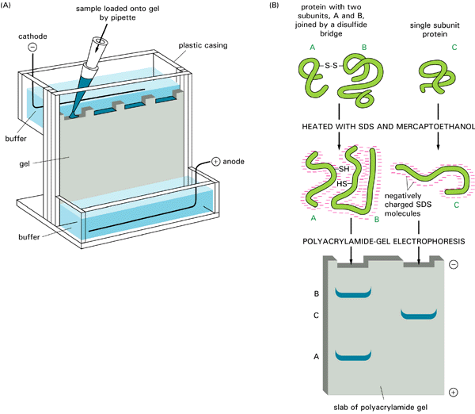
Electrophoresis
Figure: SDS polyacrylamide-gel electrophoresis (SDS-PAGE).

Slide 20
Chromatography
It is a group of separation or purification technique in which molecules are separated on the basis of the difference in their distribution between two phases i.e. the stationary phase (adsorbent) and the mobile phase (carrier).

Slide 21
Types of Chromatography
According to the stationary phase:
Column Chromatography.
Paper Chromatography.
According to the mobile phase:
Gas Chromatography.
Liquid Chromatography.
According to the mechanism of separation:
Ion Exchange Chromatography.
Size Exclusion Chromatography.

Slide 22
Paper Chromatography
Is a technique that involves placing a small dot or line of sample solution onto a strip of chromatography paper. The paper is placed in a jar containing a thin layer of solvent and sealed. As the solvent rises through the paper, it meets the sample mixture which starts to travel up the paper with the solvent. This paper is made of cellulose, a polar substance, and the compounds within the mixture travel farther if they are non-polar. More polar substances bond with the cellulose paper more quickly, and therefore do not travel as far.

Slide 23
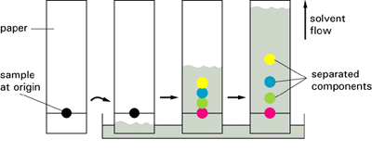
Paper chromatography
Figure: The separation of small molecules by paper chromatography. After the sample has been applied to one end of the paper (the "origin") and dried, a solution containing a mixture of two or more solvents is allowed to flow slowly through the paper by capillary action. Different components in the sample move at different rates in the paper according to their relative solubility in the solvent that is preferentially adsorbed onto the fibers of the paper.

Slide 24
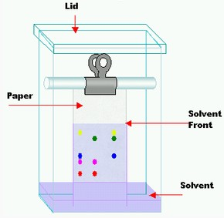
Rf is calculated:
Rf = Distance travelled by solute
Distance travelled by solvent

Slide 25
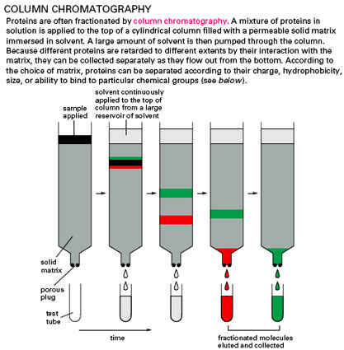

Slide 26
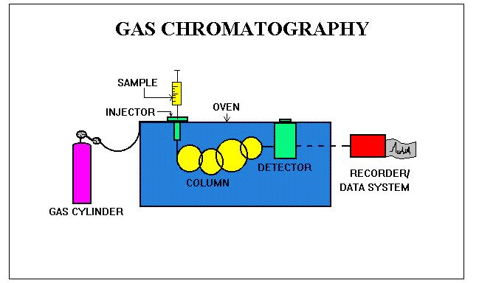

Slide 27
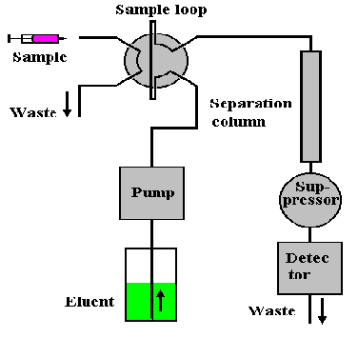
Ion Exchange Chromatography

