Slide 1
FLUID MECHANICS REVIEW
What is exactly a Fluid?
“A fluid is a substance that deforms continuously under the application of a shearing stress no matter how small”

Slide 2
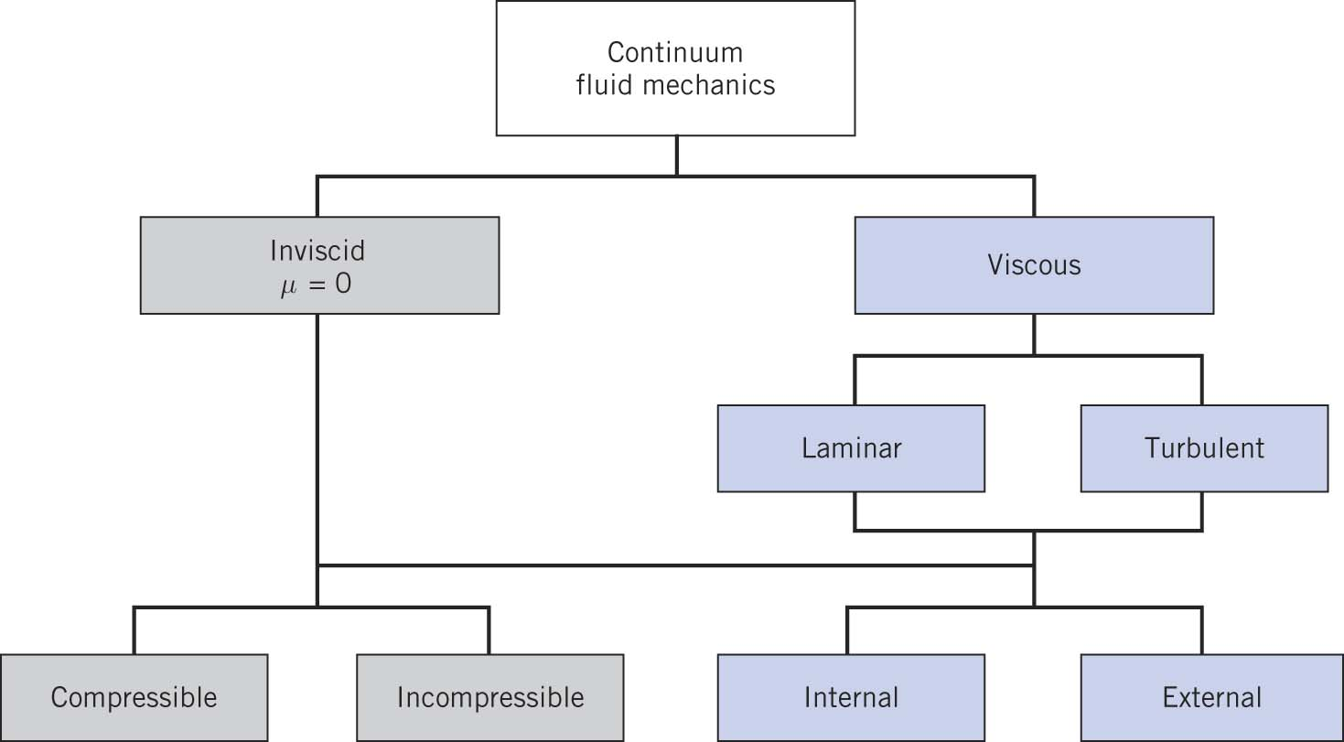
FLUID MECHANICS REVIEW
Classification of Fluid Motion

Slide 3
FLUID MECHANICS REVIEW
Basic Equations
Conservation of mass
Conservation of momentum (Newton's second law)
Conservation of moment of momentum (angular momentum)
First Law of Thermodynamics
Second Law of Thermodynamics
In addition we need
Equation of state (in case of gases)
Physical properties of fluid (density, viscosity, heat capacity)
Boundary conditions (non-slip condition: any fluid acquires the velocity of the surface it is in contact with)

Slide 4
FLUID MECHANICS REVIEW
What is a Control Volume
An arbitrary volume in space
Fluid pass through it's boundaries
Boundaries can be fixed or moving
The surface enclosing the control volume is called a Control Surface
Control surface can be real or imaginary

Slide 5
FLUID MECHANICS REVIEW
No-Slip Condition
Any fluid flowing over a solid surface, the layer of fluid in contact with the surface acquire the surface’s velocity.
Newtonian Fluid
Fluids in which the shear stress is directly proportional to the rate of deformation are called Newtonian Fluids. Other fluids where the stress is a more complex function are called Non-Newtonian Fluids.
μ is called viscosity or dynamic viscosity. It has dimensions of [M/Lt]
Units for μ are,
1 poise ≡1 g/(cm.s)
Kg/(m.s)
Another related quantity is the kinematic viscosity ν, defined as
Viscosity

Slide 6
FLUID MECHANICS REVIEW
Static, Dynamic and Stagnation Pressures
Static pressure, $p$, is the pressure that is felt by the fluid as it moves in the flow field
Stagnation pressure, $p_{0}$, is the pressure the fluid experiences as it is brought to rest with no losses
Dynamic pressure is $\frac{1}{2}ρV^{2}$
For incompressible flow
$$p_{0}=p+\frac{1}{2} ρV^{2}$$
If the static and stagnation pressures are known we can calculate the flow velocity as
$$V=\sqrt{\frac{2\left(p_{0}−p\right)}{ρ}}$$

Slide 7
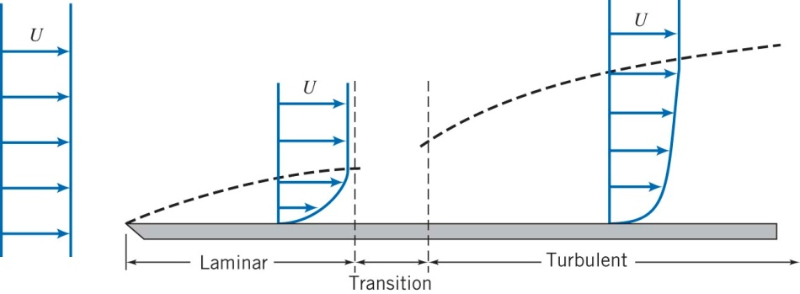
FLUID MECHANICS REVIEW
Boundary Layer on a flat plate

Slide 8
FLUID MECHANICS REVIEW
Fully Developed Flow
When a uniform flow enters a pipe or a duct, due to the no slip condition at the walls along the entire length of the pipe or duct, an entrance region is formed where the velocity profile develops.
A boundary layer, where viscous effects are dominant develops at the walls. The velocity of the is retarded due to the shear stress exerted by the walls.
The effects of the wall reach further away from the wall as the flow moves along the duct.

Slide 9
FLUID MECHANICS REVIEW
Entrance Region
Where $\overline{V}$ is the average speed in the pipe.
Since laminar flow is expected for Re<2300, then
$$L≅0.06\frac{ρ\overline{V}D}{μ}D=0.06 Re D≤0.06 \left(2300\right)D$$
$$L≤138D$$
For turbulent flows, the entrance length estimated from experiments is about $25−40$ pipe diameter. This is due to the fact that there is more mixing in turbulent flows.

Slide 10
FLUID MECHANICS REVIEW
Fully developed laminar flow in a circular pipe
The velocity is given by
$$u=−\frac{R^{2}}{4μ} \left(\frac{∂p}{∂x}\right)\left[1−{\left(\frac{r}{R}\right)}^{2}\right]$$
Shear Stress
$$τ_{rx}=\frac{r}{2}\left(\frac{∂p}{∂x}\right)$$
Volume flow rate
$$Q=\int_{A}{\vec{V}∙d\vec{A}}=\int_{A}{udθdr}=\int_{0}^{R}{u2πrdr}=−\frac{πR^{4}}{8μ}\left(\frac{∂p}{∂x}\right)$$

Slide 11
FLUID MECHANICS REVIEW
Fully developed laminar in a circular pipe
Volume flow rate as a function of pressure drop
$$Q=−\frac{πR^{4}}{8μ}\left[\frac{−∆p}{L}\right]=\frac{πR^{4}∆p}{8μL}=\frac{πD^{4}∆p}{128μL}$$
Average Velocity
$$\overline{V}=\frac{Q}{A}=\frac{Q}{πR^{2}}=−\frac{R^{2}}{8μ}\left(\frac{∂p}{∂x}\right)$$
Position of Maximum Velocity
$$\frac{du}{dr}=\frac{1}{2μ}\left(\frac{∂p}{∂x}\right)r=0$$
At $r=0 , \frac{du}{dr}=0→u=u_{max}=U=−\frac{R^{2}}{4μ}\left(\frac{∂p}{∂x}\right)=2\overline{V}$
Hence we can write the velocity in non-dimensional form as,
$$\frac{u}{U}=1−{\left(\frac{r}{R}\right)}^{2}$$

Slide 12
FLUID MECHANICS REVIEW
Turbulent velocity profile in fully developed pipe flow
The velocity profile can be approximated as,
$$\frac{\overline{u}}{U}={\left(\frac{y}{R}\right)}^{\frac{1}{n}}={\left(1−\frac{r}{R}\right)}^{\frac{1}{n}}$$
The exponent n varies with Reynolds number. This formula gives an infinite value of velocity gradient which is clearly incorrect however, it is still useful to calculate average velocities.
The exponent n can be written as a function of Reynolds number according to Hinze, as
$$n=−1.7+1.8\log{Re_{U}}$$
A value of n=7 is typical. This is referred to “one-seventh profile”
$$\frac{\overline{u}}{U}={\left(\frac{y}{R}\right)}^{\frac{1}{7}}={\left(1−\frac{r}{R}\right)}^{\frac{1}{7}}$$

Slide 13
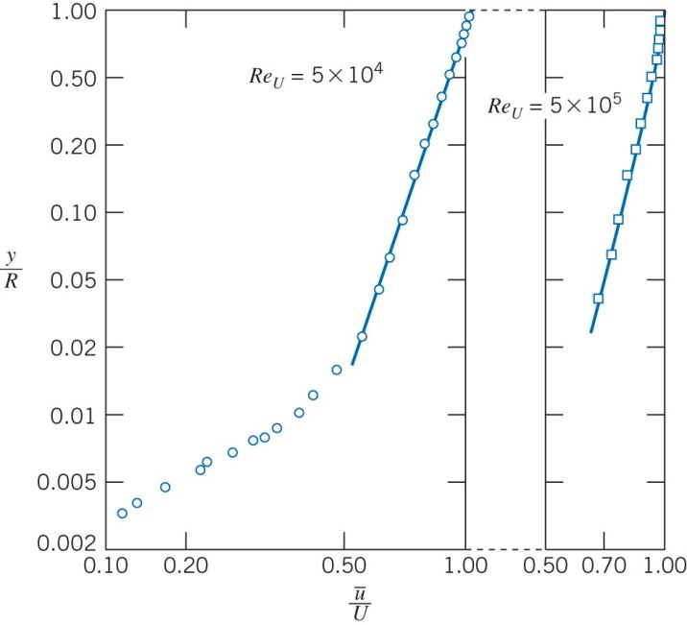
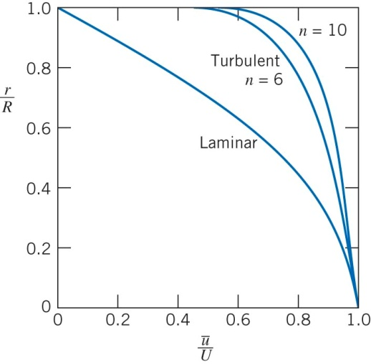
FLUID MECHANICS REVIEW
Turbulent velocity profile in fully developed pipe flow

Slide 14
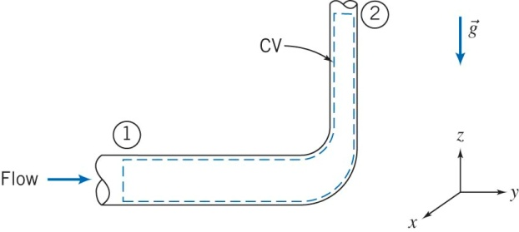
FLUID MECHANICS REVIEW
Energy Considerations in Pipe Flow
Assumptions:
${\dot{W}}_{s}=0$, ${\dot{W}}_{other}=0$
${\dot{W}}_{shear}=0$
Steady Flow
Incompressible flow
Internal energy and pressure are uniform across sections 1 and 2
$$\dot{Q}−{\dot{W}}_{s}−{\dot{W}}_{shear}−{\dot{W}}_{other}=\frac{∂}{∂t}\int_{cv}{eρd𝒱}+\int_{cv}{\left(e+pv\right)ρ\vec{V}∙d\vec{A}}$$
Where, $e=u+\frac{V^{2}}{2}+gz$and $u$ is the internal energy.

Slide 15
FLUID MECHANICS REVIEW
Energy Considerations in Pipe Flow
$$\left(\frac{p_{1}}{ρ}+\frac{α_{1}^{}{\overline{V}}_{1}^{2}}{2}+gz_{1}\right)−\left(\frac{p_{2}}{ρ}+\frac{α_{2}^{}{\overline{V}}_{2}^{2}}{2}+gz_{2}\right)=h_{l_{T}}$$
This equation enables us to calculate the losses occurring in a section of the pipe. If the flow is frictionless, then there are no losses $h_{l_{T}}=0$ and $α=1$. In this case we get Bernoulli’s equation.
Each term in the equation has dimensions of $\frac{L^{2}}{t^{2}}$ , so if we divide by $g$, it would have dimensions of length $L$.
$$\left(\frac{p_{1}}{ρg}+\frac{α_{1}^{}{\overline{V}}_{1}^{2}}{2g}+z_{1}\right)−\left(\frac{p_{2}}{ρg}+\frac{α_{2}^{}{\overline{V}}_{2}^{2}}{2g}+z_{2}\right)=\frac{h_{l_{T}}}{g}=H_{l_{T}}$$

