Slide 1
Experiment 3

Slide 2
Mercurimetric Determination of Blood or Urine Chloride
Principle:
*Chloride ions in a serum or urine sample are titrated with a standardized mercuric nitrate solution.
*Mercuric ions combine with chloride ions to form a soluble HgCL2 (Mercury(II) chloride )complex.
*The appearance of a violet-blue color produced by diphenyl carbazone indicator is used as the end point.

Slide 3
(mercuric ions combine with diphenyl carbazone to form a violet colored complex).
*The dissociation constant for HgCL2 is smaller than the dissociation constant for the Hg-diphenyl carbazone complex, so all the chloride ions must be complexed before the mercuric ions complex with diphenyl carbazone.
*The mercuric nitrate solution is standardized by titrating against a standard solution of NaCL.

Slide 4
Reagent:
1-0.0009 M mercuric nitrate in 0.04 M HNO3 = Hg(NO3)2.
2-Diphenylcarbazone (indicator).
3-0.01 M NaCL.
4-10% Na2WO4 solution (Sodium Tungstate).
5-H2SO4 (Sulfuric Acid).

Slide 5
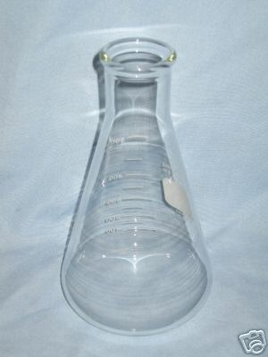
Procedure:
I)Standardization of Hg(NO3)2:
1- 2 ml NaCL
2- 4 drops indicator
3- Titrate with Hg(NO3)2 until get faint purple color (end point).

Slide 6
II)Determination of Chloride in Serum:
a)
1- 0.5 ml serum
2- 3.5 ml H2O
3- 0.5 ml Na2WO4
4- 0.5 ml H2SO4
5-Centrifuged then filtered to get Protein free filtrate (un known).

Slide 7
b)
Dilute the unknown (1:10)
1 ml unknown + 9 ml distal water
c)
2 ml dilute unknown
4 drops indicator
Titrate with Hg(NO3)2 until get faint purple color

Slide 8
Calculation:
A) calculate the concentration of Hg(NO3)2
NaCL + Hg(NO3)2 2 HgCL + Na(NO3)2
M NaCL x V NaCL = 2 ( M Hg x V Hg )
0.01 x 2 = 2 ( MHg x 13.2 )
MHg = 0.00076 M

Slide 9
b)calculate the concentration of chloride
MCL x VCL = 2( MHg x VHg )
MCL x 0.2 = 2( 0.00076 x 5.7 )
MCL = 0.04332 M

