Slide 1
The Market for Foreign Exchange
Chapter Five
© 2021 McGraw Hill. All rights reserved. Authorized only for instructor use in the classroom. No reproduction or further distribution permitted without the prior written consent of McGraw Hill.

Slide 2
Overview
Money represents purchasing power
Market for foreign exchange is the largest financial market in the world by virtually any standard
Foreign exchange (F X) market encompasses the conversion of purchasing power from one currency into another, bank deposits of foreign currency, the extension of credit denominated in a foreign currency, foreign trade financing, trading in foreign currency options and futures contracts, and currency swaps

Slide 3
Function and Structure of F X Market
Function of F X market is to assist clients in the conduct of international commerce
  Service that commercial banks provide to their clients.
Spot and forward F X markets are O T C markets, meaning trading does not take place in a central marketplace where buyers and sellers congregate
Major market segments
  Australasia: Sydney, Tokyo, Hong Kong, Singapore, and Bahrain.
  Europe: Zurich, Frankfurt, Paris, Brussels, Amsterdam, and London.
  North America: New York, Montreal, Toronto, Chicago, San Francisco, and Los Angeles.
Notes:
Over-the-Counter (OTC) Market
Trading market in which there is no central marketplace; instead, buyers and sellers are linked via a network of telephones, telex machines, computers, and automated dealing systems.
When companies do not meet the requirements to list on a standard market exchange such as the NYSE, their securities can be traded OTC but may still be subject to some regulation by the Securities and Exchange Commission.

Slide 4
F X Market Participants
F X market is a two-tier market
  Interbank (wholesale) market:
    About 100 to 200 banks worldwide stand ready to “make a market” in foreign exchange in order to serve their retail customers in conducting commerce and international investments.. etc.
    Nonbank dealers account for about 40% of the market.
    There are F X brokers who match buy and sell orders but do not carry inventory and F X specialists.
    Most of interbank trades are speculative or arbitrage transactions
  Client (retail) market :
Market participants include international banks, their customers, nonbank dealers, F X brokers, and central banks.
Notes:
Interbank:
The interbank market is a global network utilized by financial institutions to trade currencies and other currency derivatives directly between themselves.
Banks use the interbank market to manage their own exchange rate and interest rate risk as well as to take speculative positions based on research.
Most transactions within the interbank network are for a short duration—anywhere between overnight to six months.
Nonbank dealers are large nonbank financial institutions such as investment banks, mutual funds, pension funds, and hedge funds, whose size and frequency of trades make it cost effective to establish their own dealing rooms to trade directly in the interbank market for their foreign exchange needs.
Central Banks
Central Banks of all countries participate in the Forex market to some extent. Most of the times, this participation is official. Although many times Central Banks do participate in the market by covert means. This is because every Central Bank has a target range within which they would like to see their currency fluctuate. If the currency falls out of the given range, Central Banks conduct open market operations to bring it back in range. Also, whenever the currency of a given nation is under speculative attack, Central Banks participate extensively in the market to defend their currency.
Retail Market Participants
Retail market participants include tourists, students and even patients who are travelling abroad. Then there are also a variety of small businesses that indulge in foreign trade. Most of the retail participants participate in the spot market whereas people with long term interests operate in the futures market. This is because these participants only buy/sell currency when they have a personal/professional requirement and dealing with foreign currencies is not a part of their regular business.
Speculators
Speculators are a class of traders that have no genuine requirement for foreign currency. They only buy and sell these currencies with the hope of making a profit from it. The number of speculators increases a lot when the market sentiment is high and everyone seems to be making money in the Forex markets. Speculators usually do not maintain open positions in any currency for a very long time. Their positions are transient and are only meant to make a short term profit.
Arbitrageurs
Arbitrageurs are traders that take advantage of the price discrepancy in different markets to make a profit. Arbitrageurs serve an important function in the foreign exchange market. It is their operations that ensure that a market as large, as decentralized and as diffused as the Forex market functions efficiently and provides uniform price quotations all over the world. Whenever arbitrageurs find a price discrepancy in the market, they start buying in one place and selling in another till the discrepancy disappears.
Nonbank dealers are large nonbank financial institutions such as investment banks, mutual funds, pension funds, and hedge funds, whose size and frequency of trades make it cost effective to establish their own dealing rooms to trade directly in the interbank market for their foreign exchange needs.

Slide 5
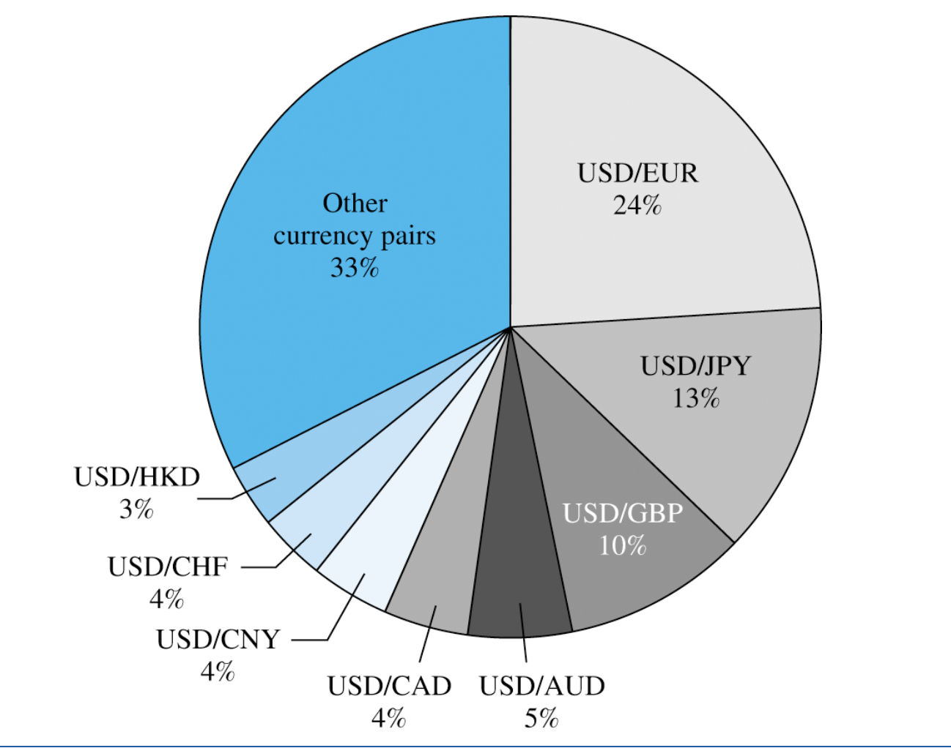
Average Daily Foreign Exchange Turnover by Currency Pair
Note: Turnover is net of local interdealer double-counting. Currency swaps and F X options are not included.
Source: Tabulated from data in Triennial Central Bank Survey, Preliminary Results, Bank for International Settlements, September 2019.
Access the text alternative for slide images.
Notes:
For each foreign exchange instrument, a reporting dealer specifies trades “with reporting dealers, local” or “with reporting dealers, cross-border”. These categories are used to eliminate double-counting, which occurs when two reporting dealers each report the same transaction.

Slide 6
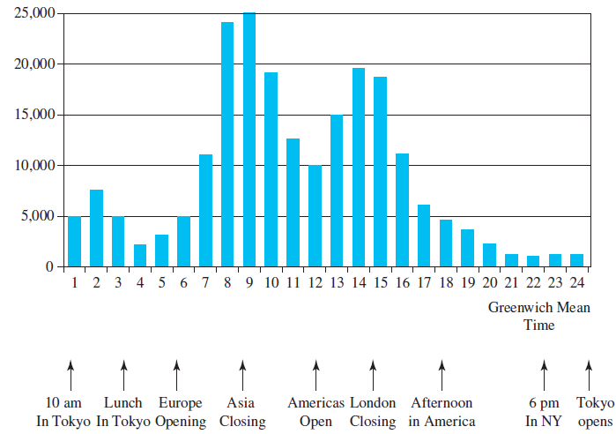
Average Electronic Foreign Exchange Conversations per Hour (Monday to Friday, 2001)
Source: Federal Reserve Bank of New York, “The Foreign Exchange Market in the United States,” 2001, www.newyorkfed.org.
Access the text alternative for slide images.

Slide 7
Correspondent Banking Relationships
Interbank market
  Made up of a network of correspondent banking relationships, with large commercial banks maintaining demand deposit accounts (that is, correspondent banking accounts) with one another.
  Correspondent bank account network facilitates the efficient functioning of the F X market.
Notes:
A demand deposit account (DDA) is a bank account from which deposited funds can be withdrawn at any time, without advance notice.
EXAMPLE 5.1: Correspondent Banking Relationship
As an example of how the network of correspondent bank accounts facilitates international foreign exchange transactions, consider U.S. Importer desiring to purchase merchandise from Dutch Exporter invoiced in euros, at a cost of €750,000. U.S. Importer will contact his U.S. Bank and inquire about the $/€ exchange rate. Say U.S. Bank offers a price of $1.3092/€1.00. If U.S. Importer accepts the price, U.S. Bank will debit U.S. Importer’s demand deposit account $981,900 = €750,000 × 1.3092 for the purchase of the euros. U.S. Bank will instruct its correspondent bank in the euro zone, EZ Bank, to debit its correspondent bank account €750,000 and to credit that amount to Dutch Exporter’s bank account. U.S. Bank will then credit its books $981,900, as an offset to the $981,900 debit to U.S. Importer’s account, to reflect the decrease in its correspondent bank account balance with EZ Bank.

Slide 8
Correspondent Banking Communications
International commercial banks communicate with one another using:
  SWIFT: Society for Worldwide Interbank Financial Telecommunications.
  CHIPS: Clearing House Interbank Payments System.
  ECHO: Exchange Clearing House Limited.
    First global clearinghouse for settling interbank F X transactions
Notes:
The Society for Worldwide Interbank Financial Telecommunication (SWIFT) allows international commercial banks to communicate instructions of the type in this example to one another. SWIFT is a private nonprofit message transfer system that is used by more than 11,000 financial institutions in more than 200 countries and territories around the world.
. The Clearing House (CHIPS), formerly known as the Clearing House Interbank Payments System, in cooperation with the U.S. Federal Reserve Bank System, called Fedwire, provides a clearinghouse for the interbank settlement for over 95 percent of U.S. dollar payments between international banks. CHIPS processes an average of $1.5 trillion of payments each day. Returning to our example, suppose U.S. Bank first needed to purchase euros in order to have them for transfer to Dutch Exporter. U.S. Bank can use CHIPS for settling the purchase of euros for dollars from, say, Swiss Bank, with structured invoice information via SWIFT to Swiss Bank to deposit the euros in its account with EZ Bank and to EZ Bank to transfer ownership to Dutch Exporter. The transfer between Swiss Bank and EZ Bank would in turn be accomplished through correspondent bank accounts or through CHIPS multilateral netting capability.
Exchange Clearing House Limited (ECHO), the first global clearinghouse for settling interbank FX transactions, began operation. ECHO was a multilateral netting system that on each settlement date netted a client’s payments and receipts in each currency, regardless of whether they are due to or from multiple counterparties. Multilateral netting eliminates the risk and inefficiency of individual settlement. In 1997, ECHO merged with CLS Services Limited and operates currently as part of CLS Group. The 18 most actively traded currencies are currently eligible for settlement among 70 members.

Slide 9
Spot Market
Spot market involves almost immediate purchase or sale of foreign exchange
One can buy (take a long position) or sell (take a short position) foreign exchange
Cash settlement is usually made in two business days after the transaction for trades between the U.S. dollar and a non-North American currency

Slide 10
Spot Rate Quotations 1
Spot rate currency quotations can be stated in direct or indirect terms
  Direct quotations refer to the price of one unit of a foreign currency in terms of the domestic currency.
  Indirect quotation is the price of one domestic currency in terms of a foreign currency.

Slide 11
Average Daily Foreign Exchange Turnover by Instrument and Counterparty
Instrument/ Counterparty | Turnover in U S D (billion) | Turnover in U S D (billion) | Percent | Percent
Spot |  | 1,987 |  | 32
with reporting dealers | 593 |  | 10
with other financial institutions | 1,236 |  | 20
with nonfinancial customers | 159 |  | 3
Outright Forwards |  | 999 |  | 16
with reporting dealers | 268 |  | 4
with other financial institutions | 615 |  | 10
with nonfinancial customers | 116 |  | 2
Foreign Exchange Swaps |  | 3,202 |  | 52
with reporting dealers | 1,498 |  | 24
with other financial institutions | 1,537 |  | 25
with nonfinancial customers | 166 |  | 3
Total |  | 6,188 |  | 100
Note: Turnover is net of local and cross-border interdealer double-counting.
Source: Tabulated from data in Table 4 in Triennial Central Bank Survey. Preliminary Results. Bank for International Settlements, September 2019.

Slide 12
Exchange Rates 1
Currencies | April 3, 2019
U.S.-dollar foreign-exchange rates in late aftrnoon New York trading
 | —Wed —
Country/Currency | In US$ | Per US$
Americas
Argentina peso | .0233 | 42.854
Brazil real | .2583 | 3.8715
Canada dollar | .7493 | 1.3345
Chile peso | .001500 | 666.73
Colombia peso | .000320 | 3123.6
Ecuador US dollar | 1 | 1
Mexico peso | .0520 | 19.220
Peru new sol | .3034 | 3.296
Uruguay peso | .02965 | 33.4300
Asia Pacific
Australian dollar | .7113 | 1.4060
1-mos forward | .7117 | 1.4051
3-mos forward | .7125 | 1.4035
6-mos forward | .7139 | 1.4008
China yuan | .1490 | 6.7114
Hong Kong dollar | .1274 | 7.8494
 | —Wed —
Country/Currency | In US$ | Per US$
Asia Pacific
India rupee | .01461 | 68.425
Indonesia rupiah | .0000703 | 14223
Japan yen | .00897 | 111.49
1-mos forward | .00899 | 111.22
3-mos forward | .00903 | 110.70
6-mos forward | .00910 | 109.90
Malaysia ringgit | .2452 | 4.0790
New Zealand dollar | .6778 | 1.4753
Pakistan rupee | .00709 | 140.47
Philippines peso | .0192 | 52.124
Singapore dollar | .7387 | 1.3537
South Korea won | .0008814 | 1134.5
Taiwan dollar | .03246 | 30.812
Thailand baht | .03150 | 31.748
Vietnam dong | .00004 | 23146.3
Notes:
First column >> Direct (from US perspective)
Second column >> Indirct

Slide 13
Exchange Rates 2
 | —Wed —
Country/Currency | In US$ | Per US$
Europe
Czech Rep. koruna | .04372 | 22.874
Denmark krone | .1505 | 6.6457
Euro area euro | 1.1233 | .8903
1-mos forward | 1.1262 | .8880
3-mos forward | 1.1319 | .8835
6-mos forward | 1.1407 | .8767
Hungary forint | .00351 | 284.71
Norway krone | .1167 | 8.5728
Poland zloty | .2619 | 3.8183
Russia ruble | .01533 | 65.241
Sweden krona | .1079 | 9.2695
Switzerland franc | 1.0018 | .9982
1-mos forward | 1.0047 | .9953
3-mos forward | 1.0104 | .9897
6-mos forward | 1.0193 | .9811
Turkey lira | .1778 | 5.6248
 | —Wed —
Country/Currency | In US$ | Per US$
Europe
UK pound | 1.3158 | .7600
1-mos forward | 1.3180 | .7588
3-mos forward | 1.3218 | .7565
6-mos forward | 1.3277 | .7532
Middle East/Africa
Bahrain dinar | 2.6526 | .3770
Egypt pound | .0577 | 17.325
Israel shekel | .2777 | 3.6016
Jordan dinar | 1.4104 | .7090
Kuwait dinar | 3.2854 | .3044
Lebanon pound | .00066 | 1507.50
Saudi Arabia riyal | .2666 | 3.7504
South Africa rand | .0707 | 14.146
U A E dirham | .2723 | 3.6730
Source: Compiled using data from Bloomberg and OANDA online currency converter at www.oanda.com.

Slide 14
Spot Rate Quotations 2
Most currencies are quoted in European terms, meaning the U.S. dollar is priced in terms of the foreign currency (an indirect quote from the U.S. perspective)
  American terms are a direct quote from the U.S. perspective.
Cross-exchange rate is an exchange rate between a currency pair where neither currency is the U.S. dollar

Slide 15
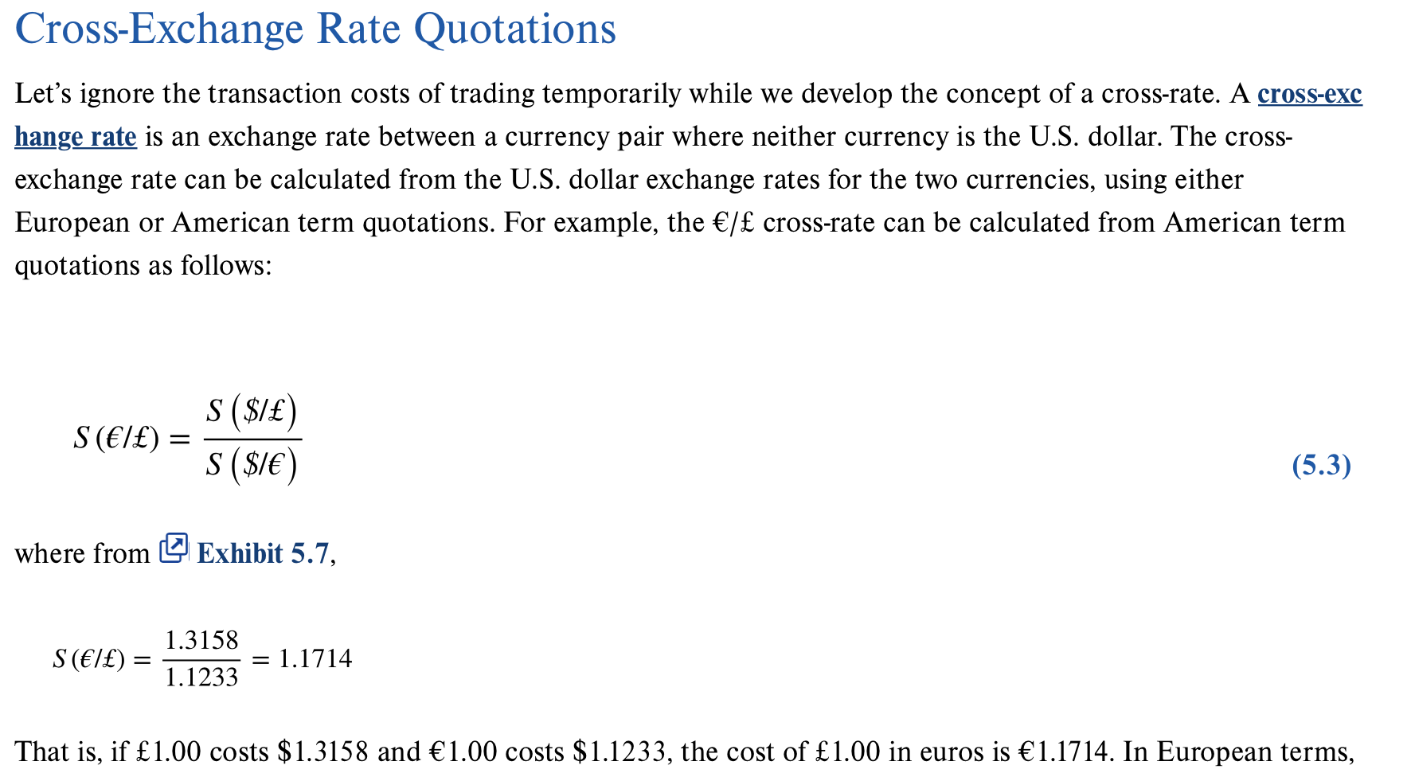

Slide 16
The Bid-Ask Spread
Interbank F X traders buy currency for inventory at the bid price and sell from inventory at the higher offer or ask price
Average of the bid and ask rates are called mid-rates
Bid-ask spread allows dealers to earn a profit
Notes:
Ask price, also called offer price, offer, asking price, or simply ask, is the price a seller states they will accept.
A bid price is the highest price that a buyer is willing to pay for a goods. It is usually referred to simply as the "bid"

Slide 17
Spot F X Trading
In the interbank market, the standard-size trade among large banks in the major currencies is for the U.S.-dollar equivalent of $10,000,000, or “ten dollars” in trader jargon.
Spot quotations are good for only a few seconds. If a trader cannot immediately make up his mind whether to buy or sell at the proffered prices, the quotes are likely to be withdrawn.
In conversation, interbank FX traders use a shorthand abbreviation in expressing spot currency quotations. Consider the $/£ bid-ask quotes from above, $1.3153–$1.3158. The “1.31” is known as the bid quote big figure, and it is assumed to be known by all traders. The second two digits to the right of the decimal place are referred to as the small figure.

Slide 18
Cross-Rate Trading Desk
Currency against currency trade is when a customer wants to trade out a nondollar currency for another nondollar currency
  For example, a customer wants to trade out of British pounds into Swiss francs.
  Typically handled by the bank selling British pounds for U.S. dollars and then selling U.S. dollars for Swiss francs.
  Handled at the cross-rate desk of the bank.

Slide 19
Calculating Cross-Exchange Rate Bid-Ask Spread
EXAMPLE 5.2: Calculating the Cross-Exchange Rate Bid-Ask Spread
Let’s assume (as we did earlier) that the $/£ bid-ask prices are $1.3153–$1.3158 and the £/$ bid-ask prices are £0.7600–£0.7603. Let’s also assume the $/€ bid-ask prices are $1.1228–$1.1233 and the €/$ bid-ask prices are €.8903–€.8906. These bid and ask prices and Equation 5.12 imply that S^{b}(€/£) = 1.3153 × .8903 = 1.17101. The reciprocal of S^{b}(€/£) implies that Sª(£/€) = .8540. Analogously, Equation 5.13 suggests that Sª(€/£) = 1.3158 × .8906 = 1.17185, and its reciprocal implies that S^{b}(£/€) = .8534. That is, the €/£ bid-ask prices are €1.17101–€1.17185 and the £/€ bid-ask prices are £0.8534–£0.8540. Note that the cross-rate bid-ask spreads are much larger than the American or European bid-ask spreads. For example, the €/£ bid-ask spread is €0.0008 versus a €/$ spread of €0.0003. The £/€ bid-ask spread is £0.0006 versus the $/€ spread of $0.0005, which is a sizable difference since a British pound is priced at more than 1.3 dollars. The implication is that cross-exchange rates implicitly incorporate the bid-ask spreads of the two transactions that are necessary for trading out of one nondollar currency and into another. Hence, even when a bank makes a direct market in one nondollar currency versus another, the trade is effectively going through the dollar because the “currency against currency” exchange rate is consistent with a cross-exchange rate calculated from the dollar exchange rates of the two currencies. Exhibit 5.9 provides a more detailed presentation of cross-rate foreign exchange transactions.

Slide 20
Cross-Rate Foreign Exchange Transactions
 | American Terms |  | European Terms
Bank Quotations | Bid | Ask |  | Bid | Ask
British pounds | 1.3153 | 1.3158 |  | .7600 | .7603
Euros | 1.1228 | 1.1233 |  | .8903 | .8906
a. Bank Customer wants to sell £1,000.000 for euros. The Bank will first buy British pounds (sell U.S. dollars) for $1.3153. The sale of pounds yields Bank Customer: £1,000,000 × $1.3153/£ = $1,315,300. The Bank will then buy dollars (sell euros) for €0.8903. The sale of dollars yields Bank Customer: $1,315,300 × €0.8903/$ = €1,171,012. Bank Customer effectively sold British pounds for euros at a €/£ bid price of €1,171,012 ÷ £1,000,000 = €1.17101/£
b. Bank Customer wants to sell €1,000,000 for British pounds. The Bank will first sell dollars (buy euros) at €0.8906/$. The sale of euros yields Bank Customer: $1,000,000 ÷ €0.8906/$ = $1,122,838. The Bank will sell British pounds (buy dollars) at $1.3158. The sale of dollars yields Bank Customer: $1,122,838 ÷ $1.3158/£ = £853,350 Bank Customer effectively bought British pounds at a €/£ ask price of €1,000,000 ÷ £853,350 = €1.17185/£ From parts (a) and (b), we see the currency against currency bid-ask spread for British pounds is €1.17101−€1.17185, the same as the bid-ask spread computed in Example 5.2.

Slide 21
Triangular Arbitrage
Triangular arbitrage is the process of trading out of the U.S. dollar into a second currency, then trading it for a third currency, which in turn is traded for U.S. dollars
  Purpose is to earn an arbitrage profit via trading from the second to the third currency when the direct cross-exchange rate between the two is not in alignment with the implied cross-exchange rate.
  Arbitrage is a zero-risk, zero-investment strategy from which a profit is guaranteed.

Slide 22
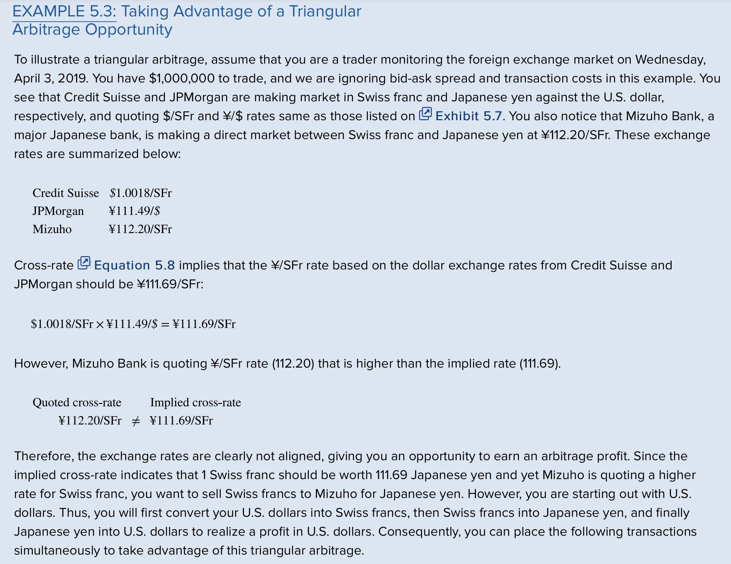

Slide 23
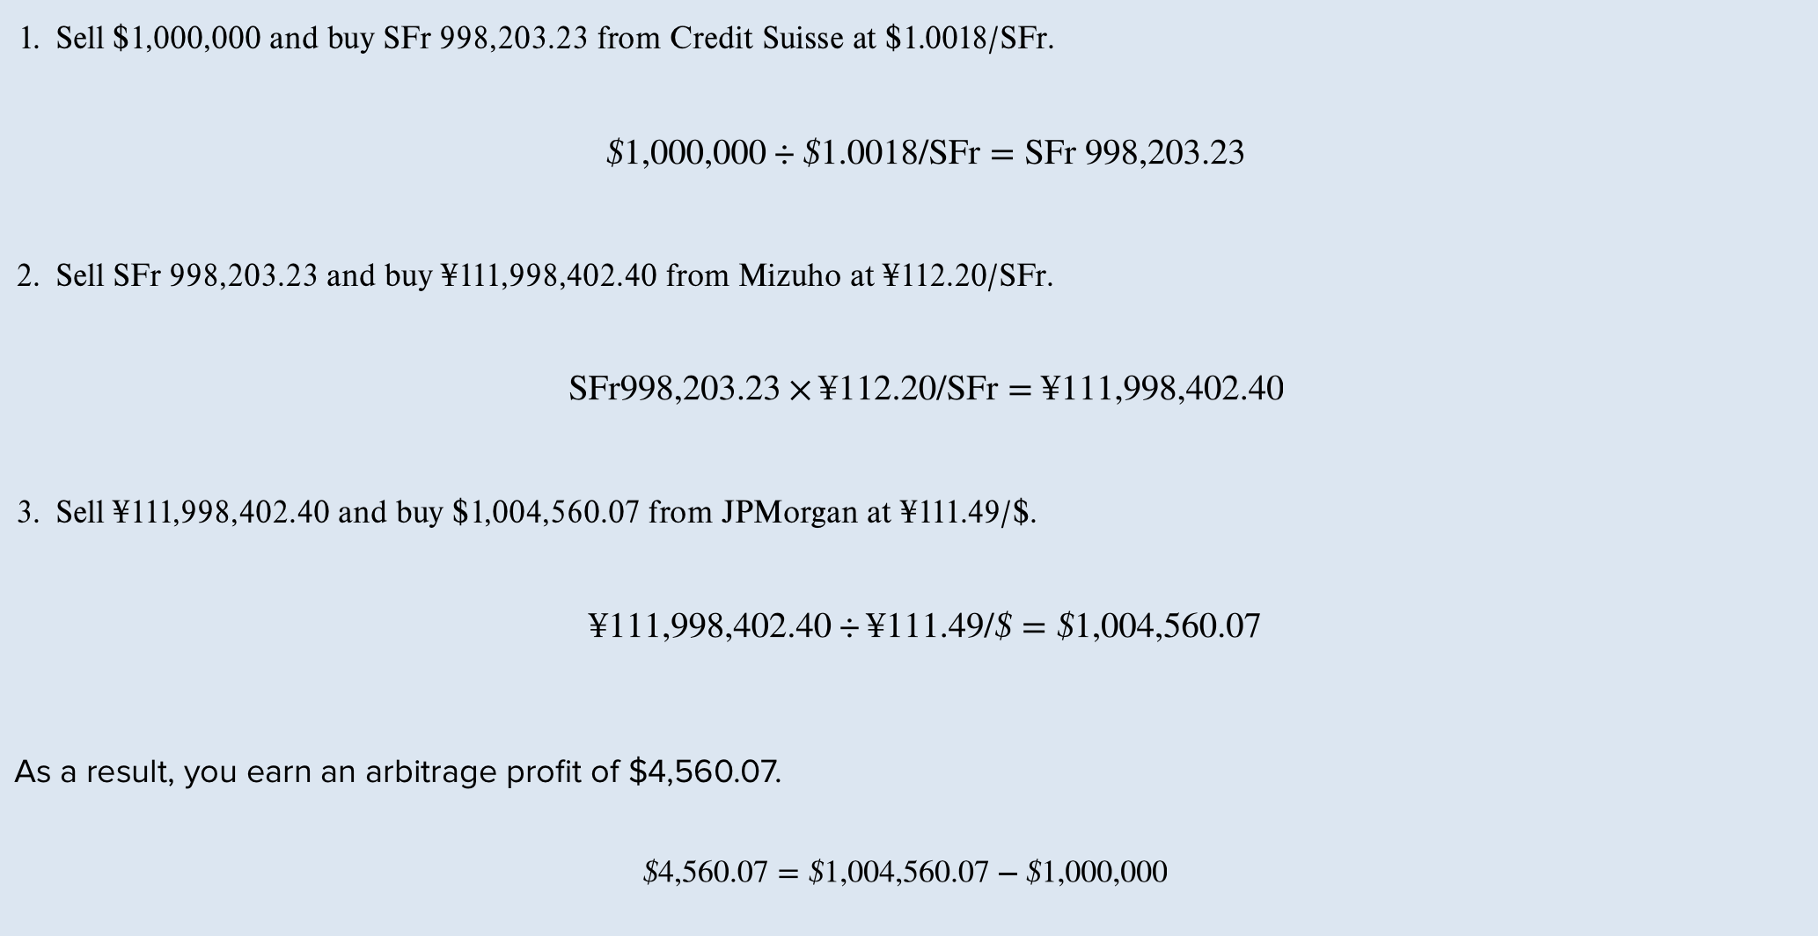

Slide 24
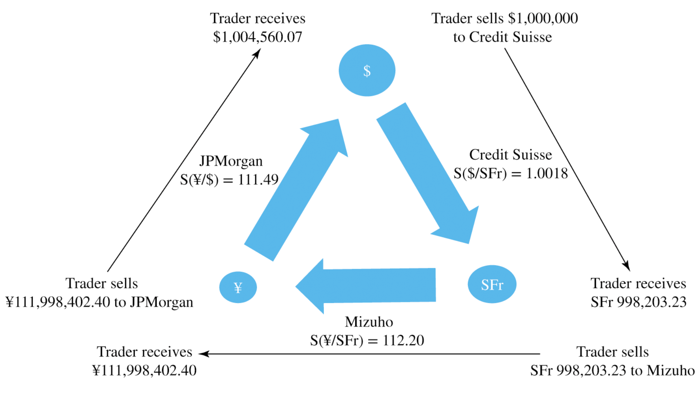

Slide 25
Spot Foreign Exchange Market Microstructure
Market microstructure refers to the basic mechanics of how a marketplace operates
Large variety of participants but less transparency.
  Studies have shown:
    Bid-ask spreads in the spot F X market increased with F X exchange rate volatility and decreased with dealer competition.
    Bid-ask spreads have a prolonged U shape and are narrowest when London and N Y are open, while trading volume and exchange rate volatility are both M-shaped with peaks at London open and the N Y open.

Slide 26
The Forward Market
Forward market involves contracting today for the future purchase or sale of F X
  No money changes hands upon entering the contract today.
  May be used to hedge F X exposure or to speculate in F X market.
  Forward price is usually higher (at a premium) or lower (at a discount) than spot price.
  Bank quotes for maturities of 1, 3, 6, 9, and 12 months are readily available.

Slide 27
Forward Rate Quotations 1
Forward rate quotations use the following notations:
  F_{N} (j/k) is the notation used to refer to the price of one unit of currency k in terms of currency j for delivery in N months.
  F notation is used to denote a forward exchange rate.
  Like spot quotes, forward quotes are either direct or indirect with one being the reciprocal of the other.

Slide 28
Forward Rate Quotations 2
American term Swiss franc forward quotations
  S($/SFr) = 1.0018
  F₁($/SFr) = 1.0047
  F₃($/SFr) = 1.0104
  F₆($/SFr) = 1.0193
European term forward quotations are the reciprocal of the American term quotes
  S(SFr/$) = 0.9982
  F₁(SFr/$) = 0.9953
  F₃(SFr/$) = 0.9897
  F₆(SFr/$) = 0.9811
Example of reciprocal calculations:
1 / 1.0018 = 0.9982
1 / 0.9928 = 1.0018

Slide 29
Forward Premium
Common to express the premium or discount of a forward rate as an annualized percentage deviation from the spot rate
  Forward premium (or discount) is useful for comparing against the interest rate differential between two countries.
  Forward premium or discount can be calculated using American or European term quotations.

Slide 30
Forward Cross-Exchange Rates

Slide 31
Non-Deliverable Forward Contracts
Due to government-instituted capital controls, currencies of some emerging market countries are not freely traded
  Not possible to obtain these currencies offshore in the spot market to settle a forward position.
  For many of these currencies, trading in non-deliverable forward (N D F) contracts exists.
  An N D F contract, unlike a deliverable forward (D F), is settled in cash at the difference between the spot exchange on the maturity date of the contract and the N D F rate times the notional amount of the contract.

Slide 32
Swap Transactions
Forward trades can be classified as outright or swap transactions
  From the bank’s standpoint, an outright forward transaction is an uncovered speculative position in a currency, even though it might be part of a currency hedge to the bank customer on the other side of the transaction.
  Swap transactions provide a means for the bank to mitigate the currency exposure in a forward trade.

Slide 33
Exchange-Traded Currency Funds
Exchange-traded fund (E T F) is a portfolio of financial assets in which shares representing fractional ownership of the fund trade on an organized exchange
  Allow small investors the opportunity to invest in portfolios of financial assets that they would find difficult to construct individually.
  Assets invested in the global E T F industry reached a new record of $5.4 trillion at the end of March 2019.

Slide 34
End of Main Content
© 2021 McGraw Hill. All rights reserved. Authorized only for instructor use in the classroom.
No reproduction or further distribution permitted without the prior written consent of McGraw Hill.

Slide 35
Accessibility Content: Text Alternatives for Images

Slide 36
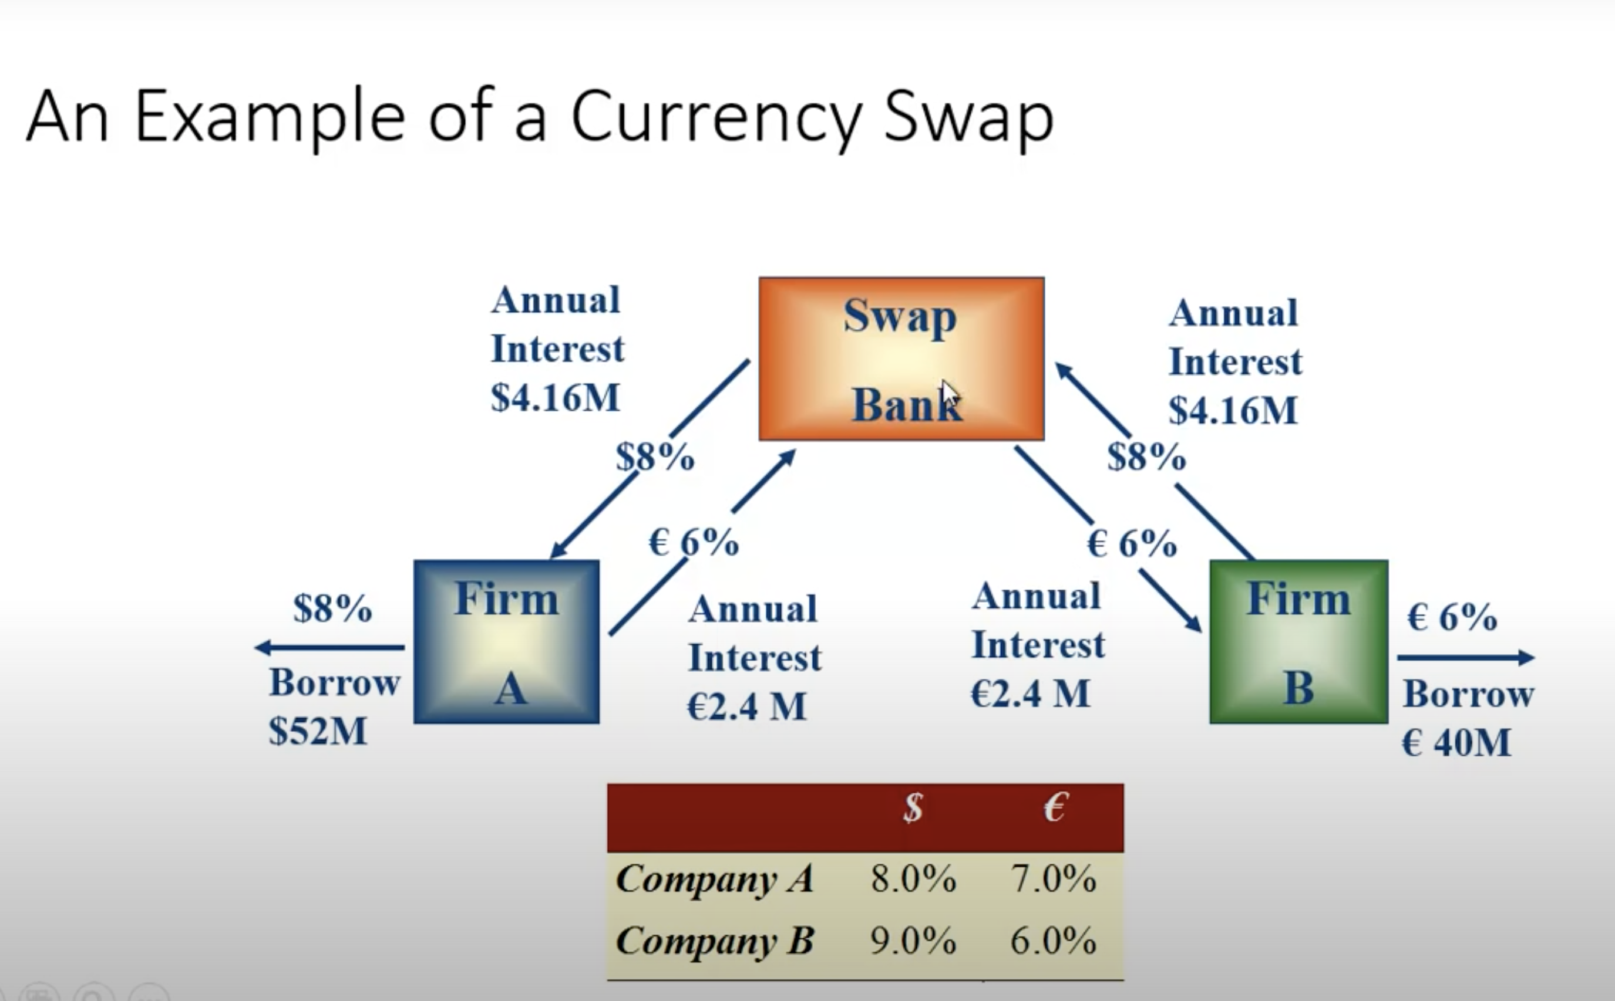
Currency Swaps

Slide 37
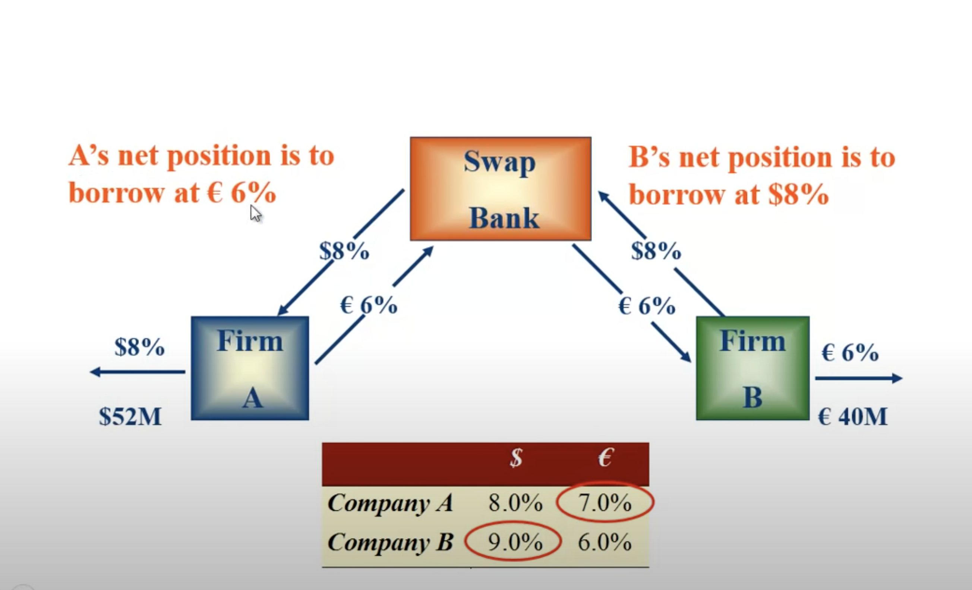

Slide 38
Shares of Reported Global Foreign Exchange Turnover by Country - Text Alternative
Return to parent-slide containing images.
The pie chart is broken down in sections for the following countries with their percentages as indicated. United Kingdom 43%, United States 17%, Singapore 8%, Hong Kong 8%, Japan 5%, Switzerland 3%, France 2%, China 2%, Germany 2%, Australia 1%, and Canada 1%. The chart notes that countries with shares of less than 1% are not included.
Return to parent-slide containing images.

Slide 39
Average Electronic Foreign Exchange Conversations per Hour (Monday to Friday, 2001) - Text Alternative
Return to parent-slide containing images.
This bar graph shows the number of conversations per hour on the y-axis starting at zero and increasing in 5,000 increments to reach 25,000. It shows Greenwich mean time on the x-axis from 1 to 24. Underneath the graph are times for individual companies pointing with upward arrows to the x-axis. 10 am in Tokyo is 1. Lunch in Tokyo is 3. Europe opening is 5. Asia closing is at 8. Americas open is at 12. London closing is at 14. Afternoon in America is at 18, 6 pm in NY is at 22, and Tokyo opens is at 24. The bar graph starts at 5,000 at 1, rises to 7,500, and then drops to 2,500 at 4. It rises to 24,000 at 8 and 25,000 at 9 and then drops to 19,000 at 10; 12,500 at 11; 10,000 at 12; 15,000 at 13; 19,000 at 14; 18,500 at 15; 11,000 at 16; 5,100 at 17; 4,900 at 18; 4,000 at 19; 2,200 at 20, and remains approximately there until 24.
Return to parent-slide containing images.

