Slide 1
Balance of Payments
Chapter Three
© 2021 McGraw Hill. All rights reserved. Authorized only for instructor use in the classroom. No reproduction or further distribution permitted without the prior written consent of McGraw Hill.

Slide 2
Overview
Balance of Payments Accounting
Balance of Payments Accounts
  The Current Account.
  The Capital Account.
  The Financial Account.
  Statistical Discrepancy.
  Official Reserves Account.
The Balance of Payments Identity
Balance of Payments Trends in Major Countries

Slide 3
Balance of Payments Accounting 1
Balance of payments is the statistical record of a country’s international transactions over a certain period of time presented in the form of double-entry bookkeeping
Important to study for a few reasons:
  Provides detailed information concerning the demand and supply of a country’s currency.
  May signal its potential as a business partner for the rest of the world.
  Used to evaluate the performance of the country in international economic competition.
Notes:
Examples of international transactions include import and export of goods and services and cross-border investments in businesses, bank accounts, bonds, stocks, and real estate.
Second, a country's balance of payment data may signal its potential as a business partner for the rest of the world. If a country is grappling gith a major balance of payment difficulty, it may not be able to expand imports from the outside world. Instead, the country may be tempted to impose measures to restrict imports and discourage capital outflows in order to improve the balance of payment situation. On the other hand, a country experiencing a significant balance of payment surplus would be more likely to expand imports, offering marketing opportunities for foreign enterprises, and less likely to impose foreign exchange restrictions.
Third, balance of payments data can be used to evaluate the performance of the country in international economic competition. Suppose a country is experiencing trade deficits year after year. This trade data may then signal that the country's domestic industries lack international competitiveness.

Slide 4
Balance of Payments Accounting 2
Any transaction that results in a receipt from foreigners will be recorded as a credit, with a positive sign, in the U.S. balance of payments
  For example, foreign sales of U.S. goods and services, goodwill, financial claims, and real assets.
Any transaction that gives rise to a payment to foreigners will be recorded as a debit, with a negative sign, on the U.S. balance of payments
  For example, U.S. purchases of foreign goods and services, goodwill, financial claims, and real assets.

Slide 5
Balance of Payments Accounts
International transactions can be grouped into the following four main types:
  Current account includes the export and import of goods and services.
  Capital account consists of capital transfers and the cross-border acquisition and disposal of nonproduced nonfinancial assets. (tend to be large & infrequent)
  Financial account (excluding official reserves) includes all purchases and sales of financial assets, such as stocks, bonds, bank accounts, etc.
  Official reserve account covers all purchases and sales of international reserve assets.
Notes:
nonproduced nonfinancial assets: e.g. mineral rights , land , air space.
Official reserve account : e.g. gold , foreign exchange, borrow from anthor foreign central bank

Slide 6
Summary of the U.S. Balance of Payments for 2018 ($b) 1
 | Credits | Debits
Current Account
[1] Exports | 2,500.7
[1.1] Goods | 1,672.3
[1.2] Services | 828.4
[2] Imports |  | −3,122.9
[2.1] Goods |  | −2,563.7
[2.2] Services |  | −559.2
[3] Primary income | 1,060.4 | −816.1
[4] Secondary income | 140.6 | −251.2
Balance on current account [[1] + [2] + [3] + [4]] |  | −488.5
Capital Account | 9.4 | 0
Balance on capital account | 9.4

Slide 7
Summary of the U.S. Balance of Payments for 2018 ($b) 2
 | Credits | Debits
Financial Account
[5] Direct investment | 267.1 | 50.6
[6] Portfolio investment | 340.3 | −210.4
[6.1] Equity securities | 147.2 | −97.2
[6.2] Debt securities | 172.8 | −113.2
[6.3] Derivatives, net | 20.3
[7] Other investment | 213.8 | −136.9
Balance on financial account [[5] + [6] + [7]] | 524.5
[8] Statistical discrepancies |  | −40.5
Overall balance | 4.9
Official Reserve Account |  | −4.9
Source: The U.S. Bureau of Economic Analysis.

Slide 8
The Current Account 1
Divided into four finer categories:
  Goods trade represents exports and imports of tangible goods (for example, oil, wheat, clothes, automobiles, computers, etc.)
  Services include payments and receipts for legal, consulting, financial, and engineering services; royalties for patents and intellectual properties; shipping fees; and tourist expenditures.
  Primary income consists largely of payments and receipts of interest, dividends, and other income on foreign investments that were previously made.
  Secondary income involves “unrequited” payments.
Notes:
Secondary income : e.g. reparations, foreign aids, gifts

Slide 9
The Current Account 2
Current account balance, especially the trade balance, tends to be sensitive to exchange rate changes
  Currency depreciation or devaluation can improve (worsen) the trade balance if imports and exports are responsive (inelastic).
J-curve effect refers to the initial deterioration and eventual improvement of trade balance following the depreciation of a country’s currency
Notes:
The J-curve effect is often cited in economics to describe, for instance, the way that a country’s balance of trade initially worsens following a devaluation of its currency, then quickly recovers and finally surpasses its previous performance.
Immediately after a nation's currency is devalued, imports get more expensive and exports get cheaper, creating a worsening trade deficit (or at least a smaller trade surplus).
Shortly thereafter, the sales volume of the nation's exports begins to rise steadily, thanks to their relatively cheap prices.
At the same time, consumers at home begin to buy more locally-produced goods because they are relatively affordable compared to imports.
Over time, the trade balance between the nation and its partners bounces back and even exceeds pre-devaluation times.

Slide 10
The Financial Account
Measures the difference between U.S. sales of assets to foreigners and U.S. purchases of foreign assets
Can be divided into three categories:
  Foreign direct investment (F D I) occurs when the investor acquires a measure of control of the foreign business.
  Portfolio investment mostly represents sales and purchases of foreign financial assets, such as stocks and bonds, that do not involve a transfer of control.
  Other investment includes transactions in currency, bank deposits, trade credits, etc.

Slide 11
Statistical Discrepancy
Exhibit 3.1 shows a statistical discrepancy of −$40.5 billion in 2018
  Recordings of payments/receipts arising from international transactions are done at different times and places, possibly using different methods.
  Financial transactions may be mainly responsible for discrepancy.
Overall balance (or official settlement balance ) is the cumulative balance of payments including the current account, capital account, financial account, and the statistical discrepancies
Notes:
Exhibit 3.1 is shown on Slide 6.
While goods trade can be recorded with a certain degree of accuracy at the customs houses, provisions of invisible services like consulting can escape detection. Cross-border financial transactions, a bulk of which might have been conducted electronically, are far more difficult to keep track of. For this reason, the balance of payments always presents a “balancing” debit or credit as a statistical discrepancy
It is also indicative of the pressure that a country’s currency faces for depreciation or appreciation. If, for example, a country continuously realizes deficits on the overall balance, the country will eventually run out of reserve holdings and its currency may have to depreciate against foreign currencies. In 2018, the United States had a $4.9 ­billion surplus on the overall balance. This means that the United States received a net payment equal to that amount from the rest of the world. If the United States had realized a deficit on the overall balance, the United States would have made a net payment to the rest of the world.

Slide 12
The Official Reserves Account
Official reserve account includes transactions undertaken by the authorities to finance the overall balance and intervene in foreign exchange markets
Post- 19 45, international reserve assets comprise:
  Gold.
  Foreign exchanges.
  Special drawing rights (S D Rs).
  Reserve positions in the I M F.
Notes:
Special drawing rights (SDR) are an artificial currency instrument created by the International Monetary Fund, which uses them for internal accounting purposes.
The value of the SDR is calculated from a weighted basket of major currencies, including the U.S. dollar, the euro, Japanese yen, Chinese yuan, and British pound.﻿
The SDR interest rate (SDRi) provides the basis for calculating the interest rate charged to member countries when they borrow from the IMF and paid to members for their remunerated creditor positions in the IMF.

Slide 13
The Balance of Payments Identity (B O P I)
where
  B C A = balance on current account
  B K A = balance on capital account
  B F A = balance on financial account
  B R A = balance on the reserves account
Under fixed exchange regime, countries maintain official reserves that allow them to have B O P disequilibrium

Slide 14
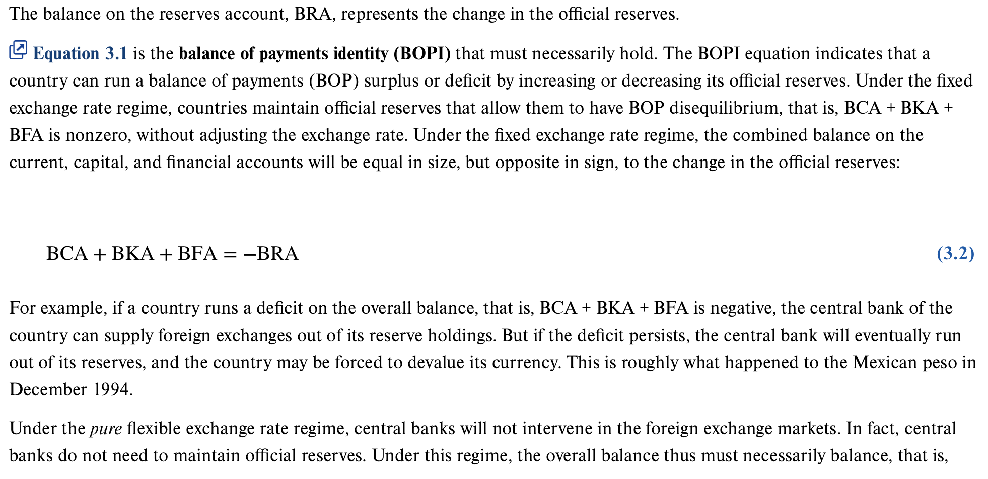
The Balance of Payments Identity (B O P I)

Slide 15
B O P Trends in Major Countries 1
U.S. has experienced continuous deficits on the current accounts since 19 82 and continuous surpluses on the financial account; with the sole exception of 19 91
  Magnitude of U.S. current account deficits is far greater than any that other countries ever experienced during the 36-year sample period.
Japan has had an unbroken string of current account surpluses (and financial account deficits) since 19 82 even though the value of the yen rose steadily until the mid-19 90s

Slide 16
B O P Trends in Major Countries 2
U.K. recently experienced continuous current account deficits, coupled with financial account surpluses
  Magnitude is far less than that of the U.S.
Germany traditionally had current account surpluses, but between 19 91 to 2001 experienced current account deficits
  Attributed to German reunification and the resultant need to absorb more output domestically to rebuild the East German region.
  Since 2002, Germany has returned to its earlier pattern.

Slide 17
B O P Trends in Major Countries 3
China tends to have a surplus on the current account, as well as the financial account (until recently)
“Global imbalance”
  Overall, U.S. and U.K. generally use up more outputs than they produce, whereas the opposite holds for China, Japan, and Germany.

Slide 18
Top U.S. Trading Partners, 2018 ($b)
Rank | Country | Imports | Exports | Trade Balance | Total Trade
1 | China | 539.5 | 120.3 | −419.2 | 659.8
2 | Canada | 318.5 | 298.7 | −19.8 | 617.2
3 | Mexico | 346.5 | 265.0 | −81.5 | 611.5
4 | Japan | 142.6 | 75.0 | −67.6 | 217.6
5 | Germany | 125.9 | 57.7 | −68.2 | 183.6
6 | Korea, Republic | 74.3 | 56.3 | −18.0 | 130.6
7 | United Kingdom | 60.8 | 66.2 | 5.4 | 127.0
8 | France | 52.5 | 36.3 | −16.2 | 88.8
9 | India | 54.4 | 33.1 | −21.3 | 87.5
10 | Italy | 54.7 | 23.2 | −31.5 | 77.9
11 | Taiwan | 45.8 | 30.2 | −15.6 | 76.0
12 | Netherlands | 24.6 | 49.4 | 24.8 | 74.0
13 | Brazil | 31.2 | 39.5 | 8.3 | 70.7
14 | Ireland | 57.5 | 10.7 | −46.8 | 68.2
15 | Switzerland | 41.1 | 22.2 | −18.9 | 63.4
Source: Census Bureau.

Slide 19
End of Main Content
© 2021 McGraw Hill. All rights reserved. Authorized only for instructor use in the classroom.
No reproduction or further distribution permitted without the prior written consent of McGraw Hill.

