Slide 1
Enzyme-Linked Immunosorbent Assay
Principle
Types

Slide 2
ELISA Principle
Labeling technique
An enzyme conjugated with an Ab reacts with a colorless substrate to generate a colored reaction product
Substrate is known as chromogenic substrate
Optical density measured by micro-plate reader
Enzymes are alkaline phosphatase(AP), horse radish peroxidase (HRP)

Slide 3
Types of ELISA used in the detection of antigens or antibodies
Labeling technique
1-Non-competitive ELISA
Direct ELISA
Indirect ELISA
Sandwich ELISA
Ab Capture ELISA
2- Competitive ELISA
Notes:
Graphic self prepared

Slide 4
Direct Elisa
To detect Ag in patient sample
  -Immobilize sample Ag on solid phase
  -Add labeled conjugate (antibody IgG + enzyme)
  -Amount of labeled Ab bound is proportional to amount of Ag in the sample.
Labeled Ab
E
E
Y
Patient sample
Ag
Solid
Phase
Quantitative

Slide 5
Indirect Elisa
To detect Ab in patient sample
  -Immobilize Ag on solid phase
  -Incubate with sample
  -Add labeled conjugate (anti-Ig + enzyme)
  -Amount of labeled Ab bound is proportional to amount of Ab in the sample
  -Method of choice to detect the presence of serum antibodies against HIV
Labeled
Anti-Ig
Ab in
Patient’s
sample
E
Y
Y
Immobilized
Ag
Solid
Phase
Quantitative

Slide 6
Sandwich Elisa
To detect Ag
  -Immobilize Ab on solid phase
  -Incubate with sample
  -Add labeled antibody conjugated with enzyme
  -Amount of labeled Ab bound is proportional to the amount of Ag in the sample
Labeled Ab
Ag in
Patient’s
sample
E
Y
Ag
Immobilized
Y
Solid
Phase
Quantitative

Slide 7
Sandwich ELISA
- Ab (not Ag) is immobilized on a microtiter well
- sample containing Ag is added and allowed to react with immobilized Ab
- After well is washed, a second enzyme-linked Ab specific for a different epitope on the Ag is added and allowed to react with the bound Ag
- after any free 2nd Ab is removed by washing, substrate is added, and the colored reaction product is measured

Slide 8
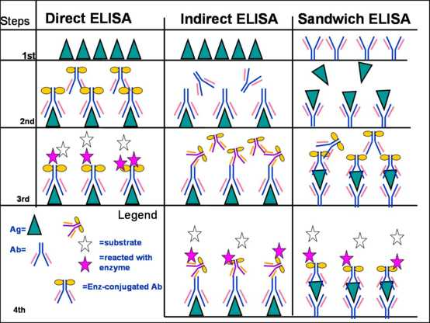
Types of Non Competitive ELISA

Slide 9
Ab Capture ELISA
To detect IgM inpatient sample
Anti-IgM is immobilized on solid phase
Sample is added( look for IgM)
Conjugate is added( Ag bound to antibody conjugated o enzyme
Amount of labeled Ab bound is proportional to the amount of IgM in the sample
Labeled Ag-Ab
E
Y
Patient’s
sample
Ag
Y
Anti-IgM
Y
Solid
Phase
Quantitative

Slide 10
Competitive RIA/ELISA for Ag
  Principle:
  Both labeled and patient Ag compete for Ab adsorbed on solid phase
Test
E
Y
+
+
↔
Y
+
  Concentration is determined from a standard curve using known amounts of unlabeled Ag
Solid
Phase
Labeled
Ag
Patient’s
sample
Solid
Phase
Quantitative
  Most sensitive test

Slide 11
Competitive ELISA
Labeling technique
Antigen or antibody are labeled with enzyme and allowed to compete with unlabeled ones (in patient serum) for binding to the same target
Hydrolysis signal from Ag-Ab complex (enzyme-labeled) is measured
Antigen or antibody in serum is then calculated
No need to remove the excess/unbound Ag or Ab from the reaction plate or tubes)
Notes:
Graphic self prepared

Slide 12
ELISA:
Performance, applications
Advantages
  Automated, inexpensive
  Safe chemicals and instruments
  Sensitive ,small quantities are used
  Class specific antibodies measurable
  Stable chemicals
Limitations
--Not as sensitive as RIA
Time taken : minutes, hours ,1 day

Slide 13
ELISA
Washing is an important step to remove unbound ( excess/ non specific)Ag or Ab
Insufficient washing results in false +ve results
Excessive washing results in false –ve results
Microtiter plate wells are coated with Ag or Ab
100ul volume is used in most steps.
Patient serum must be diluted 1:101 in most kits.

Slide 14
Elisa
Substrate must be prepared 10-20 minutes before use.
A stopping solution is used as last step in Elisa test. It is used to stop the action of enzyme on substrate.
The stopping solution could be strong acid ( HCL/ H2SO4) or base( NaoH).
The absorbance of wavelength is measured using Elisa reader within 1 hour of adding stopping solution.

Slide 15
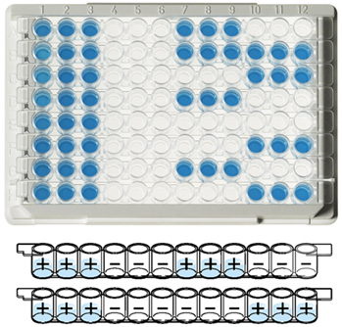
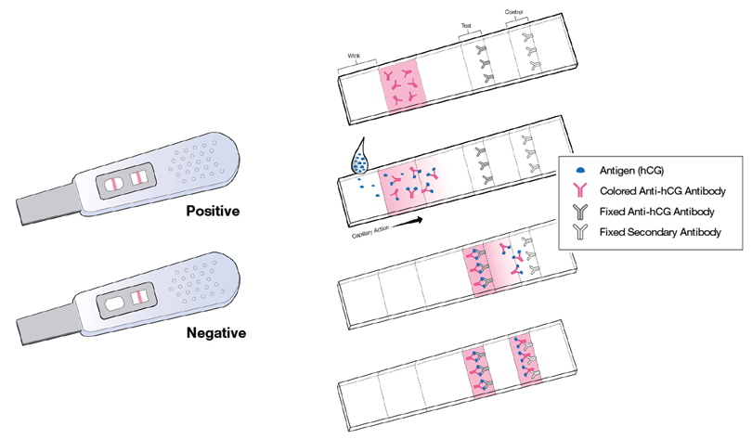
ELISA
Response
Antibody
Notes:
Picture public domain

Slide 16
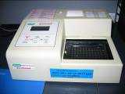
Elisa reader
Micro-plate reader

Slide 17
An Elisa test to detect Toxoplasma IgG Ab in patient serum
Is an Indirect Elisa test
The Ag ( inactivated Toxoplasma) is bound to microtiter plate wells .
Following incubation with diluted serum ,the specific Igs are bound to the Ag.
After washing the unbound Ab ,incubation with conjugate (anti human IgG labeled with HRP is performed.
The unbound conjugate is washed and substrate(peroxidase) is added

Slide 18
An indirect Elisa test to detect Toxoplasma IgG Ab in patient serum
Stopping solution
Substrate
Incubation
Washing
Conjugate (Anti human IgG-(Enzyme HRP
Incubation
Washing
Patient serum
IgG Ab
Non specific Ab ِ
Toxoplasma Ag
Solid phase

Slide 19
Method
Place 100ul of diluted sample calibrators to the wells
Incubate for 30min at 37c
Wash 4 times with 300ul
Add 100ul of conjugate to each well
Incubate for 30 min at 37c
Wash 4 times with 300ul
Add 100ul of substrate to each well
Incubate 10-15 min at room temperature
Add 100 ul of stop solution to each well
Read absorbance at 450nm/620nm/405nm

