Slide 1
Abdulaziz Alomar, MD, MSc, FRCSC Assistant Professor and consultant Orthopaedic surgeon. KKUH, KSU
Elbow & Forearm Exam

Slide 2
Intro
Important for U/E function, ADLs etc
3 articulations
Ulnohumeral joint (uniaxial hinge)
Radiocapitellar joint (uniaxial hinge)
PRUJ (uniaxial pivot joint)

Slide 3
Important stabilizers
MCL
3 bands
Anterior tight in extension
Most important one (mcq)
Posterior tight in flexion
Transverse ligament
Often torn during elbow dislocations

Slide 4
LCL
Radial collateral ligament
Lateral ulnar collateral ligament (PLRI)
Annular ligament
Accessory lateral collateral ligament
Radiocapitellar articulation
Ulnohumeral articulation

Slide 5
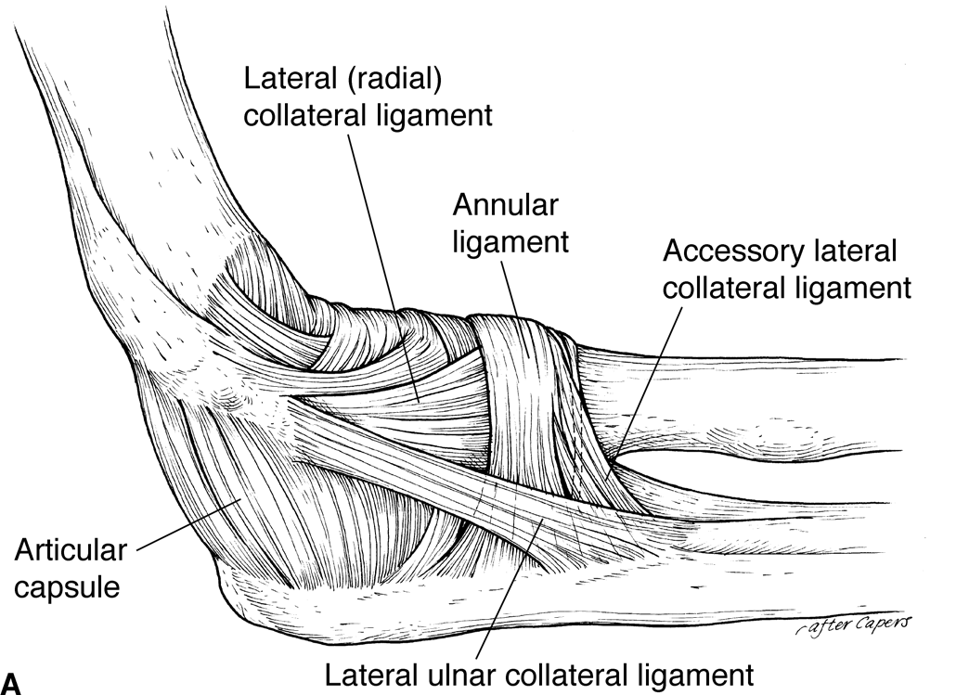

Slide 6
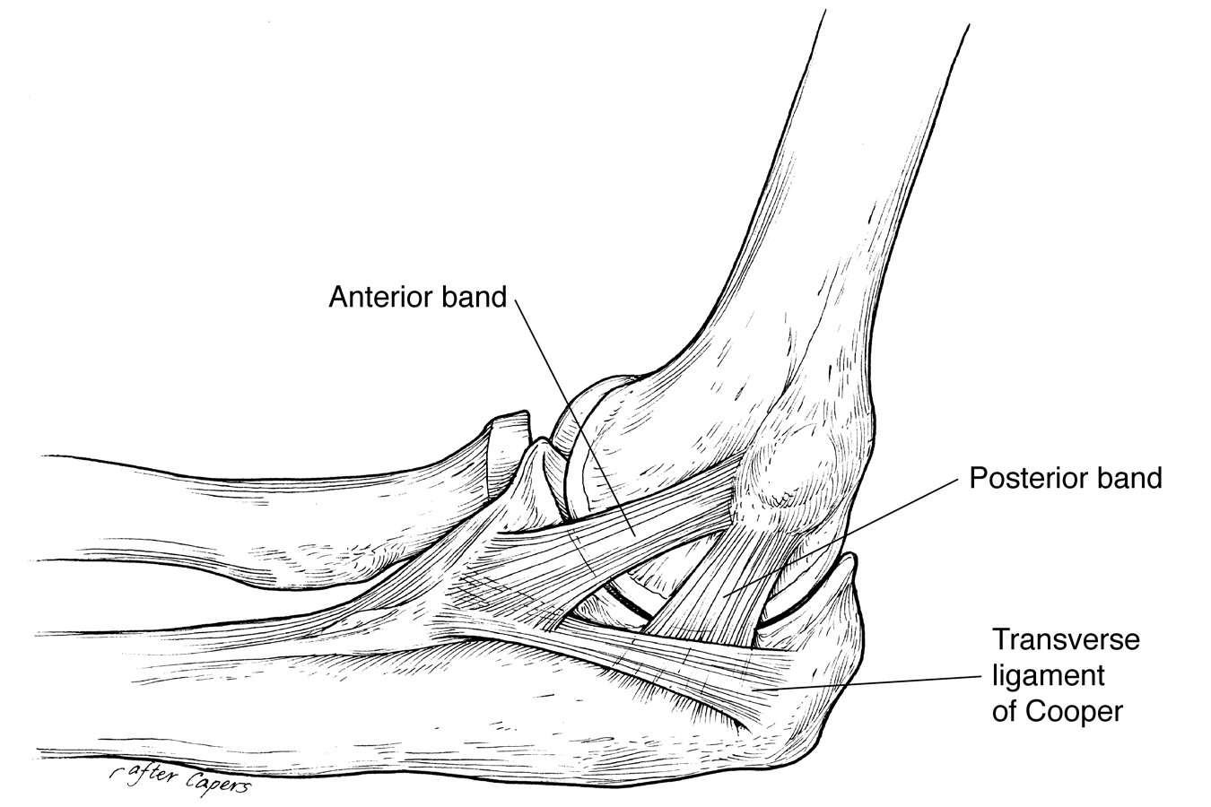

Slide 7
Inspection
SEADS
olecranon bursa
Triangular zone
Carrying angle
Males 5 to 10, females 10 to 15
Cubitus varus
Cubitus valgus
other

Slide 8
Palpation
All soft tissue and bony prominences
LCL, MCL, LUCL, annulus
Medial and lateral condyles
Flexor and extensor masses
Cubital fossa
Cubital tunnel
Intraosseous membrane (essex lopresti lesions will be tender)

Slide 9
Range of Motion
Normally 0 to 140
Some (women) 10 hyperextension as normal
Functional range is 30 to 130 for ADL’s, etc
Supination is 90
Pronation is 80
Functional range is 50 for both
Active before passive

Slide 10
Special Tests
Ligament stability
Unlock ulnohumeral articulation by flexing the elbow to 20 or 30 degrees
LCL complex
Pronate the forearm to tighten the extensor mass
One hand on the elbow, one on the wrist
Some say to IR humerus (Regan & Morrey, et al)
Apply a varus load
Compare to the opposite side

Slide 11
MCL
Same thing, except valgus force
ER of humerus recommended by same guys
PLRI
LUCL tear in elbow injury / dislocation
Lateral pivot shift test
Patient is supine with arm overhead
The elbow is extended fully

Slide 12
You apply an axial load with a valgus force, while bringing the arm into flexion
At around 20 to 30 degrees, you will get apprehension = + sign
If fully relaxed (sedation), you may get subluxation and a palpable clunk at reduction with further flexion or return to extension

Slide 13
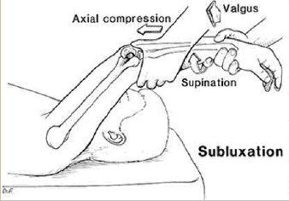

Slide 14
Lateral epicondylitis
AKA tennis elbow
Patient actively pronates and extends the wrist while you palpate the lateral condyle, positive with recreation of symptoms
Passively move into pronation and full flexion, placing stretch on mass, positive is recreation of symptoms
Resisted extension of 3rd digit, tests EDC, pain +

Slide 15
Medial epicondylitis
Passive supination and wrist extension, stretching the flexor mass, recreation of symptoms is +

Slide 16
Neurovascular
Tinel’s sign
Ulnar nerve compression at cubital tunnel
Tingling at and distal is positive
Wartenburg’s sign
Hand on table, passively abduct fingers
Patient adducts them together and little finger lags behind
Positive for ulnar neuropathy

Slide 17
Kiloh – Nevin syndrome
AIN motor
“ok” sign unable do to flexor / pinch paralysis
C5 is lateral arm, T1 is medial
Lateral cutaneous nerve
Medial cutaneous nerve
***Nerve Compression Tests***

Slide 18
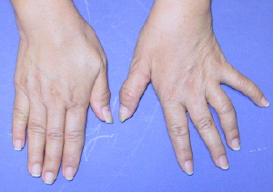
Wartenberg’s Sign
Kiloh-Nevin, “ok” is not achievable

