Slide 1
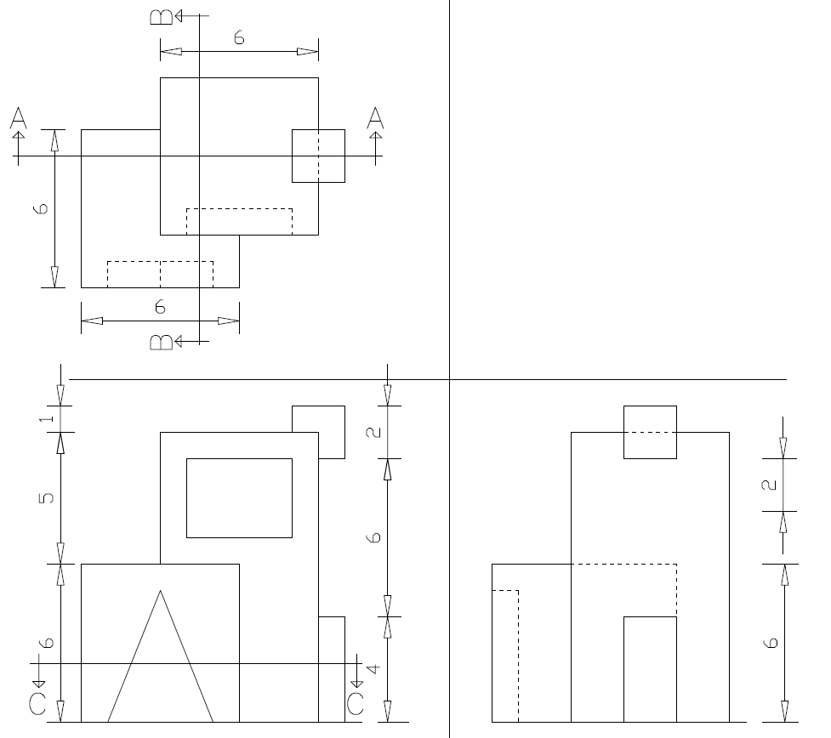
College of A & P / 255 ARCH / Dr. Sameer Alwattar
Exercise: 09B Homework:
On your A3 paper: Draw the 3 Sections (from the projection axes)
& the Isometric & write the dimensions on the sections
Draw the Isometric Here

