Slide 1
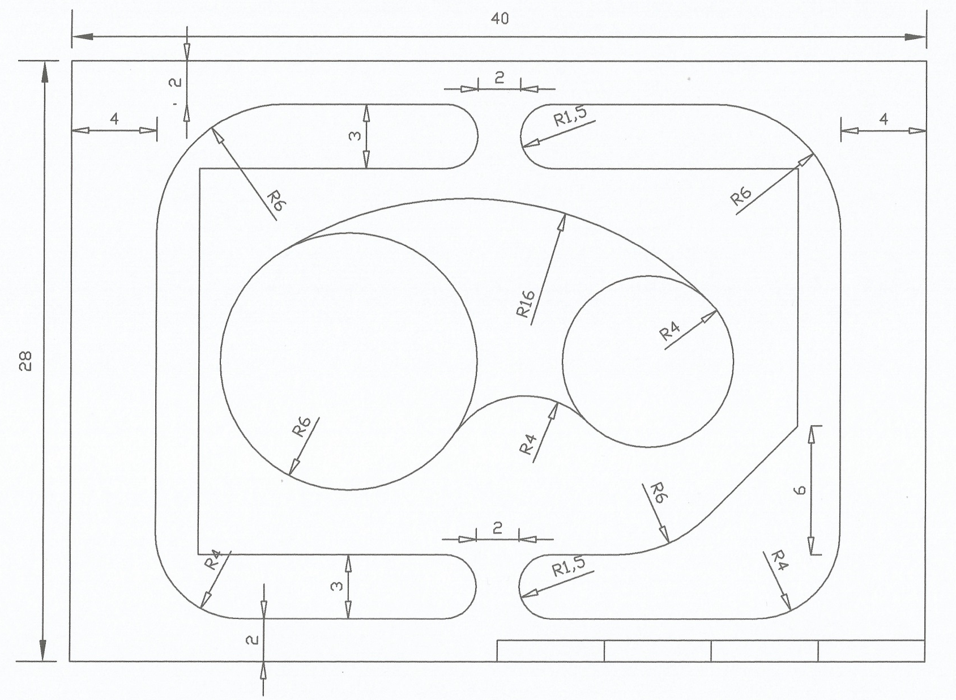
College of A & P / 255 ARCH / Dr. Sameer Alwattar
Exercise: 04A (In Class):
On your A3 paper draw the following by Tools

