Slide 1
Britain’s Prehistory The Celts The Romans Christianity The Vikings ‘feudalism’

Slide 2
Britain’s history connected with the sea
Island / Ice age
easy to travel/helped trade/ saved from danger
a strong national sense associated with the sea

Slide 3
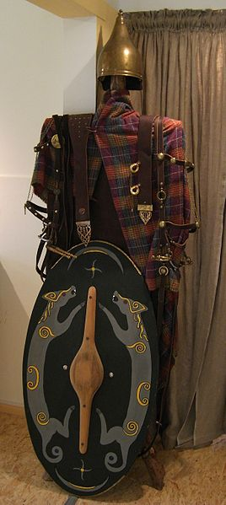
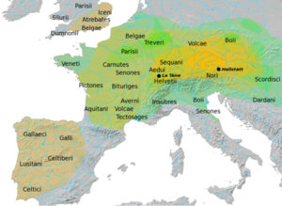
The Celts:
(700 BC- appearance/clothes- technically advanced-money- imp/ancestors- trade/imp – warrior rulers- women/ independent- Roman invasions-Boadicea)

Slide 4
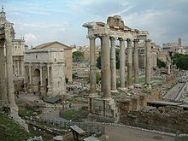
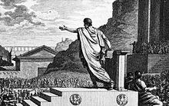

The Romans:
(800 BC-5th c. -‘Pritani’- reading and writing- imp ideas/power- spoke Latin and Greek/ Celts remained illiterate - Anglo Saxons invasion/Britain more literate under the Romans/ towns/ basis of administration & civilization – at 1st army camps called ‘castra’)

Slide 5
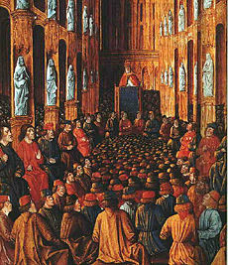
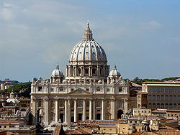
Christianity
(Celtic church- Bishops- Church increased powers of Kings/support- Christian ceremony/crowned kings- monasteries/read & write)

Slide 6
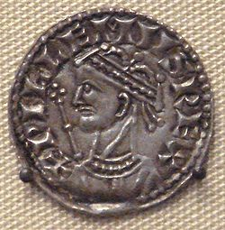
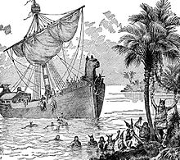
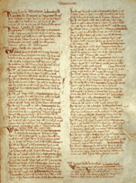
The Vikings
(8th c. - William the Conqueror- Feudalism)

Slide 7
The Vikings
(end of 8th c.)
Pirates/ Norway and Denmark/invaded/ Christianity
William the conqueror (1066)/ King of England
The middle ages
Feudalism
- rewards to captains/ personal property
- ‘feu’ = land held in return for duty or service to a lord./ French/economic purpose/ basis ‘Land’
- central idea: ‘all land was owned by the king but it was held by others’
- ‘vassals’ (homage- chain- responsible)
- ‘serfs’
- Two basic principles:
1- every man had a lord
2- every lord had land
- Economic Survey- ‘Doomsday’ book (1086)
- Feudalism declined

Slide 8
(1258) The Parliament = discussion meeting
- (council of nobles/ laws and political decisions/ House of Lords)
Taxation problem
Edward I (‘representative institution’/ the House of Commons/ imp cooperation between houses)
Economical overview
- England as an agricultural society
- trade and industry (self sufficient)
- Wool: (Flemish weavers/new towns/high)
-rise of a new middle class / capitalist economy free from feudalism

Slide 9
Language, Literature and Culture
Growth of Literacy + Renaissance (14th-17th )
- Italy/ revival of arts, literature and learning in Europe.
Schools: (grammar- catholic)
Latin: (the educated language/ not English)
French: the language of Law
(12th c.) Schools of higher education in England:
1- Oxford 2- Cambridge

Slide 10
(14th c.)
- the age of chivalry
- Edward III + Black Prince
- admired/ courage + courtly manners
-symbols of the ‘code of chivalry’
- that ‘war was a noble & glorious thing’
- plague (Black death)
- Revolution of the poor

Slide 11
(15th c.)
- discontent w/ church
(taxes & greed/ increase of knowledge)
- end of middle ages
- ranks (dukes+earls+lords/ knights+gentry)
- new middle class (Literate class/ educated merchants + lawyers/ questioned church & state)
- Educated Language became (English+Latin)
- education developed enourmosly
- major technical development
(printing press/William Caxton/ cheaper and plentiful books/ standardize spelling & grammar/ information for newly educated/ encouraged literacy)

Slide 12
(16th c.):
- growth in international trade (spices) & industry e.g. shipbuilding
- population increased/ larger areas of land used
- greater social & economic problems
- inflation/ sudden increase in population (doubled)/ worse living conditions
- London English became the Standard English (printing)/ Literacy increase (half)
- Artistic development/ Renaissance (late) (music/ painting ‘miniature portrait’/ literature ‘Shakespeare’)

Slide 13
17th c.
- shift in economic power (to merchants & landowners)
- Revolution in thought and scientific thinking and discoveries
- 13th/14th c. (Oxford- Bacon/light and heat- Marlee/ weather)
- 17th c.
-Francis Bacon established a new mood in science (experiment)
-William Harvey (circulation of blood)
-Isaac Newton (gravity- physics)

Slide 14
18th c.
- Britain as powerful as France (industry growth-trading empire- strongest navy)
- taxation problem with American colonies
- American war of Independence (1775-1783)
- larger cities (bad smell- streets as lavatories- no drains- rubbish- muddy and narrow streets- disease spread in big towns- ppl buried together)
- middle of century- government efforts- better wider streets/ lighting system/ healthier towns
- taxing citizens (parliament)/ social services/ local tax
-four classes of people(wealthy merchants- ordinary merchants- craftsmen- workers)

