Slide 1
Geographical Location Of England Arts & Inventions in the English Culture 9th c. – 21st c.

Slide 2
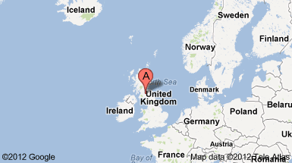
So, where in the world is England

Slide 3
The United Kingdom consists of four political regions:
England- Scotland – Wales – North Ireland
England is geographically divided into two main zones:
1- Lowlands: midlands- Anglia-Pennines- Lake district in north
2- Uplands: Dartmoor- Exmoor in southwest

Slide 4
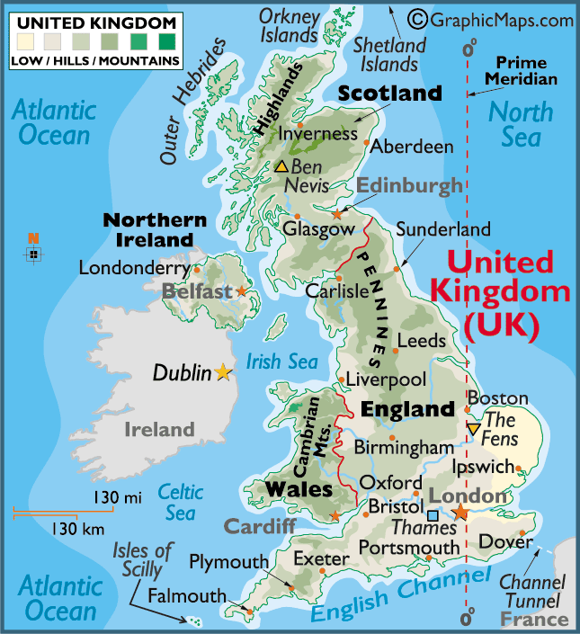

Slide 5
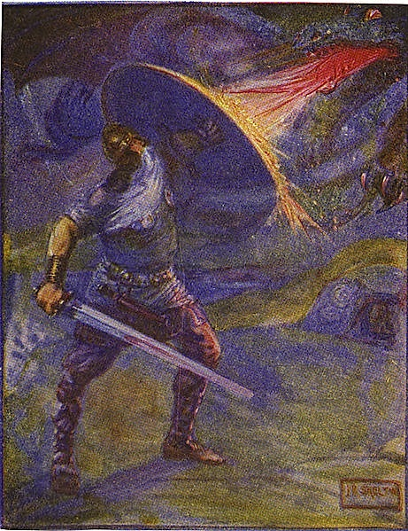
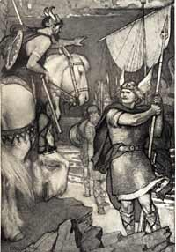
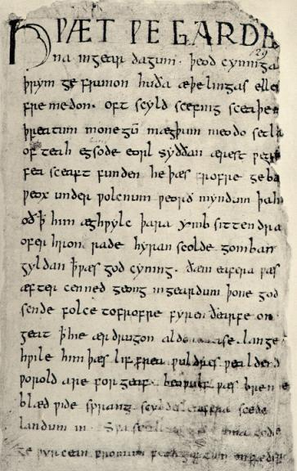
2000 years of Art and Invention
9th c. –-“Beowulf” / Schools for English nobles

Slide 6
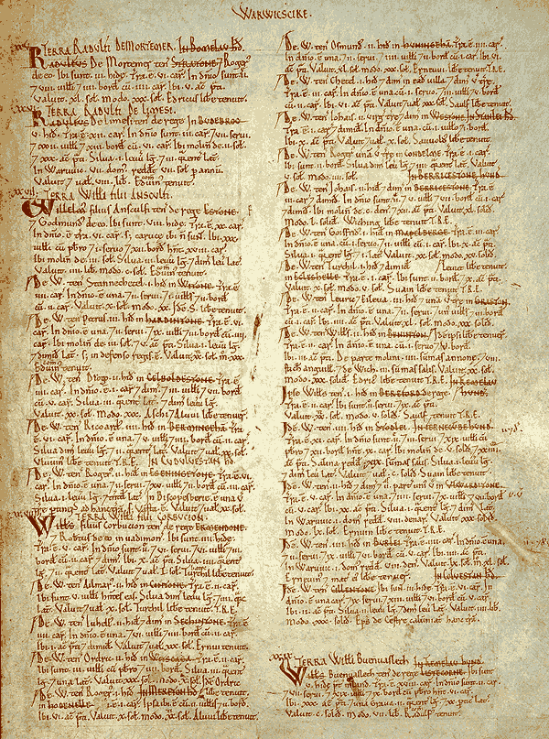
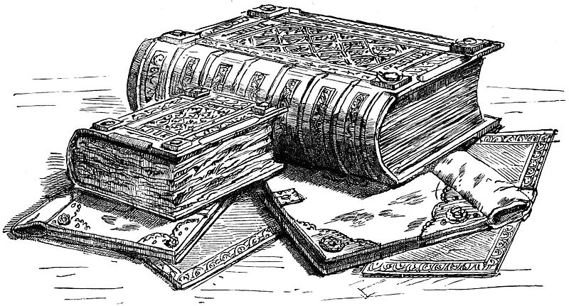
- 11th c. _ Doomsday book

Slide 7
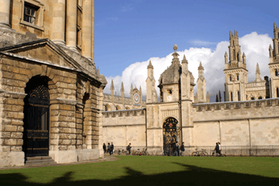
12th c. _ Oxford founded
Four kings, 46 Nobel Prize winners (and counting), several great poets, the inventor of DNA "fingerprinting", and three saints have studied or taught at Oxford University.

Slide 8
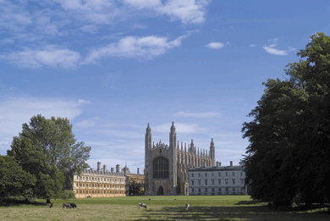
13th c. _ Cambridge founded
Scientists of stellar intellect – Newton, Maxwell, Rutherford, Watson, and Crick – have studied or taught at Cambridge along with one queen, several martyrs, and more Nobel Prize winners than any other institution in the world.

Slide 9
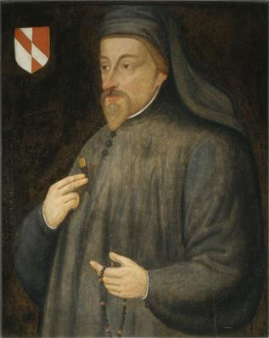
14 c _ Geoffrey Chaucer
Geoffrey Chaucer, known as the Father of English literature, is widely considered the greatest English poet of the Middle Ages and was the first poet to have been buried in Poet's Corner of Westminster Abbey.

Slide 10
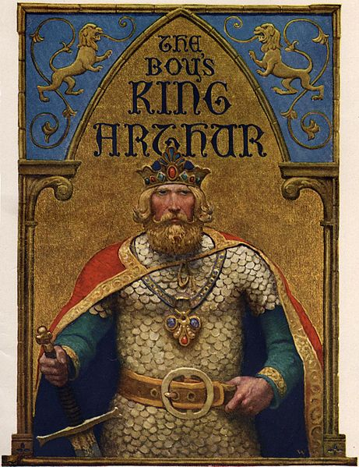
15th c.
Setting of the Printing press.
Le Morte d'Arthur is a compilation by Sir Thomas Malory of Romance tales about the legendary King Arthur, Guinevere, Lancelot, and the Knights of the Round Table. Le Morte d'Arthur is perhaps the best-known work of English-language Arthurian literature today. Many modern Arthurian writers have used Malory as their principal source.

Slide 11
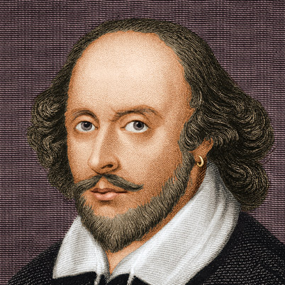
16th c. _ 1st English translation of Bible / Shakespeare
The first English translation of the whole Bible.
William Shakespeare was an English poet and playwright, widely regarded as the greatest writer in the English language and the world's pre-eminent dramatist. He is often called England's national poet and the "Bard of Avon".

Slide 12
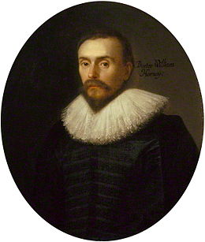
17 c _ Circulation of blood
William Harvey was an English physician. He was the first to describe completely and in detail the systemic circulation and properties of blood being pumped to the body by the heart, though earlier writers had provided precursors of the theory.

Slide 13
17th c.
George Chapman : translates he Greek epic Homer into English
John Milton: considered the 2nd most imp English literary writer after Shakespeare- Wrote his famous epic poem ‘paradise lost’ about the story of Adam & Eve – in 12 books

Slide 14
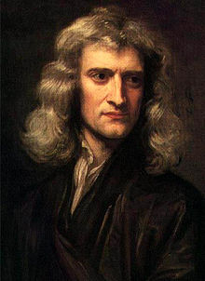
17th c. Isaac Newton
Sir Isaac Newton PRS MP was an English physicist and mathematician who is widely regarded as one of the most influential scientists of all time and as a key figure in the scientific revolution.

Slide 15
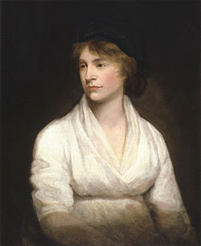
18 c.
1st steam engine/ cricket/ 1st English dictionary/Oxygen/Rights of women
Mary Wollstonecraft was an eighteenth-century British writer, philosopher, and advocate of women's rights.

Slide 16
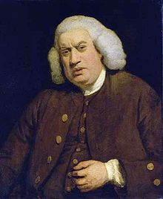
18th c.
Samuel Johnson, often referred to as Dr Johnson, was an English writer who made lasting contributions to English literature as a poet, essayist, moralist, literary critic, biographer, editor and lexicographer. He compiled the first useful English Dictionary.

Slide 17

19th c.
_ 1st steam locomotive/ 1st passenger railway/ 1st thesaurus/Rugby football/1st synthetic dye/1st traffic light/ 1st tube train/ 1st brain tumor surgery

Slide 18
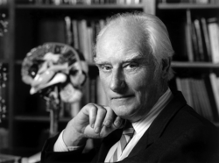
20th c.
Vitamins/ 1st motion picture/ 1st TV studio/ 1st jet engine aircraft/ 1st computer at Manchester univ/DNA/ The Beatles/ High Speed trains/ genetic fingerprinting/ World Wide Web
Francis Harry Compton Crick, OM, FRS was an English molecular biologist, biophysicist, and neuroscientist, and most noted for being a co-discoverer of the structure of the DNA molecule in 1953 together with James D. Watson.

Slide 19
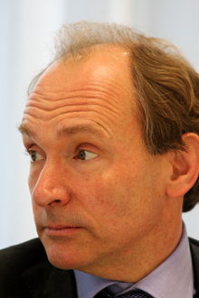
20th c.
Sir Timothy John "Tim" Berners-Lee, OM, KBE, FRS, FREng, FRSA, also known as "TimBL," is a British computer scientist, best known as the inventor of the World Wide Web.

Slide 20
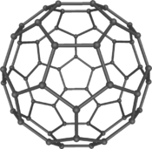
21th c.
_Cosmology (discover the lightest particle in the universe)
Nanotechnology
Nanotechnology (sometimes shortened to "nanotech") is the manipulation of matter on an atomic and molecular scale. With a variety of potential applications, nanotechnology is a key technology for the future and governments have invested billions of dollars in its research. Nanotechnology could be used to eradicate disease, improve agriculture, and create easily available sources of energy for cars and low-cost materials for everything from computers and electronic devices to wound dressings. Semiconductor development at the University of Sheffield represents some of the most industrially advanced areas of nanotechnology.

Slide 21
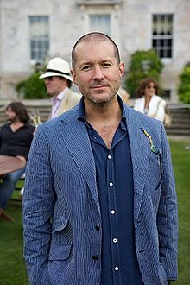
21th c.
Sir Jonathan Paul "Jony" Ive, KBE is an English designer and the Senior Vice President of Industrial Design at Apple Inc. He revolutionized computer designs, including imacs, ipads, ipods and iphones. He also provides leadership and direction for Human Interface software teams across the company.

