Slide 1
Introduction
Learning about culture permits one to learn more about the ‘world
To look at issues in a different way
The world as a ‘global village’ – electronic communication
‘English’ culture has a very particular significance

Slide 2
Culture
Defining “Culture” (people/history/traditions)
Elements that need to be examined when studying culture
Does ‘ English culture’ exist only in England?
How are culture and language connected?
‘Language symbolizes culture’
Defining ‘Language’ (medium –tool- vehicle)
- Dev of language can be seen as a reflection of civilization and culture)

Slide 3
Brief overview of the development of the English language of today
English Language of today reflects many centuries of development in the political, social , cultural history of the English ppl.
Political & social events contributing to the ‘English’ language of today:
(Christianising of Britain – Latin civilization/ Scandinavian invasions/ Norman conquest/ Renaissance/ expansion of British empire/ growth of commerse & industry)
- ‘English’ greatly changed in form & vocabulary

Slide 4
Languages seen as ‘dead’ or ‘alive’
‘English’ a live language
constant growth and decay
Latin ‘dead’ language
Change most seen in voc
dev of new words to meet new conditions
‘nice’ in Shakespeare meant ‘foolish’

Slide 5
The importance of the English language:
1- Strong relationship bet a language & ppl who spk it
- if the ppl are imp their Language will be imp - politically, economically, scientifically, and artistically
- imp Lang (English/ French/ German/ Arabic)
- unimportant (Malay/ Romaniian0
- Classical Greek/ why is it imp
2- English having the advantage of numbers in the west (340 m) – the largest of the ‘occidental’ languages
- ‘Chinese’ the largest in the world
- English as a second language (300 m)
- Will English become the language of the world?

Slide 6
The language of a country often symbolizes its independence & nationalism
The official Languages of the United Nations
(English - French - Russian - Spanish – Chinese – Arabic)
A century ago – ‘ French’ the diplomatic language of the world
It is the combined effect of economic & cultural political and social forces (e.g. scientific – revolution in communication) rather than legistlations by national & international bodies that will determine the world languages of the future.

Slide 7
English viewed as a Germanic language
-A family of languages :
The languages thus brought into relationship by decent or progressive differentiation from a parent speech.
- Overview of Indo-European Family of Languages
- the name ‘ Indo-European’ suggests the geographical extent of the family:

Slide 8
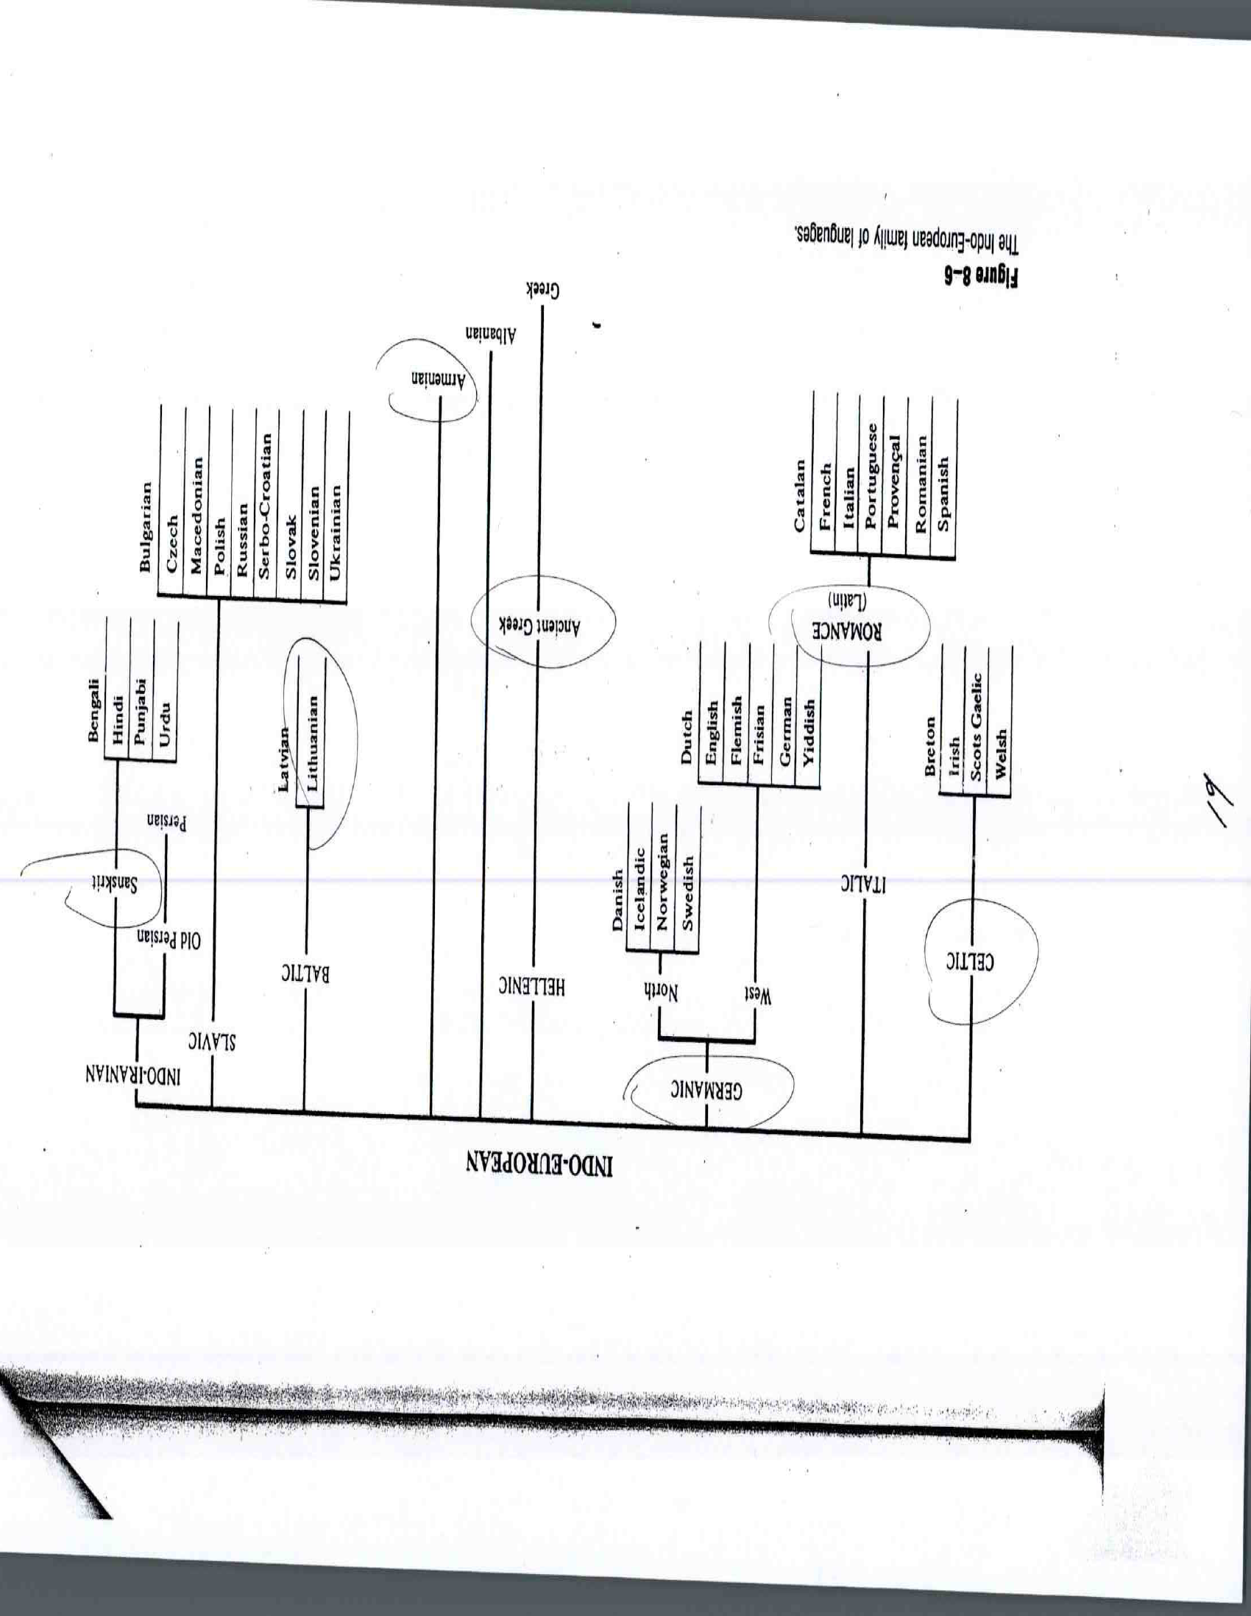

Slide 9
The Indo-European languages share similar linguistic features (pronunciation-meaning- grammatical structure)
e.g.
English | Old Slavic | Irish | Sanskrit | German | Greek | Gothic
brother | bratu | brathair | Pitar- | bruder | phrater
father |  |  | bhratar | vater | pater | fadar
water |  |  |  | wasser
bread |  |  |  | brot
milk |  |  |  | milch

Slide 10
The English Language contains borrowings from many other languages- goes outside its own linguistic resources/ cosmopolitan vocabulary/ an undoubted asset- internationalism
e.g.
from American Indian: Chipmunk-skunk-racoon
from Spanish: alligator- vanilla- mosquito
from Italian: balcony-piano-volcano
from Persian: caravan-shawl-lemon

