Slide 1
Experiment 8 Cooling and Dehumidification
Shereef Sadek
ME 322

Slide 2
Experiment 8 Cooling and Dehumidification
Refrigeration
Refrigeration is the achievement of a temperature below that of the immediate surroundings [1].
To maintain this lower temperature removal of heat from the product at low temperature and the discharge of this heat to a higher temperature is required.
Methods of Refrigeration
Rise in temperature of coolant
Change of phase
Expansion of a liquid
Steady Flow expansion of a perfect gas
Emptying process
Electrical process

Slide 3
Experiment 8 Cooling and Dehumidification
Psychrometry
Psychrometry is the study of the properties of mixture of air and water vapor.
Psychrometry is important since air is almost always mixed with water vapor
All air-conditioning processes must factor in the presence of water vapor
Psychrometric charts facilitates the calculation of processes involving a mixture of air and water-vapor
The coordinates of a Psychrometric chart are the water vapor pressure as the ordinate (y-axe) and the mixture temperature as the abscissa (x-axe).
The left boundary of the char t is the water saturation line, the region to the right is called superheated water vapor

Slide 4
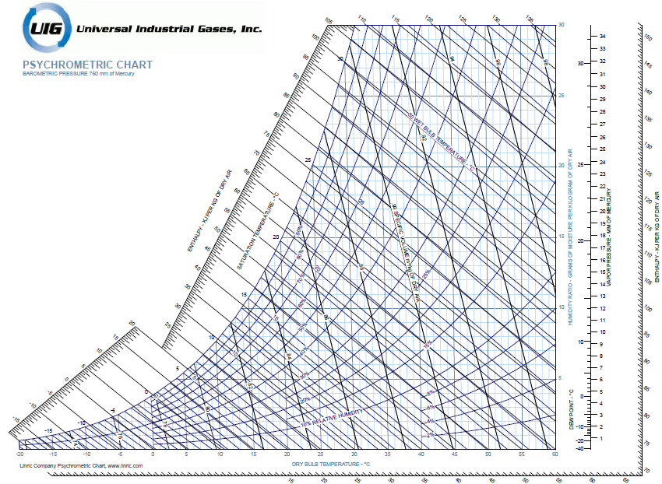
Experiment 8 Cooling and Dehumidification

Slide 5
Experiment 8 Cooling and Dehumidification

Slide 6
Experiment 8 Cooling and Dehumidification
Relative humidity
$$φ=\frac{Existing partial pressure of water vapor}{saturation pressure of pure water at the same temperature}$$
Humidity Ratio
$$W=\frac{weight of water vapor}{weight of dry air in the mixture}$$
Wet bulb temperature
The temperature indicated by a thermometer which has a wetted bulb in contact with blowing air.

Slide 7
Experiment 8 Cooling and Dehumidification
${\dot{m}}_{a}=0.0517\sqrt{\frac{z}{ν_{E}}}$ $1$
${\dot{m}}_{condensate}={\dot{m}}_{a}\left(ω_{B}−ω_{C}\right)$ $2$
${\dot{Q}}_{cooling}=m_{a} (h_{B}−h_{C} )−m_{W} h_{W}$ $3$
${\dot{Q}}_{cooling}=m_{ref} (h_{1}−h_{4} )$ $4$
Nomenclature
$z$ Orifice differential head (mm H2O)
$v_{E}$ Specific volume of air calculated by assuming air to be a perfect gas.
$ν_{E}=\frac{RT_{9}}{P_{Lab}−P_{ν}}≅\frac{RT_{9}}{P_{Lab}} \frac{m^{3}}{kg \left(dry air\right)}$ $5$
$m_{a}$ Air mass flow rate in kg/sec
$ω$ Specific humidity, kg/kg
$h$ Specific enthalpy
$m_{ref}$ Refrigerant mass flow rate ,
$h_{1} , h_{4}$ Refrigerant enthalpies after and before the evaporator coil.

Slide 8
Experiment 8 Cooling and Dehumidification
References
Stoecker, W. F. “Refrigeration and Air Conditioning”. McGraw-Hill, 1958.

