Slide 1
353 كيم – Chem 353
طرق التحليل الكهروكيميائية
Electrochemical Analytical Techniques

Slide 2
353 كيم – طرق التحليل الكهروكيميائية - Electrochemical Analytical Techniques - Chem 353
محتوى مقرر 353 كيم Chem 353 Course Content -
Electrochemical cell
Cell potential and Nernst Equation
Calculation of the cell potential
Types of electrodes: reference electrodes and working electrodes
Junction potential
Potentiometry and potentiometric methods
Ion selective electrodes
Electrogravimetric methods
Coulometric methods
Voltammetric methods of analysis
Polarography and stripping voltammetry

Slide 3
353 كيم – طرق التحليل الكهروكيميائية - Electrochemical Analytical Techniques - Chem 353
Some Definitions - بعض المصطلحات
Electrochemistry - deals with the relationship of chemical reactions and electricity.
Redox Reactions - Chemical reactions which involve a transfer of electrons.
Electrochemical Cell - a system consisting of electrodes that dip into an electrolyte in which a reaction either generates or uses an electric current.
Voltaic Cell - An electrochemical cell in which a spontaneous reaction generates an electric current.
Electrolytic Cell - An electrochemical cell in which an electric current forces a reaction to occur.

Slide 4
353 كيم – طرق التحليل الكهروكيميائية - Electrochemical Analytical Techniques - Chem 353
Some Definitions - بعض المصطلحات
Two General Classes of Chemical Reactions:
Redox & Non-Redox
Redox reactions = ones in which electrons are transferred &
two processes are associated with redox reactions:
1) Electrolysis: Electricity forces a chemical reaction to occur. Example:
2 H₂O + electricity 2 H_{2(g)} + O_{2(g)}

Slide 5
353 كيم – طرق التحليل الكهروكيميائية - Electrochemical Analytical Techniques - Chem 353
Redox Reactions - تفاعلات الأكسدة و الإختزال
Oxidation = loss of electrons.
Reduction = gain of electrons.
Both must occur together, but we frequently break them up into
two half reactions.
Example: Znº + Cu⁺² -----) Zn⁺² + Cuº
Oxidation: Znº -----) Zn⁺² + 2 e⁻
Reduction: Cu⁺² + 2 e⁻ -----) Cuº
a) Oxidizing Agent causes oxidn. & is reduced (Cu²⁺)
b) Reducing Agent causes redn. & is oxidized (Znº)
Some Classes of Redox Reactions: Combination, Decomposition, Displacement, Combustion…

Slide 6
353 كيم – طرق التحليل الكهروكيميائية - Electrochemical Analytical Techniques - Chem 353
Oxidation Number (ON) - عدد الأكسدة
Definition: The charge that an atom (or group of atoms) would have if it were ionic
Usefulness:
1) Naming variably charged compounds.
Example: FeCl₃ = Iron(III) chloride
2) Determining if a reaction is redox.
3) Balancing a redox reaction.
Rules for Determining Oxidation Number: Note - priority of rules are important; lowest # rule takes precedent when a conflict occurs.

Slide 7
353 كيم – طرق التحليل الكهروكيميائية - Electrochemical Analytical Techniques - Chem 353
Oxidation Number (ON) - عدد الأكسدة
1) The sum of ONs must add up to give the charge
2) The ON of a neutral element by itself is 0
3) Group 1, 2, 13 elements in ionic form are +1, +2 & +3 respectively (H -1 when combined with 1, 2, 13)
4) F is -1
5) O is -2 (O is -1 when found as a peroxide, O₂⁻²)
6) Cl, Br, I are -1 (when together, most electronegative rules)

Slide 8
353 كيم – طرق التحليل الكهروكيميائية - Electrochemical Analytical Techniques - Chem 353
ON Examples - أمـثـلـة عن عدد الأكسدة
Which reaction(s) are redox:
1) Mg + Cl₂ MgCl₂
2) CH₄ + 2 O₂ CO₂ + 2 H₂O
3) HCl + NaOH H₂O + NaCl
In any redox reaction you should be able to determine:
The ON for each element
Which reagent has been oxidized
Which reagent has been reduced
Which reagent is the oxidizing agent
Which reagent is the reducing agent
What are the two half reactions
How many moles of e⁻ are transferred in each half reaction

Slide 9
353 كيم – طرق التحليل الكهروكيميائية - Electrochemical Analytical Techniques - Chem 353
تعديل تفاعلات الأكسدة و الإختزال – الوسط الحمضي
Balancing Redox Reactions – Acidic Media
Many are difficult and require a systematic method: Note that you must first determine if the reaction occurs in acid or base.
Steps: 1-3 for acidic media & Steps 1-6 for basic media
1. Assign ON’s & split into two half reactions
2. Complete & balance each half reaction:
a. balance atom undergoing redox
b. balance O by adding H₂O’s
c. balance H by adding H⁺’s
d. balance ionic charge by adding e^{-’}s
3. Combine half reactions and finish (if in acidic media):
a. 1st - multiply half reactions by integers to cancel e^{-’}s.
b. 2nd - add ½ Rxns & cancel same species on both sides.

Slide 10
353 كيم – طرق التحليل الكهروكيميائية - Electrochemical Analytical Techniques - Chem 353
تعديل تفاعلات الأكسدة و الإختزال – الوسط الحمضي
Balancing Redox Reactions – Basic Media
4. If in basic media add OH⁻ equal to # H⁺ to both sides.
5. Convert H⁺ & OH⁻ on same side to H₂O & simplify by canceling H₂O if needed.
6. Check result by noting if following are both balanced: elements & charge.

Slide 11
353 كيم – طرق التحليل الكهروكيميائية - Electrochemical Analytical Techniques - Chem 353
تعديل تفاعلات الأكسدة و الإختزال – مثال 1
Balancing Redox Reactions – Example 1
Zn + NO₃⁻ + H⁺ Zn⁺² + NH₄⁺ + H₂O
1) Zn -----) Zn²⁺ 0 ---) +2 for Zn (Oxidn.)
NO₃⁻ -----) NH₄⁺ +5 ---) -3 for N (Redn.)
2) Zn -----) Zn²⁺ + 2 e⁻ (balance redox atom)
NO₃⁻ -----) NH₄⁺ + 3 H₂O (balance O with H₂O)
10 H⁺ + NO₃⁻ -----) NH₄⁺ + 3 H₂O (balance H with H⁺ )
10 H⁺ + NO₃⁻ + 8 e⁻-----) NH₄⁺ + 3 H₂O (bal. charge w e⁻)
3) 4 [Zn -----) Zn²⁺ + 2 e⁻] (8e⁻ lost)
1 x [ 10 H⁺ + NO₃⁻ + 8 e⁻ -----) NH₄⁺ + 3 H₂O ] (8e⁻ gained)
4 x [ Zn + 10 H⁺ + NO₃⁻ + 8 e⁻ ---) 4 Zn²⁺ + 8 e⁻ + NH₄⁺ + 3 H₂O ]
4 Zn + 10 H⁺ + NO₃⁻ 4 Zn²⁺ + NH₄⁺ + 3 H₂O

Slide 12
353 كيم – طرق التحليل الكهروكيميائية - Electrochemical Analytical Techniques - Chem 353
تعديل تفاعلات الأكسدة و الإختزال – مثال 2
Balancing Redox Reactions – Example 2
Pb(OH)₃⁻ + ClO⁻ PbO₂ + Cl⁻
1) ClO⁻ -----) Cl⁻ +1 ---) -1 on Cl (red.)
Pb(OH)₃⁻ -----) PbO₂ +2 ---) +4 on Pb (ox.)
2) 2 H⁺ + ClO⁻ + 2 e⁻ -----) Cl⁻ + H₂O
Pb(OH)₃⁻ -----) PbO₂ + H₂O + H⁺ + 2e⁻
3) 2H⁺ + ClO⁻ + Pb(OH)₃⁻ + 2e⁻ -----) Cl⁻ + 2H₂O + H⁺ + PbO₂ + 2e⁻
H⁺ + ClO⁻ + Pb(OH)₃⁻ -----) Cl⁻ + 2H₂O + PbO₂
4) OH⁻ + H⁺ + ClO⁻ + Pb(OH)₃⁻ ---) Cl⁻ + 2H₂O + PbO₂ + OH⁻
5) H₂O + ClO⁻ + Pb(OH)₃⁻ ---) Cl⁻ + 2 H₂O + PbO₂ + OH⁻
6) ClO⁻ + Pb(OH)₃⁻ Cl⁻ + H₂O + PbO₂ + OH⁻

Slide 13
353 كيم – طرق التحليل الكهروكيميائية - Electrochemical Analytical Techniques - Chem 353
تعديل تفاعلات الأكسدة و الإختزال – مثال 3
Balancing Redox Reactions – Example 3
MnO₄⁻ + S₂O₃²⁻ Mn²⁺ + SO₄²⁻ (acidic)
1) a) MnO₄⁻ ----) Mn²⁺ [+7 ---) +2 Mn (red.) ]
b) S₂O₃²⁻ ----) SO₄²⁻ [+4 ---) +6 S (ox.) ]
2) a) 5e⁻ + 8H⁺ + MnO₄⁻ ----) Mn²⁺ + 4H₂O (x 8)
b) 1S₂O₃²⁻ -----) 2SO₄²⁻
5H₂O + S₂O₃²⁻ -----) 2SO₄²⁻ + 10H⁺
5H₂O + S₂O₃²⁻ -----) 2SO₄²⁻ + 10H⁺ + 8e⁻ (x 5)
3) 40e⁻ + 64H⁺ + 8MnO₄⁻ + 25H₂O + 5S₂O₃²⁻ ---) 8Mn²⁺ + 32H₂O + 10SO₄²⁻ + 50H⁺ + 40e⁻
14 H⁺ + 8 MnO₄⁻ + 5 S₂O₃²⁻ 8 Mn²⁺ + 7 H₂O + 10 SO₄²⁻

Slide 14
353 كيم – طرق التحليل الكهروكيميائية - Electrochemical Analytical Techniques - Chem 353
تعديل تفاعلات الأكسدة و الإختزال – مثال 4
Balancing Redox Reactions – Example 4
MnO₄⁻ + I⁻ MnO₂ + IO₃⁻ (basic)
1) MnO₄⁻ -----) MnO₂ +7 ---) +4 Mn
I⁻ -----) IO₃⁻ -1 ----) +5 I
2) 4H⁺ + MnO₄⁻ + 3e⁻ -----) MnO₂ + 2H₂O
3H₂O + I⁻ -----) IO₃⁻ + 6H⁺ + 6e⁻
3) 2 [4H⁺ + MnO₄⁻ + 3e⁻ -----) MnO₂ + 2H₂O]
1 [3H₂O + I⁻ -----) IO₃⁻ + 6H⁺ + 6e⁻]
8H⁺ + 2MnO₄⁻ + 6e⁻ + 3H₂O + I⁻ ----) 2MnO₂ + 4H₂O + IO₃⁻ + 6H⁺ + 6e⁻
2H⁺ + 2MnO₄⁻ + I⁻ ----) 2MnO₂ + H₂O + IO₃⁻
4) 2OH⁻ + 2H⁺ + 2MnO₄⁻ + I⁻ ----) 2MnO₂ + H₂O + IO₃⁻ + 2OH⁻
5) 2H₂O + 2MnO₄⁻ + I⁻ ----) 2MnO₂ + H₂O + IO₃⁻ + 2OH⁻
H₂O + 2MnO₄⁻ + I⁻ 2MnO₂ + IO₃⁻ + 2OH⁻
(Double check balancing of atoms & charge.)

Slide 15
353 كيم – طرق التحليل الكهروكيميائية - Electrochemical Analytical Techniques - Chem 353
مسائل نموذجية – Sample Exercises
Balance the following redox reactions in acidic solution:
1) Br–(aq) + MnO₄–(aq) → Br₂(l) + Mn²⁺(aq)
2) Cr₂O₇²⁻(aq) + H₂O₂(aq) → Cr³⁺(aq) + H₂O(l) + O₂(g)
Balance the following redox reactions in basic solution:
1) Br₂(aq) + OH⁻(aq) → BrO₃⁻(aq) + Br⁻(aq) + H₂O
2) Cr(OH)₄⁻(aq) + OH⁻(aq) → CrO₄²⁻(aq) + H₂O

Slide 16
353 كيم – طرق التحليل الكهروكيميائية - Electrochemical Analytical Techniques - Chem 353
الخلية الكهروكيميائية Electrochemical Cell

Slide 17
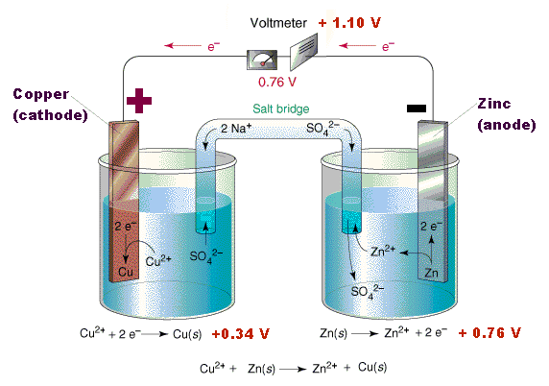
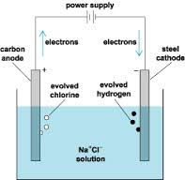
353 كيم – طرق التحليل الكهروكيميائية - Electrochemical Analytical Techniques - Chem 353
Electrochemical Cells - الخلايا الكهروكيميائية
Galvanic cell الخلية الجلفانية –
تفاعل تلقائي عند الأقطاب. بحيث ينتج تيارا كهربائيا
Spontaneous redox reactions at electrode. It gives raise to a current flow.
Electrolytic cell الخلية الكهروليتية –
تفاعل غير تلقائي عند الأقطاب. يتم التفاعل باستخدام مصدر طاقة خارجي
Non- spontaneous redox reactions at electrodes. Driven by an external energy supply.

Slide 18
353 كيم – طرق التحليل الكهروكيميائية - Electrochemical Analytical Techniques - Chem 353
Galvanic Cell - الخلية الجلفانية
A device in which chemical energy is converted to electrical energy.
It uses a spontaneous redox reaction to produce a current that can be used to generate energy or to do work.

Slide 19
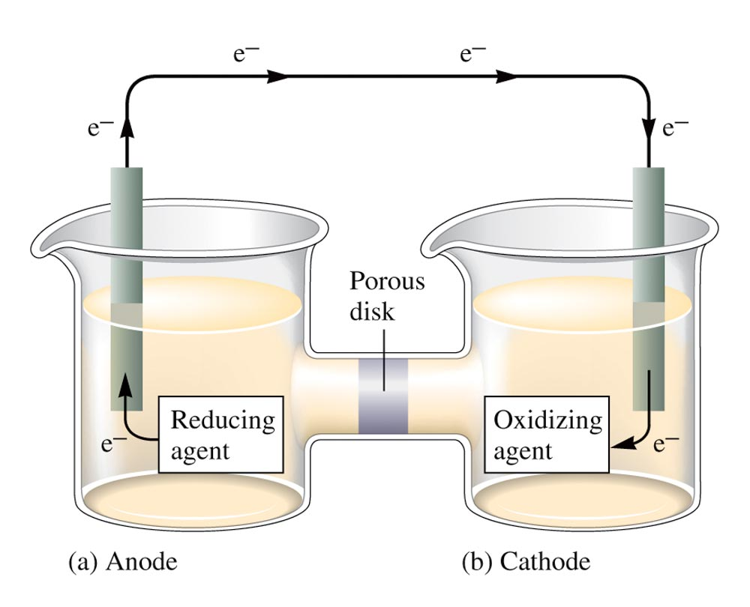
353 كيم – طرق التحليل الكهروكيميائية - Electrochemical Analytical Techniques - Chem 353
Galvanic Cell - الخلية الجلفانية

Slide 20
353 كيم – طرق التحليل الكهروكيميائية - Electrochemical Analytical Techniques - Chem 353
Galvanic Cell - الخلية الجلفانية
Oxidation occurs at the anode.
Reduction occurs at the cathode.
Salt bridge or porous disk allows ions to flow without extensive mixing of the solutions.
Salt bridge – contains a strong electrolyte held in a gel–like matrix.
Porous disk – contains tiny passages that allow hindered flow of ions.

Slide 21
353 كيم – طرق التحليل الكهروكيميائية - Electrochemical Analytical Techniques - Chem 353
Galvanic Cell - الخلية الجلفانية
1.) Basic Set-up:
a) Two electrodes
b) electrolytes solution
c) external connection between electrodes (wire)
d) internal connection via contact with a common solution or by different solutions connected by a salt bridge.
salt bridge – acts to isolate two halves of electrochemical cell while allowing migration
of ions and current flow.
- usually consists of a tube filled with potassium chloride
- separate species to prevent direct chemical reactions

Slide 22
353 كيم – طرق التحليل الكهروكيميائية - Electrochemical Analytical Techniques - Chem 353
Relative potential - الجهد النسبي
Zn
Cu
e⁻
Copper (Cu) is more electronegative than Zinc (Zn)
When the two metals are connected electrically, current (electrons) will flow spontaneously from Zinc to Copper
Zinc (Zn) is oxidized; Copper (Cu) is reduced
Zinc (Zn) is the anode; Copper (Cu) is the cathode

Slide 23
353 كيم – طرق التحليل الكهروكيميائية - Electrochemical Analytical Techniques - Chem 353
Relative potential - الجهد النسبي
mV
e⁻ → e⁻ → e⁻ →
Zn⁰
Cu⁰
Zn²⁺
Cu²⁺
Zn⁰ → Zn²⁺ + 2e⁻
Cu²⁺ + 2e⁻ → Cu⁰

Slide 24
353 كيم – طرق التحليل الكهروكيميائية - Electrochemical Analytical Techniques - Chem 353
Galvanic Cell - الخلية الجلفانية
Basic Set-up:
a) Two electrodes
b) Electrolytes solution
c) External connection between electrodes (wire)
d) Internal connection via contact with a common solution or by different solutions connected by a salt bridge.
Salt bridge – acts to isolate two halves of electrochemical cell while allowing migration of ions and current flow.
- usually consists of a tube filled with potassium chloride
- separate species to prevent direct chemical reactions

Slide 25
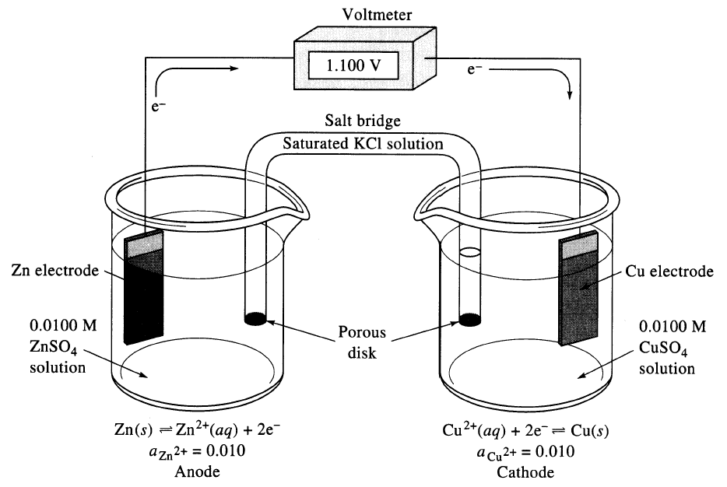
353 كيم – طرق التحليل الكهروكيميائية - Electrochemical Analytical Techniques - Chem 353
Galvanic Cell - الخلية الجلفانية

Slide 26
353 كيم – طرق التحليل الكهروكيميائية - Electrochemical Analytical Techniques - Chem 353
Galvanic Cell - الخلية الجلفانية
Flow of current (charge) in cell:
a) electrons (e⁻) within wires between two electrodes
b) ions within solution of each ½ cell (anions & cations) and through salt bridge
c) electrochemical reactions at electrode
At Cu electrode: Cu²⁺ + 2e⁻ ↔ Cu(s) → reduction – gain of e⁻ net decrease in charge
At Zn electrode: Zn(s) ↔ Zn²⁺ + 2e⁻ → oxidation – loss of e⁻ net increase in charge
Net Reaction: Cu²⁺ + Zn(s) ↔ Zn²⁺ + Cu(s)

Slide 27
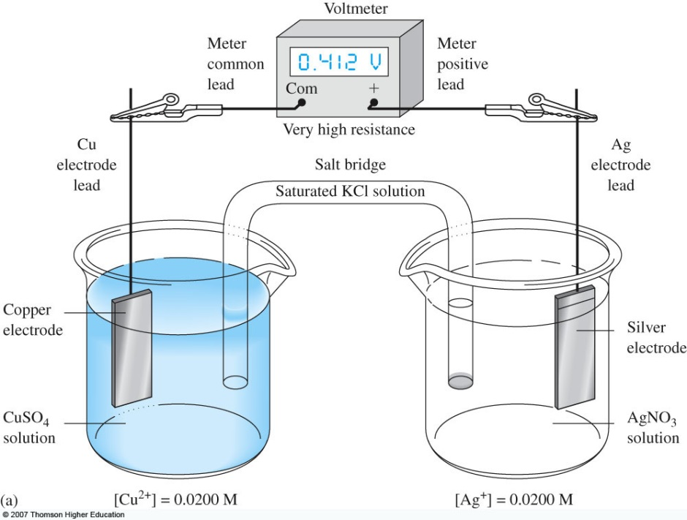
353 كيم – طرق التحليل الكهروكيميائية - Electrochemical Analytical Techniques - Chem 353
Galvanic Cell - الخلية الجلفانية
In galvanic cells: - reaction occurs naturally
- positive potential (E_{cell} = +)
- exothermic reaction → it produces energy

Slide 28
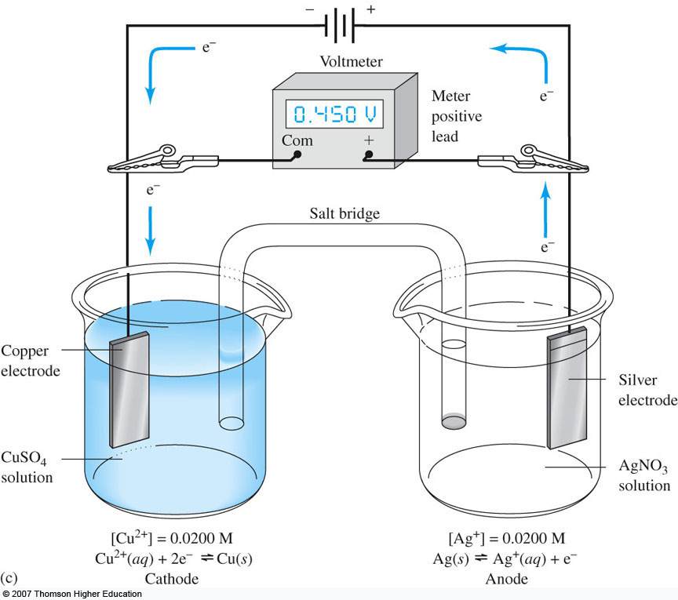
353 كيم – طرق التحليل الكهروكيميائية - Electrochemical Analytical Techniques - Chem 353
Electrolytic Cell - الخلية الإلكتروليتية
In electrolytic cells: - reaction does not occur naturally, it requires external stimulus (energy) to occur
- negative potential (E_{cell} = -)
- endothermic reaction → it requires energy
External battery at higher power than cell potential
Chemically reversible cell : a cell in which reversing the direction of the current simply reverses the chemical reaction

Slide 29
353 كيم – طرق التحليل الكهروكيميائية - Electrochemical Analytical Techniques - Chem 353
Electrodes - الأقطاب
1) Cathode : electrode where reduction occurs
Examples of cathode ½ reactions:
Cu²⁺ + 2e⁻ ↔ Cu(s)
Fe³⁺ + e⁻ ↔ Fe²⁺
AgCl(s) + e⁻ ↔ Ag(s) + Cl⁻
- e⁻ supplied by electrical current
via electrode
- species (products/reactants) can
both be in solution (Fe³⁺/Fe²⁺),
solids or coated on electrodes
(AgCl(s)/Ag(s) or combination
(Cu²⁺/Cu(s)
e⁻

Slide 30
353 كيم – طرق التحليل الكهروكيميائية - Electrochemical Analytical Techniques - Chem 353
Electrodes - الأقطاب
Anode : – electrode where oxidation occurs
Examples of anode ½ reactions:
Cu(s) ↔ Cu²⁺ + 2e⁻
Fe²⁺ ↔ Fe²⁺ + e⁻
Ag(s) + Cl⁻ ↔ AgCl(s) + e⁻
- e⁻ is taken up by electrode
into electrical circuit
e⁻

Slide 31
353 كيم – طرق التحليل الكهروكيميائية - Electrochemical Analytical Techniques - Chem 353
Liquid junction - الرابط السائل
Liquid junction is the interface between two solutions with different components or concentrations
Small potentials may develop at junction that affect overall cell potential
Liquid Junction

Slide 32
353 كيم – طرق التحليل الكهروكيميائية - Electrochemical Analytical Techniques - Chem 353
Representation of cells - رمز الخلايا
By convention it starts with anode on left
Zn|ZnSO₄(C_{ZN}2+ = 0.0100)||CuSO₄(C_{Cu}2+ = 0.0100)|Cu
Phase boundary
Electrode/solution interfaces
anode
cathode
oxidation
2 liquid junctions
due to salt bridge
reduction
Solution in contact with
anode & its concentration
Solution in contact with
cathode & its concentration

Slide 33
353 كيم – طرق التحليل الكهروكيميائية - Electrochemical Analytical Techniques - Chem 353
Cell Potential - جهد الخلية
A galvanic cell consists of an oxidizing agent (in cathode half-cell) and a reducing agent (in anode half-cell).
Electrons flows through a wire from the anode half-cell to the cathode half-cell.
The driving force that allows electrons to flow is called the electromotive force (emf) or the cell potential (E_{cell}).
The unit of electrical potential is volt (V).
1 V = 1 J/C of charge transferred.

Slide 34
353 كيم – طرق التحليل الكهروكيميائية - Electrochemical Analytical Techniques - Chem 353
Cell Potential - جهد الخلية
The cell potential is always positive for a galvanic cell, where
E°_{cell} = E°_{(cathode half-cell)} – E°_{(anode half-cell)}
Anode is the negative pole and cathode is the positive pole .
Electrons flow from the anode (-) to cathode (+).
Current flows from cathode (+) to anode (-).
Positive ions flow from anode to cathode half-cells and negative ions flows from cathode to anode though the “salt bridge”.

Slide 35
353 كيم – طرق التحليل الكهروكيميائية - Electrochemical Analytical Techniques - Chem 353
الجهد القياسي للإختزال
Standard Reduction Potential
Values of E° are given in standard table of half-cell potentials are for reduction half-cell reactions
Standard conditions: 1 M, 1 atm, 25°C
When a half-reaction is reversed, the algebraic sign of E° changes.
When a half-reaction is multiplied by an integer, the value of E° remains the same.
A galvanic cell runs spontaneously in the direction that gives a positive value for E° _{cell}

Slide 36
353 كيم – طرق التحليل الكهروكيميائية - Electrochemical Analytical Techniques - Chem 353
Examples of Cell Potential - أمثلة عن جهد الخلية
Reaction: Fe³⁺(aq) + Cu(s) → Cu²⁺(aq) + Fe²⁺(aq)
Half-Reactions:
Fe³⁺ + e– → Fe²⁺ E° = 0.77 V
Cu²⁺ + 2e– → Cu E°= 0.34 V
To balance the cell reaction and calculate the cell potential, we must reverse reaction 2.
Cu → Cu²⁺ + 2e– – E°= – 0.34 V
Each Cu atom produces two electrons but each Fe³⁺ ion accepts only one electron, therefore reaction 1 must be multiplied by 2.
2Fe³⁺ + 2e– → 2Fe²⁺ E°= 0.77 V

Slide 37
353 كيم – طرق التحليل الكهروكيميائية - Electrochemical Analytical Techniques - Chem 353
الجهد القياسي للخلية
Standard Cell Potential
Half-reactions:
2Fe³⁺ + 2e– → 2Fe²⁺ ; E° = 0.77 V (cathode)
Cu → Cu²⁺ + 2e– ; – E° = – 0.34 V (anode)
Balanced Cell Reaction:
Cu + 2Fe³⁺ → Cu²⁺ + 2Fe²⁺
Cell Potential: E
E°_{cell} = E°(cathode) – E°(anode)
E°_{cell} = 0.77 V – 0.34 V = 0.43 V

Slide 38
353 كيم – طرق التحليل الكهروكيميائية - Electrochemical Analytical Techniques - Chem 353
حساب الجهد القياسي للخلية
Calculating Standard Cell Potential
Given the following reduction potentials:
Ag⁺(aq) + e⁻ → Ag(s); E° = 0.80 V
Zn²⁺(aq) + 2e⁻ → Zn(s); E° = -0.76 V
Calculate the cell potential for the following reaction and predict whether the reaction will take place:
Zn(s) + 2Ag⁺(aq) → Zn²⁺(aq) + 2Ag(s)

Slide 39
353 كيم – طرق التحليل الكهروكيميائية - Electrochemical Analytical Techniques - Chem 353
حساب الجهد القياسي للخلية
Calculating Standard Cell Potential
Given the following reduction potentials:
Cu²⁺(aq) + 2e⁻ → Cu(s); E° = +0.34 V
Ni²⁺(aq) + 2e⁻ → Ni(s); E° = -0.23 V
Predict whether the following reaction will take place:
Cu(s) + Ni²⁺(aq) → Cu²⁺(aq) + Ni(s)

Slide 40
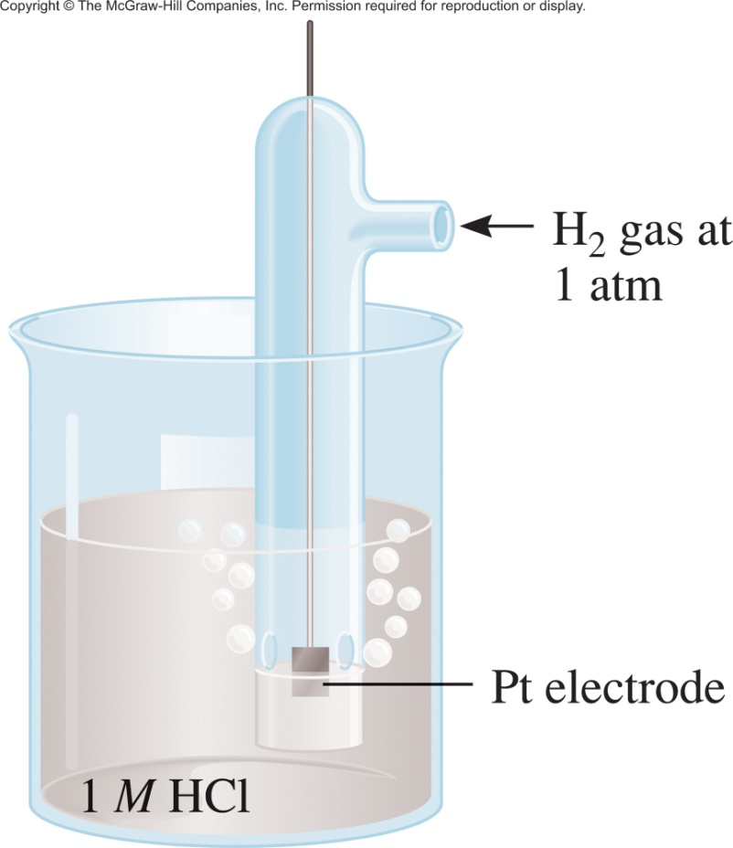
353 كيم – طرق التحليل الكهروكيميائية - Electrochemical Analytical Techniques - Chem 353
الجهد القياسي - Standard Potential
Standard reduction potential (E⁰) is the voltage associated with a reduction reaction at an electrode when all solutes are 1M and all gases are at 1atm.
Reference electrode:
Standard hydrogen electrode (SHE)
It corresponds to the
reduction reaction:
2H⁺ (1M) + 2e⁻ H₂ (1atm)
EH⁺/H₂ = 0 V
40

