Slide 1
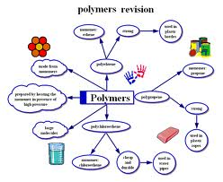
CHEM330
Physical chemistry of polymers
Credit hours: 1 h course + 1 h Laboratory
College of Science
Chemistry department
1444H-2022/23

Slide 2
Grades
1^{rst} Midterm Exam :15 points
2nd Midterm Exam :15 points
* lab: 30 points
*Final Exam :40 points

Slide 3
References and books
Ger Challa “Polymer chemistry: an introduction: Ellis Horwood, 1993
Polymer Synthesis and Characterization, Basic laboratory course, Edited by Florian Paulus, Dirk Steinhilber, Tobias Becherer 2011/2012
Industrial Polymers, Specialty Polymers, and Their Applications, 1rt Edition, Manas Chanda, Salil K. Roy, 2008.

Slide 4
Course Objectives
1-Definition and classification of polymers
2-Polymers and copolymers Nomenclature
3- Structure and microstructure of polymers
4- Polymerization reactions
5- Techniques of polymerization
6- Techniques used to determine the average molecular weights
7- Thermal properties of polymers

Slide 5
1. Generalities

Slide 6
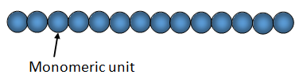
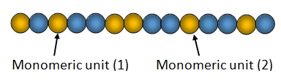
1.1Definition and classification of polymers
A polymer is one or several sequences of several molecules of the same type called “monomeric units” linked by covalent or coordination bonds.
“All polymers are macromolecules but not all macromolecules are polymers, because a macromolecule does not necessarily include repetitive units”
There are two types of polymer, depending on the nature of the monomeric units.
Homogeneous also called “homopolymer” in which all the monomeric units are similar
Heterogeneous called “copolymer” in which the monomeric units are different

Slide 7
Examples: Homogeneous polymers
Polyethylene (PE), Poly(methyl methacrylate)(PMMA), poly(dimethyl siloxane)(PDMS), polystyrene (PS)…
The parenthesis (…): We must put the name of the monomer in parentheses only if is composed of two or more words
For example:
Polyethylene: “ethylene” is only in one word
Poly(methyl methacrylate): “methyl methacrylate” is composed of two words
methyl and methacrylate
Examples: Heterogeneous polymers
Poly(ethylene-co-terephtalate) (PET), Poly(styrene-co-butadiene)(PSB)
The symbol “co” indicates the two first letters of the word “copolymer” and indicates that the two units coexist in the same polymer chain.

Slide 8
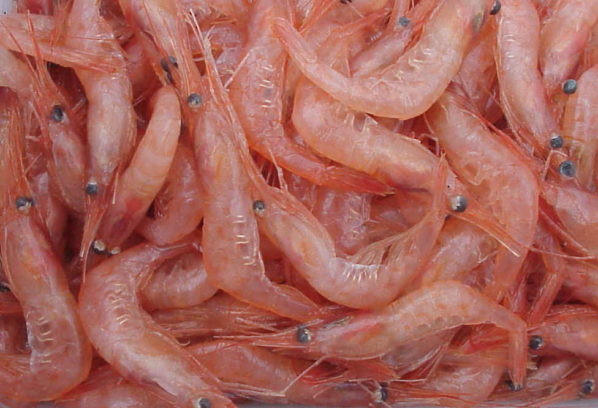
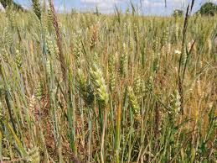
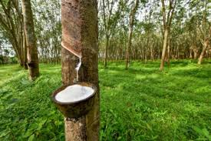
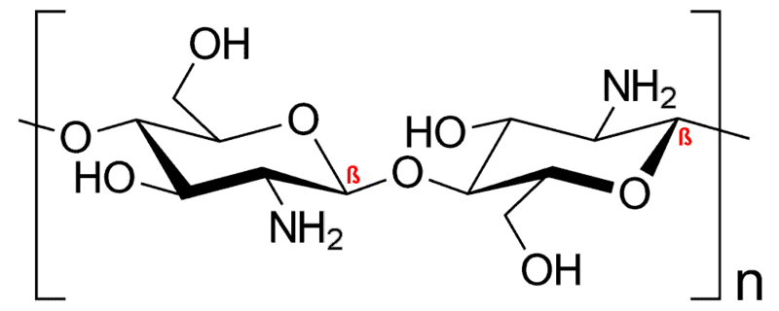
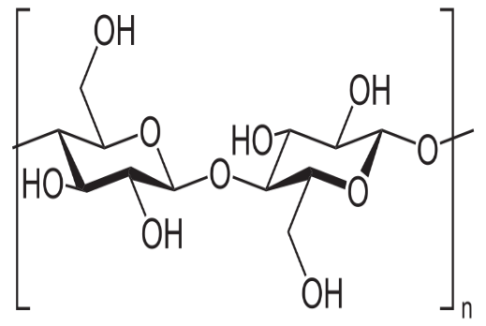
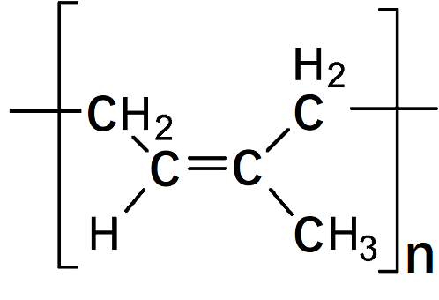
1.2 Nature of polymer
According to its origin, a polymer can be natural or synthetic
1.2.1 Natural polymers: These polymers are of animal origin such as
Chitosan (shrimp shell), or plant like cellulose, natural rubber (vegetable plants)
Shrimp
Vegetable plants
rubber tree

Slide 9
1.2.2 Synthetic polymers:
These polymers are obtained from the polymerization of monomers containing vinylic, acetylenic, di or more functional active groups and ring opening monomers containing heteroatoms.
Examples:
Polymerization of vinylic monomers leads to obtain polystyrene, poly(vinyl chloride), poly(vinyl alcohol)…. etc.
Polymerization of acetylenic monomers leads to obtain polyacetylene, poly(phenyl acetylene), poly(alkyl acetylene)… etc.
Polymerization of monomers having di functional active groups leads to obtain poly(ethylene oxide), poly(dimethyl siloxane) oil, polyester, polyurethane … etc.
Polymerization of monomers having tri functional active groups leads to obtain poly(dimethyl siloxane) rubber
Polymerization by ring opening of monomers leads to obtain poly (caprolactone), ethylene oxide… etc.

Slide 10
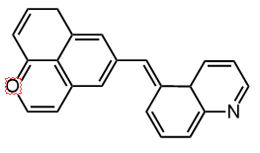
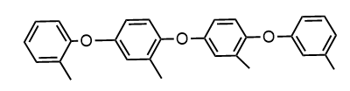


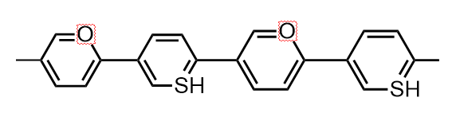
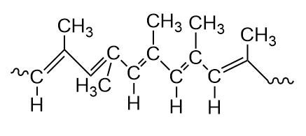
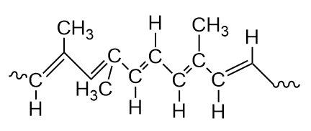
Exercises
Exercise1: Which among the following molecules are polymers
Exercise2: Which Among the following polymers, classify the homogeneous polymers and the heterogeneous polymers

Slide 11
Answers
Exercise 1
Polymers are:
Exercise 2
Homopolymers are:

Slide 12
Exercise 2
Heteropolymers (copolymers)
Answers

Slide 13
Exercises
Exercises 3. Give two examples of natural vegetal polymer
Exercises 4. Give four examples of natural animal polymer
Exercises 5. Give three examples of synthetic polymer

Slide 14
Answers
Exercise 3.
Amylopectine,
Lignin
Exercise 4.
Albumin,
Collagen,
Gelatin,
Chondroitin
Exercise 5.
Poly(methyl methacrylate) (Plexiglass)
Nylon
Acid polyacrylic

Slide 15
2. Structure and microstructure

Slide 16
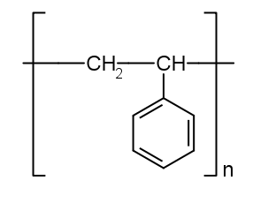
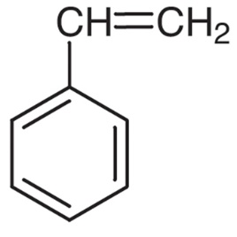
2. 1 Chemical structure and microstructure
A polymer is represented by a structure well defined which is based on that of the corresponding monomer, but a polymer can have several microstructures which play a determining role in its properties.
Chemical structure of polymer
Examples:
Polystyrene its molecule is symbolized by the following structure:
styrene: polystyrene:

Slide 17
Triple bonds such as acethylene and alkylacetylene
nCH≡CH ─ polymerization → -[CH=CH]n-
n R-C≡CH - polymerization → -[C(R)=CH]n-
Two or more functional groups such as ethylene glycol
Example:

Slide 18
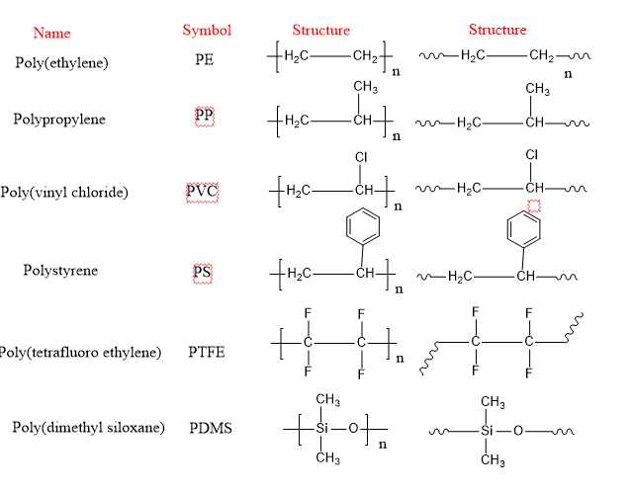
2. 3 Naming the polymers and copolymers

Slide 19
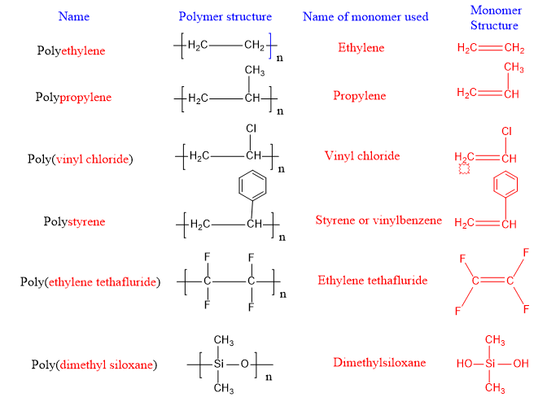
2.3Naming the polymers and copolymers

Slide 20
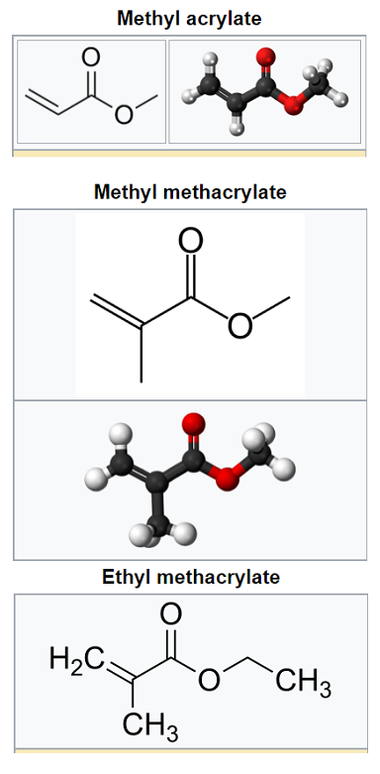

Slide 21
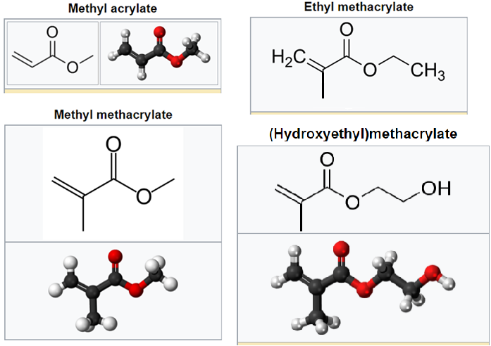

Slide 22
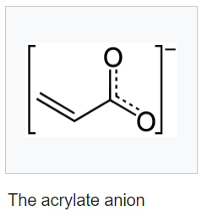
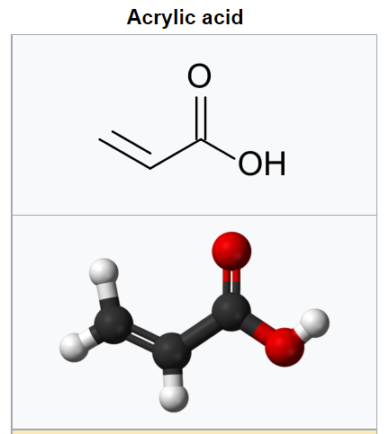

Slide 23
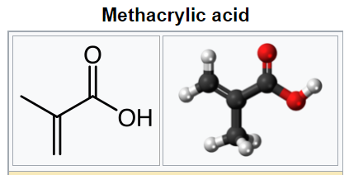
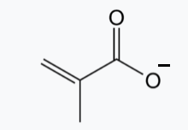

Slide 24
Exercise 1: What is the nomenclature and the structure of each polymer synthesized from the following monomers?
Acrylononitrile (CH2=CH-CN)
Acrylic acid (CH2=CH-COOH
Acrylamide (CH2=CH-CO-NH2)
Vinylalcohol (CH2=CH-OH)
Vinylacetate (CH2=CH-O-CO-CH3)
Exercise 2: What is the nomenclature and the structure of each monomer used in the synthesis of the following polymers?
poly(methyl methacrylate)
Poly(vinylpyridine)
Poly(2-hydroxyethylmethacrylate)
Poly(ethylene glycol)
Poly(vinylnaphtalene)

Slide 25
CORRECTION 1
Nomenclature: Polyacrylonitrile structure: -[CH2-CH(CN)]n-
B) Nomenclature: Poly(acrylic acid) structure: -[CH2-CH(COOH)]n-
C) Nomenclature: Polyacrylamide) structure: -[CH2-CH(CO-NH2)]n-
D) Nomenclature: Poly( vinyl alcohol) structure: -[CH2-CH(OH)]n-
A) Nomenclature: Poly(vinyl acetate) structure: -[CH2-CH(O-CO-CH3)]n-

Slide 26
CORRECTION 2
Nomenclature: methyl methacrylate
Structure: CH2=C(CH3)(COOCH3)
Nomenclature: vinylpyridine
Structure: CH2=CH(C5H4N)
C) Nomenclature: 2-hydroxyethylmethacrylate
Structure: CH2=C(CH3)(COO-(CH2)2-OH)]n-
D) Nomenclature: ethylene glycol
Structure: HO-CH2-CH2-OH
Nomenclature: vinylnaphtalene
Structure: CH2=CH-C10H8

Slide 27
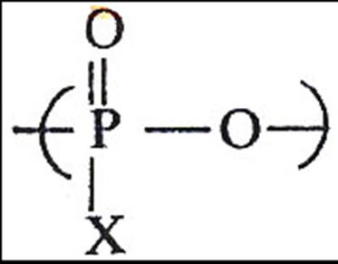

Inorganic polymer
-[PH – NH]n- Poly(phosphazene)

Slide 28
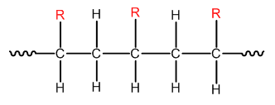
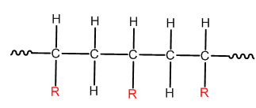
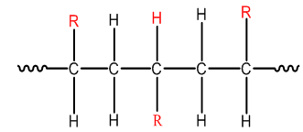
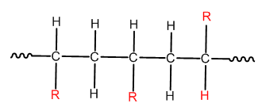
2.4 Polymer microstructure (tacticity, cis/trans)
A-Tacticity of Polymers
A polymer can be present three distinct microstructures
1) Isotactic
2) Syndiotactic
3) Atactic
or

Slide 29
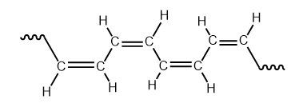
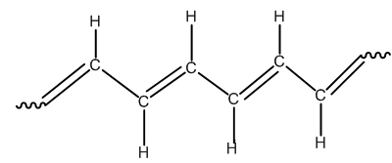
B- Isomery Cis/Trans
A polyconjugated polymer can be present two microstructures cis or trans with respect to the double bonds
Example
Microstructure Cis:
Microstructure Trans:

Slide 30
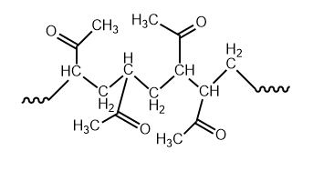
EXERCISES
Exercise 1
Among the following polymers Indicate those have a tacticity.
-[CH2-CH(COOH)]n-; -[CH2-CH(C6H5)]n-; -[CH2-CH2]n-; -[CH2-CH2-O-]n-; -[O-C6H4-]n-
Exercise 2
What is the tacticity of the following molecule.
Exercise 3
Write the miscrostructure syndiotactic for the following molecules. – Poly(vinyl chloride); Poly( sodium acrylate)

Slide 31
Correction 1
The molecules that have tacticities are:
-[CH2-CH(COOH)]n-; -[CH2-CH(C6H5)]n-
Because these molecules have substituent : in the first one presence of carboxylic group and in the second one presence of benzyl group

Slide 32
Correction 2
The tacticity of this molecule is syndiotactic. Because the substitutents are distributed alternativement on both sides of the polymer chain (backbone)

Slide 33
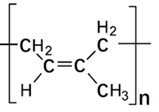
Correction 3

Slide 34
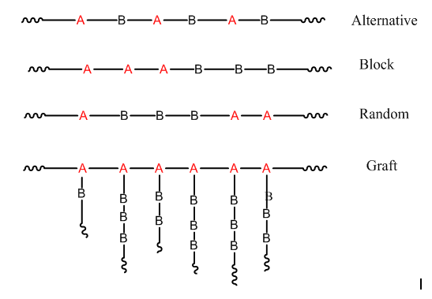
Copolymer structure
A copolymer also called heterogene polymer contains two or more monomeric units in its chain.
If A and B are its monomer units, we can write Its structure as follow:

Slide 35
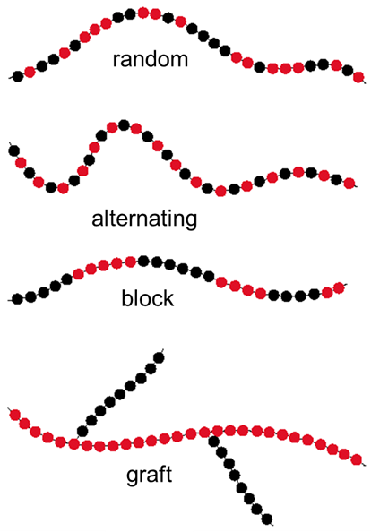

Slide 36
Examples
Nomenclature: The polymerization of ethylene with vinyl alcohol give a copolymer called poly(ethylene-co-vinyl alcohol) or copoly(ethylene/vinylalcohol)
Structure: -[CH2-CH2]n-[CH2-CH(OH)]m-
If this copolymer is alternative: poly(ethylene-alt-vinyl alcohol)
If this copolymer is sequenced: poly(ethylene-block-vinyl alcohol)
If this copolymer is random: poly(ethylene-rand-vinyl alcohol)
If this copolymer is grafted: poly(ethylene-graf-vinyl alcohol)

Slide 37
Exercises
Exercise1: Indicate the name and the formula of a grafted copolymer prepared from styrene and acrylic acid
Exercise2: Indicate the name and the formula of a block copolymer prepared from acrylonitrile and acrylamide
Exercise3: Indicate the name and the formula of a grafted copolymer prepared from acrylonitrile and styrene
Exercise4: Indicate the name and the formula of a random copolymer prepared from acrylonitrile and styrene
Exercise5: Indicate the name and the formula of a random terpolymer prepared from acrylonitrile, styrene and methyl methacrylate

Slide 38
Corrections

Slide 39
3. Polymer crystallinity

Slide 40
3. Crystalline polymer and amorphous polymer
The principle of crystallinity in polymers is different from that of small molecules. Because a crystalline system in small molecules is characterized by a well-defined geometry of crystals in the crystal lattice. NaCl crystals, for example, have cubic shapes. But in polymers, only parts of the chain are in orderly condition with other parts of other chains. In this case the crystallinity in the polymers means that some parts of the chains are in a certain ordered state as shown in the figure above. A state is said to be amorphous when the chains are randomly arranged in the polymer matrix and do not obey any defined order.

Slide 41
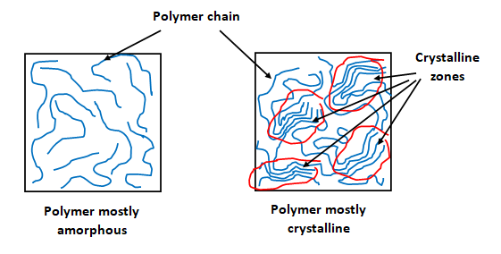
The crystallinity of polymers can be compared to hair that is neither smooth nor crisp. There is no 100% crystalline polymer , polymer has a semi -crystalline structure, the most crystalline does not exceed 80% and varies according to the nature and the structure and microstructure of the polymer.

Slide 42
3. Crystalline polymer and amorphous polymer
The more linear polymer chains, the higher their degrees of crystallinity.
For example, the maximum degree of crystallinity (~ 80 %) is found in polyethylene because polyethylene does not have substituents.
Poly(methyl methacrylate) (PMMA) is amorphous, because this polymer has bulky substituents.
Most polymers are amorphous due to the presence of very crowded substitutes. Most amorphous polymers do not have melting temperatures.

Slide 43
A- Amorphous polymers:
3. Polymer crystalline and polymer amorphous
Properties
1- Clear
2- High elongation
3- Nonspecific melting temperature
4- Low-moderate chemical resistance

Slide 44
B- Semi-crystalline polymers
3. Polymer crystalline polymer and polymer amorphous
Properties
1- cloudy opaque
2- low elongation
3- specific melting temperature
4- good-to high chemical resistance

Slide 45
Crystalline polymers
3. Crystalline polymer and amorphous polymer
1- Opaque
2- Low elongation
3- Specific melting temperature
4- Good to high chemical resistance
5- Strength
6- Higher density
7- Less Soluble
8- Less Permeable

Slide 46
Factors affecting the crystallinity
3. Crystalline polymer and amorphous polymer
Crystalline (rigid, soluble)…… amorphous(Soft, rubbery material)
1- Rate of cooling during solidification
2- monomer complexity
3- side group
4- Copolymerization
* Alternating and block can crystallize more easily as compared to random and graft

Slide 47
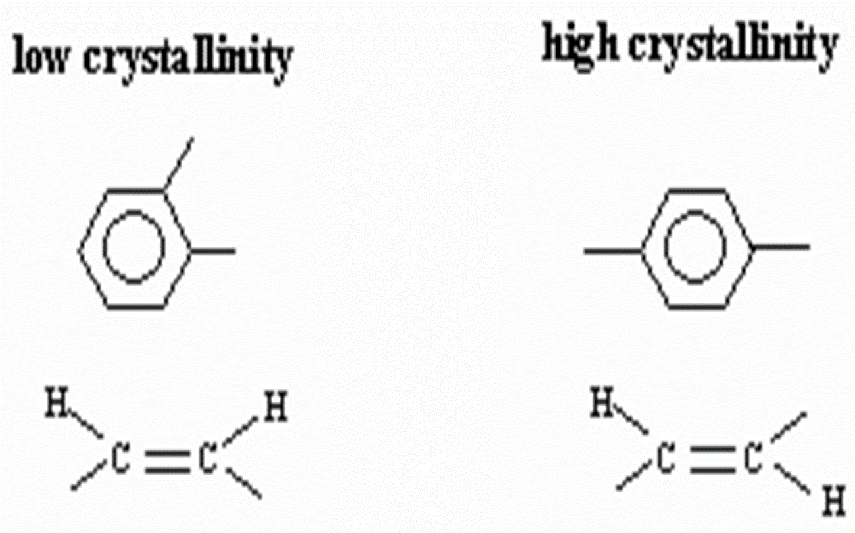
Factors affecting on the crystallinity
5- Chain flexibility
Ether, imine, double bonds in cis form, C-O and C-N

Slide 48
Factors affecting the crystallinity
6- chain structure
Linear polymers crystallize relatively easily
Branches inhibit crystallization,
Network polymers almost completely amorphous
Cross-linked polymers can be both crystalline and amorphous

Slide 49
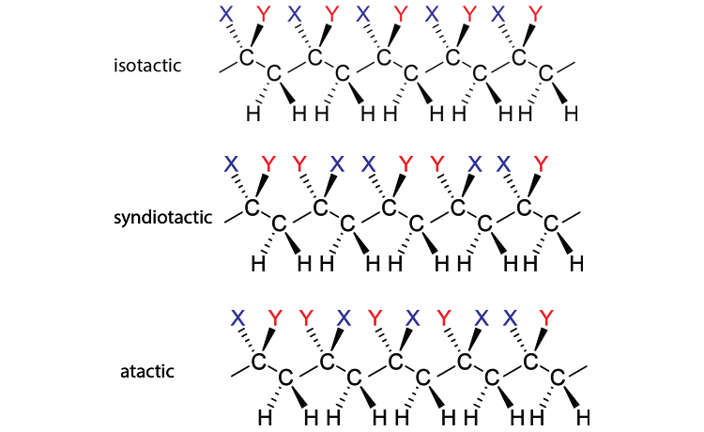
Factors affecting the crystallinity
7- Isomerism
*Isotactic and syndiotactic polymers crystallize relatively easily
*atactic difficult to crystallize

Slide 50
Measuring Crystallinity
3. Polymer crystalline polymer and polymer amorphous
A-Density measurements
B-X-ray diffraction e.g. powder (XRD)
C-Differential scanning calorimeter (DSC)

Slide 51
4. Polymerization and copolymerization monomers

Slide 52
Principal polymerization reactions
Polyaddition
Polycondensation
Ring opening
Vinylic, ethylenic and acetylenic monomers
Monomers having two or more functional groups
Monomers cyclic heteroatomic

Slide 53
4.1 Polyaddition reactions
Polyadditions
Free radical polymerization
Ionic polymerization
Coordination polymerization
Chemical polymerization
Anionic polymerization
Ziegler-Natta polymerization
Physical polymerization
Cationic polymerization
Metathesis polymerization

Slide 54
Monomer used: Vinylic monomers having as substituent an attractor atom or group of atoms such as : CH2=CH-X with X = Halogen, carboxylic, amine, amide, phenyl, …etc.
Chemical initiator used: Chemical substance capable to generate free radical such as: peroxide, azoisobutyronitrile (AIBN), potassium persulfate (KPS)… etc.
Physical initiator used: heat and radiation (UV, Gamma, Alpha, …etc.)
4.1.1 Free radical Polymerization

Slide 55
A-Steps of polymerization
Steps of polymerization
Initiation
Propagation
Termination
Formation of the active center
Progression of chains or chains growth
Maturation of the polymer chains
A-M✽
A-M-M-M-M✽
A-M-M-M-M-M

Slide 56
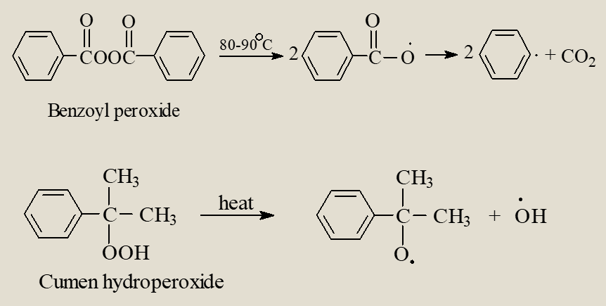
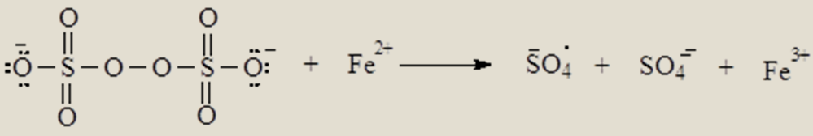
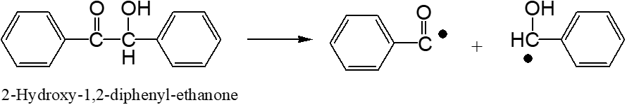
A-1.Initiators and free radical formation
60ºC

Slide 57

Initiation ( formation of the active center):
Initiators and free radical formation
If A2 is the chemical initiator and M the monomer
For example:
A2 : diacyl peroxid : C6H5-CO-O-O-CO-C6H5
M: Acrylic acid: CH2=CH-COOH
C6H5-CO-O-O-CO-C6H5 →
2 C6H5-CO-O*
C6H5-CO-O* + CH2=CH-COOH → C6H5-CO-O -CH2-CH*(COOH)
(Active center)

Slide 58
Propagation (Chains progression)
(Macroradical formation)
C6H5-CO-O -CH2-CH*(COOH) + n (CH2=CHCOOH)
C6H5-CO-O –[CH2-CH*COOH]n- CH2-CH*COOH
(Macroradical)

Slide 59
This step can be achieved by different reactions
A- Transfer to the impurity according to the following reactions:
Termination
presence of impurity (I) in the reaction mixture
C6H5-CO-O –[CH2-CH*COOH]n- CH2-CH*COOH + I
(Macroradical)
C6H5-CO-O –[CH2-CH*COOH]n- CH2-CHCOOH + I*
I* + m (CH2=CH-COOH) →
I-CH2-CH*COOH]n- CH2-CH*COOH

Slide 60
B) Transfer to the solvent (S)
C6H5-CO-O –[CH2-CH*COOH]n- CH2-CH*COOH + S
(Macroradical)
C6H5-CO-O –[CH2-CH*COOH]n- CH2-CHCOOH + S*
(Mature chain)
S* + m (CH2=CH-COOH) →
S-CH2-CH*COOH]n- CH2-CH*COOH
(Macroradical)
This termination type can occur in the hologened solvent such as chloroform.

Slide 61
C) Transfer to the Monomer (M)
C6H5-CO-O –[CH2-CHCOOH]n- CH2-CH*COOH + M
(Macroradical)
C6H5-CO-O –[CH2-CHCOOH]n- CH2-CHCOOH + M*
(Mature chain)
M* + m (CH2=CH-COOH) →
M-CH2-CHCOOH]n- CH2-CH*COOH

Slide 62
D) Termination by combination of two macroradical
C6H5-CO-O –[CH2-CHCOOH]n- CH2-CH*COOH
(Macroradical)
+
C6H5-CO-O –[CH2-CHCOOH]n- CH2-CH*COOH
(Macroradical)
C6H5-CO-O –[CH2-CH*COOH]n- CH2-CHCOOH
C6H5-CO-O –[CH2-CH*COOH]n- CH2-CHCOOH
Usually this type of termination leads to long polymer chains

Slide 63
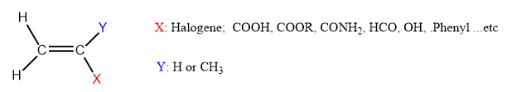

4.1.2 Anionic polymerization
Initiators: Strong base such as : NaOH, KOH, KNH2, Carbanion such as Butyl lithium (Li⁺C4H9⁻), sodium ethanolate (NaOC2H5) …etc.
Monomers: vinylic monomers having attractor atoms or group of atoms and other molecules such as ethylene epoxide.
Vinylic monomers

Slide 64

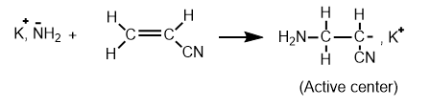
Initiation ( Active center formation)
Example:
Initiator= KNH2 (Potassium amide)
Monomer = H2C=CH-CN (Acrylonitrile)

Slide 65
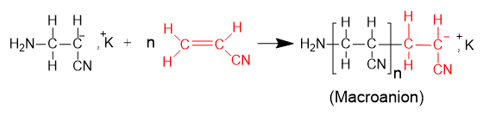
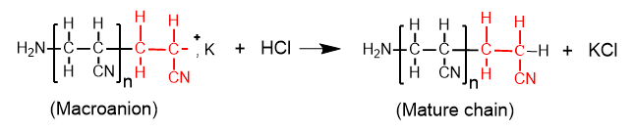
Propagation ( Chain growth)
Termination (Chain maturation)
In most cases the termination is achieved by adding small amounts of mineral acid such as HCl, HNO3, … etc.

Slide 66
4.1.3 Cationic polymerization
Initiators: Strong acid such as: HCl, H2SO4, HNO3, Carbocation (Iodate tertiobutylate(CH3)3I), Lewis acids, … etc.
Monomers: Vinyl monomers, epoxide, two conjugated double bonds
Initiation (active center formation)
For example : BF3 as initiator and traces of H2O or ROH as co-initiator
CH2=C(CH3)2 as monomer

Slide 67
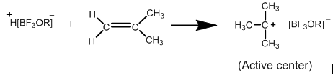


Initiation
Propagation (chain growth)
Termination (chain maturation)
In most cases the termination is achieved by adding small amounts of mineral base

Slide 68
Factors affecting the rate of ionic polymerization
(anionic and cationic)
A- Effect of the temperature of polymerization
B- Effect of the solvent
C- Effect of the counter ion of the catalyst
D- Effect of the monomer structure
HW1:Compare between anionic and cationic polymerization

Slide 69
4.1.4 Coordination polymerization
Initiators = complex formed from a catalyst + co-catalyst system
Catalyst: Transition element + halogen ligand
Examples: TiCl4, TiCl3, VCl3, CoCl2, … etc
Co-catalyst: Aluminum chloride (AlCl3), Alkyl Aluminum Al(Butyl)3, … etc.
Monomers:
All vinylic, ethylenic and acetylenic monomers do not weigh attracting atoms such as oxygen, nitrogen, sulfur, phosphate. Monomers with fully carbon aromatic rings polymerize by these catalysts such as styrene and phenyl acetylene.

Slide 70
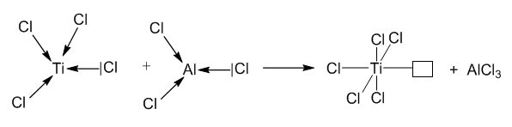
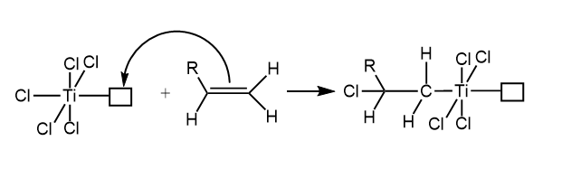
Complex formation
Initiation (active center formation)
(Active center)

Slide 71
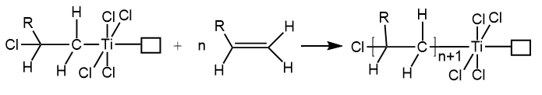
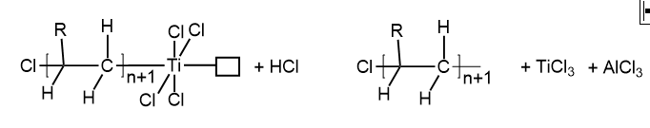
Propagation ( chain growth)
Termination (Chain maturation)
In most cases the termination is achieved by adding small amounts of mineral base of mineral acid

Slide 72
Polyaddition/Exercises
Exercise 1: Among the following initiators, which of them can polymerize acrylic acid through radical polymerization route.
NaOH; HCl; AlCl4; Ph-CO-O-O-CO-Ph; Et-ONa; TiCl4
Exercise 2: Among the following initiators, which of them can polymerize acrylic acid through anionic polymerization route.
NaOH; HCl; AlCl4; Ph-CO-O-O-CO-Ph; Et-ONa; TiCl4
Exercise3: Among the following initiators, which of them can polymerize acrylic acid through cationic polymerization route.
NaOH; HCl; AlCl4; Ph-CO-O-CO-Ph; Et-ONa; TiCl4
Exercise 4: Among the following initiators, which of them can polymerize propylene through coordination polymerization (Ziegler-Natta) route.
NaOH; HCl; AlCl4; Ph-CO-O-CO-Ph; Et-ONa; TiCl4; TiCl4/AlCl3; NaCl/AlCl3; Et-Na/AlCl4

Slide 73

Polyaddition/Exercises
Exercise5: Among the following monomers indicate which of them can be polymerized through a radical polymerization way?
Exercise6: Among the following monomers indicate which of them can be polymerized through an anionic polymerization way?

Slide 74


Polyaddition/Exercises
Exercise5: Among the following monomers indicate which of them can be polymerized through a radical polymerization way?
Exercise6: Among the following monomers indicate which of them can be polymerized through an anionic polymerization way?

Slide 75
Polyaddition/Exercises
Exercise 9. In general, the increase in the temperature of the polymerization leads to:
A) Increase the polymerization rate
B) decrease the polymerization rate
C) Increase the molecular weight of resulted polymer
C) decrease the molecular weight of resulted polymer
D) Increase the yield of polymerization
E) decrease the yield of polymerization

Slide 76
Polyaddition/Exercises
Exercise 10- What is the effect of polar solvent on the polymerization of styrene
Exercise 11- What is the effect of non-polar solvent on the polymerization of acrylic acid
Exercise 12- What is the effect of the counter ion on the cationic polymerization of styrene
Exercise 13- What is the effect of the monomer structure on the polymerization

Slide 77
Exercise7: Among the following monomers indicate which of them can be polymerized through a ziegler-Natta (coordination) polymerization way?
Polyaddition/Exercises
Exercise8: Among the following monomers indicate which of them can be polymerized through a cationic polymerization way?

Slide 78

4.2 Ring Opening Polymerization
Ring Opening Polymerization can be realized by anionic or cationic catalysts
Anionic catalysts:
Exemples: Sodium ethanolate; sodium amide; NaOH; carbanion.
Monomers:
Examples: Heteroatomic cycle such as: ethylene epoxide, caprolactone, valerolactone.

Slide 79


Cationic catalysts: Ter-butyl iodide [C(CH3)3I]
Monomer: ethylene epoxide
Initiation
Propagation
Termination
Living polymer

Slide 80


Cationic catalyst: H2SO4
Monomer: ℇ-caprolactone
Initiation
Propagation
Termination: leads to living polymers

Slide 81
Exercise 1: Write a ring polymerization of L-lactide
Exercise 2: Write the structure of the monomer that used to obtain the following polymer

Slide 82
4.3. Polycondensation reaction
Monomers: Molecules having two or more functional active groups.
Homogene such as:
Ethylene glycol (HO-(CH2)2-OH); dicarboxylic acid (HOOC-(CH2)n-COOH; dialkylamine (H2N-(CH2)n-NH2)
Heterogene such as: HO-(CH2)2-COOH; HO-(CH2)n-NH2; HCO2-(CH2)n-NH2
Catalysts:
Strong acid: H2SO4; HCl; HNO3
Strong base: NaOH, NaOC2H5; NH2Na,

Slide 83
4.3 Polycondensation/Reactions
Step-growth Polymerization: Polymerization of monomers containing two functional groups propagates from both advancing chain to give a linear polymer and elimination of small molecules such as water, HCl...
On the other hand, the monomers containing three or four functional groups propagates on the three or four ends of the chain in progression giving a crosslinked polymer with elimination of small molecules such as water or HCl.
Example of linear polymer:
Produces Linear and Cross linked Polymers
Thermoplastic
Thermoset

Slide 84
Example of polycondensation leading to a crosslinked polymer
Monomer: methyltriolsiloxane
Catalyst: H2SO4
(Silicone rubber) (PDMS)

Slide 85


4.3 Polycondensation /properties
Kevlar
Properties
very strong material
used for reinforcing car tires
Used to make ropes
20 times as strong as steel ropes of the same weight
Used for making reinforced aircraft wings and bullet-proof vests

Slide 86


4.2 Polycondensation/properties
Dacron
is the DuPont trademark for the polyester, Polyethylene terephthalate
(PET, PETE, PETP) Sometimes called Terylene
Polymer chains are held together by strong dipole-dipole interaction.

Slide 87


4.3 Polycondensation/properties
Dacron
Strong
Tough
Smooth
Resistant to water and chemicals

Slide 88
Among the interests of copolymerization reaction are:
1- to improve the properties of a polymer
2- to obtain the properties of two or more homopolymers in one
3- to obtains new properties in the resulted hybrid polymer
4.4. Copolymerization of vinylic monomers and reactivity ratio
The copolymerization reaction of vinyl monomers proceeds exactly like the homopolymerization of a monomer but it involves two or more different monomers.

Slide 89
4.4.1 Copolymerization reaction
Example:
Acrylic acid + styrene → poly(acrylic acid-co-styrene)
In a general way: nA + mB → poly(A-co-B)
In the copolymerization reaction not all A monomers always react with B monomers. This depends on the reactivity of each monomer with respect to the other.
For example: if we start from a mixture containing 50 mol% of A and 50 mol % of B, this does not necessarily give a copolymer containing 50 of A and 50 of B.
To have an idea of the composition of the copolymer resulting from a copolymerization reaction between two monomers A and B, it is then necessary to know the reactivity ratio of these two monomeric entities.

Slide 90
4.4.2 Reactivity ratio
The reactivity ratio is determined from the kinetic reactions of A and B during the copolymerization reaction
The kinetics of copolymerization of monomer A with B in the presence of the initiator radical Am✽ are written as follows:
kAA
A → Am-A-A✽
Am✽ + A → Am-A✽
kAB
B → Am-A-B✽
kBA
A → Am-B-A✽
Am✽ + B → Am-B✽
kBB
B → Am-B-B✽

Slide 91



In this case two kinetics reactions can be generated:
$\frac{dA}{dt}$= kAA(Am-A✽)(A) + kAB(Am-A✽)(B)
$\frac{dB}{dt}$= kBB(Am-B✽)(B) + kBA(Am-B✽)(A)
Dividing the first equation by the second
$$\frac{dA}{dB}=\frac{k_{AA}\left[Am−A^{∗}\right]\left[A\right]+k_{AB}\left[Am−A^{∗}\right]\left[B\right]}{K_{BB}\left[Am−B^{∗}\right]\left[B\right]+k_{BA}\left[Am−B^{∗}\right]\left[A\right]}$$
By replacing $\frac{k_{AA}}{k_{AB}}$ by RA, $\frac{K_{BB}}{K_{BA}}$ by RB , the mole fraction of A in the feed $\frac{\left[A\right]}{\left[A\right]+\left[B\right]}$ by fA and the mole fraction of A in the copolymer $\frac{d\left[A\right]}{d\left[A\right]+d\left[B\right]} by FA$ fA + fB =1 and FA+FB=1

Slide 92


The reactivity ratio equation
$$\frac{dA}{dB}=\frac{k_{AA}\left[Am−A^{∗}\right]\left[A\right]+k_{AB}\left[Am−A^{∗}\right]\left[B\right]}{K_{BB}\left[Am−B^{∗}\right]\left[B\right]+k_{BA}\left[Am−B^{∗}\right]\left[A\right]}$$
can be written as follows:
$$F_{A}=\frac{R_{A}×f_{A}^{2}+f_{A}f_{B}}{R_{A}f_{A}^{2}+2f_{A}f_{B}+R_{B}f_{B}^{2}}$$
5 cases can arise:
If RA ~ RB >
1 → Block copolymer
→ Random copolymer
If RA ~ RB = 1
→ Alternating copolymer
If RA = RB = 0
→ Mixture of two homopolymers
If RA ~ RB >> 1
If RA < 1 and RB < 1
→ Azeotrope system ( feed composition = copolymer composition)

Slide 93
From this equation, knowing the reactivity ratios RA and RB, we can evaluate the composition of co-monomers in the copolymer.
In general, the reactivity ratios are given in the tables.
For examples
Monomer A | Monomer B | RA | RB
Styrene | Butadiene | 1.0 | 1.0
Styrene | Vinyl acetate | 0.55 | 0.35
butadiene | Methyl methacrylate | 0.98 | 1.05
Acrylonitrile | Butadiene | 0.02 | 0.05
Vinyl acetate | Methylacrylate | 0.71 | 0. 34
Vinyl chloride | Vinylidene chloride | 2. 30 | 3.56

Slide 94
Exercises
Exercise 1. Using the data of the previous table indicate the distribution in co-comonomers in poly(Styrene-co-butadiene).
Exercise 2. Using the data of the previous table indicate the distribution in co-comonomers in poly(Sthyrene-co-vinyl acetate).
Exercise 3. Using the data of the previous table indicate the distribution in co-comonomers in poly( Butadiene-co-methyl methacrylate).
Exercise 4. Using the data of the previous table indicate the dstribution in co-comonomers in poly( Acrylonitrile-co-butadiene).
Exercise 5. Using the data of the previous table indicate the dstribution in co-comonomers in poly( Vinyl acetate-co-methyl acrylate).
Exercise 6. Using the data of the previous table indicate the dstribution in co-comonomers in poly( Vinyl chloride-co- vinylidene chloride).

Slide 95
Corrections
Answer 1. Randum copolymer
Answer 1. Randum copolymer
Answer 2. Azeotropic system
Answer 3. Random copolymer
Answer 4. Alternating copolymer
Answer 5. Azeotropic system
Answer 6. Block copolymer

Slide 96
5. Polymerization techniques

Slide 97
There are 6 ways to polymerize a monomer
1. Bulk polymerization
2. Polymerization in solution
3. Polymerization by precipitation
4. Polymerization in suspension
5. Polymerization in emulsion
6. Polymerization in Interface

Slide 98
5.1 Bulk polymerization
*Need initiator and monomer only
*do not require a solvent, so the monomer must be in a liquid state, such as styrene
The polymer resulted is pure dissolved in the residual monomer (non reacted). The polymer is isolated by precipitation or by solvent evaporation.

Slide 99
5.2 Polymerization in Solution
*This polymerization requires the presence of a solvent that dissolves the monomer, initiator, and the resulting polymer.
*The resulting polymer is obtained by precipitating in non solvent or by solvent evaporation.
Advantages/disadvantages
Advantages
*easy way
*don't need complicated devices
*High yield and molecular mass
Disadvantages
*Noneconomic ( need solvent)

Slide 100
5.3 Polymerization by precipitation
*This polymerization requires the presence of a solvent that dissolves the monomer and initiator, but the resulting polymer does not dissolve and is therefore easy to remove.
Advantages/desadvantages
Advantages
* Easy way
* Obtaining low molecular mass
* Don't need complicated devices
Desadvantages
Noneconomic (need solvent)

Slide 101

5.4 Polymerization in suspension
- This process need monomer, initiator and water
Initiator must be soluble in monomer, and both are insoluble in water.
Initiator dissolved in monomer is in the form of a droplet suspended in water.
-The resulting polymer is solid and insoluble in water.

Slide 102
5.4 Polymerization in suspension
Advantages/disadvantages
Advantages
1- The presence of water, which leads to the absorption of heat
2- The size of the polymer particles can be controlled by the suspension factor
Disadvantages
The resulting polymer is impure due to the presence of a suspension agent and is therefore not used in food applications

Slide 103
5.5 Polymerization in emulsion
This process needs monomer, initiator, water and surfactant (soap)
There are two types of emulsion : microemulsion rich in water (W/O) and emulsion rich in organic (O/W).
Conditions:
This process only applies when the monomer is organic insoluble in water.
- The emulsion must be rich in water (W/O).
Micelles formation

Slide 104


In this case, the monomer and initiator will be surrounded by water molecules. The polymerization reaction will take place in the center of the micelle and when the polymer reaches maturity it precipitates immediately by difference in density (polymer / water).

Slide 105
5.4 Polymerization in interface
This process needs two monomers and water
*Two monomers, one soluble in an organic solvent and the other in water
*The polymer is formed at the interface
Such as nylon 6.6

Slide 106
6. Determination of molecular wights of polymers and copolymers

Slide 107

6. 1 Notion of molecular weight in the polymers (statistical calculation)
In a same polymer, the chains do not have the same lengths (the same masses) and this comes from the step of termination , in particular the transfer reactions. For this reason we use the term " average molecular mass" noted
, so there is a distribution of molecular weights. There are several ways based on statistical formula used to define an average molecular weight.

Slide 108


Slide 109


Slide 110


Slide 111

6.1Polydispersity index

Slide 112
Importance of the molecular weight in the polymer
1- increase tensile strength
2- increase viscosity
3- increase chemical resistance
4- increase impact resistance
5- increase strength
6- decrease elongation
7- decrease creep
8- decrease melt flow

Slide 113

Exercises
Exercise 1: A polymer sample contains 9 moles of chains have molecular of 30,000 g/mol and 5 moles of chains have molecular weight of 50,000 g/mol. calculate
Exercise 2: A polymer sample contains 10⁵ moles of chains have molecular weight 10⁴ g/mol and 10⁶ moles of chains have molecular weight 10³ g/mol. Calculate the viscosimetric average molecular weight. given that a = 1.34.
Exercise 3: A polymer sample, synthesized by radical polymerization route, contains 10⁵ moles of chains with molecular weight 10⁴ g/mol and 10⁶ moles of chains with molecular weight 10³ g/mol. Calculate the number average molecular weight , the weight average molecular weight and the polydispersity index. What do you think about the distribution of molecular weight of this sample ( polydisperse or monodisperse).
Exercise 4: A sample of polystyrene has the following information:
2 chain (DP= 1000), 3 chain (DP= 100), 6 chain (DP = 20) and 7 chain ( DP= 40), Calculate

Slide 114
Exercises/Solutions
Exercise 1:
g/mol
g/mol
g/mol

Slide 115

6. 2 Experimental methods used to determine the molecular masses of polymers

Slide 116

6. 2.1 Determination of molecular weight by freezing point depression
This method is used when the polymeric solution is infinitely
diluted according to the Raoult’s Law and only for polymers having low molecular mass
$\frac{{∆T}_{f}}{C}=\frac{RT^{2}}{ρ×∆H_{f}×M_{n}}+A_{2}$C
∆T_{f} : freezing-point depression,
C : the concentration
R : gas constant
T : freezing point
∆Hf: the latent heats of fusion
A2 is called second coefficient of Virial and measures the interaction between polymer and solvent.

Slide 117

6. 2.2 Determination of molecular weight by boiling point elevation
This method is used when the polymeric solution is infinitely
diluted according to the Raoult’s Law and only for polymers having low molecular mass
$\frac{{∆T}_{b}}{C}=\frac{RT^{2}}{ρ×∆H_{v}×M_{n}}+A_{2}$C
∆T_{b} : Boiling point depression,
C : the concentration
R : gas constant
T : freezing point
∆Hv: vaporization heats
A2 is called second coefficient of Virial and measures the interaction between polymer and solvent.

Slide 118

6. 2.3 Determination of molecular weight by Osmometry method
This method is used when the polymeric solution is infinitely
diluted according to the Raoult’s Law and only for polymers having low molecular mass
According to van't Hoff equation

Slide 119


Slide 120
Example: calculation of molecular mass by osmometry method
The osmotic pressures of solutions of poly(vinylchloride), PVC, in cyclohexanone at 298K are given below. The pressures are expressed in terms of the heights of solution (of mass density ῥ = 0.980 g.cm⁻³) in balance with the osmotic pressure. The concentration of this polymeric solution is 1.0 g/dm³ and the height of the solution in the capillary tube is 0.21 cm. If the concentration of the polymeric solution is considered as infinitely diluted
Determine the molar mass of the polymer.
M = 1200000 g/mol = 1.2 10⁵ g/mol

Slide 121

6.2.4. Determination of molecular weights of polymers by Light scattering method
This method is used to determine any molecular weights,
but very sensitive to solid impurities. the solution must be clean and filtered carefully.
Precautions
1- The polymer solution should be completely free of impurities
2- There should be a difference between the refractive index of the solvent and the polymer
Rayleigh Equation:

Slide 122
Ʈ= turbidity
C : concentration
no: refractive index of the solvent
λ : wavelength of the incident light
No : Avogadro's number
dn/dc : specific refractive increment
P() : function of the angle,θ
A2 : second virial coefficient

Slide 123


6.2.5 Determination of molecular weights of polymers by viscosimetry method
This technique is very sensitive to solid impurities. Any solid impurity in the capillary tube reduces the flow rate. Therefore, prepared solution must be devoid of any solid impurities. Filtration of the solution is necessary.
Ubbelohde viscosimetry tube

Slide 124


Example: What is the average molecular weight of polystyrene if its intrinsic viscosity is 1.42 g/dm³ and the constants “a” and “k” are 0.88 and 1.5 10⁻³, respectively.
6.2.6 Determination of molecular weights of polymers by viscosimetry method

Slide 125

6.2.7 Determination of molecular weights of polymers by size exclusion Chromatography (SEC)
This technique is also called gel permeation chromatography (GPC)
HW2:What is the difference between separating organic materials and polymers by column chromatography?

Slide 126



Determination of average molecular weight by size exclusion chromatography (SEC) or gel permeation chromatography (GPC)
Example: Determine the average molecular weight of poly(methyl methacrylate) by SEC technique. Given that the retention volume (Vm) is 15 mL and the standard polystyrene has an average molecular weight equal to 10⁵ g/mol gives a retention volume of 14.32 mL.
Solution:
The molecular mass of a polymer is inversely proportional to its volume of retention

Slide 127
7. Degree of polymerization

Slide 128


Example:
If the molecular mass of a polytetrafluoroethylene is 120,000 g/mol and the molar mass of its monomer is 100 g/mol its degree of polymerization is:
120,000/100 = 1200 units

Slide 129
EXERCISES
Exercise 1: Calculate the degree of polymerization of nylon 6,6 if the mass of its repeated unit is: 226.32 g/mol.
and the molecular mass of this polymer is 23,000 g/mol
Exercise 2: Calculate the average molecular weight of a poly(dimethylsiloxane) if the molar mass of its monomer is 74 g/mol and the polymerization degree is 2367.
Exercise 3: What is the molar mass of the monomer used to obtain a polymer with an average molar mass of 10⁵ g/mol and a polymerization degree of 232.

Slide 130

Correction1
With a molar mass of polymer= 23,000 g/mol
And molar mass of monomer = 226.32 g/mol

Slide 131

Correction 2

Slide 132

Correction 3

Slide 133
Degree of polymerization
High degree of polymerization are known as polymers having high number of monomeric units ,while those having comparatively low degree of polymerization (low number of monomeric units) are known as oligomers )Dimers, trimers, and tetramers ( several thousands.
Examples:
Dimers: -[O-CH2-CH2]2- ; -[CH2-CH-Cl]2-; -[Si(CH3)2O]2-
Polymerization degree is 2 ( polymer having 2 monomeric units)
Trimers: -[O-CH2-CH2]3- ; -[CH2-CH-Cl]3-; -[Si(CH3)2O]3-
Polymerization degree is 3 ( polymer having 3 monomeric units)
Tetramers: -[O-CH2-CH2]4- ; -[CH2-CH-Cl]4-; -[Si(CH3)2O]4-
Polymerization degree is 4 ( polymer having 4 monomeric units)

Slide 134

Suplementary informations on the polymers

Slide 135
8. Thermal properties of polymers

Slide 136

The thermal properties of polymers are different from those of small molecules. Polymers have neither vaporization temperature nor heat of vaporization as in the case of small organic molecules. Sometimes do not have fusion nor crystallization temperature as in the case of poly(vinyl chloride) because this polymer burns before its fusion.
By heating the small molecules, their state changes from
fusion towards vaporization and this transition is called
“First order transition”
By heating the polymers, their state changes from the
solid state called “glassy state” to the soft state and
this transition is called the “second order transition”.

Slide 137
8.1 Glass transition temperature (Tg)
The glass transition temperature in the polymer is the limit temperature called “Tg” localized between its glass state and its soft state.
When the chains of the polymer absorb a certain energy (second transition energy) the chains begin to slide against each other due to the breaking of certain physical bonds such as van der Waals, hydrogen bond, newton etc.
8.2 Melting temperature (Tm)
When the chains of the polymer absorb a certain energy (first transition energy) all the chains slide against each other due to the breaking of physical bonds such as van der Waals, hydrogen bond, newton etc.

Slide 138
8.3 Crystallization temperature Tc
During the cooling of the polymer from the molten state to a certain temperature called crystallization temperature the polymer releases the energy which it absorbed during the fusion causing the immobility of the chains due to the development of the interchain forces again.
8.4 Temperature of degradation Td
At temperatures higher than that of fusion, the polymer degrades according to a radical mechanism. The products that generate the degradation are:
1- Radical reactions between related chains giving cross-linking polymer.
2- Radical reactions accompanied by chain scission resulting in the formation of chain fragments.
3- Elimination reactions leading to the evaporation of small molecules such as H2O, CO2, ethylene, benzene, etc.
4- Sometimes among the products of thermal decomposition of the polymer we find the regeneration of the monomer.

Slide 139


Slide 140
Factors affecting Tg
8.5 Transition phenomenon
Structure- thermal properties relationship
There are 7 factors affecting Tg value
1-chain flexibility
2- interchain attractive forces
3- side group
4- Cross linking
5- crystallinity
6- Plasticization
7- molecular weight

Slide 141
1-chain flexibility
1- Long chain aliphatic
2- Ether and ester linkage
Flexibility Tg
2- interchain attractive forces (IAF)
Tg increases with increasing IAF
Tg of PVC (87) > Tg of PE (-120)
3- side group
With increasing size of side group increases Tg
Tg of PS (100) > PE (-120)

Slide 142

4-Crosslinking
Crosslinking leads to increasing of Tg (HW such as)
5- Crystallinity
With increasing crystallinity % decrease Tg

Slide 143
6- Plasticization
Decrease Tg
Increase Tg
7- Molecular weight
Tg of PP (0) > Tg of PE (-120)

Slide 144
8.6 Determination of the thermal parameters
There are different techniques used to determine the different thermal parameters.
1- The differential scanning calorimetry (DSC)
2- The thermogravimetry analysis (TGA)
3- The inverse gas chromatography (IGC)
4- The thermal dynamic mechanical Analysis (TDMA)
We mention in this program only the most commonly techniques used such as the DSC and theTGA.
1- DSC Analysis
This technique is based on the measurement of the heat released or absorbed by the polymer during its heating. Since the heat capacity (Cp (glass)) of the glass state is different from that of the soft state (Cp(solft)), during the transition from one state to another the materials keep the temperature constant. during this time they absorb or release energy called transition energy.

Slide 145
Before the glass transition, the heating enthalpy is:
∆H1 = Cp(glass)(Tg-T1)
After the glass transition, the heating enthalpy is:
∆H2 = Cp(soft)(T2-Tg)
During the glass transition the enthalpy absorbed is the latent heat of glass transition (Lg) and during fusion the enthalpy absorbed is the latent heat of fusion (Lf). These two parameters are practically independent of temperature.
The total heat (∆HT ) required to heat the polymer from start to finish is equal to:
∆HT = Cp(glass)(Tg-T1) + Lg +Cp(soft)(T2-Tg) + Lf
The variation of the heating enthalpy as a function of temperature is represented by as following curve called “DSC thermogram”:

Slide 146
DSC Thermogram (Heating mode)
Heat Flow
Exothermic
Heating
ΔH(Glass)
ΔH(Soft)
Tg
Lg
Tm
Endothermic
Lf
-20 0 20 40 60 80 100
Temperature (^{O}C)

Slide 147
During the cooling, the polymer passes from the liquid state where it is at high temperature through the crystalline state, then through the soft state and finally it will end up in the glass state (solid).
During this step, the polymer first releases the heat that was absorbed during fusion which is called the heat of crystallization (ΔH (crystallization) then the soft state and puts back the heat of the glass transition to pass to the glass state as shown in the DSC diagram below. Noting in this case all energy are exothermic.

Slide 148
Thermogram DSC ( Cooling mode)
Thermogram DSC ( Cooling mode)
Heat flow
Cooling
Exothermic
Tc
ΔH(Soft)
ΔH(Glass)
Lg
Lc
Endothermic
-20 0 20 40 60 80 100
Temperature (^{O}C)

Slide 149


Slide 150
2-Thermogravimetry Analysis (TGA)
This technique measures the weight loss of the polymer sample during the period of its thermal degradation using a microbalance incorporated into the analysis system.
This analysis generates a curve indicating the weight loss of the polymer sample versus temperature called “TGA thermogram”.
The first break in this thermogram indicates the limit of the thermal stability of the polymer. In the Figure, different TGA thermograms attributed to the degradation of poly(vinyl chloride) (PVC), poly(methyl methacrylate) (PMMA), low density polyethylene (LDPE), poly(ethylene terephthalate) (PTFE) and polyisoprene (PI).
These thermograms shows the thermal stability (TS) of each polymer. TS(PVC) = 220 ºC; TS(PMMA) = 260ºC; TS(LDPE)= 340ºC; TS(PTFE) = 450 ºC and TS(PI) = 520ºC.

Slide 151


Slide 152





9-Solubility of polymer
Solution(solvent +polymer)
types of solvents:
1- good solvent
2- bad solvent
3- Edge solvent(theta solvent)
Factors affecting the solubility of polymers
1- polarity
2- Mwt
Solubility
3- Cross linking
S
4- Crystalinity

