Slide 1
Phys 110
Chapter 5
The Laws of Motion

Slide 2
LECTURE OUTLINE
5.1 The Concept of Force
5.2 Newton’s First Law and Inertial Frames
5.3 Mass
5.4 Newton’s Second Law
5.5 The Gravitational Force and Weight
5.6 Newton’s Third Law
5.7 Some Applications of Newton’s Laws
5.8 Forces of Friction

Slide 3
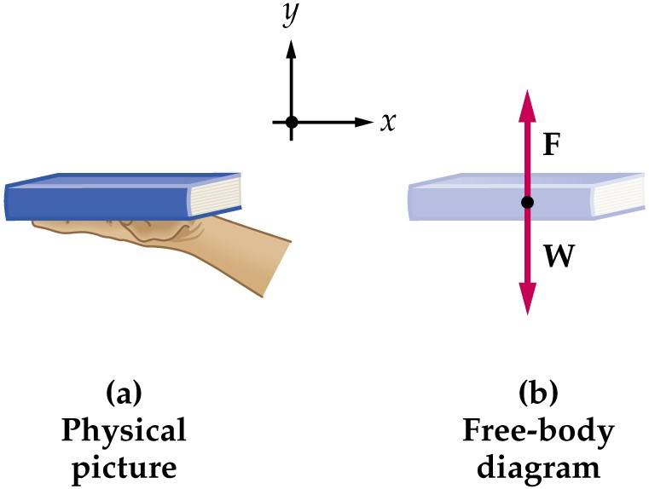
Free Body Diagram
The most important step in solving problems involving Newton’s Laws is to draw the free body diagram
Be sure to include only the forces acting on the object of interest
Include any field forces acting on the object
Do not assume the normal force equals the weight
F _{hand on book}
F _{Earth on book}
Notes:
So far, we have discussed Newton’s laws and analyzed several particular forces. We can start to work out some problems using Newton’s laws. The most important step in solving problems involving Newton’s Laws is to draw the free body diagram. The free body diagram can simplifies the problem. Free-body diagrams are diagrams used to show the relative magnitude and direction of all forces acting upon an object in a given situation. The size of the arrow in a free-body diagram is reflects the magnitude of the force. The direction of the arrow shows the direction which the force is acting. Each force arrow in the diagram is labeled to indicate the exact type of force.
Be sure to include only the forces acting on the object of interest. Include any field forces acting on the object.

Slide 4
Hints for Problem-Solving
Read the problem carefully at least once
Draw a picture of the system, identify the object of primary interest, and indicate forces with arrows
Label each force in the picture in a way that will bring to mind what physical quantity the label stands for (e.g., T for tension)
Draw a free-body diagram of the object of interest, based on the labeled picture. If additional objects are involved, draw separate free-body diagram for them
Choose a convenient coordinate system for each object
Apply Newton’s second law. The x- and y-components of Newton second law should be taken from the vector equation and written individually. This often results in two equations and two unknowns
Solve for the desired unknown quantity, and substitute the numbers

Slide 5

PROBLEMS
Sections 5.1 through 5.6
3. A 3.00-kg object undergoes an acceleration given by
a =(2.00ˆi + 5.00ˆj) m/s².
Find the resultant force acting on it and the magnitude of the resultant force.
SOLUTIONS TO PROBLEM:
$$\sum{F}=ma$$
$$│\sum{F│=\sqrt{{F_{x}}^{2}+{F_{y}}^{2}}}$$

Slide 6

PROBLEMS
Sections 5.1 through 5.6
7. An electron of mass 9.11 × 10^-31 kg has an initial speed of 3.00 × 10^5 m/s. It travels in a straight line, and its speed increases to 7.00 × 10^5 m/s in a distance of 5.00 cm. Assuming its acceleration is constant, (a) determine the force exerted on the electron and (b) compare this force with the weight of the electron, which we neglected.
SOLUTIONS TO PROBLEM:
$$\sum{F}=ma , {v_{f}}^{2}={v_{i}}^{2}+2ax_{f}$$
$$F_{f}=mg$$

Slide 7

PROBLEMS
Sections 5.1 through 5.6
11. Two forces F1 and F2 act on a 5.00-kg object. If F1 = 20.0 N and F2 =15.0 N, find the accelerations in (a) and (b) of Figure P5.11.
SOLUTIONS TO PROBLEM:
$\sum{F}=F_{1}$+$F_{2} , \sum{F}=ma$
$│a│=\sqrt{{a_{x}}^{2}+{a_{y}}^{2}}$.
$θ=\tan^{−1}\frac{a_{y}}{a_{x}}$.
$$F_{2x}=15\cos{60}$$
$$F_{2y}=15\sin{60}$$
$$F_{2}=F_{2x}i+F_{2y}j$$
$\sum{F}=F_{1}$+$F_{2}=ma$
$│a│$ and $θ$

Slide 8
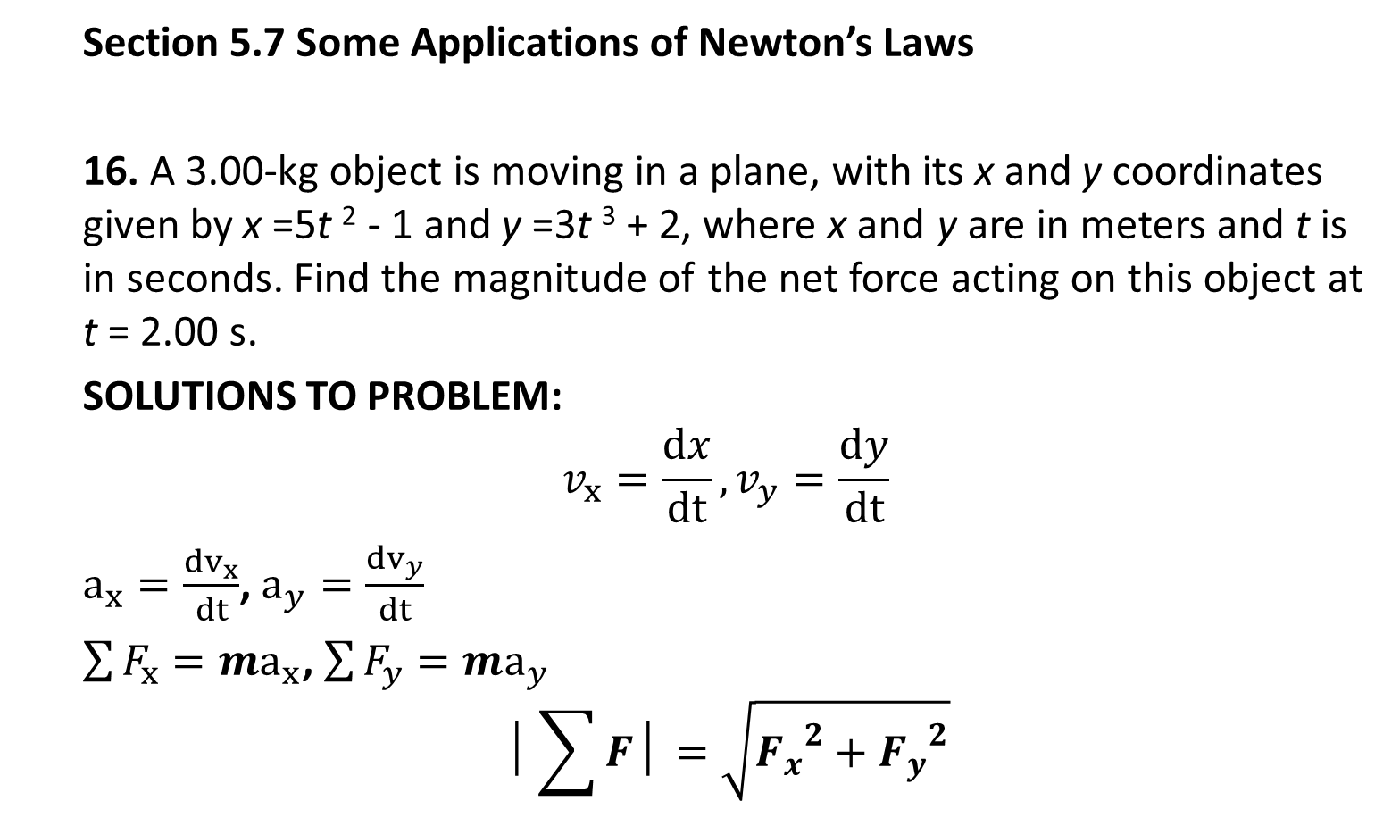
PROBLEMS
Section 5.7 Some Applications of Newton’s Laws
16. A 3.00-kg object is moving in a plane, with its x and y coordinates given by x =5t ² - 1 and y =3t ³ + 2, where x and y are in meters and t is in seconds. Find the magnitude of the net force acting on this object at t = 2.00 s.
SOLUTIONS TO PROBLEM:
$$v_{x}=\frac{dx}{dt}, v_{y}=\frac{dy}{dt}$$
$a_{x}=\frac{dv_{x}}{dt}$, $a_{y}=\frac{dv_{y}}{dt}$
$\sum{F_{x}}=ma_{x}$, $\sum{F_{y}}=ma_{y}$
$$│\sum{F│=\sqrt{{F_{x}}^{2}+{F_{y}}^{2}}}$$

Slide 9
PROBLEMS
Section 5.7 Some Applications of Newton’s Laws
18. A bag of cement of weight 325 N hangs from three wires as suggested in Figure P5.18. Two of the wires make angles θ₁= 60.0° and θ₂= 25.0° with the horizontal. If the system is in equilibrium, find the tensions T₁, T₂, and T₃ in the wires.
SOLUTIONS TO PROBLEM:
T₃₌ F_{g}
T₁ sin θ₁+T₂ sin θ₂₌F_{g}
T₁ cos θ₁=T₂ cosθ₂

Slide 10
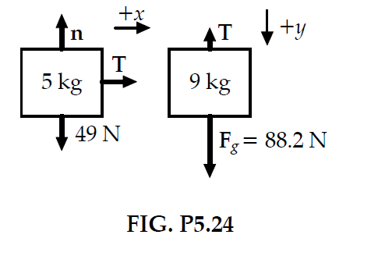
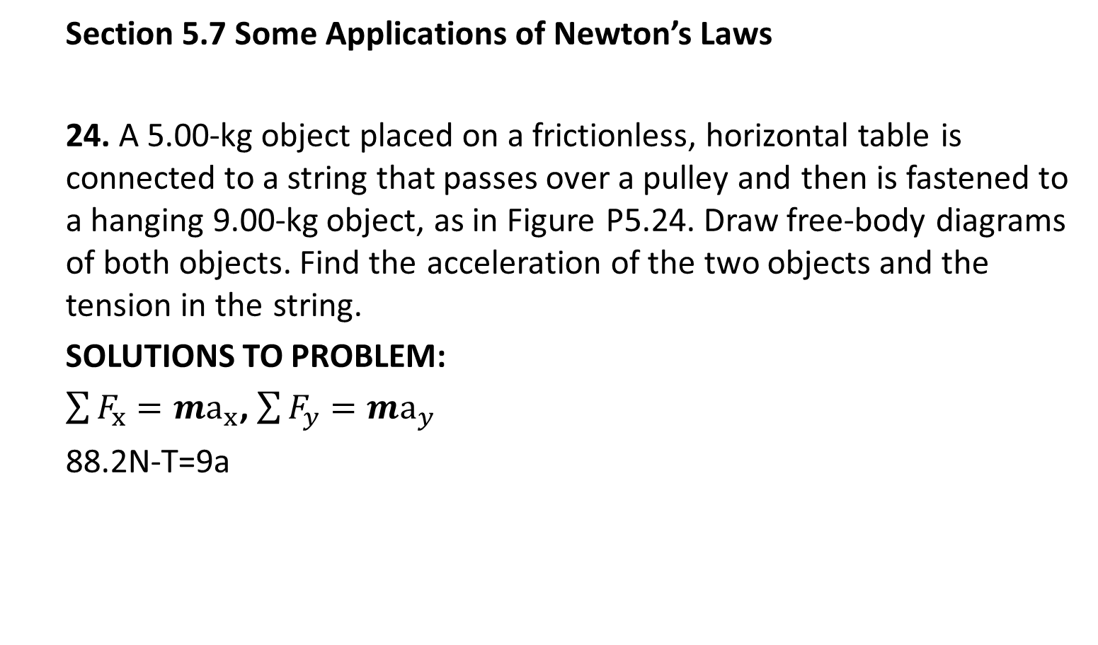
PROBLEMS
Section 5.7 Some Applications of Newton’s Laws
24. A 5.00-kg object placed on a frictionless, horizontal table is connected to a string that passes over a pulley and then is fastened to a hanging 9.00-kg object, as in Figure P5.24. Draw free-body diagrams of both objects. Find the acceleration of the two objects and the tension in the string.
SOLUTIONS TO PROBLEM:
$\sum{F_{x}}=ma_{x}$, $\sum{F_{y}}=ma_{y}$
88.2N-T=9a

Slide 11

PROBLEMS
Section 5.7 Some Applications of Newton’s Laws
25. A block is given an initial velocity of 5.00 m/s up a frictionless 20.0° incline (Fig. P5.22). How far up the incline does the block slide before coming to rest?
SOLUTIONS TO PROBLEM:
After it leaves your hand, the block’s speed changes only because of one component of its weight:
$$\sum{F_{x}}=ma_{x} −mgsin20=ma$$
$${v_{f}}^{2}={v_{i}}^{2}+2a\left(x_{f}−x_{i}\right)taking{ v}_{f}=0$$
$$x_{f=?}$$

Slide 12

PROBLEMS
Section 5.7 Some Applications of Newton’s Laws
26. Two objects are connected by a light string that passes over a frictionless pulley, as in Figure P5.26. Draw free-body diagrams of both objects. If the incline is frictionless and if m₁ = 2.00 kg, m₂ = 6.00 kg, and θ = 55.0°, find (a) the accelerations of the objects, (b) the tension in the string, and (c) the speed of each object 2.00 s after being released from rest.
SOLUTIONS TO PROBLEM:
$$\sum{F_{x}}=m2gsinθ−T=m2 a$$
And $T−m1g=m1 a$
${ v}_{i}=0$ ${ v}_{f}=at$

Slide 13
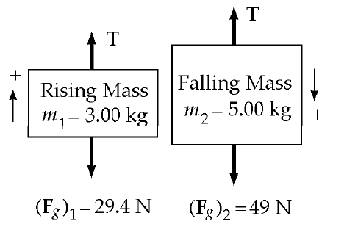
PROBLEMS
Section 5.7 Some Applications of Newton’s Laws
28. Two objects with masses of 3.00 kg and 5.00 kg are connected by a light string that passes over a light frictionless pulley to form an Atwood machine, as in Figure 5.14a. Determine (a) the tension in the string, (b) the acceleration of each object, and (c) the distance each object will move in the first second of motion if they start from rest.
SOLUTIONS TO PROBLEM:

Slide 14

PROBLEMS
Section 5.7 Some Applications of Newton’s Laws
28.
SOLUTIONS TO PROBLEM:
First, consider the 3.00 kg rising mass. The forces on it are the tension, T, and its weight, 29.4 N. With the upward direction as positive, the second law becomes
$$\sum{F_{y}}=may :T−29=3a$$
The forces on the falling 5.00 kg mass are its weight and T, and its acceleration is the same as that of the rising mass. Calling the positive direction down for this mass, we have
$\sum{F_{y}}=may :49−T=5a$
$$y_{f}=y_{i}+v_{yi}t+\frac{1}{2}a_{y}t^{2}=\frac{1}{2}a_{y}t^{2}$$

Slide 15
PROBLEMS
Section 5.7 Some Applications of Newton’s Laws
31. In the system shown in Figure P5.31, a horizontal force F_{x} acts on the 8.00-kg object. The horizontal surface is frictionless.
For what values of F_{x} does the 2.00-kg object accelerate upward? (b) For what values of F_{x} is the tension in the cord zero?
SOLUTIONS TO PROBLEM:

Slide 16
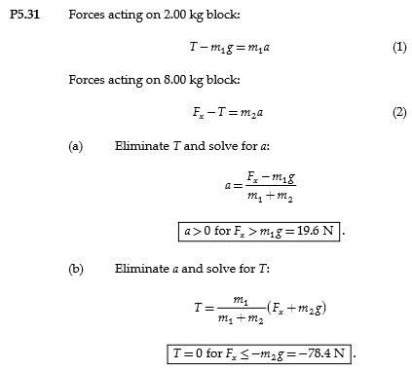
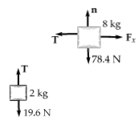

Slide 17
PROBLEMS
Section 5.8 Forces of Friction
37. A car is traveling at 50.0 mi/h on a horizontal highway. (a) If the coefficient of static friction between road and tires on a rainy day is 0.100, what is the minimum distance in which the car will stop? (b) What is the stopping distance when the surface is dry and µ_{s} = 0.600?
SOLUTIONS TO PROBLEM:

Slide 18
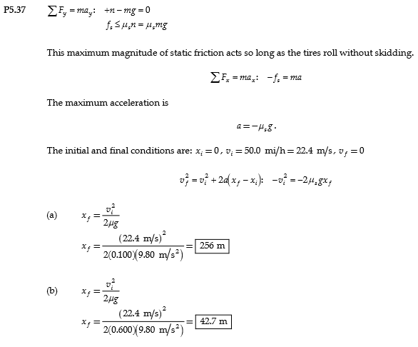

Slide 19
PROBLEMS
Section 5.8 Forces of Friction
41. A 3.00-kg block starts from rest at the top of a 30.0° incline and slides a distance of 2.00 m down the incline in 1.50 s. Find (a) the magnitude of the acceleration of the block, (b) the coefficient of kinetic friction between block and plane, (c) the friction force acting on the block, and (d) the speed of the block after it has slid 2.00 m.
SOLUTIONS TO PROBLEM:

Slide 20
PROBLEMS
Section 5.8 Forces of Friction
44. Three objects are connected on the table as shown in Figure P5.44. The table is rough and has a coefficient of kinetic friction of 0.350. The objects have masses of 4.00 kg, 1.00 kg, and 2.00 kg, as shown, and the pulleys are frictionless. Draw free-body diagrams of each of the objects. (a) Determine the acceleration of each object and their directions. (b) Determine the tensions in the two cords.
SOLUTIONS TO PROBLEM:

Slide 21
PROBLEMS
Section 5.8 Forces of Friction
44.
SOLUTIONS TO PROBLEM:

Slide 22
PROBLEMS
Section 5.8 Forces of Friction
45. Two blocks connected by a rope of negligible mass are being dragged by a horizontal force F (Fig. P5.45). Suppose that F = 68.0 N, m1 = 12.0 kg, m2 = 18.0 kg, and the coefficient of kinetic friction between each block and the surface is 0.100. (a) Draw a free-body diagram for each block. (b) Determine the tension T and the magnitude of the acceleration of the system.
SOLUTIONS TO PROBLEM:

Slide 23
PROBLEMS
Section 5.8 Forces of Friction
46. A block of mass 3.00 kg is pushed up against a wall by a force P that makes a 50.0° angle with the horizontal as shown in Figure P5.46. The coefficient of static friction between the block and the wall is 0.250. Determine the possible values for the magnitude of P that allow the block to remain stationary.
SOLUTIONS TO PROBLEM:

Slide 24
