Slide 1
Phys 110 Chapter 5 The Laws of Motion

Slide 2
LECTURE OUTLINE
5.1 The Concept of Force
5.2 Newton’s First Law and Inertial Frames
5.3 Mass
5.4 Newton’s Second Law
5.5 The Gravitational Force and Weight
5.6 Newton’s Third Law
5.7 Some Applications of Newton’s Laws
5.8 Forces of Friction

Slide 3
5.1 The Concept of Force
An object accelerates due to an external force.
If the net force exerted on an object is zero, the acceleration of the object is zero and its velocity remains constant.
When the velocity of an object is constant (including when the object is at rest), the object is said to be in equilibrium.
There are 2 types of forces:
Contact forces (e.g. when you pull a spring or press it)
Field forces (e.g. the force between earth and the moon)
The only known fundamental forces in nature are all field forces: (1) gravitational forces between objects, (2) electromagnetic forces between electric charges, (3) nuclear forces between subatomic particles, and (4) weak forces that arise in certain radioactive decay processes.

Slide 4
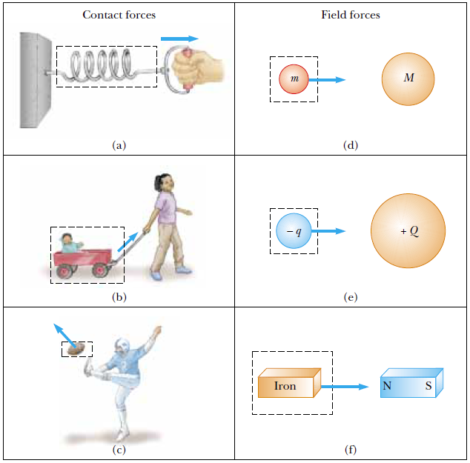
5.1 The Concept of Force
Examples of Contact and Field forces

Slide 5
5.2 Newton’s First Law and Inertial Frames
Newton’s First Law
In the absence of external forces, when viewed from an inertial reference frame, an object at rest remains at rest and an object in motion continues in motion with a constant velocity.
In simpler terms, we can say that when no force acts on an object, the acceleration of the object is zero.
If nothing acts to change the object’s motion, then its velocity does not change.
From the first law, we conclude that any isolated object (one that does not interact with its environment) is either at rest or moving with constant velocity.
The tendency of an object to resist any attempt to change its velocity is called inertia.

Slide 6
5.3 Mass
The SI unit of mass is the kilogram.
The greater the mass of an object, the less that object accelerates under the action of a given applied force.
Mass is an inherent property of an object and is independent of the object’s surroundings.
Mass should not be confused with weight. Mass and weight are two different quantities. The weight of an object is equal to the magnitude of the gravitational force exerted on the object and varies with location.
On the other hand, the mass of an object is the same everywhere: an object having a mass of 2 kg on the Earth also has a mass of 2 kg on the Moon.

Slide 7
5.4 Newton’s Second Law
Newton’s Second Law
Acceleration of an object is directly proportional to the force acting on it.
In mathematical form: we can write this law as:
$$\sum{F}=ma$$
$\sum{F_{x}=ma_{x}}$ $\sum{F_{y}=ma_{y}}$ $\sum{F_{z}=ma_{z}}$

Slide 8
Quick Quiz : You push an object, initially at rest, across a frictionless ﬂoor with a constant force for a time interval Δt, resulting in a ﬁnal speed of v for the object. You repeat the experiment, but with a force that is twice as large. What time interval is now required to reach the same ﬁnal speed v?
(a) 4 Δt (b) 2 Δt (c) Δt (d) Δt/2 (e) Δt/4.
d) With twice the force, the object will experience twice the acceleration. Because the force is constant, the acceleration is constant, and the speed of the object (starting from rest) is given by v =at. With twice the acceleration, the object will arrive at speed v at half the time.

Slide 9
5.5 The Gravitational Force and Weight
The attractive force exerted by the Earth on an object is called the gravitational force Fg
This force is directed toward the center of the Earth, and its magnitude is called the weight of the object.
Thus: the weight of an object = mg
Kilogram is Not a Unit of Weight: You may have seen the “conversion” 1 kg = 2.2 lb. Despite popular statements of weights expressed in kilograms, the kilogram is not a unit of weight, it is a unit of mass. The conversion statement is not an equality; it is an equivalence that is only valid on the surface of the Earth.

Slide 10
Quick Quiz : A baseball of mass m is thrown upward with some initial speed. A gravitational force is exerted on the ball (a) at all points in its motion (b) at all points in its motion except at the highest point (c) at no points in its motion.
(a). The gravitational force acts on the ball at all points in its trajectory.

Slide 11
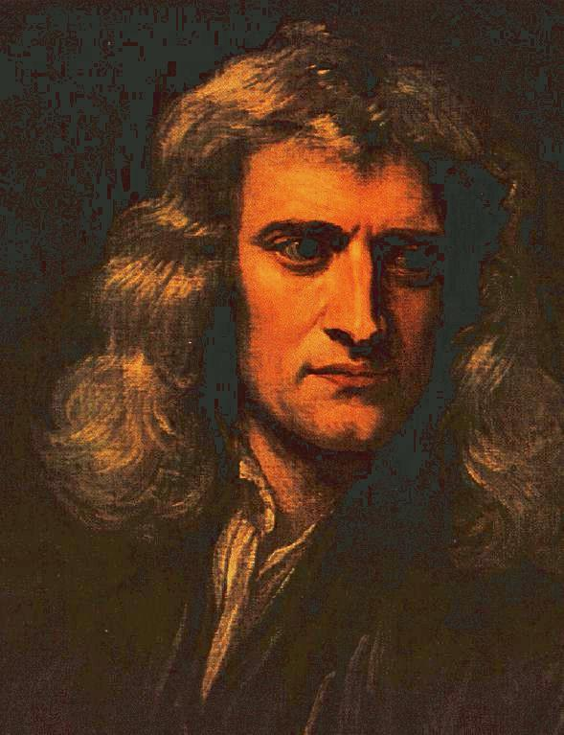
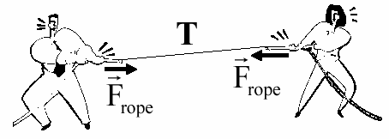
5.6 Newton’s Third Law
If object 1 and object 2 interact, the force exerted by object 1 on object 2 is equal in magnitude but opposite in direction to the force exerted by object 2 on object 1
Equivalent to saying a single isolated force cannot exist

Slide 12
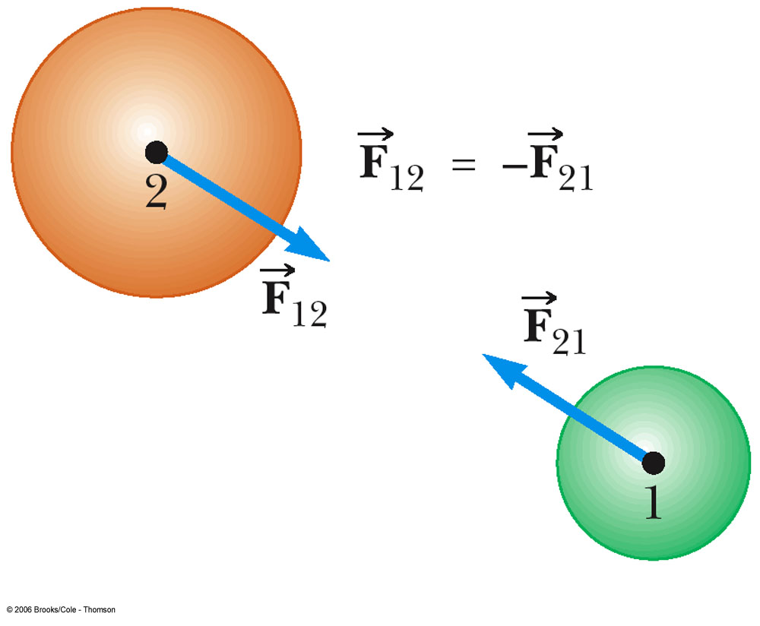
Newton’s Third Law cont.
F₁₂ may be called the action force and F₂₁ the reaction force
Actually, either force can be the action or the reaction force
The action and reaction forces act on different objects

Slide 13
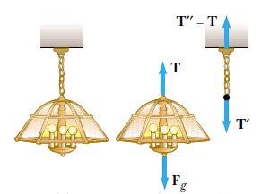
5.7 Some Applications of Newton’s Laws
when we apply Newton’s laws to an object, we are interested only in external forces that act on the object
Objects in Equilibrium:
If the acceleration of an object is zero, the particle is in equilibrium
$\sum{F_{x}=0}$ $\sum{F_{y}=0}$ $\sum{F_{z}=0}$
For example: a lamp hang by a robe from the ceiling, is in equilibrium because:
$$\sum{F_{y}=T−mg=0}$$
$$ma=0 so a=0$$
A lamp suspended from a ceiling by a chain of negligible mass balanced Under the effect of two forces T and Fg.

Slide 14
5.8 Forces of Friction
When an object is in motion either on a surface or in a viscous medium such as air or water, there is resistance to the motion because the object interacts with its surroundings. We call such resistance a force of friction
There are two types of frictional forces: Static: f_{s} and kinetic: f_{k}
f_{s} =μ_{s}n
f_{k} =μ_{k}n
We define these two types as:
μ_{s} is called coefficient of static friction, and μ_{k}is called coefficient of kinetic friction. μ_{s}> μ_{k}, (0≤ μ ≤1)
The direction of the friction force on an object is parallel to the surface with which the object is in contact and opposite to the actual motion.

Slide 15
Lecture Summary
Newton’s first law: defined earlier.
Newton’s second law: $\sum{F}=ma$.
The gravitational force: weight of an object = mg.
Newton’s third law: F₁₂=-F₂₁ .
The maximum force of static friction (f_{s}, max) between an object and a surface is proportional to the normal force acting on the object.
In general, fs≤ μ_{s} n, where μ_{s} is the coefficient of static friction and n is the magnitude of the normal force.
When an object slides over a surface, the direction of the force of kinetic friction f_{k} is opposite the direction of motion of the object relative to the surface and is also proportional to the magnitude of the normal force. The magnitude of this force is given by f_{k}≤ μ_{k}n, where μ_{k} is the coefficient of kinetic friction.

