Slide 1
Alkenes/Alkynes
Alkenes are typically relatively weakly coordinating ligands. They are also extremely important substrates for catalytic reactions. The strongest alkene-metal bonds occur with third row metals (as with almost all ligands) and when one can get more π-backbonding to occur.
The amount of π-backbonding depends strongly on how electron-rich the metal center is and whether or not there are electron-withdrawing groups on the alkene to make it a better acceptor ligand.

Slide 2
If the metal is electron-rich enough and/or if there are electron-withdrawing groups on the alkene, one can actually get a formal oxidation of the metal via the transfer of 2e- to the alkene to form a dianionic metallocyclopropane ligand that is now coordinated via two anionic alkyl σ-bonds (thus the assignment of Pt(+2)).

Slide 3
The electron-withdrawing fluorine groups on the F₂C=CF₂ alkene makes it a better π-acceptor ligand. This weakens the C=C bond, but strengthens the alkene-metal bond.

Slide 4
Zr is in a very low oxidation state (+2, but really wants to be +4) and is, therefore, extremely electron-rich. So electron-rich that it transfers two electrons to the butadiene via the π-backdonation and generates a metallo­cyclopentene resonance structure

Slide 5
Electronic Effects
Ethylene Complex | νC=C (cm⁻¹)
Free Ethylene | 1623
[Ag(H₂C=CH₂)₂]⁺ | 1584
Fe(CO)₄(H₂C=CH₂) | 1551
[Re(CO)₄(H₂C=CH₂)₂]⁺ | 1539
[CpFe(CO)₂(H₂C=CH₂)]⁺ | 1527
Pd₂Cl₄(H₂C=CH₂)₂ | 1525
[PtCl₃(H₂C=CH₂)]⁻ | 1516
CpMn(CO)₂(H₂C=CH₂) | 1508
Pt₂Cl₄(H₂C=CH₂)₂ | 1506
CpRh(H₂C=CH₂)₂ | 1493

Slide 6
The thermodynamic stability of metal-alkene complexes is strongly affected by the nature of the alkene (and metal):
1) Electron-withdrawing groups on the alkene generally increase the strength of the metal-alkene bonding, while electron-donating groups generally decrease the stability. Exception??
In cases where cis-trans isomerism is possible, the more stable complex is almost always formed by the cis-alkene (steric factors).
3) Metal complexes of ring-strained cycloalkenes (e.g., cyclopropene) display higher than expected stability. The ring strain raises the energy of the cycloalkene ring system making it a better donor to the metal center (better orbital energy matching).
4) Chelating dienes show the expected stabilization from the chelate effect. The most common examples are norbornadiene and cyclooctadiene shown below.
5) Third-row metals form the strongest bonds and most stable complexes (as with most ligands).

Slide 7
Problem: To which of the following (each with a single open coordination site) will trifluoroethylene bond to the most strongly? Why?

Slide 8
Cyclobutadiene
A triumph of the early days of organometallic chemistry was the successful synthesis of (η⁴-C₄H₄)₂Ni₂(μ-Cl)₂Cl₂, a stable metal-coordinated cyclobutadiene molecule, by Criegee in 1959. This was actually predicted theoretically by Longuet-Higgins and Orgel in 1956 using an early form of molecular orbital theory.
A simpler route was discovered shortly after involving the cyclodimerization of diphenyl acetylene by Fe(CO)5:

Slide 10
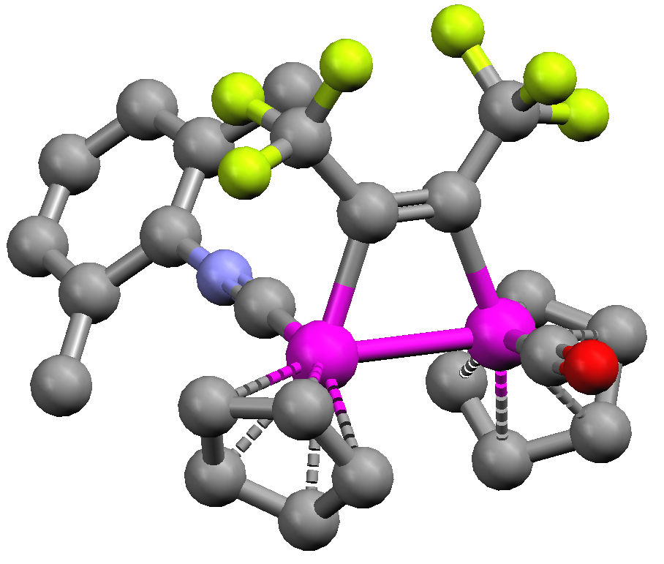
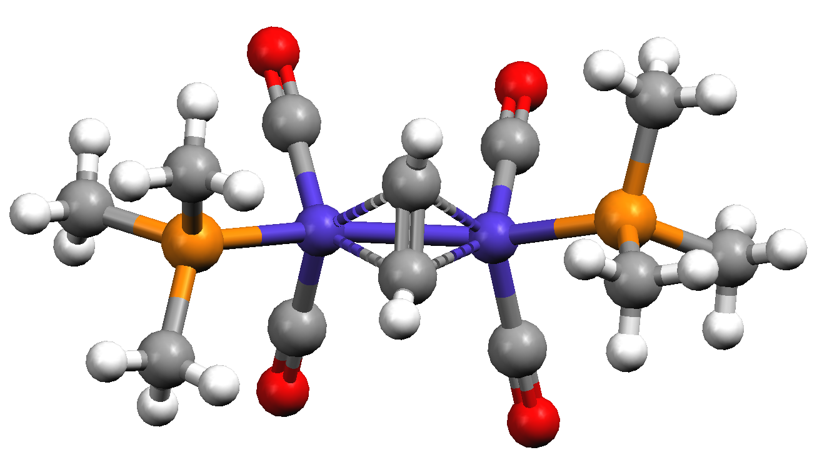
Alkynes
Alkynes are essentially like alkenes, only with another perpendicular pair of π-electrons. Thus they can act as neutral 2 or 4 e- donors, depending on the needs of the metal center. They are also much better bridging ligands because of this second set of π-electrons.
Note how the bridging alkyne is drawn. This indicates a perpendicular bridging mode and that both carbons are interacting equally with both metals (the alkyne is donating 2e- to each metal). It dos NOT indicate that each carbon has 6 bonds to it !!
When alkynes bridge, they almost always do so perpendicular to the M-M axis, the parallel bridging mode is known, but is quite rare:

Slide 11
Problem: The Cp₂Rh₂[μ-(CF₃C≡CCF₃)](CO)(C≡N-R) complex shown below has a Rh-Rh bond distance of 2.67 Å, strongly indicating a covalent bond between the rhodium atoms. How would you electron count this complex to accommodate a Rh-Rh covalent bond?

Slide 12
Problem: Which of the following ligands will coordinate the most strongly to a generic metal center (not too electron-rich or deficient, with enough open coordination sites)?

