Slide 1

FUNDAMENTALS OF PHYSICS
( 10th edition )- HALLIDAY & RESNICK

Slide 2

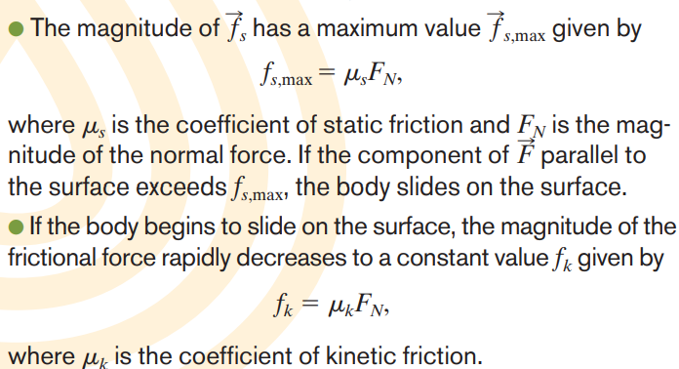

Slide 3
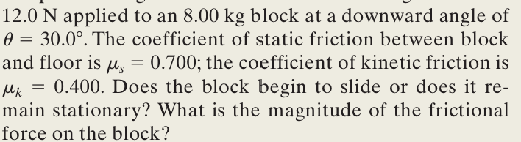
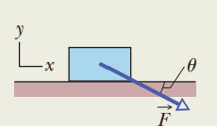
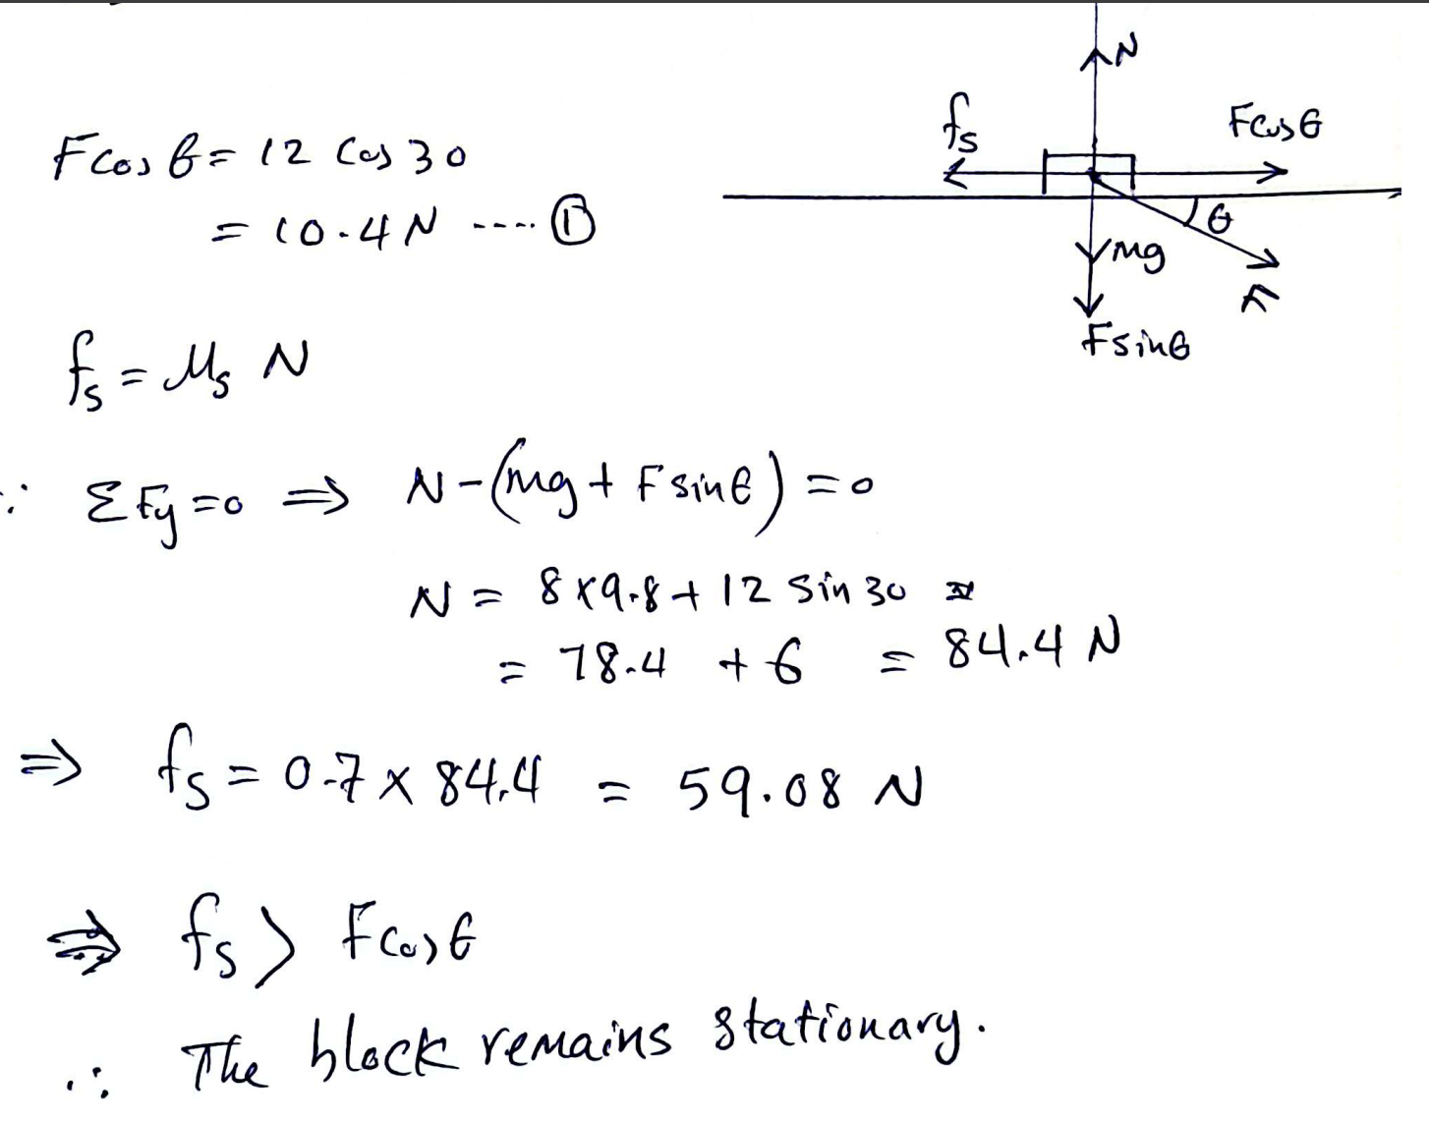

Slide 4
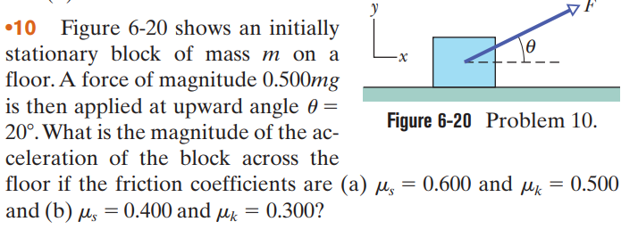
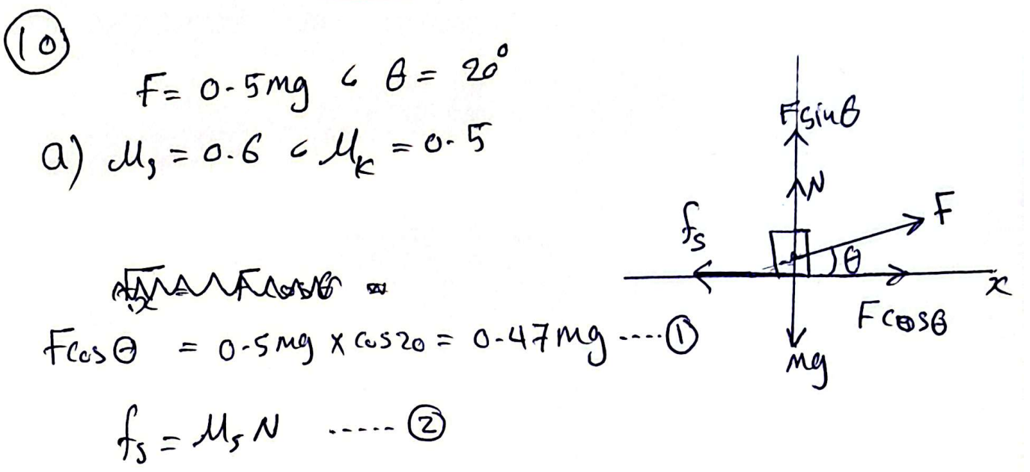

Slide 5
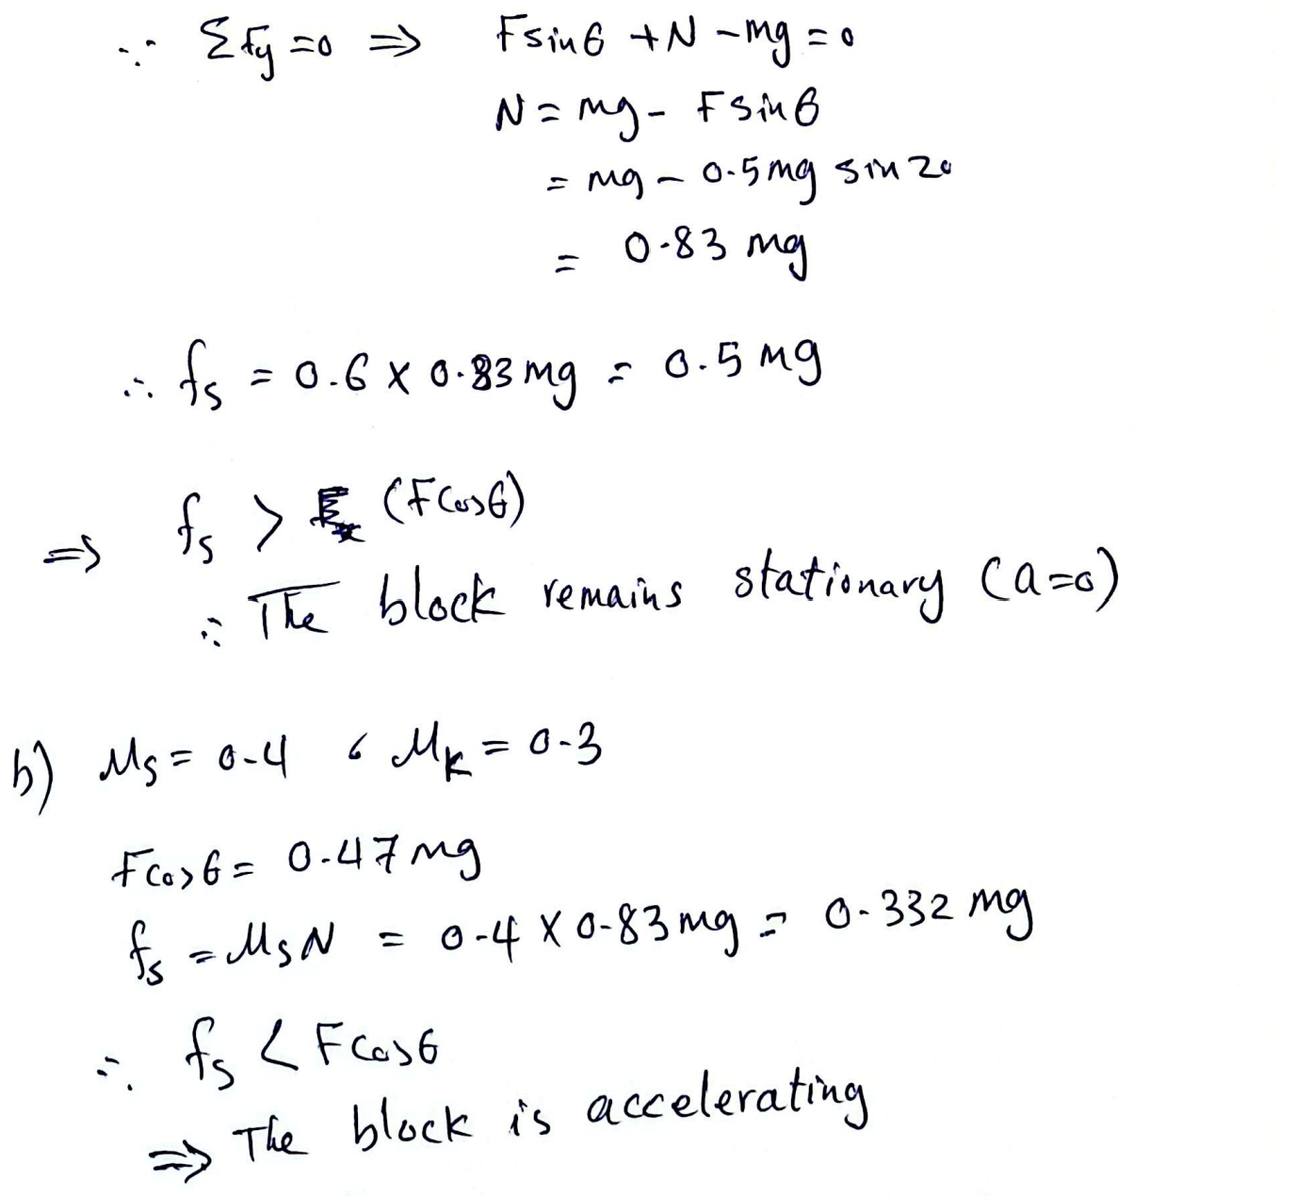
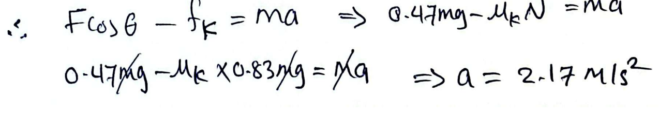

Slide 6
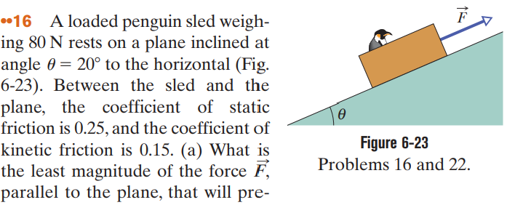


Slide 7
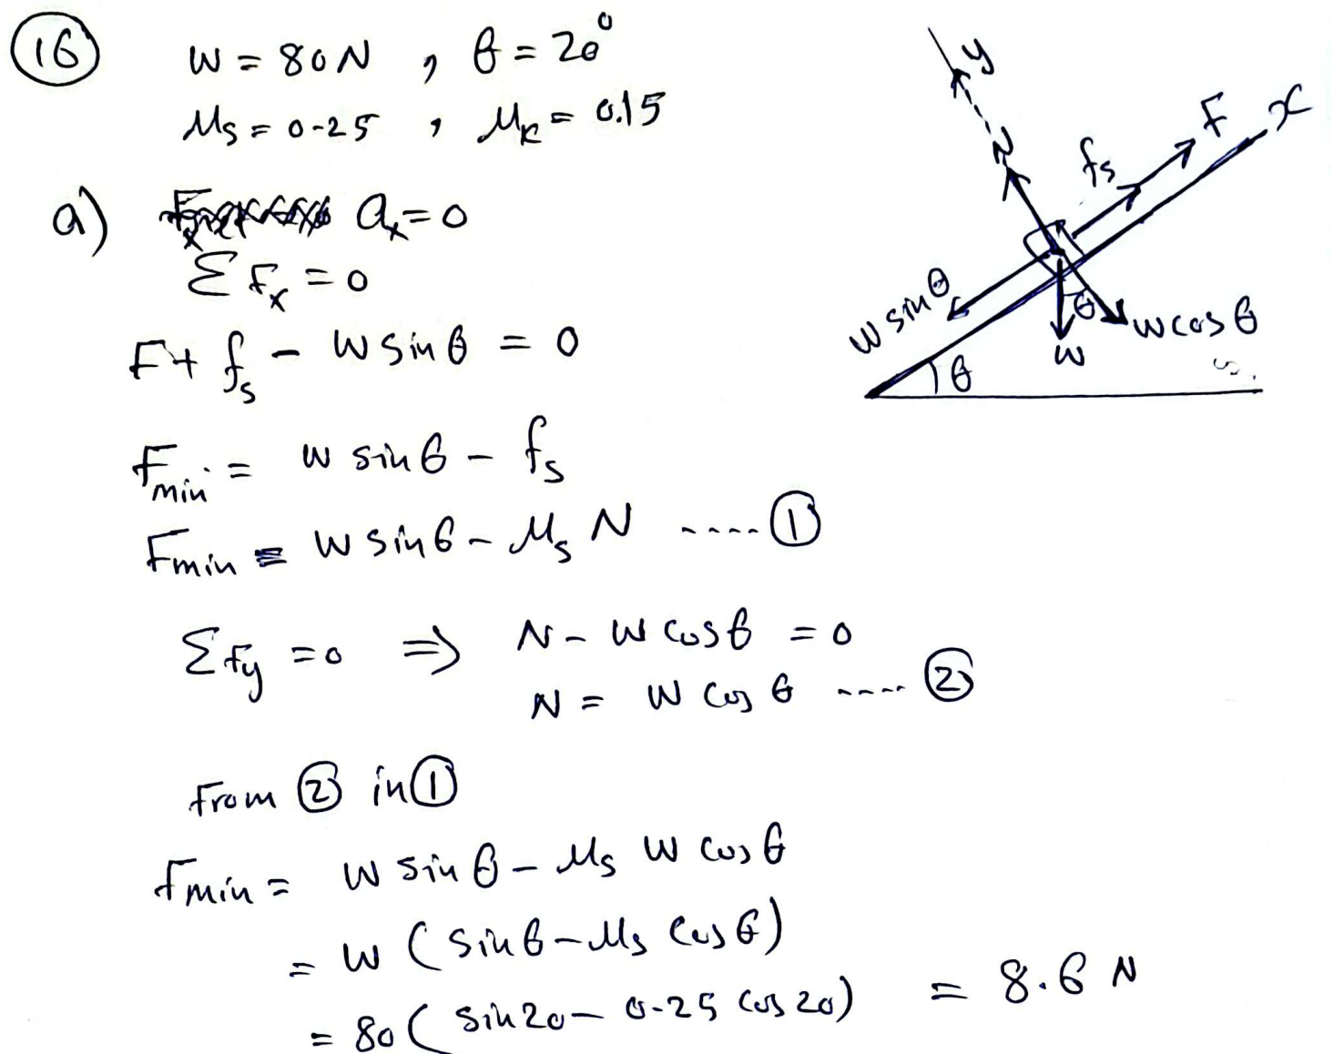

Slide 8
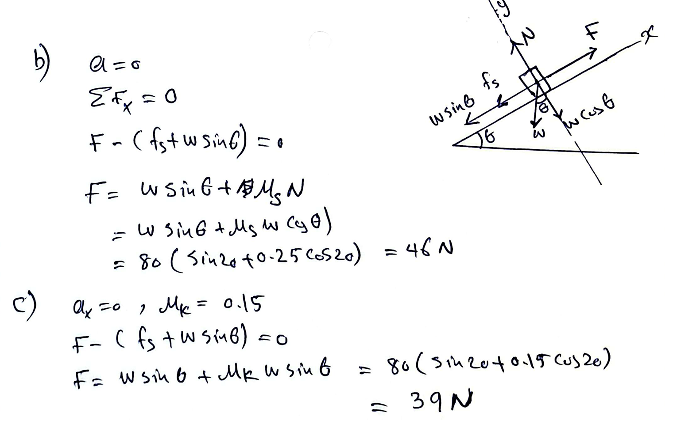

Slide 9
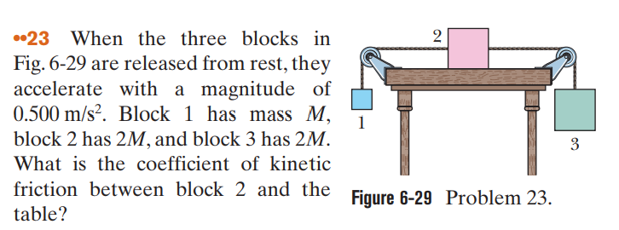

Slide 10
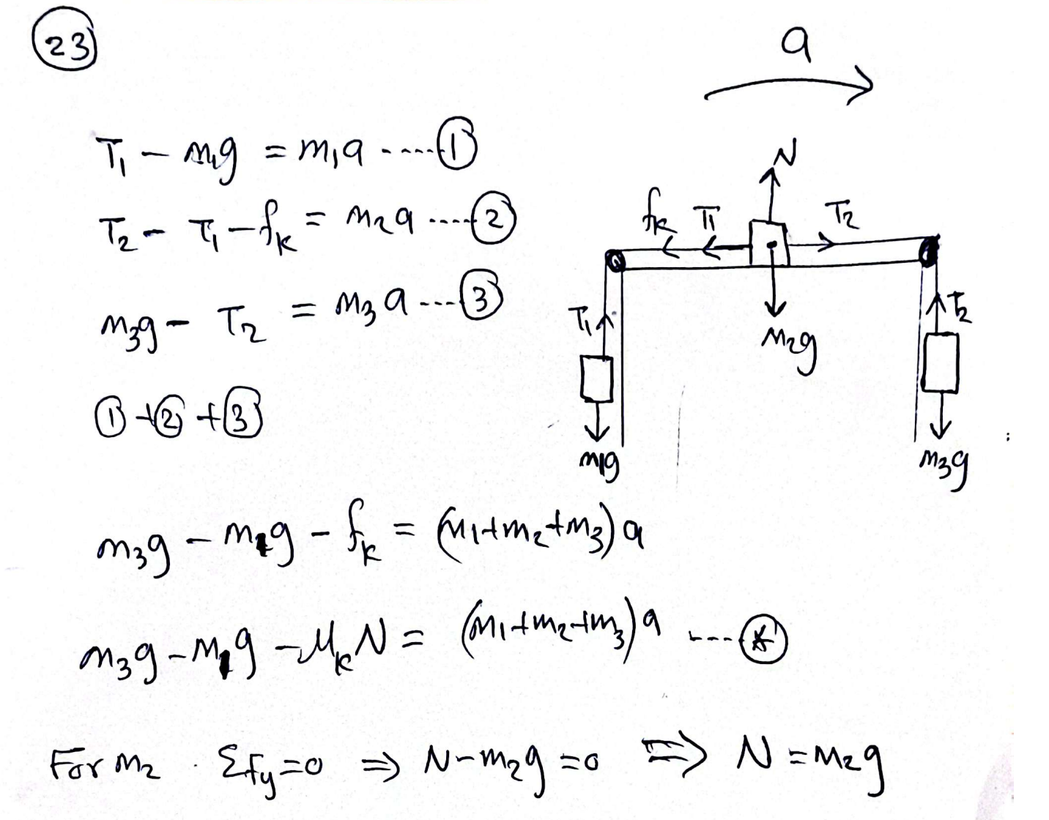

Slide 11
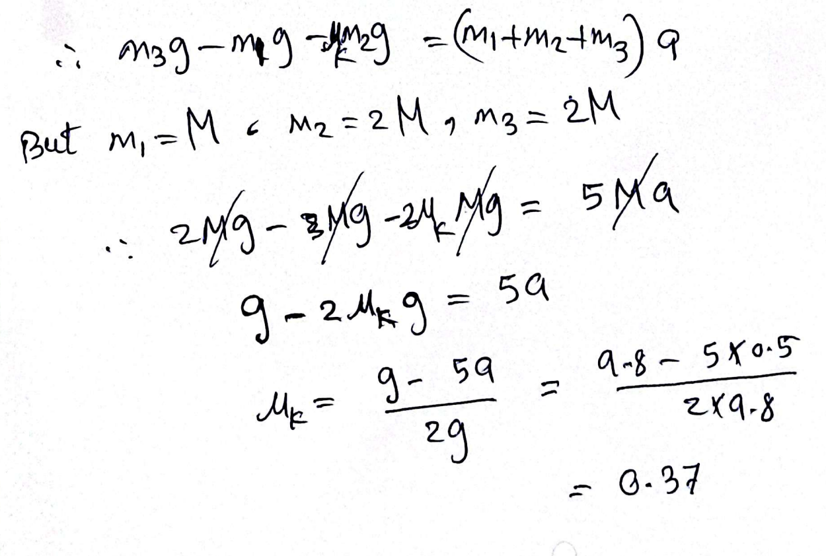

Slide 12
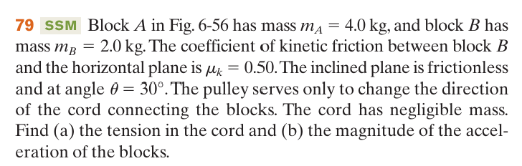
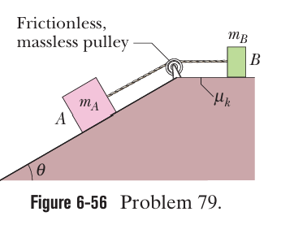

Slide 13
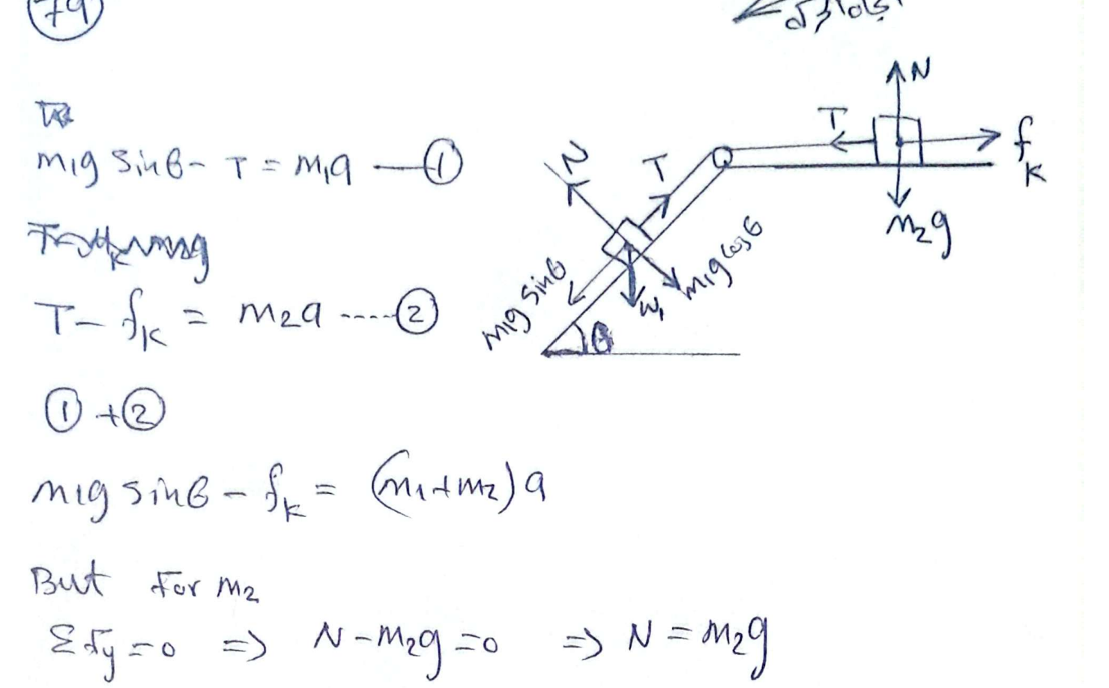

Slide 14
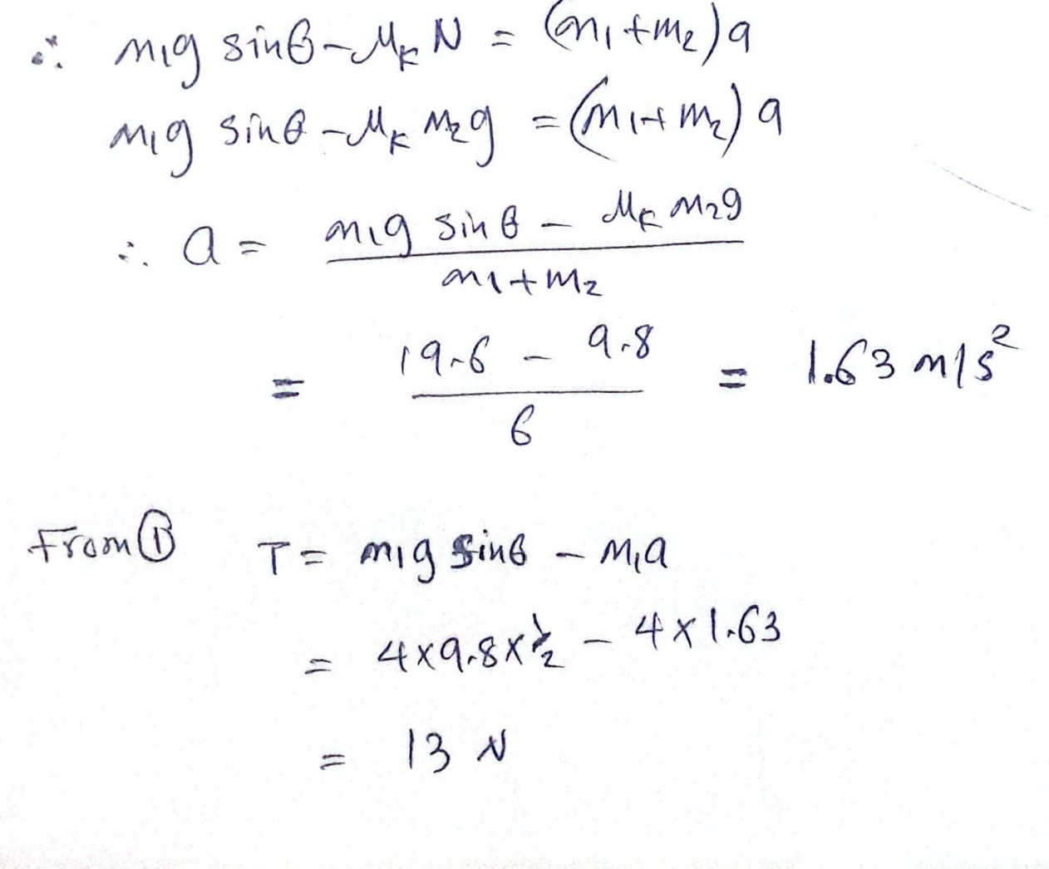

Slide 15


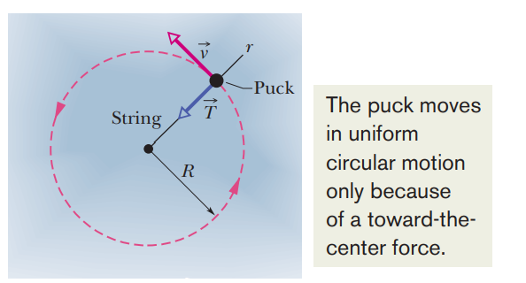
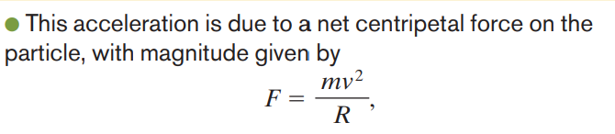

Slide 16
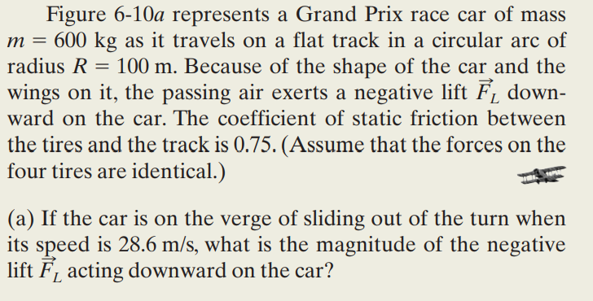
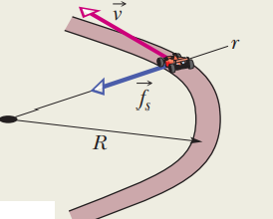
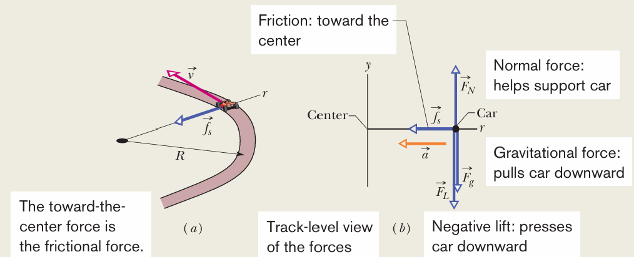
b) What is the magnitude of the negative lift for a speed of 90 m/s?

Slide 17

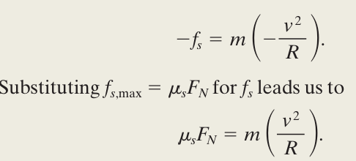

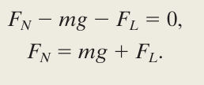

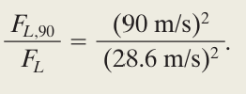
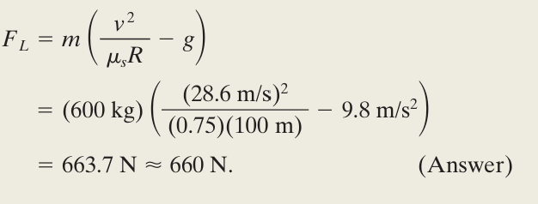

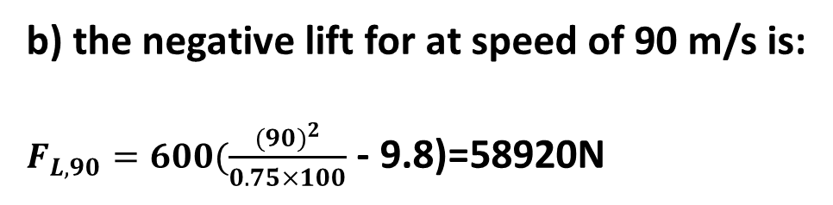
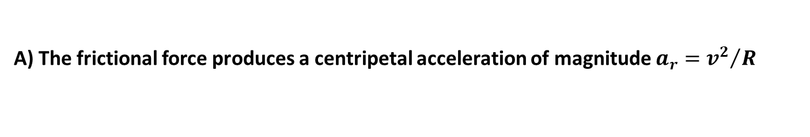
A) The frictional force produces a centripetal acceleration of magnitude $a_{r}={v^{2}}/R$
b) the negative lift for at speed of 90 m/s is:
$F_{L,90}=600(\frac{{(90)}^{2}}{0.75×100}$ - 9.8)=58920N
Or

Slide 18
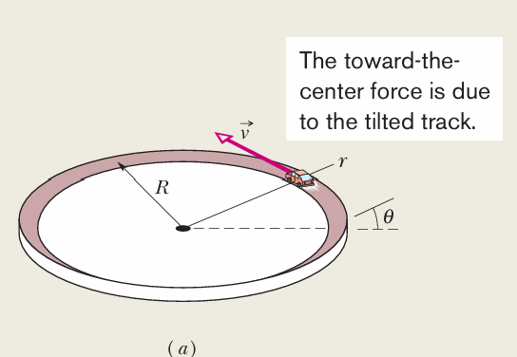
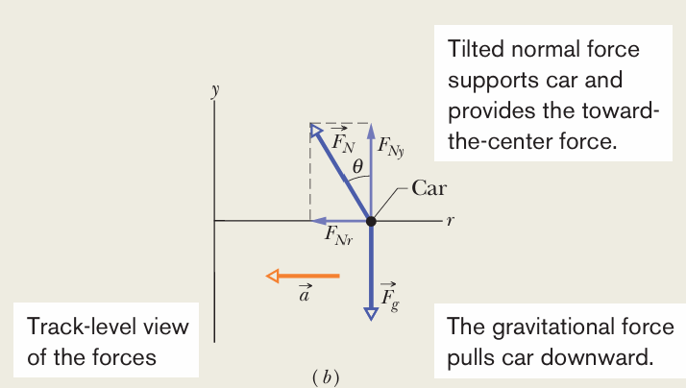
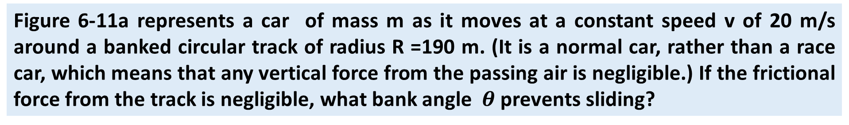
Figure 6-11a represents a car of mass m as it moves at a constant speed v of 20 m/s around a banked circular track of radius R =190 m. (It is a normal car, rather than a race car, which means that any vertical force from the passing air is negligible.) If the frictional force from the track is negligible, what bank angle $θ$prevents sliding?

Slide 19

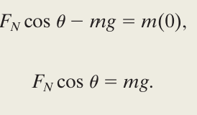
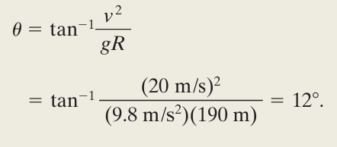

Slide 20
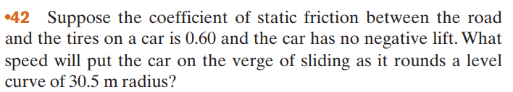
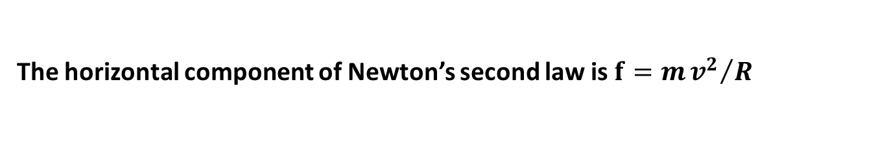
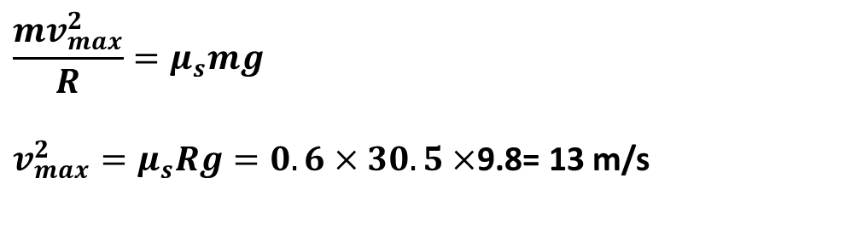
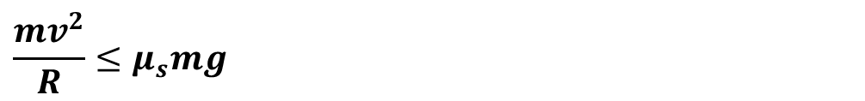
The horizontal component of Newton’s second law is $f=m{v^{2}}/R$
If the car does not slip,$f≤μ_{s}mg$. This means
$$\frac{mv^{2}}{R}≤μ_{s}mg$$
Consequently, the maximum speed with which the car can round the curve without slipping is
$$\frac{mv_{max}^{2}}{R}=μ_{s}mg$$
$v_{max}^{2}=μ_{s}Rg=0.6×30.5×$9.8= 13 m/s

Slide 21
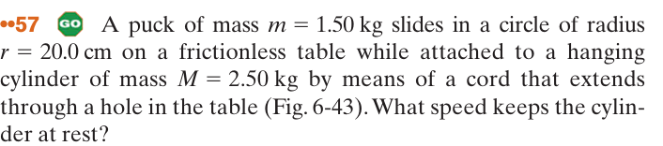
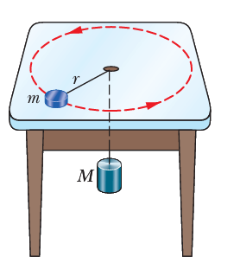
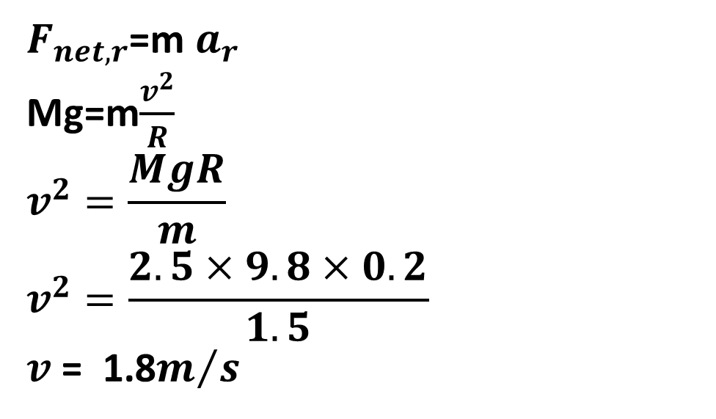
$F_{net,r}$=m $a_{r}$
Mg=m$\frac{v^{2}}{R}$
$$v^{2}=\frac{MgR}{m}$$
$$v^{2}=\frac{2.5×9.8×0.2}{1.5}$$
$v$= 1.8$m/s$

Slide 22
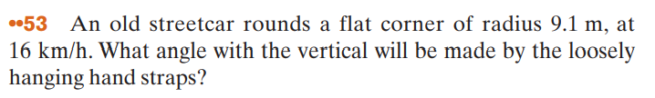
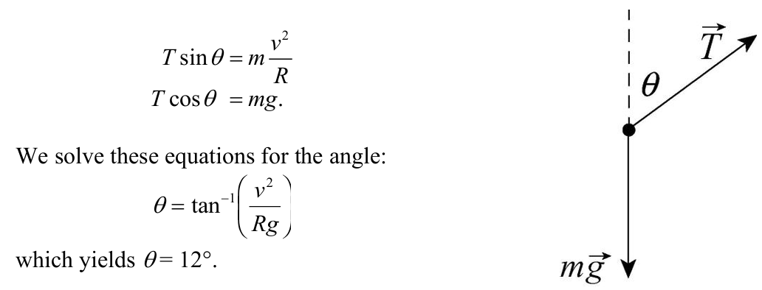

Slide 23
